Slide 1

Information Extraction from Scientific Literature
Project By:-
Sameep Shah - 77422376591
Tania Laha – 77422961632

Slide 2
Background
Problem Statement: Build an efficient Knowledge Management System (KMS) for finding out relevant research papers as per given user query.
Objective: The goal of this project is to help fellow researchers with recommendation of research papers relevant to their topic of interest. To achieve our goal, we have developed a framework using Python 3, than can be helpful in building a Knowledge Management System, capable of querying and information retrieval.
Data: The dataset for testing our NLP model will be some (belonging to diversified domains) research publications or articles from different databases.

Slide 3
Workflow diagram
Title
Tokenized sentences
PDFs
Text
  Similarity Calculation
parse
Section (Abstract, Introduction etc.)
Text Summarization
Output display
Query Search and input pdf

Slide 4
Solution Approach
We have divided the entire project into smaller chunks of tasks for ease of solving them. There are 4 steps as follows:
a. Text Extraction: Firstly, we extract text from each section of input paper (pdf) provided by the user and then apply LSA for summarization of the text in each section. We use Bidirectional and Auto-Regressive Transformer (BART) from Hugging face as a secondary model for comparison.
b. Similarity Scores: Then we match the query with extracted text of individual sections of the given research paper and provide an average cosine similarity score for both BART as well as LSA models.
c. Evaluation Metric: We then use Evaluation Metrics like ROUGE, METEOR and BLeU scores for checking how well the summarization has been done by models compared to summaries made by human intervention.
d. Output Display: Finally, we measure similarity of the pdf title with query and display the output containing similarity scores of each sections within an excel file. The excel output keeps adding the result of any new input as a new sheet of existing workbook.

Slide 5
Text Extraction
Title
Title extraction using PyPDF2 and PyMUPDF library.
Text pre-processing is done on extracted title and gets cleaned.
Other Sections
Entire pdf text is parsed, pre-processing is done and ‘References’ is removed.
A list is created with section names and its respective text.
Section headers are derived using details of font-size and font-name.
Back

Slide 6
2. Text Summarization
LSA
Sentences of each section are vectorized using TF-IDF.
Truncated SVD is applied on TF-IDF matrix and LSA scores are calculated.
BART
Bi-directional and Auto-Regressive Transformer (BART) is a denoising autoencoder for pre-training sequence to sequence models
The pre-trained model from Hugging face transformer is loaded library and used Spacy to extract individual sentences of each section
Each sentences of any particular section is sorted in descending manner based on their importance and explainability of context.
Top-5 sentences of each section are chosen as summaries.
A dictionary with section names and respective summaries are created.
The individual sentences concatenated into a string, encoded it using BART tokenizer and passed the encoded input to BART model for summarization
The summary is decoded from generated summary ids
A dictionary is created with section names and respective summaries containing abstractive summary.
Back

Slide 7
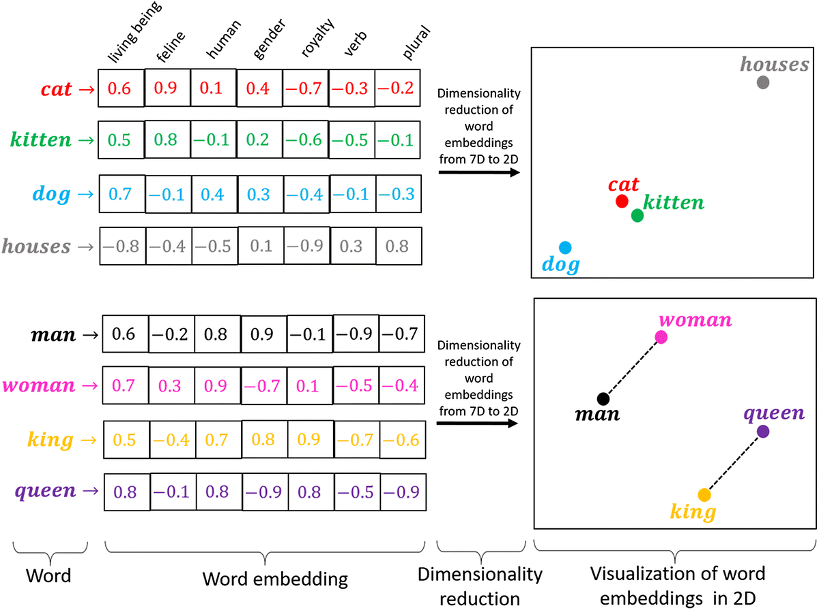
3. Similarity calculation
Cosine Similarity
Embedding
Cosine similarity is a measure used to determine how similar two vectors are, particularly in the context of high-dimensional spaces like text documents or word embeddings.
Formula : similarity(A,B) = A.B / ∥A∥×∥B∥
LSA model : Query text and summarized text are embedded using TF-IDF and Glove embedding.
BART model – We use the same method to find similarity scores that we used for LSA
Cosine similarity function of Sklearn is used.
Similarity of Title vs query is also calculated.
Score calculation
Back

Slide 8
4. Evaluation and output
Evaluation Metrics
Human Evaluation
Output display
METEOR - METEOR is an automatic evaluation metric for machine translation and text generation tasks that considers both exact word matches and semantic similarity between reference and hypothesis text, using stemming and synonymy matching.
BleU - BLEU is a metric commonly used for evaluating the quality of machine-translated text by comparing the n-grams in the machine-generated output to those in one or more reference translations, with higher scores indicating better translation quality. BLEU is predominantly precision based.
ROUGE - ROUGE is a set of evaluation metrics commonly used for automatic summarization tasks, measuring the overlap between the n-grams (sequences of words) in the generated summary and the reference summaries, where higher scores indicate better agreement. ROUGE is predominantly Recall based. We use 3 different forms of ROUGE, ROUGE-1, ROUGE-2 and ROUGE – L.
Due to unavailability of human evaluation, we take help of Chatbot.
Reference summaries of each section are created using ChatGPT.
An excel workbook with each of its sheets contain information about similarity scores of individual input pdfs is created.
As soon as a new input enters the final excel workbook keeps adding the result of that particular input as a new worksheet.
Back

Slide 9
Evaluation Metric Scores
 | BLEU | ROUGE - 1 | ROUGE - L | METEOR
PDF – 1 (Satellite Imagery) | LSA – 0.068 BART – 0.028 | LSA – 0.374 BART – 0.281 | LSA – 0.208 BART – 0.148 | LSA – 0.296 BART – 0.220
PDF – 2 (GAN) | LSA – 0.063 BART – 0.045 | LSA – 0.352 BART – 0.354 | LSA – 0.182 BART – 0.183 | LSA – 0.277 BART – 0.293
PDF – 3 (Neural Machine Translation) | LSA – 0.086 BART – 0.065 | LSA – 0.402 BART – 0.368 | LSA – 0.228 BART – 0.217 | LSA – 0.275 BART – 0.276
PDF – 4 (Low Resource Neural Machine Translation) | LSA – 0.057 BART – 0.03 | LSA – 0.243 BART – 0.286 | LSA – 0.164 BART – 0.166 | LSA – 0.346 BART – 0.315

Slide 10
Comparing Average Similarity Scores of Multiple PDF’s
 | LSA | BART | TITLE
PDF – 1 (Satellite Imagery) | 0.262 | 0.243 | 0.577
PDF – 2 (GAN) | 0.143 | 0.160 | 0.000
PDF – 3 (Neural Machine Translation) | 0.168 | 0.140 | 0.000
PDF – 4 (Low Resource Neural Machine Translation) | 0.188 | 0.134 | 0.288

Slide 11
Limitations and Observations
LSA model seems to be performing better on non-processed text rather than processed text (especially while stop-words are removed).
For the display of the final output in case LSA summaries we have used TF-IDF embeddings over GloVe as we see a better performance in terms of comparisons of different PDF’s to the same query. We validate this using a query which is relevant for one pdf but non-relevant to others.
Due to the restriction of resources provided by Hugging Face for using BART LLM we were only able to use the BART summarization feature with a restriction of 1000 tokens.
Our current system is only able to process a single PDF at a time however we are working on adding the multiple input feature.
In future, we will try to retain and process the data from figures and tables.
We are yet to build an user-interface which is our immediate enhancement plan.

Slide 12
THANK YOU

