Slide 1
Installing MySQL and PHP
Instructor: Ashok Singh Sairam
ashok@iitg.ac.in
Notes:
Our objective is to develop web applications. Local development: run your own Apache and MySQL.

Slide 2
Three-tier Architecture
Browser
Web Server
Database Server
HTML
Request
Call Database
(SQL)
Parse
Response
Static
Files
Apache
MySQL
HTML
Response
PHP
Code
Return
Data
Notes:
To develop a dynamic web page that can connect to a database to retrieve information, we need three components – a web browser, a web server and a database server.

Slide 3
Software stack
A software stack is a collection of software
The collection of software used to manage a webserver and database
XAMPP: X to be read as cross (cross platform). A : Apache HTTP Server; M : MySQL; P : PHP; P: Perl
MAMP: M: Machintosh (Windows version is also available); A: Apache; M: MySQL; P: PHP
WAMP: W: Windows ; A: Apache; M: MySQL; P: PHP
LAMP: L: Linux ; A: Apache; M: MySQL; P: PHP

Slide 4
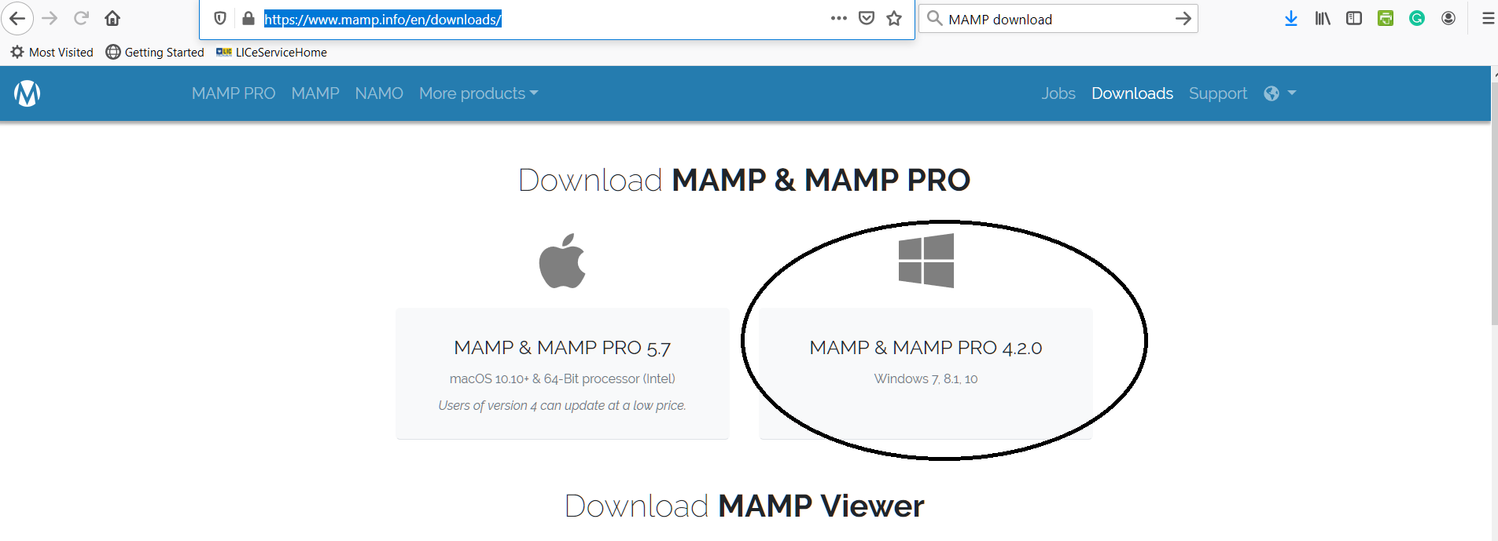
Installing MAMP
Download MAMP for windows
https://www.mamp.info/en/downloads/

Slide 5
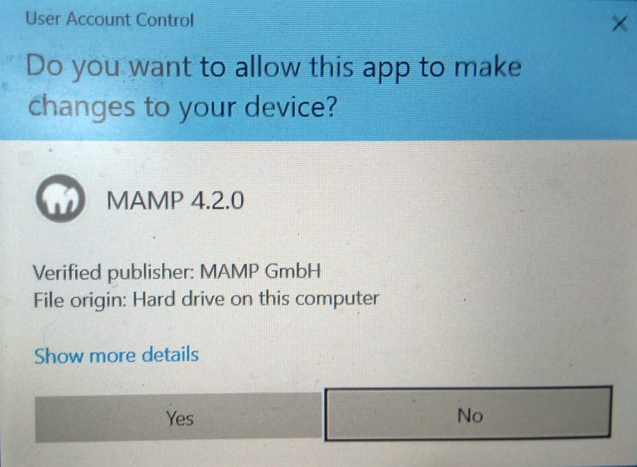
Execute
Execute the MAMP_MAMP_PRO_4.2.0.exe file
You will get a window saying
“Install MAMP PRO in addition
to MAMP”
Uncheck this box, do not
install it, unless you want to pay
Follow the other instructions
Accept agreement, etc

Slide 6
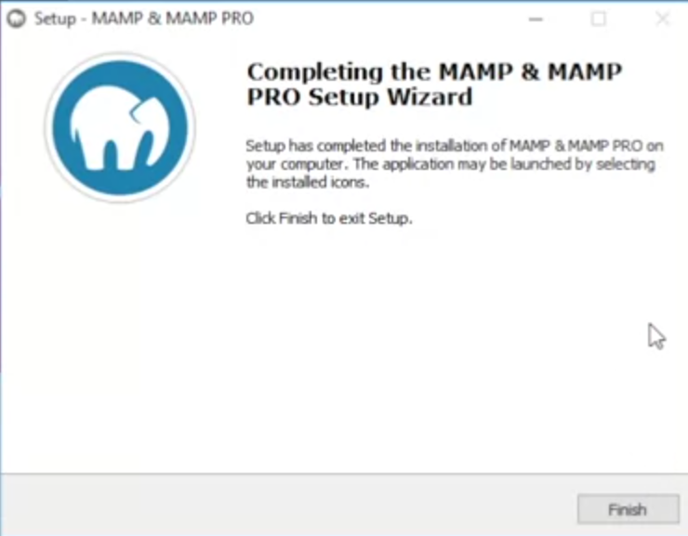
Complete the installation
The installation will take about 8 – 10 minutes.
Finish the installation

Slide 7
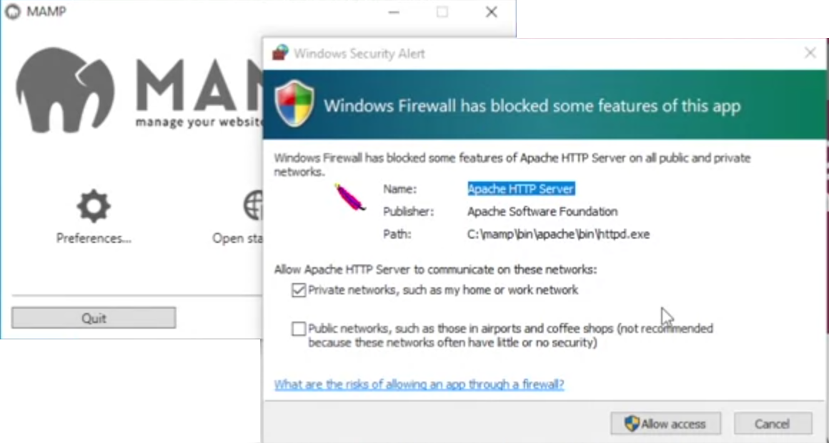
Starting MAMP
Allow the app
Check both the boxes
Notes:
When you start it for the first time, you may get a message like “Windows server has blocked some features of this app”…It is very important to allow the webserver on the firewall. Check both the boxes

Slide 8
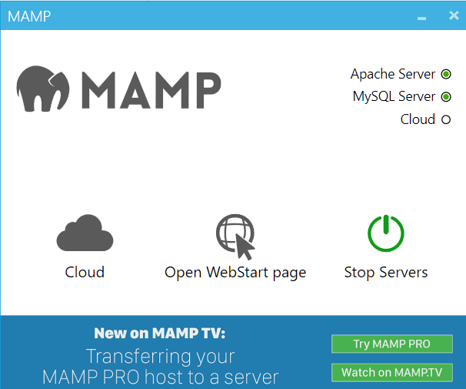
MAMP successfully started
You can see both the Apache and MySQL server running
Click on “Open WebStart Page”

Slide 9
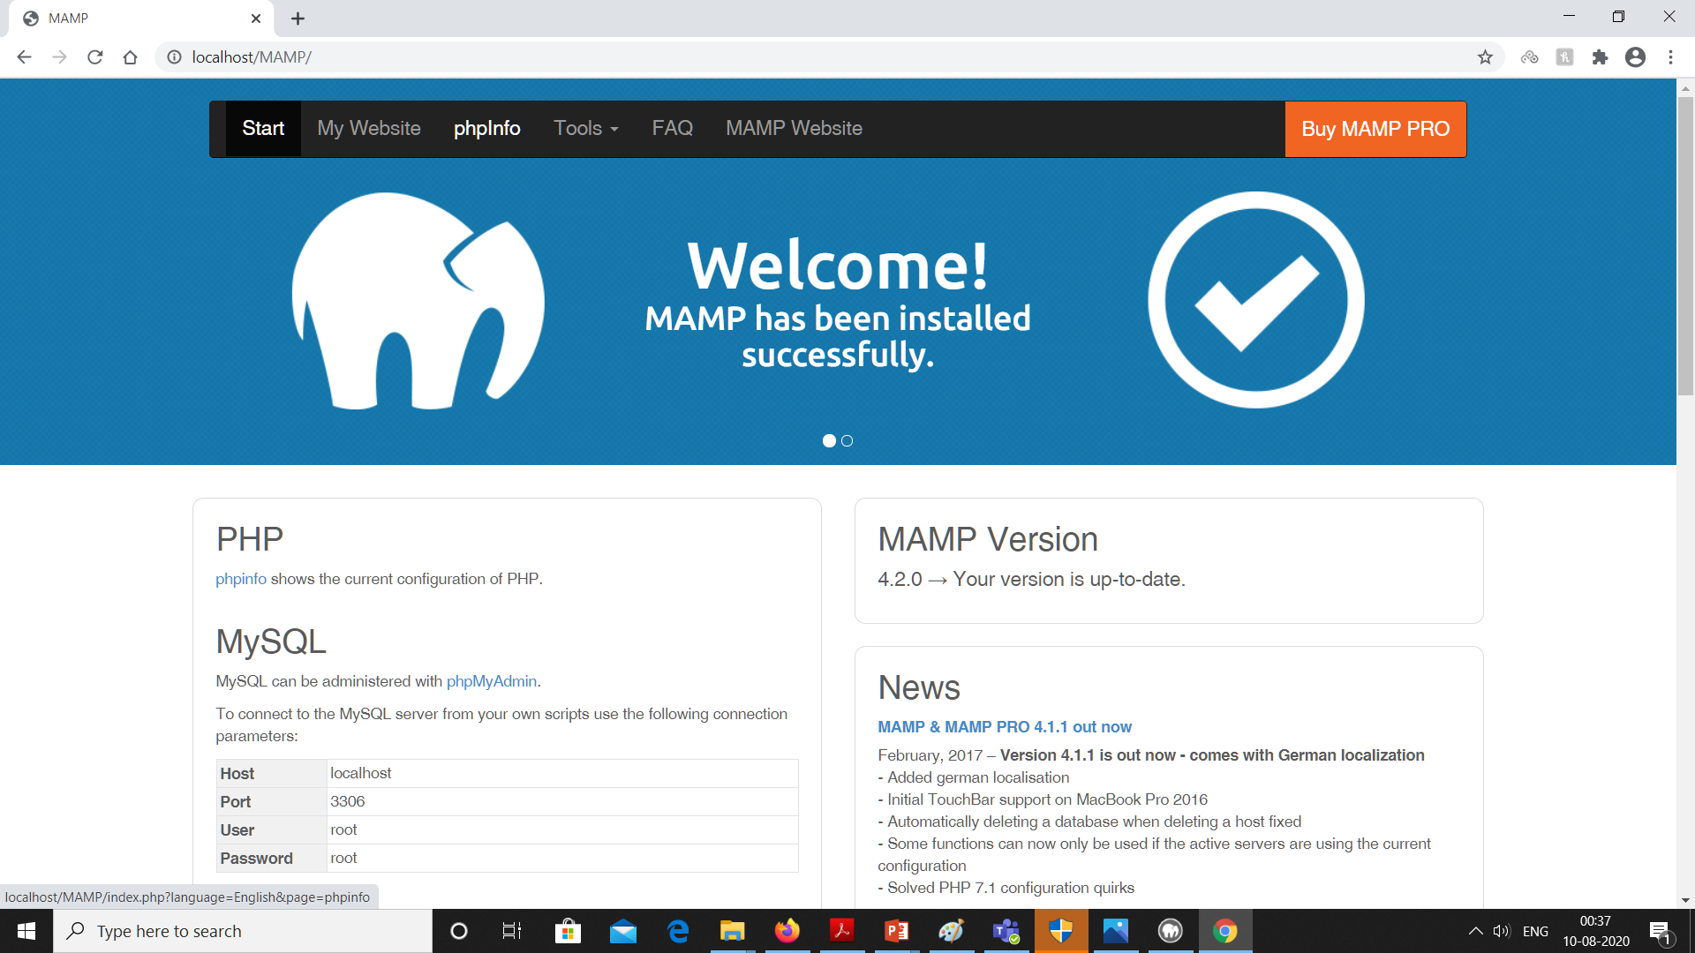
Notes:
Now you can explore the different tabs.

Slide 10
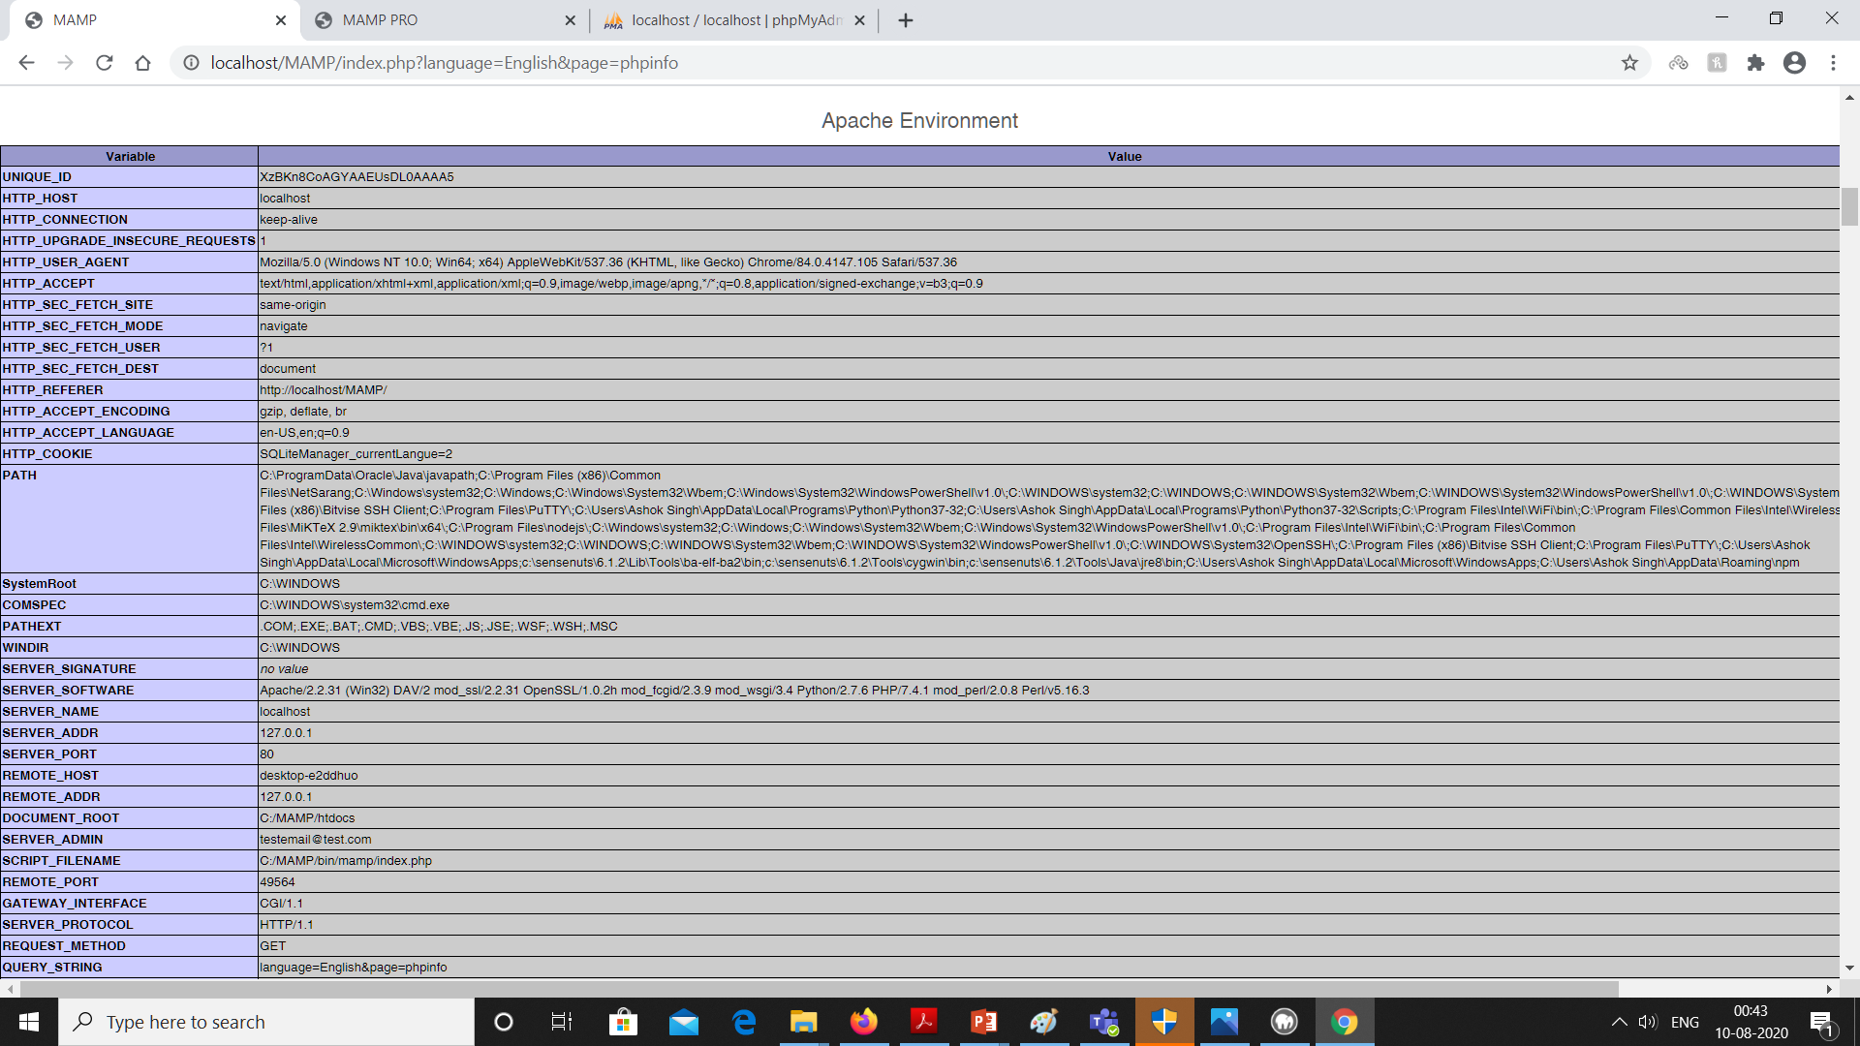
Notes:
Click on phpinfo, scroll down and examine the Apache Environment. In particular check out the Document_root.

Slide 11
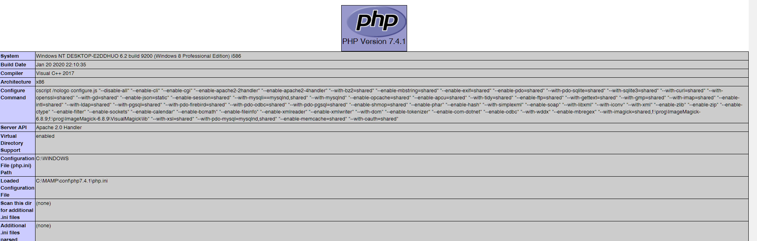
PHP Configuration File

Slide 12
Handling errors
Look out for the configuration file
Use phpinfo to locate the configuration file
C:\mamp\conf\php7.4.1\php.ini
Set display errors on
display_errors=on
display_startup_errors=on

