Slide 1
Connecting to SQL Server MA 518: Database Management Systems
Instructor: Ashok Singh Sairam
ashok@iitg.ac.in

Slide 2
Lecture Plan
Connecting to SQL Server
Dump Contents in Array
Print data in tabular format
Insert data into table
Delete data from table

Slide 3
Three-Tier Architecture (Review)
Browser
Web Server
Database Server
1. HTML
Request
D
O
M
Static
Files
Parse
Response
Apache
MySQL
PHP
Code

Slide 4
Three-Tier Architecture (Review)
Browser
Web Server
Database Server
1. HTML
Request
D
O
M
Static
Files
Parse
Response
Apache
MySQL
2. HTML
Response
PHP
Code

Slide 5
Three-Tier Architecture
Browser
Web Server
Database Server
1. HTML
Request
2. Call Database
(SQL)
D
O
M
Static
Files
Parse
Response
Apache
MySQL
PHP
Code

Slide 6
Three-Tier Architecture
Browser
Web Server
Database Server
1. HTML
Request
2. Call Database
(SQL)
D
O
M
Static
Files
Parse
Response
Apache
MySQL
4. HTML
Response
PHP
Code
3. Return
Data

Slide 7
Ways to access MySQL
PHP is evolving - there are three ways to access MySql
Legacy non-OO mysql_ routines (deprecated)
New mysqli (OO version that is similar to mysql_)
PDO - Portable Data Objects
Recommendation: PDO MySQL extensions
Other ways to connect
ODBC Stands for Open Database Connectivity – Use with languages like C, C++; works only with Windows
JDBC Stands for java database connectivity – Use with Java
Explore REST API (Representational State Transfer)
https://www.php.net/manual/en/mysqlinfo.api.choosing.php

Slide 8
Anatomy of PDO connection
$pdo=new PDO('mysql:host=<hname>;port=<port#>;dbname=<dbname>',‘<user>',‘<pass>');
1. hname : Name/IP address of the server where the DB resides
Ex: localhost or 127.0.0.1
2. port# : Port number where the database server is running
Ex: 3306 (for windows)
3. dbname: Name of the database you want to access
Ex: marks (the database we created in the last lecture)
4. user: username that exists in the database
5. pass: password of the user

Slide 9
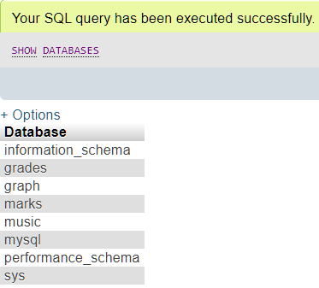
Create Users(1)
Run the SQL statement “show databases;”
Note there is a database named mysql
The database mysql has a table named user
Run the SQL statement “DESCRIBE mysql.user” to check the fields of the table
SELECT * from mysql.user;
List the users in the table

Slide 10

Create Users(2)
Syntax to create a user
CREATE USER ‘user’@’host’ IDENTIFIED BY ‘password’;
Ex: create a user with userid ‘user1’ and password ‘test1’

Slide 11

Create Users(3)
Next grant privileges to the user to access a database
GRANT privileges_names ON object TO user;
Ex: Grant all privileges to ‘user1’;
GRANT ALL PRIVILEGES ON marks.* to ‘user1'@'localhost‘
Note that the GRANT statement is a Data Control Language

Slide 12
Connecting to the database
<?php $servername = "localhost"; //Name of the server where database resides, ex: 127.0.0.1 $port_no = 3306; // Port number for Windows
$username = “user1"; $password = “test1"; $myDB= “grades”; //Name of the database to access

Slide 13
Connecting to the database
<?php $servername = "localhost"; //Name of the server where database resides, ex: 127.0.0.1 $port_no = 3306; // Port number for Windows
$username = “user1"; $password = “test1"; $myDB= “marks”; //Name of the database to access
try { $conn = new PDO("mysql:host=$servername; port= $port_no, dbname=$myDB",
$username, $password); // set the PDO error mode to exception $conn->setAttribute(PDO::ATTR_ERRMODE, PDO::ERRMODE_EXCEPTION); echo "Connected successfully"; } catch(PDOException $e) { echo "Connection failed: " . $e->getMessage(); } ?>

Slide 14

First Program: Connecting to the database
<?php $servername = "localhost"; //Name of the server where database resides, ex: 127.0.0.1 $port_no = 3306; // Port number for Windows
$username = “user1"; $password = “test1"; $myDB= “marks”; //Name of the database to access
try { $conn = new PDO("mysql:host=$servername; port= $port_no, dbname=$myDB",
$username, $password); // set the PDO error mode to exception $conn->setAttribute(PDO::ATTR_ERRMODE, PDO::ERRMODE_EXCEPTION); echo "Connected successfully"; } catch(PDOException $e) { echo "Connection failed: " . $e->getMessage(); } ?>

Slide 15
Review: Creating database
CREATE DATABASE marks;
USE marks;
CREATE TABLE student (
name varchar(28) not null,
rollno INT(7),
branch varchar(20),
cpi decimal(4,2)
};
Insert into student values (“John”, 12345, “MnC”,9.1);

Slide 16
Second Program: Dump data from table
<?php $servername = "localhost"; //Name of the server where database …..
$conn = new PDO("mysql:host=$servername; port= $port_no, dbname=$myDB", $username, $password);
…..
echo "<pre>\n";
$stmt = $conn->query("SELECT * FROM marks.student");
while ($row = $stmt->fetch(PDO::FETCH_ASSOC)) {
print_r($row);
}

Slide 17
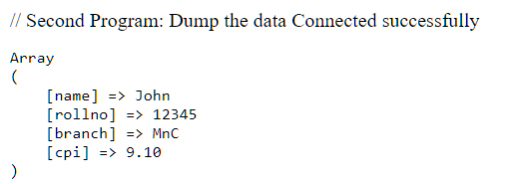
Second Program: Dump data from table
<?php $servername = "localhost"; //Name of the server where database …..
$conn = new PDO("mysql:host=$servername; port= $port_no, dbname=$myDB", $username, $password);
…..
echo "<pre>\n";
$stmt = $conn->query("SELECT * FROM marks.student");
while ($row = $stmt->fetch(PDO::FETCH_ASSOC)) {
print_r($row);
}

Slide 18
Third Program: Output in tabular format
<?php $servername = "localhost"; //Name of the server where database …..
$conn = new PDO("mysql:host=$servername; port= $port_no, dbname=$myDB", $username, $password);
…..
$stmt = $conn->query("SELECT name, rollno, branch, cpi FROM marks.student");
echo '<table border="1">',"\n";
echo "<tr> <td> Name </td> <td> Roll No </td> <td> Branch </td> <td> CPI </td> </tr>";
while ($row=$stmt->fetch(PDO::FETCH_ASSOC)) {
echo "<tr> <td>";
echo $row['name'];
echo "</td><td>";

Slide 19
Third Program: Output in tabular format
<?php $servername = "localhost"; //Name of the server where database …..
$conn = new PDO("mysql:host=$servername; port= $port_no, dbname=$myDB", $username, $password);
…..
$stmt = $conn->query("SELECT name, rollno, branch, cpi FROM marks.student");
echo '<table border="1">',"\n";
echo "<tr> <td> Name </td> <td> Roll No </td> <td> Branch </td> <td> CPI </td> </tr>";
while ($row=$stmt->fetch(PDO::FETCH_ASSOC)) {
echo "<tr> <td>";
echo $row['name'];
echo "</td><td>";

Slide 20
Third Program: Output in tabular format
<?php $servername = "localhost"; //Name of the server where database …..
$conn = new PDO("mysql:host=$servername; port= $port_no, dbname=$myDB", $username, $password);
…..
$stmt = $conn->query("SELECT name, rollno, branch, cpi FROM marks.student");
echo '<table border="1">',"\n";
echo "<tr> <td> Name </td> <td> Roll No </td> <td> Branch </td> <td> CPI </td> </tr>";
while ($row=$stmt->fetch(PDO::FETCH_ASSOC)) {
echo "<tr> <td>";
echo $row['name'];
echo "</td><td>";

Slide 21
Third Program: Output in tabular format
echo $row[‘rollno'];
echo "</td><td>";
echo $row[‘branch'];
echo "</td><td>";
echo $row[‘cpi'];
echo "</td></tr>";
}
echo "</table>";

Slide 22
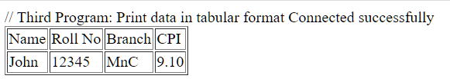
Third Program: Output in tabular format
echo $row[‘rollno'];
echo "</td><td>";
echo $row[‘branch'];
echo "</td><td>";
echo $row[‘cpi'];
echo "</td></tr>";
}
echo "</table>";

Slide 23
4th Program: Insert data from a HTML form
<html> <head> </head> <body>
<p> Add a student </p>
<form method="post">
<p> Name: <input type="text" name="name" size="40"></p>
<p> Roll No: <input type="number" name="rollno" size="6"> </p>
<p> branch: <input type="text" name="branch" size="12"></p>
<p> cpi: <input type="text" name="cpi" size="2"> </p>
<p> <input type="submit" value="Add student"></p>
</form>
</body>

Slide 24
<?php
require_once 'connect_marks.php';
if ( isset($_POST['name']) && isset($_POST['rollno']) && isset($_POST['branch']) && isset($_POST['cpi'])) {
$sql="INSERT INTO marks.student (name,rollno,branch,cpi) VALUES (:name, :rollno, :branch, :cpi)";
$stmt=$conn->prepare($sql);
$stmt->execute(array(
':name' =>$_POST['name'],
':rollno' =>$_POST['rollno'],
':branch' =>$_POST['branch'],
':cpi' =>$_POST['cpi']));
}
?>

Slide 25
<?php
require_once 'connect_marks.php';
if ( isset($_POST['name']) && isset($_POST['rollno']) && isset($_POST['branch']) && isset($_POST['cpi'])) {
$sql="INSERT INTO marks.student (name,rollno,branch,cpi) VALUES (:name, :rollno, :branch, :cpi)";
$stmt=$conn->prepare($sql);
$stmt->execute(array(
':name' =>$_POST['name'],
':rollno' =>$_POST['rollno'],
':branch' =>$_POST['branch'],
':cpi' =>$_POST['cpi']));
}
?>

Slide 26
<?php
require_once 'connect_marks.php';
if ( isset($_POST['name']) && isset($_POST['rollno']) && isset($_POST['branch']) && isset($_POST['cpi'])) {
$sql="INSERT INTO marks.student (name,rollno,branch,cpi) VALUES (:name, :rollno, :branch, :cpi)";
$stmt=$conn->prepare($sql);
$stmt->execute(array(
':name' =>$_POST['name'],
':rollno' =>$_POST['rollno'],
':branch' =>$_POST['branch'],
':cpi' =>$_POST['cpi']));
}
?>

Slide 27
<?php
require_once 'connect_marks.php';
if ( isset($_POST['name']) && isset($_POST['rollno']) && isset($_POST['branch']) && isset($_POST['cpi'])) {
$sql="INSERT INTO marks.student (name,rollno,branch,cpi) VALUES (:name, :rollno, :branch, :cpi)";
$stmt=$conn->prepare($sql);
$stmt->execute(array(
':name' =>$_POST['name'],
':rollno' =>$_POST['rollno'],
':branch' =>$_POST['branch'],
':cpi' =>$_POST['cpi']));
}
?>

Slide 28
<?php
require_once 'connect_marks.php';
if ( isset($_POST['name']) && isset($_POST['rollno']) && isset($_POST['branch']) && isset($_POST['cpi'])) {
$sql="INSERT INTO marks,student (name,rollno,branch,cpi) VALUES (:name, :rollno, :branch, :cpi)";
$stmt=$conn->prepare($sql);
$stmt->execute(array(
':name' =>$_POST['name'],
':rollno' =>$_POST['rollno'],
':branch' =>$_POST['branch'],
':cpi' =>$_POST['cpi']));
}
?>

Slide 29
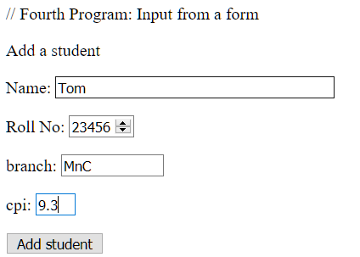
<?php
require_once 'connect_marks.php';
if ( isset($_POST['name']) && isset($_POST['rollno']) && isset($_POST['branch']) && isset($_POST['cpi'])) {
$sql="INSERT INTO marks.student (name,rollno,branch,cpi) VALUES (:name, :rollno, :branch, :cpi)";
$stmt=$conn->prepare($sql);
$stmt->execute(array(
':name' =>$_POST['name'],
':rollno' =>$_POST['rollno'],
':branch' =>$_POST['branch'],
':cpi' =>$_POST['cpi']));
}
?>

Slide 30
Delete
$sql="DELETE FROM marks.student where rollno=12345";
$stmt=$conn->prepare($sql);
if ($stmt->execute())
{
$count=$stmt->rowCount();
echo "$count";
echo "\nUser deleted";
}

Slide 31
Thank You

