Slide 1
Tuple Relational Calculus MA 518: Database Management Systems
Instructor: Ashok Singh Sairam
ashok@iitg.ac.in

Slide 2
Relational Query Languages
Query languages allow the manipulation and retrieval of data from a database
Two mathematical Query Languages form the basis for “real” languages (e.g. SQL),
Relational Algebra
Procedural query language (step-by-step procedure)
used to represent execution plans
Relational Calculus
Non-procedural (declarative) query language
Describe what you want, rather than how to compute it
Foundation for SQL

Slide 3
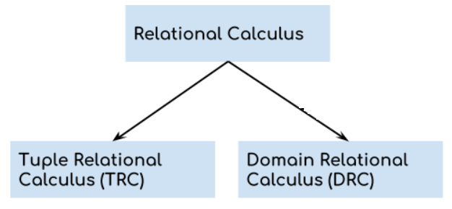
Relational Calculus types

Slide 4
Tuple Relational Calculus
Interested in finding tuples for which a predicate (condition) is true. Based on use of tuple variables.

Slide 5
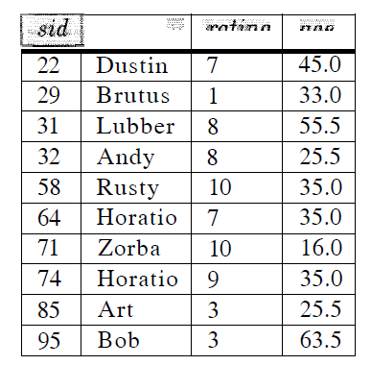
Tuple Relational Calculus
Interested in finding tuples for which a predicate (condition) is true. Based on use of tuple variables.
Tuple variable is a variable that ‘ranges over’ a named relation: i.e., variable whose only permitted values are tuples of the relation.
Sailors
S: tuple variable

Slide 6
Tuple Relational Calculus
Interested in finding tuples for which a predicate (condition) is true. Based on use of tuple variables.
Tuple variable is a variable that ‘ranges over’ a named relation: i.e., variable whose only permitted values are tuples of the relation.
Specify range of a tuple variable S as the Sailor relation as:
Sailor(S) or S ϵ Sailor
Sailors

Slide 7
Tuple Relational Calculus Query
A TRC query is of the form
{𝑇|p(𝑇)}
which means select those tuples T that satisfy a given condition(s) p(T)
T: resulting tuples
p(T): Predicate (condition) used to fetch T.
That is the set of all tuples T where formula p(T) evaluates to TRUE

Slide 8
TRC: Example
To find details of all sailors whose age is less than 35
{S | Sailor(S) ∧ S.age < 35}
sname
rating
age
S: Sailors

Slide 9
Quantifiers
TRC can use two quantifiers to tell how many instances the predicate applies to:
Existential quantifier ∃ (‘there exists’)
Universal quantifier ∀ (‘for all’)
Tuple variables qualified by ∀ or ∃ are called bound variables, otherwise called free variables.

Slide 10
Existential quantifier
Existential quantifier used in formulae implies that it must be true for at least one instance, such as:
Sailor(S) ∧ (∃R)(Reserves(R) ∧ S.sid = R.sid) ∧ R.bid = 102)
Means ‘There exists a Reserves tuple with same sid as the sid of the current Sailor tuple, S, and the boat id is 102’.

Slide 11
Universal quantifier
Universal quantifier is used in statements about every instance, such as:
(∀B) (B.color ≠ ‘red’)
Means ‘For all Boat tuples, the color is not red’.
Can also use ~(∃B) (B.color = ‘red’) which means ‘There are no boats with color red’.

Slide 12
TRC: Formula
{𝑇|p(𝑇)}
Formula
A (well-formed) formula is made out of atoms:
R(S_{i}) or S_{i} ϵ R, where S_{i} is a tuple variable and R is a relation
S_{i}.a₁ οp S_{j}.a₂
S_{i}.a₁ οp constant
op: Set of operators {<, ≤, =, ≥, >}

Slide 13
TRC: Formula
{𝑇|p(𝑇)}
Formula
A (well-formed) formula is made out of atoms:
R(S_{i}), where S_{i} is a tuple variable and R is a relation
S_{i}.a₁ οp S_{j}.a₂
S_{i}.a₁ οp constant
op: Set of operator {<, ≤, =, ≥, >}
Can recursively build up formulae from atoms:
An atom is a formula
If p and q are formulae, so are their conjunction, p ∧ q; disjunction, p ∨ q; and negation, ~p
∃R(p(R)), where p(R) denotes a formula and R is a tuple variable
∀R(p(R))

Slide 14
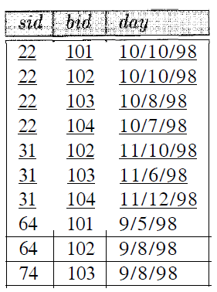
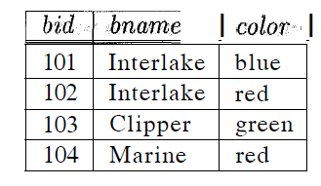
Example Relations
sname
rating
age
H1: Boats
S3: Sailors
R2: Reserves

Slide 15


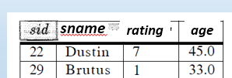
TRC Example: Selection and Projection
Ex1: Find all sailors with rating above 7

Slide 16
TRC Example: Selection and Projection
Ex1: Find all sailors with rating above 7
{S |S ∈Sailors ∧ S.rating > 7}

Slide 17
TRC Example: Selection and Projection
Ex1: Find all sailors with rating above 7
Ex2: Find names and ages of sailors with rating above 7.
{S |S ∈Sailors ∧ S.rating > 7}

Slide 18
TRC Example: Selection and Projection
Ex1: Find all sailors with rating above 7
Ex2: Find names and ages of sailors with rating above 7.
Note, here S is a tuple variable of 2 fields (i.e. {S} is a projection of sailors), since only 2 fields are ever mentioned and S is never used to range over any relations in the query.
{S |S ∈Sailors ∧ S.rating > 7}
{S | ∃S1 ∈Sailors(S1.rating > 7 ∧ S.sname = S1.sname
∧ S.age = S1.age)}

Slide 19
Example Relations
Ex3: Find sailors rated > 7 who’ve reserved boat #103
sname
rating
age
H1: Boats
S3: Sailors
R2: Reserves

Slide 20
TRC Example: Joins
Ex3: Find sailors rated > 7 who’ve reserved boat #103
{S | S∈Sailors ∧ S.rating > 7 ∧ ∃R(R∈Reserves ∧ R.sid = S.sid
∧ R.bid = 103)}
Note the use of ∃ to find a tuple in Reserves that `joins with’ the Sailors tuple under consideration

Slide 21
Example Relations
Ex4: Find sailors rated > 7 who’ve reserved a red boat
sname
rating
age
H1: Boats
S3: Sailors
R2: Reserves

Slide 22
TRC Example: Joins contd.
Find sailors rated > 7 who’ve reserved a red boat
{S | S∈Sailors ∧ S.rating > 7 ∧
∃R(R∈Reserves ∧ R.sid = S.sid
∧ ∃B(B∈Boats ∧ B.bid = R.bid
∧ B.color = ‘red’))}
Observe how the parentheses control the scope of each quantifier’s binding. (Similar to SQL!)

Slide 23
Example Relations
Ex5: Find sailors who’ve reserved all boats
sname
rating
age
H1: Boats
S3: Sailors
R2: Reserves

Slide 24



TRC Example: Division
Sailors
Reserves
Ex5: Find sailors who’ve reserved all boats
{S | S∈Sailors ∧
∀B∈Boats (∃R∈Reserves
(S.sid = R.sid
∧ B.bid = R.bid))}
Boats
Find all sailors S such that for each tuple B in Boats there is a tuple in Reserves showing that sailor S has reserved it.

Slide 25
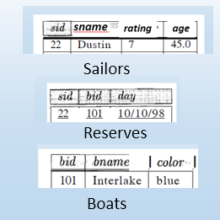
TRC Example: Division continued
Ex6: Find sailors who’ve reserved all Red boats

Slide 26
TRC Example: Division continued
Ex6: Find sailors who’ve reserved all Red boats
{ S | S∈Sailors ∧
∀B ∈ Boats ( B.color = ‘red’ ⇒
∃R(R∈Reserves ∧ S.sid = R.sid ∧ B.bid = R.bid))}

Slide 27

TRC Example: Division continued
Find sailors who’ve reserved all Red boats
S | S∈Sailors ∧
∀B ∈ Boats ( B.color = ‘red’ ⇒
∃R(R∈Reserves ∧ S.sid = R.sid ∧ B.bid = R.bid))}
$p⇒q is equivalent to ¬p \bigvee{q}$.
p |  | q
 |  | T | F
 | T | T | F
 | F | T | T

Slide 28
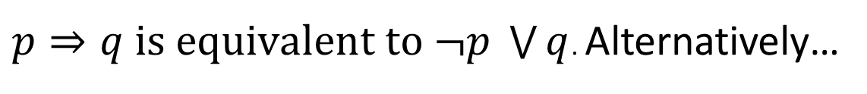
TRC Example: Division continued
Find sailors who’ve reserved all Red boats
S | S∈Sailors ∧
∀B ∈ Boats ( B.color = ‘red’ ⇒
∃R(R∈Reserves ∧ S.sid = R.sid ∧ B.bid = R.bid))}
$p⇒q is equivalent to ¬p \bigvee{q}$. Alternatively…
{S | S∈Sailors ∧
∀B ∈ Boats ( B.color ≠ ‘red’ ∨
∃R(R∈Reserves ∧ S.sid = R.sid
∧ B.bid = R.bid))}

Slide 29
TRC Query (Revisited)
The use of quantifiers and in a formula is said to bind X in the formula.
A variable that is not bound is free.
Let us revisit the definition of a query:
{T | p(T)}
There is an important restriction
the variable T that appears to the left of `|’ must be the only free variable in the formula p(T).
in other words, all other tuple variables must be bound using a quantifier.

Slide 30
Unsafe Queries
∃ syntactically correct calculus queries that have an infinite number of answers! Unsafe queries.
e.g.,
Solution???? Don’t do that!

Slide 31
Unsafe Queries
∃ syntactically correct calculus queries that have an infinite number of answers! Unsafe queries.
e.g.,
Solution???? Don’t do that!
A TRC is safe if all values in its results are members of its domain

Slide 32
Summary
The relational model has rigorously defined query languages — simple and powerful.
Relational algebra is more operational
useful as internal representation for query evaluation plans.
Relational calculus is non-operational
users define queries in terms of what they want, not in terms of how to compute it. (Declarative)

Slide 33
Practice Exercises
Ex: 4.3 (write the TRC queries)

