Slide 1
Domain Relational Calculus MA 518: Database Management Systems
Instructor: Ashok Singh Sairam
ashok@iitg.ac.in

Slide 2
Domain Relational Calculus
Domain variable: represent values in the domain of an attribute
for example the domain variable can be integer if it represent an attribute whose domain is the set of integers

Slide 3
Domain Relational Calculus
Query has the form:
xi is either a domain variable or a constant
Answer includes all tuples that make the formula be true.
Formula is recursively defined, starting with simple atomic formulas (getting rows from relations or making comparisons of values), and building bigger and better formulas using the logical connectives.

Slide 4
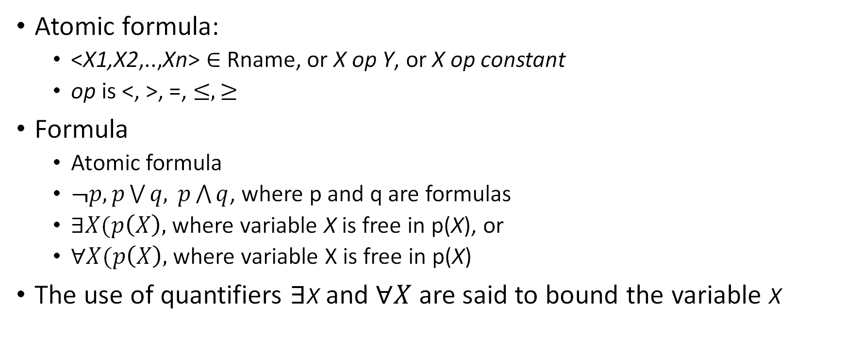
DRC Formulas
Atomic formula:
<X1,X2,..,Xn> $∈$ Rname, or X op Y, or X op constant
op is <, >, =, $≤, ≥$
Formula
Atomic formula
$¬p, p\bigvee{q, }p\bigwedge{q}$, where p and q are formulas
$∃X(p\left(X\right),$where variable X is free in p(X), or
$∀X(p\left(X\right),$where variable X is free in p(X)
The use of quantifiers $∃$X and $∀X$ are said to bound the variable X

Slide 5
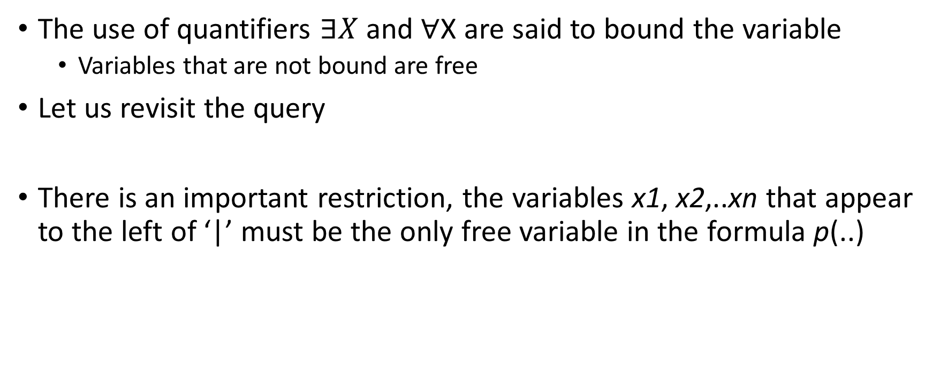
Free and Bound variables
The use of quantifiers $∃X$ and $∀$X are said to bound the variable
Variables that are not bound are free
Let us revisit the query
There is an important restriction, the variables x1, x2,..xn that appear to the left of ‘|’ must be the only free variable in the formula p(..)

Slide 6
Domain Relational Calculus
Example: To find details of all sailors whose age is less than 35
{S | Sailor(S) ∧ S.age < 35} (TRC)

Slide 7
Domain Relational Calculus
Example: To find details of all sailors whose age is less than 35
{S | Sailor(S) ∧ S.age < 35} (TRC)
{<I,N,T,A> | (I,N,T,A) ϵ Sailors ∧ A > 35} (DRC)
Note: (I,N,T,A) ϵ Sailors the domain variables I, N, T and A are bound to fields of the same Sailors tuple

Slide 8
DRC: Examples
Ex1: Find all sailors with a rating above 7
{S |S ∈Sailors ∧ S.rating > 7} (TRC)

Slide 9
DRC: Examples
Ex1: Find all sailors with a rating above 7
{S |S ∈Sailors ∧ S.rating > 7} (TRC)
(DRC)
The condition ensures that the domain variables I, N, T and A are bound to fields of the same Sailors tuple.
The term to the left of `|’ (which should be read as such that) says that every tuple that satisfies T>7 is in the answer.

Slide 10
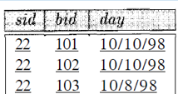
DRC: Examples
Ex2: Find sailors rating > 7 who’ve reserved boat #103
{S | S∈Sailors ∧ S.rating > 7 ∧
∃R(R∈Reserves ∧ R.sid = S.sid ∧ R.bid = 103)} (TRC)

Slide 11

DRC: Examples
Ex2: Find sailors rating > 7 who’ve reserved boat #103
{S | S∈Sailors ∧ S.rating > 7 ∧
∃R(R∈Reserves ∧ R.sid = S.sid ∧ R.bid = 103)} (TRC)
(DRC)
We have used ∃ Ir, Br, D (. . .) as a shorthand for ∃ Ir ( ∃ Br ( ∃ D(. . .)))
Note the use of $∃$to find a tuple in Reserves that `joins with’ the Sailors tuple under consideration

Slide 12
DRC: Examples
bid | bname | color
101 | interlake | red
103 | marine | green
Sailors
Reserves
Boats
Ex3: Find sailors rated > 7 who’ve reserved a red boat
{S | S∈Sailors ∧ S.rating > 7 ∧
∃R(R∈Reserves ∧ R.sid = S.sid
∧ ∃B(B∈Boats ∧ B.bid = R.bid ∧ B.color = ‘red’))} (TRC)

Slide 13
DRC: Examples
bid | bname | color
101 | interlake | red
103 | marine | green
Sailors
Reserves
Boats
Ex3: Find sailors rated > 7 who’ve reserved a red boat
{S | S∈Sailors ∧ S.rating > 7 ∧
∃R(R∈Reserves ∧ R.sid = S.sid
∧ ∃B(B∈Boats ∧ B.bid = R.bid ∧ B.color = ‘red’))} (TRC)
(DRC)

Slide 14
DRC: Examples
bid | bname | color
101 | interlake | red
103 | marine | green
Sailors
Reserves
Boats
Ex4: Find sailors who’ve reserved all boats
{S | S∈Sailors ∧
∀B∈Boats (∃R∈Reserves (S.sid = R.sid ∧ B.bid = R.bid))} (TRC)

Slide 15
DRC: Examples
bid | bname | color
101 | interlake | red
103 | marine | green
Sailors
Reserves
Boats
Ex4: Find sailors who’ve reserved all boats
{S | S∈Sailors ∧
∀B∈Boats
(∃R∈Reserves (S.sid = R.sid ∧ B.bid = R.bid))} (TRC)
(DRC)

Slide 16
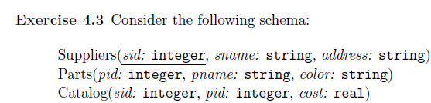
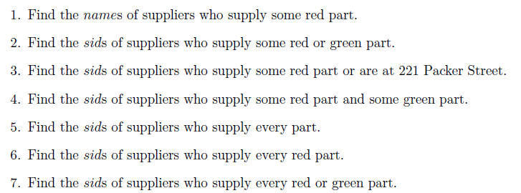
Practice Exercise

Slide 17

Practice Exercise – (1)

Slide 18
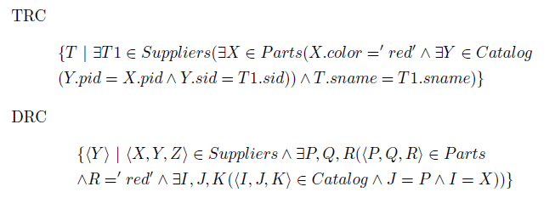
Practice Exercise – (1)

Slide 19
Practice Exercise – (2)

Slide 20
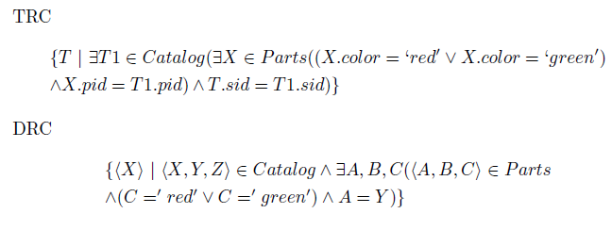
Practice Exercise – (2)

Slide 21
Practice Exercise – (3)

Slide 22
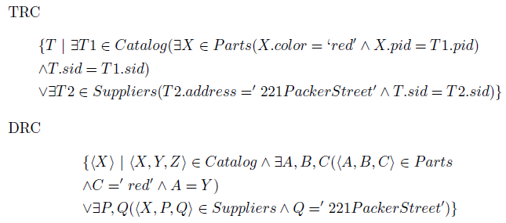
Practice Exercise – (3)

Slide 23
Practice Exercise – (4)

Slide 24
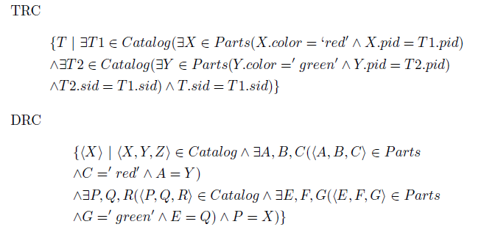
Practice Exercise – (4)

Slide 25
Practice Exercise – (5)

Slide 26
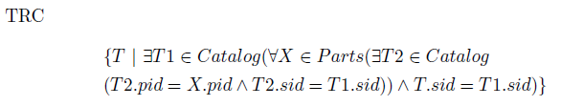
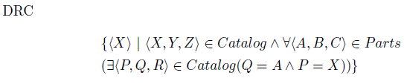
Practice Exercise – (5)

Slide 27
Practice Exercise – (6)

Slide 28
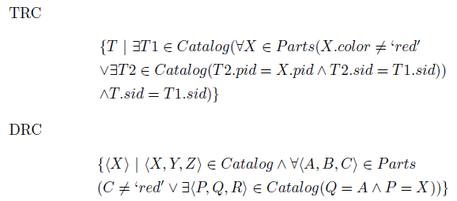
Practice Exercise – (6)

Slide 29
Practice Exercise – (7)

Slide 30
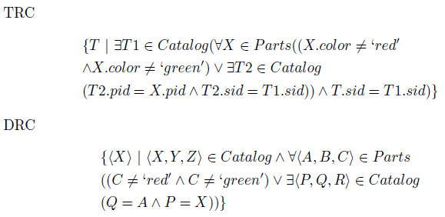
Practice Exercise – (7)

Slide 31
Relational Completeness
Expressive Power (Theorem due to Codd):
every query that can be expressed in relational algebra can be expressed as a safe query in DRC / TRC; the converse is also true.
Relational Completeness: Query language (e.g., SQL) can express every query that is expressible in relational algebra/calculus. (actually, SQL is more powerful, as we will see…)

Slide 32
Summary
Relational calculus is non-operational, and users define queries in terms of what they want, not in terms of how to compute it. (Declarative)
Algebra and safe calculus have same expressive power, leading to the notion of relational completeness.

Slide 33
Practice Exercises
Ex 4.5

