Slide 1
SQL: Structured Query Language
Basic SQL Query
Instructor: Ashok Singh Sairam
ashok@iitg.ac.in

Slide 2
SQL: Introduction
“S.Q.L.” or “sequel”
Supported by all major commercial database systems
Standardized – many new features over time
Declarative language

Slide 3
SFW Query
Select-From-Where (SFW) Expressions
Every query must have SELECT clause which specifies columns to be retained
Must have a FROM clause which specifies a cross product of tables
The optional WHERE clause specifies the conditions to select the rows
SELECT <columns> FROM <table name> WHERE <conditions>

Slide 4
Columns
SELECT <columns> FROM <table name> WHERE <conditions>
Which columns are you interested in?
Delete attributes that are not in COLUMNS
SELECT *
SELECT name, age
SELECT S.name, S.age
SELECT name AS studentName, age
SELECT name, age * 365 as ageDay
The AS keyword is used to assign temporary names to table/columns

Slide 5
Table Name
Name the list of table(s) your are interested
Compute the cross-product of tables
FROM Sailors
FROM Sailors S [S is a range variable]
FROM Sailors, Reserves
FROM Sailors S, Reserves R
SELECT <columns> FROM <table name> WHERE <conditions>

Slide 6
Conditions
SELECT <columns> FROM <table name> WHERE <conditions>
Which rows are you interested in?
Comparisons (Attr op const or Attr1 op Attr2, where op is one of
combined using AND, OR and NOT.
Discard resulting tuples if they fail condition
WHERE gpa > 3.5
WHERE school = ‘SFU’ AND gpa > 3.5
WHERE (school = ‘SFU’ OR school = ‘UBC’) AND gpa > 3.5
WHERE age * 365 > 7500

Slide 7
SQL: A little more detail
SQL commands are case insensitive:
Same: SELECT, Select, select
Same: Student, student
Same: gpa, GPA
Values are not:
Different: 'SFU', 'sfu'
SQL strings are enclosed in single quotes
e.g. name = 'Mike’
Single quotes in a string can be specified using an initial single quote character as an escape
author = 'Shaq O''Neal'
Strings can be compared alphabetically with the comparison operators
e.g. 'fodder' < 'foo' is TRUE

Slide 8
DISTINCT: Eliminating Duplicates
DISTINCT is an optional keyword indicating that the answer should not contain duplicates. Default is that duplicates are not eliminated!
SELECT [DISTINCT] <columns> FROM <table name> WHERE <conditions>

Slide 9
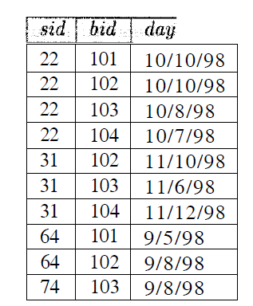
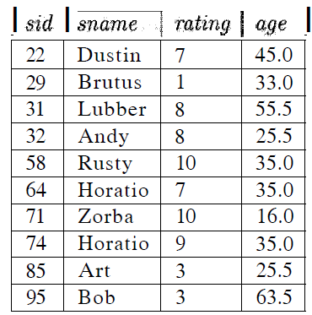
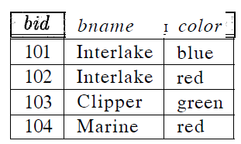
Example Instances
We will use these instances of the Sailors, Reserves and Boats relations in our examples
R2 of Boats
S3 of Sailors
B1 of Boats

Slide 10
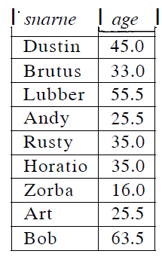
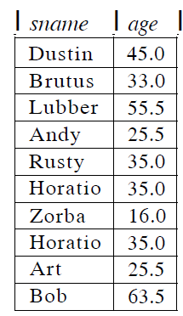
Example 1
Find the name and age of all sailors
SELECT DISTINCT S.sname, S.age
FROM Sailors S
Without DISTINCT the record Horatio will appear twice!

Slide 11
Example 2
R
S
Find name of all sailors who have reserved boat id 103

Slide 12
Example 2
R
S
Find name of all sailors who have reserved boat id 103
SELECT S.sname
FROM Sailors S, Reserves R
WHERE S.sid=R.sid AND R.bid=103

Slide 13
A note on range variables
The previous query
can also be written without using range variables
Range variables needed only if the same relation appears twice in the FROM clause
It is a good style however to use range variables!
SELECT S.sname
FROM Sailors S, Reserves R
WHERE S.sid=R.sid AND R.bid=103
SELECT sname
FROM Sailors, Reserves
WHERE Sailors.sid=Reserves.sid AND bid=103

Slide 14
ORDER BY: Sorting the Results
The output of an SQL query can be ordered
By any number of attributes, and
In either ascending or descending order
The default is to use ascending order
The keywords ASC and DESC, following the column name, sets the order
SELECT DISTINCT sname, age
FROM Sailors
ORDER BY sname ASC, age DESC

Slide 15
Renaming field name
AS is a way to name fields in result
SELECT DISTINCT sname AS Sailor_Name, age AS Sailor_AGE
FROM Sailors
ORDER BY sname ASC, age DESC

Slide 16
LIKE: Simple String Pattern Matching
SQL provides pattern matching support with the LIKE operator and two symbols
The % symbol stands for zero or more arbitrary characters
The _ symbol stands for exactly one arbitrary character
The % and _ characters can be escaped with \
E.g., name LIKE ’Michael\_Jordan'
SELECT S.sname, S.age
FROM Sailors S
WHERE S.sname LIKE ‘B_%B’

Slide 17

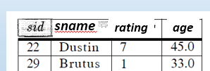

Example 3
Find name of sailors who’ve reserved a red or a green boat

Slide 18
Example 3
Find name of sailors who’ve reserved a red or a green boat
If we replace OR by AND we get an empty set (same as in relational calculus!)
SELECT S.sname
FROM Sailors S, Boats B, Reserves R
WHERE S.sid=R.sid AND R.bid=B.bid
AND (B.color=‘red’ OR B.color=‘green’)

Slide 19
Union
UNION - Can be used to compute the union of any two union-compatible sets of tuples (which are themselves the result of SQL queries).

Slide 20
Union
UNION - Can be used to compute the union of any two union-compatible sets of tuples (which are themselves the result of SQL queries).
Find name of sailors who’ve reserved a red or a green boat
This query says that we want the union of the set of sailors who have reserved red boats and the set of sailors who have reserved green boats
SELECT S.sname
FROM Sailors S, Boats B, Reserves R
WHERE S.sid=R.sid AND R.bid=B.bid
AND B.color=‘red’
UNION
SELECT S.sname
FROM Sailors S, Boats B, Reserves R
WHERE S.sid=R.sid AND R.bid=B.bid
AND B.color=‘green’

Slide 21
Example 4:
Find name of sailors who’ve reserved a red and a green boat
INTERSECT - Can be used to compute the intersection of any two union-compatible sets of tuples

Slide 22
Example 4:
Find name of sailors who’ve reserved a red and a green boat
INTERSECT - Can be used to compute the intersection of any two union-compatible sets of tuples
SELECT S.sname
FROM Sailors S, Boats B, Reserves R
WHERE S.sid=R.sid AND R.bid=B.bid
AND B.color=‘red’
INTERSECT
SELECT S.sname
FROM Sailors S, Boats B, Reserves R
WHERE S.sid=R.sid AND R.bid=B.bid
AND B.color=‘green’

Slide 23
Example 5
Find name of sailors who’ve reserved red boats but not green boats
EXCEPT - Can be used to compute set-difference of any two union-compatible sets of tuples

Slide 24
Example 5
Find name of sailors who’ve reserved red boats but not green boats
EXCEPT - Can be used to compute set-difference of any two union-compatible sets of tuples
SELECT S.sname
FROM Sailors S, Boats B, Reserves R
WHERE S.sid=R.sid AND R.bid=B.bid
AND B.color=‘red’
EXCEPT
SELECT S.sname
FROM Sailors S, Boats B, Reserves R
WHERE S.sid=R.sid AND R.bid=B.bid
AND B.color=‘green’

Slide 25
Nested Queries
Nested query: a query that has another query embedded within it
Many of the previous queries can be specified in an alternative form using nesting
Can be recursive. The embedded query can be a nested query
The embedded query generally appears within the WHERE clause although it can also appear in the FROM clause
SELECT <columns> FROM <table name> WHERE
IN
(SELECT <columns> FROM <table name> WHERE <conditions>)

Slide 26
Example 2 (revisited)
Find names of sailors who’ve reserved boat #103
SELECT S.sname
FROM Sailors S
WHERE S.sid IN (SELECT R.sid
FROM Reserves R
WHERE R.bid=103)

Slide 27
Example 2 (revisited)
Find names of sailors who’ve reserved boat #103
For each Sailors tuple, check whether the same sid has reserved a boat with bid=103
To find sailors who’ve not reserved #103, use NOT IN.
SELECT S.sname
FROM Sailors S
WHERE S.sid IN
SELECT R.sid
FROM Reserves R
WHERE R.bid=103)

Slide 28
Example 6: Multiply nested query
Find names of sailors who have reserved a red boat
SELECT S.sname
FROM Sailors S
WHERE S.sid IN (SELECT R.sid
FROM Reserves R
WHERE R.bid IN ( SELECT B.bid
FROM Boats B
WHERE B.color = ‘red’))

Slide 29
Example 6: Multiply nested query
Find names of sailors who have reserved a red boat
SELECT S.sname
FROM Sailors S
WHERE S.sid IN (SELECT R.sid
FROM Reserves R
WHERE R.bid IN ( SELECT B.bid
FROM Boats B
WHERE B.color = ‘red’))
Innermost query
returns bid
102 and 104

Slide 30
Example 6: Multiply nested query
Find names of sailors who have reserved a red boat
SELECT S.sname
FROM Sailors S
WHERE S.sid IN (SELECT R.sid
FROM Reserves R
WHERE R.bid IN ( SELECT B.bid
FROM Boats B
WHERE B.color = ‘red’))
Mid query
returns sid
22, 31 and 64
Innermost query
returns bid
102 and 104

Slide 31
Example 6: Multiply nested query
Find names of sailors who have reserved a red boat
SELECT S.sname
FROM Sailors S
WHERE S.sid IN (SELECT R.sid
FROM Reserves R
WHERE R.bid IN ( SELECT B.bid
FROM Boats B
WHERE B.color = ‘red’))
Returns
Dustin, Lubber
and Horatio
Mid query
returns sid
22, 31 and 64
Innermost query
returns bid
102 and 104

Slide 32
Nested Queries with Correlation
In the examples that we have seen so far, the embedded query has been completely independent from the outer query
Correlated with nested queries: Embedded query depend on the row being currently examined in the outer query
EXISTS another set comparison operator, like IN is used in nested queries
Allows us to test whether a set is empty or not

Slide 33
Example 7: (Example 2 revisited)
Find names of sailors who’ve reserved boat #103
The occurrence of S in the subquery is called a correlation and such queries are called correlated queries
SELECT S.sname
FROM Sailors S
WHERE EXISTS (SELECT *
FROM Reserves R
WHERE R.bid=103 AND S.sid=R.sid)
correlation

Slide 34
Example 7: (Example 2 revisited)
Find names of sailors who’ve reserved boat #103
If UNIQUE is used, and * is replaced by R.bid, it finds sailors with at most one reservation for boat #103. (UNIQUE checks for duplicate tuples; * denotes all attributes)
SELECT S.sname
FROM Sailors S
WHERE EXISTS (SELECT *
FROM Reserves R
WHERE R.bid=103 AND S.sid=R.sid)
correlation

Slide 35
More on Set-Comparison Operators
We’ve already seen IN, EXISTS and UNIQUE. Can also use NOT IN, NOT EXISTS and NOT UNIQUE
Also available: op ANY, op ALL, op IN where op is one of { }

Slide 36
Example 7
Find sailors whose rating is greater than that of some sailor called Horatio
SELECT *
FROM Sailors S
WHERE S.rating > ANY (SELECT S2.rating
FROM Sailors S2
WHERE S2.sname=‘Horatio’)

Slide 37
Example 8: (Example 4 revisited)
Find name of sailors who’ve reserved both a red and a green boat
Similar to the example 4 (INTERSECT), except query rewritten using AND and IN
SELECT S.sname
FROM Sailors S, Boats B, Reserves R
WHERE S.sid=R.sid AND R.bid=B.bid AND B.color=‘red’
AND S.sid IN (SELECT S2.sid
FROM Sailors S2, Boats B2, Reserves R2
WHERE S2.sid=R2.sid AND R2.bid=B2.bid
AND B2.color=‘green’)

