Slide 1
SQL: Structured Query Language
Part II
Instructor: Ashok Singh Sairam
ashok@iitg.ac.in

Slide 2
Review of last lecture
Examined SFW query
Queries that can be expressed in RA can often be expressed more naturally in SQL
Nested Queries
Many alternative ways to write a query; optimizer should look for most efficient evaluation plan.
In practice, users need to be aware of how queries are optimized and evaluated for best results.

Slide 3
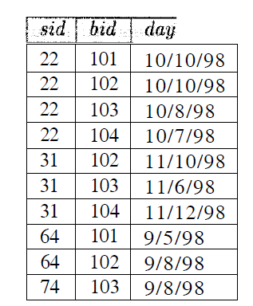
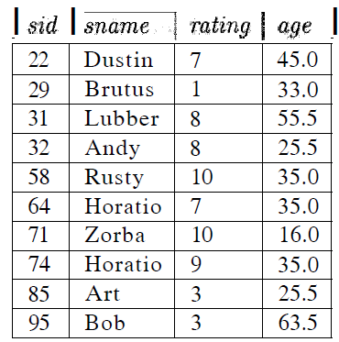
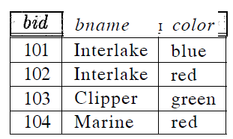
Example Instances
We will use these instances of the Sailors, Reserves and Boats relations in our examples
R2 of Boats
S3 of Sailors
B1 of Boats

Slide 4
Example 9 (continued from last lecture)
Find sailors who’ve reserved all boats

Slide 5
Example 9
Find sailors who’ve reserved all boats
SELECT S.sname
FROM Sailors S
WHERE NOT EXISTS (( SELECT B.bid
FROM Boats B)
EXCEPT
(SELECT R.bid
FROM Reserves R
WHERE R.sid=S.sid ))

Slide 6
Example 9
Find sailors who’ve reserved all boats
SELECT S.sname
FROM Sailors S
WHERE NOT EXISTS (( SELECT B.bid
FROM Boats B)
EXCEPT
(SELECT R.bid
FROM Reserves R
WHERE R.sid=S.sid ))
Select the bid of all boats

Slide 7
Example 9
Find sailors who’ve reserved all boats
SELECT S.sname
FROM Sailors S
WHERE NOT EXISTS (( SELECT B.bid
FROM Boats B)
EXCEPT
(SELECT R.bid
FROM Reserves R
WHERE R.sid=S.sid ))
Select the bid of all boats
Select the bid of all boats
reserved by the current
sailor instance

Slide 8
Example 9
Find sailors who’ve reserved all boats
SELECT S.sname
FROM Sailors S
WHERE NOT EXISTS (( SELECT B.bid
FROM Boats B)
EXCEPT
(SELECT R.bid
FROM Reserves R
WHERE R.sid=S.sid ))
Select the bid of all boats
Select the bid of all boats
reserved by the current
sailor instance
Compute their difference

Slide 9
Example 9
Find sailors who’ve reserved all boats
SELECT S.sname
FROM Sailors S
WHERE NOT EXISTS (( SELECT B.bid
FROM Boats B)
EXCEPT
(SELECT R.bid
FROM Reserves R
WHERE R.sid=S.sid ))
Select the bid of all boats
If difference null,
return the sailor name
Select the bid of all boats
reserved by the current
sailor instance
Compute their difference

Slide 10
Today’s Lecture Plan
Aggregate operators
Grouping and Aggregation
GROUP BY and HAVING
NULL values
Triggers

Slide 11
Aggregation
SQL allows the use of arithmetic expression on the attributes to perform some computation or summarization
SELECT agg(column) FROM <table name> WHERE <conditions>
agg = COUNT, SUM, AVG, MAX and MIN
Except count, all aggregations apply to a single attribute

Slide 12
Examples – count, sum avg
Count the number of sailors
Find the sum of age of all the sailors
Find the average age of sailors with a rating of 10
SELECT COUNT (*)
FROM Sailors S
SELECT SUM(S.age)
FROM Sailors S
WHERE S.rating=10
SELECT AVG (S.age)
FROM Sailors S
WHERE S.rating=10

Slide 13
Examples – min and max
Find the age of the youngest sailor
Find the name and age of the oldest sailor
SELECT MIN(S.age)
FROM Sailors S
SELECT S.sname, S.age
FROM Sailors S
WHERE S.age = (SELECT MAX(S2.age)
FROM Sailors S2)

Slide 14
The need for group-by
How to get the average sailor’s age for each rating level ?
SELECT AVG (S.age)
FROM Sailors S
WHERE S.rating=1
SELECT AVG (S.age)
FROM Sailors S
WHERE S.rating=2
…………………
SELECT AVG (S.age)
FROM Sailors S
GROUP BY rating
Allows aggregate operators to be applied to a number of groups
Number of groups depend on the relational instance and not known in advance

Slide 15
Grouping and Aggregation
SELECT select-list FROM <table name> WHERE <conditions>
GROUP BY <column>
Every column name that appears in the select-list, the corresponding name must also appear in GROUP BY
Columns that are result of aggregate operators do not have a name, hence useful to give a column name using AS
agg = COUNT, SUM, AVG, MAX and MIN

Slide 16
How is the following query processed?
Semantics of the query
Compute the FROM and WHERE clauses
Group by the attributes in the GROUP BY
Compute the SELECT clause: grouped attributes and aggregates
SELECT S.rating, AVG(S.age) AS “Avg. age”
FROM Sailors S
WHERE S.age >= 18
GROUP BY S.rating;

Slide 17
1. Compute the FROM and WHERE clauses
SELECT S.rating, AVG(S.age) AS “Avg. age”
FROM Sailors S
WHERE S.age >= 18
GROUP BY S.rating;
Sailors
sid | sname | rating | age
22 | Dustin | 7 | 45.0
29 | Brutus | 1 | 33.0
31 | Lubber | 8 | 55.5
32 | Andy | 8 | 25.5
58 | Rusty | 10 | 35.0
64 | Horatio | 7 | 35.0
71 | Zorba | 10 | 16.0
74 | Horatio | 9 | 35
85 | Art | 3 | 25.5
95 | Bob | 3 | 63.5
sid | sname | rating | age
22 | Dustin | 7 | 45.0
29 | Brutus | 1 | 33.0
31 | Lubber | 8 | 55.5
32 | Andy | 8 | 25.5
58 | Rusty | 10 | 35.0
64 | Horatio | 7 | 35.0
74 | Horatio | 9 | 35
85 | Art | 3 | 25.5
95 | Bob | 3 | 63.5

Slide 18
2. Group by the attributes in the GROUP BY
SELECT S.rating, AVG(S.age) AS “Avg. age”
FROM Sailors S
WHERE S.age >= 18
GROUP BY S.rating;
sid | sCname | rating | age
22 | Dustin | 7 | 45.0
29 | Brutus | 1 | 33.0
31 | Lubber | 8 | 55.5
32 | Andy | 8 | 25.5
58 | Rusty | 10 | 35.0
64 | Horatio | 7 | 35.0
74 | Horatio | 9 | 35
85 | Art | 3 | 25.5
95 | Bob | 3 | 63.5
rating | sid | sname | age
1 | 29 | Brutus | 33.0
3 | 85 | Art | 25.5
 | 95 | Bob | 63.5
7 | 22 | Dustin | 45.0
 | 64 | Horatio | 35.0
8 | 31 | Lubber | 55.5
 | 32 | Andy | 25.5
9 | 74 | Horatio | 35
10 | 58 | Rusty | 35.0

Slide 19
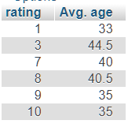
3. Compute the SELECT clause: grouped attributes and aggregates
SELECT S.rating, AVG(S.age) AS “Avg. age”
FROM Sailors S
WHERE S.age >= 18
GROUP BY S.rating;
rating | sid | sname | age
1 | 29 | Brutus | 33.0
3 | 85 | Art | 25.5
 | 95 | Bob | 63.5
7 | 22 | Dustin | 45.0
 | 64 | Horatio | 35.0
8 | 31 | Lubber | 55.5
 | 32 | Andy | 25.5
9 | 74 | Horatio | 35.0
10 | 58 | Rusty | 35.0

Slide 20

Invalid Selection
SELECT S.name, S.rating, AVG(S.age) AS “Avg. age”
FROM Sailors S
WHERE S.age >= 25
GROUP BY S.rating;
sid | sCname | rating | age
29 | Brutus | 1 | 23.0
85 | Art | 3 | 25.5
95 | Bob | 3 | 63.5
rating | sid | sname | age
3 | 85 | Art | 25.5
 | 95 | Bob | 63.5
rating | sname | age
3 | ?? | 44.5
 | ??

Slide 21
Having clause
SELECT agg(column) FROM <table name> WHERE <conditions>
GROUP BY <columns>
HAVING <columns>
HAVING clause contains conditions on aggregates
Determines whether an answer row is to be generated for a given group

Slide 22
Example: HAVING
SELECT S.rating, AVG(S.age) AS “Avg. age”
FROM Sailors S
WHERE S.age >= 18
GROUP BY S.rating
HAVING COUNT (*) > 1;
Create the cross product of the tables in the FROM clause
Remove rows not meeting the WHERE condition
Divide records into groups by the GROUP BY clause
Remove groups not meeting the HAVING clause
Create one row for each group and remove columns not in the SELECT clause

Slide 23
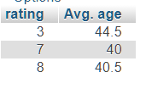
Remove groups not meeting the HAVING clause
SELECT S.rating, AVG(S.age) AS “Avg. age”
FROM Sailors S
WHERE S.age >= 18
GROUP BY S.rating
HAVING COUNT (*) > 1;
rating | sid | sname | age
1 | 29 | Brutus | 33.0
3 | 85 | Art | 25.5
 | 95 | Bob | 63.5
7 | 22 | Dustin | 45.0
 | 64 | Horatio | 35.0
8 | 31 | Lubber | 55.5
 | 32 | Andy | 25.5
9 | 74 | Horatio | 35
10 | 58 | Rusty | 35.0
rating | sid | sname | age
3 | 85 | Art | 25.5
 | 95 | Bob | 63.5
7 | 22 | Dustin | 45.0
 | 64 | Horatio | 35.0
8 | 31 | Lubber | 55.5
 | 32 | Andy | 25.5

Slide 24
Null Values
Field values in a row are sometimes unknown (e.g., a rating has not been assigned)
SQL provides a special value null for such situations
NULL is not a constant that can be explicitly used as an argument of some expression.
NULL values need to be taken into account when evaluating conditions in the WHERE clause

Slide 25
Rules for NULL values
Rules for NULL values:
An arithmetic operator with (at least) one NULL argument always returns NULL .
The comparison of a NULL value to any second value returns a result of UNKNOWN.
A selection returns only those tuples that make the condition in the WHERE clause TRUE, those with UNKNOWN or FALSE result do not qualify.

Slide 26
Truth Value Unknown
Three-valued logic: TRUE, UNKNOWN, FALSE.
Can think of TRUE = 1, UNKNOWN = ½, FALSE = 0
AND of two truth values: their minimum.
OR of two truth values: their maximum.
NOT of a truth value: 1 – the truth value.
Examples:
TRUE AND UNKNOWN = UNKNOWN
FALSE AND UNKNOWN = FALSE
FALSE OR UNKNOWN = UNKNOWN
NOT UNKNOWN = UNKNOWN

Slide 27
Impact of NULL value on SQL constructs
In the absence of NULL values, the WHERE clause eliminates rows which does not evaluate to TRUE
In the presence of NULL values, the WHERE clause eliminates rows which does evaluate to FALSE or UNKNOWN
We can disallow NULL values by specifying NOT NULL as part of the field definition

Slide 28
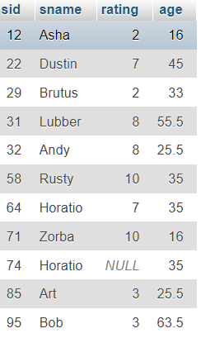
Example: NULL values
SELECT S.rating, AVG(S.age) AS “Avg. age”
FROM Sailors S
WHERE S.age >= 18
GROUP BY S.rating;

Slide 29
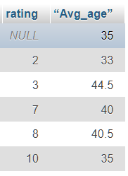
Example: NULL values
SELECT S.rating, AVG(S.age) AS “Avg. age”
FROM Sailors S
WHERE S.age >= 18
GROUP BY S.rating;

Slide 30
Example: NULL values – contd.
SELECT *
FROM Sailors S
WHERE S.rating > 0;

Slide 31
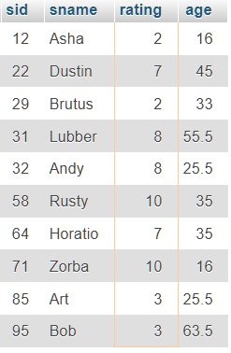
Example: NULL values – contd.
SELECT *
FROM Sailors S
WHERE S.rating > 0;

Slide 32
Practice Exercise
Ex 5.1 – 5.4

