Slide 1
SCHEMA REFINEMENT
Part I
Instructor: Ashok Singh Sairam
ashok@iitg.ac.in

Slide 2
Lecture Plan
Redundancy Problems
Handling redundancy problems
NULL value and Decomposition
Decomposition
Functional Dependency (FD)
Closure of FD
Attribute closure

Slide 3
Redundancy Problems
Storing the same information redundantly in a database is the root cause of several problems
Four types of anomalies
Redundant storage – Same information stored repeatedly
Update anomaly – Can result in inconsistent data if all redundant data are not simultaneously update
Insertion anomaly – May not be possible to insert a record unless some other unrelated information is stored as well
Deletion anomaly – May not be possible to delete a record without deleting some other unrelated record

Slide 4
1. Redundant storage
What’s wrong?
Student | Course | Room
Mahesh | MA518 | C1-101
Paes | MA518 | C1-101
Sindhu | MA518 | C1-101
If every course is in only one room, contains redundant information!

Slide 5
2. Update Anomaly
What’s wrong?
Student | Course | Room
Mahesh | MA518 | C1-101
Paes | MA518 | C2-101
Sindhu | MA518 | C1-101
If we update the room number for one tuple, we get inconsistent data = an update anomaly

Slide 6
3. Insertion Anomaly
What’s wrong?
Student | Course | Room
Mahesh | MA518 | C1-101
Paes | MA518 | C1-101
Sindhu | MA518 | C1-101
 | CS348 | C2-103
We can’t reserve a room without students (an unrelated information) = an insert anomaly

Slide 7
4. Delete anomaly
All students have dropped the course!
What’s wrong?
Student | Course | Room
.. | .. | ..
If everyone drops the class, we lose what room the class is in(an unrelated information)! = a delete anomaly

Slide 8
Addressing anomalies – NULL value
Allow NULL value
Cannot resolve redundant storage or updation anomaly
Can partially resolve insertion and deletion anomalies
RollNo | Student | Course | Room
1201 | Mahesh | MA518 | C1-101
1202 | Paes | MA518 | C1-101
1203 | Sindhu | MA518 | C1-101
 |  | CS348 | C2-103

Slide 9
Addressing anomalies - Decomposition
Decomposition
Replace a relation with a collection of “smaller” relations
Student | Course | Room
Mahesh | MA518 | C1-101
Paes | MA518 | C1-101
Sindhu | MA518 | C1-101
Redundancy?
Update anomaly?
Delete anomaly?
Insert anomaly?
Student | Course
Mahesh | MA518
Paes | MA518
Sindhu | MA518
Course | Room
MA518 | C1-101

Slide 10
Problems with decomposition
What problems will the decomposition cause?
May need to perform joins to answer queries. While performing can loose information.
To avoid losing information while performing joins, the decomposition should have lossless-join property
May not be able to enforce all the constraints on the smaller relations
The decomposition should have dependency-preserving property. That is enforce constraints on the original relation by enforcing some constraints on the smaller relations
If queries require join operation on the decomposed relations frequently, there can be performance issues

Slide 11
Problems with decomposition
When do we perform decomposition?
Answer: Normal Forms
If a relation is in one of the normal forms, then it is known that certain problems cannot arise
The theory behind normal forms is functional dependencies

Slide 12
Functional Dependency (FD)
Functional Dependency is a relation between attributes of a relation schema
Let R be a relation schema and X,Y be non-empty sets of attributes in R
A functional dependency X Y holds over relation R if, for every allowable instance r of R:
t1 r, t2 r, (t1) = (t2) implies (t1) = (t2)
i.e., X→Y means whenever two tuples agree on X then they agree on Y
(X and Y are sets of attributes.)
K is a candidate key for R means that K → R
However, K → R does not require K to be minimal!

Slide 13
Example: Functional Dependencies
The figure satisfies the FD AB → C
Now, if we add a tuple <a1, b1, c2, d1> than the FD will be violated
A | B | C | D
a1 | b1 | c1 | d1
a1 | b1 | c1 | d2
a1 | b2 | c2 | d1
a2 | b1 | c3 | d1
Role of FDs in detecting redundancy:
Consider a relation R with 3 attributes, ABC.
No FDs hold: There is no redundancy here.
Given A → B: Several tuples could have the same A value, and if so, they’ll all have the same B value!

Slide 14
Finding FDs?
We find out from application domain that a relation satisfies some FDs. Does it mean we have found all the FDs?
There could be more FDs implied by the ones we have
Provided FDs:
Does it always hold? Name, Category → Price
1. Name → Color
2. Category → Department
3. Color, Category → Price
Answer: Find the closure of the provided FDs.
That is the set of all FDs that can be inferred from the provided FDs

Slide 15
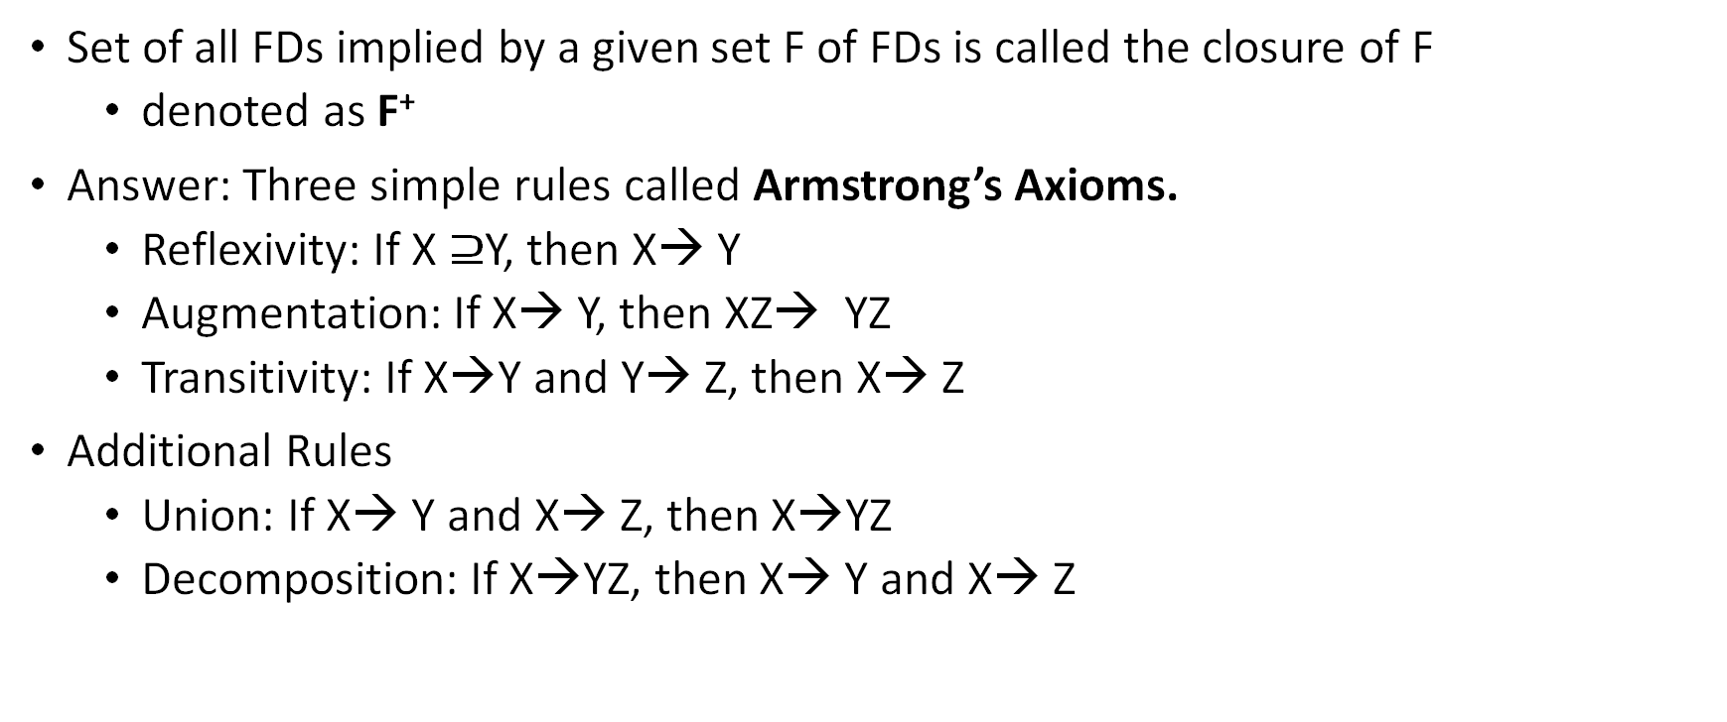
Closure of FDs
Set of all FDs implied by a given set F of FDs is called the closure of F
denoted as F⁺
Answer: Three simple rules called Armstrong’s Axioms.
Reflexivity: If X $⊇$Y, then X→ Y
Augmentation: If X→ Y, then XZ→ YZ
Transitivity: If X→Y and Y→ Z, then X→ Z
Additional Rules
Union: If X→ Y and X→ Z, then X→YZ
Decomposition: If X→YZ, then X→ Y and X→ Z

Slide 16
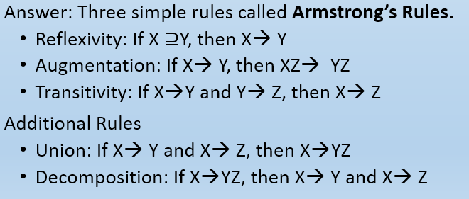
Ex: Inferred FD
Provided FDs:
1. {Name} → {Color}
2. {Category} → {Dept.}
3. {Color, Category} → {Price}
Inferred FDs:
Inferred FD | Rule used
4. Name, Category → Name | ?
5. Name, Category → Color | ?
6. Name, Category → Category | ?
7. Name, Category → Color, Category | ?
8. Name, Category → Price | ?
Which / how many other FDs hold?

Slide 17
Inferred FDs:
Provided FDs:
Inferred FD | Rule used
4. Name, Category → Name | Reflexivity
5. Name, Category → Color | Transitive (4 -> 1)
6. Name, Category → Category | Reflexivity
7. Name, Category → Color, Category | Union (5 + 6)
8. Name, Category → Price | Transitive (7 -> 3)
1. {Name} → {Color}
2. {Category} → {Dept.}
3. {Color, Category} → {Price}
Can we find an algorithmic way to do this?

Slide 18
Coming back to our question
Provided FDs (F):
Inferred FD | Rule used
4. Name, Category → Name | Reflexivity
5. Name, Category → Color | Transitive (4 -> 1)
6. Name, Category → Category | Reflexivity
7. Name, Category → Color, Category | Union (5 + 6)
8. Name, Category → Price | Transitive (7 -> 3)
1. Name → Color
2. Category → Department
3. Color, Category → Price
Does the FD always hold? Name, Category → Price
Yes, because the FD is in the closure of F⁺
I just wanted to check X→ Y, do I need to compute closure of the set of FDs F?
No, compute the Attribute closure (X⁺) wrt F, which is the set of attributes B
X → B can be inferred using the Armstrong axioms

Slide 19
Closure of a set of Attributes
Given a set of attributes X={A₁, …, A_{n}} and a set of FDs F:
Then the closure, {A₁, …, A_{n}}⁺ is the set of attributes B, s.t.
{A₁, …, A_{n}} → B
Example: F =
name → color
category → department
color, category → price
Closures:
{name}⁺ = {name, color}
{name, category}⁺ = {name, category, color, dept, price}
{color}⁺ = {color}

Slide 20

Closure Algorithm
Start with X = {A₁, …, A_{n}} and set of FDs F.
Repeat until X doesn’t change; do:
if {B₁, …, B_{n}} → C is in F
and {B₁, …, B_{n}} $⊆$ X
then add C to X.
Return X as X⁺

Slide 21
Ex: Closure Algorithm
Find all FD’s implied by
Requirements
Non-trivial FD (i.e., no need to return A, B → A)
The right-hand side contains a single attribute (i.e., no need to return A, B → C, D)
A,B → C A,D → B
B → D

Slide 22
A,B → C A,D → B
B → D
Given F =
Step 1: Compute X+, for every set of attributes X:
{A}⁺ = {A}
{B}⁺ = {B,D}
{C}⁺ = {C}
{D}⁺ = {D}
{A,B}⁺ = {A,B,C,D}
{A,C}⁺ = {A,C}
{A,D}⁺ = {A,B,C,D}
{B,C}⁺ = {B,C,D}
{B,D}⁺ = {B,D}
{C,D}⁺ = {C,D}
{A,B,C}⁺ = {A,B,C,D}
{A,B,D}⁺ = {A,B,C,D}
{A,C,D}⁺ = {A,B,C,D}
{B,C,D}⁺ = {B,C,D}
{A,B,C,D}⁺ = {A,B,C,D}

Slide 23
A,B → C A,D → B
B → D
Given F =
Step 2: Enumerate all FDs X → Y, s.t. Y ⊆ X⁺ and X ⋂ Y = Ф:
{A}⁺ = {A}
{B}⁺ = {B,D}
{C}⁺ = {C}
{D}⁺ = {D}
{A,B}⁺ = {A,B,C,D}
{A,C}⁺ = {A,C}
{A,D}⁺ = {A,B,C,D}
{B,C}⁺ = {B,C,D}
{B,D}⁺ = {B,D}
{C,D}⁺ = {C,D}
{A,B,C}⁺ = {A,B,C,D}
{A,B,D}⁺ = {A,B,C,D}
{A,C,D}⁺ = {A,B,C,D}
{B,C,D}⁺ = {B,C,D}
{A,B,C,D}⁺ = {A,B,C,D}
B → D
A,B → C
A,B → D
A,D → B
A,D → C
B,C → D
A,B,C → D
A,B,D → C
A,C,D → B

Slide 24
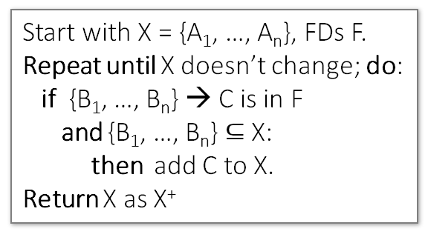
Closure Algorithm
Name, Category → Price ???
Start with X = {A₁, …, A_{n}}, FDs F.
Repeat until X doesn’t change; do:
if {B₁, …, B_{n}} → C is in F
and {B₁, …, B_{n}} $⊆$ X:
then add C to X.
Return X as X⁺
{name, category}⁺ = {name, category}
F =
name → color
category → dept
color, category → price

Slide 25
Closure Algorithm
Name, Category → Price ???
Start with X = {A₁, …, A_{n}}, FDs F.
Repeat until X doesn’t change; do:
if {B₁, …, B_{n}} → C is in F
and {B₁, …, B_{n}} $⊆$ X:
then add C to X.
Return X as X⁺
{name, category}⁺ =
{name, category}
{name, category}⁺ =
{name, category, color}
F =
name → color
category → dept
color, category → price

Slide 26
Closure Algorithm
Name, Category → Price ???
Start with X = {A₁, …, A_{n}}, FDs F.
Repeat until X doesn’t change; do:
if {B₁, …, B_{n}} → C is in F
and {B₁, …, B_{n}} $⊆$ X:
then add C to X.
Return X as X⁺
{name, category}⁺ =
{name, category}
{name, category}⁺ =
{name, category, color}
F =
{name, category}⁺ =
{name, category, color, dept}
name → color
category → dept
color, category → price

Slide 27
Closure Algorithm
Name, Category → Price Yes
Start with X = {A₁, …, A_{n}}, FDs F.
Repeat until X doesn’t change; do:
if {B₁, …, B_{n}} → C is in F
and {B₁, …, B_{n}} $⊆$ X:
then add C to X.
Return X as X⁺
{name, category}⁺ =
{name, category}
{name, category}⁺ =
{name, category, color}
{name, category}⁺ =
{name, category, color, dept}
F =
name → color
category → dept
color, category → price
{name, category}⁺ =
{name, category, color, dept, price}

Slide 28
Ex-1
Check whether AB → E, AB → F and AF → E ?
R(A,B,C,D,E,F)
A,B → C
A,D → E
B → D
A,F → B

Slide 29
Ex-1
R(A,B,C,D,E,F)
A,B → C
A,D → E
B → D
A,F → B
Compute {A,B}⁺ = {A, B, }

Slide 30
R(A,B,C,D,E,F)
A,B → C
A,D → E
B → D
A,F → B
Compute {A,B}⁺ = {A, B, C, D }

Slide 31
R(A,B,C,D,E,F)
A,B → C
A,D → E
B → D
A,F → B
Compute {A,B}⁺ = {A, B, C, D, E}

Slide 32
Assignment-1
R(A,B,C,D,E,F)
A,B → C
A,D → E
B → D
A,F → B
Compute {A, F}⁺ = {A, F, B, D, C, E }

Slide 33
Summary
Redundancy Problems
Storage redundancy, updation, insertion and deletion anomaly
Handling Redundancy
NULL values and Decomposition
Closure of FDs
Armstrong Rules – Reflexivity, Augmentation and Transitivity
Additional Rules – Union and Decomposition
Attribute Closure algorithm

Slide 34
Exercise
Ex 19.3 and 19.4

