Slide 1
SCHEMA REFINEMENT
Part II
Instructor: Ashok Singh Sairam
ashok@iitg.ac.in

Slide 2
Lecture Plan
Review of last lecture
Normal Forms
1NF, 2NF
“Good” Vs “Bad” FDs
BCNF and 3NF
BCNF Decomposition algorithm
Examples

Slide 3
Review of Part I of the lecture
Redundancy Problems
Storage redundancy, updation, insertion and deletion anomaly
Functional Dependency
Dependence between attributes of a relation
Closure of FDs
Set of all FDs implied by a given set F of FDs is called the closure of F (denoted as F⁺)
Use Armstrong Rules Armstrong Rules – Reflexivity, Augmentation and Transitivity
Additional Rules – Union and Decomposition
Attribute Closure algorithm

Slide 4
Normal Forms
Does the schema require refinement?
If a relation is in a certain normal form (BCNF, 3NF etc.), it is known that certain kinds of problems are avoided/minimized.
This can be used to help us decide whether decomposing the relation will help.
Normal Form types
first normal form (1NF) - All tables are flat.
second normal form (2NF) – Non-prime attributes depend on candidate Key. Not used!
third normal form (3NF) – Similar to BCNF
Boyce-Codd normal form (BCNF) – No redundancy can be detected from the FDs information alone
The normal forms are increasingly restrictive

Slide 5
1st Normal Form (1NF)
A relation is in first normal form if every attribute in that relation is singled valued attribute
Student | Course
Mahesh | {MA518, CS348}
Paes | {MA518, MA251}
Student | Course
Mahesh | MA518
Mahesh | CS348
Paes | MA518
Paes | MA251
Violates 1NF.
In 1st NF
1NF Constraint: Types must be atomic!

Slide 6
Second Normal Form (2NF)
For a table to be in 2NF, there are two requirements
The database is in first normal form
All nonkey attributes in the table must be functionally dependent on the entire primary key (does not have partial dependencies)
Example (Convert to 2NF)
R {Title, PubId, AuId, Price, AuAddress}, The FDs are
{Title, PubId, AuID} → {Price}
{AuID} → {AuAddress}
Is it 2NF?
No, 2 violates 2NF since AuID does not belong to a key

Slide 7
“Good” Vs “BAD” FDs
EmpID | Name | Phone | Position
E0045 | Smith | 1234 | Clerk
E3542 | Mike | 9876 | Salesrep
E1111 | Smith | 9876 | Salesrep
E9999 | Mary | 1234 | Lawyer
EmpID → Name, Phone, Position
Good FD since EmpID can determine everything
EmpID is a Key
Position → Phone
Bad FD since Position cannot determine everything

Slide 8
Ex1:
What is a good and bad FD in this table?
Student | Course | Room
Mahesh | MA518 | C1-101
Paes | MA518 | C1-101
Sindhu | MA518 | C1-101
Student, Course → Room
Good FD!
Course → Room
Bad FD!

Slide 9
What's bad about “bad” FDs?
If X →Y is a Bad FD, then X functionally determines some of the attributes; therefore, those attributes can be duplicated
Recall: this means there is redundancy
And redundancy like this can lead to data anomalies!
Student | Course | Room
Mahesh | MA518 | C1-101
Paes | MA518 | C1-101
Sindhu | MA518 | C1-101

Slide 10
Boyce-Codd Normal Form (BCNF)
Main idea is that we define “good” and “bad” FDs as follows:
X → A is a “good FD” if X is a key
In other words, if A is the set of all attributes
X → A is a “bad FD” otherwise
We will try to eliminate the “bad” FDs!

Slide 11
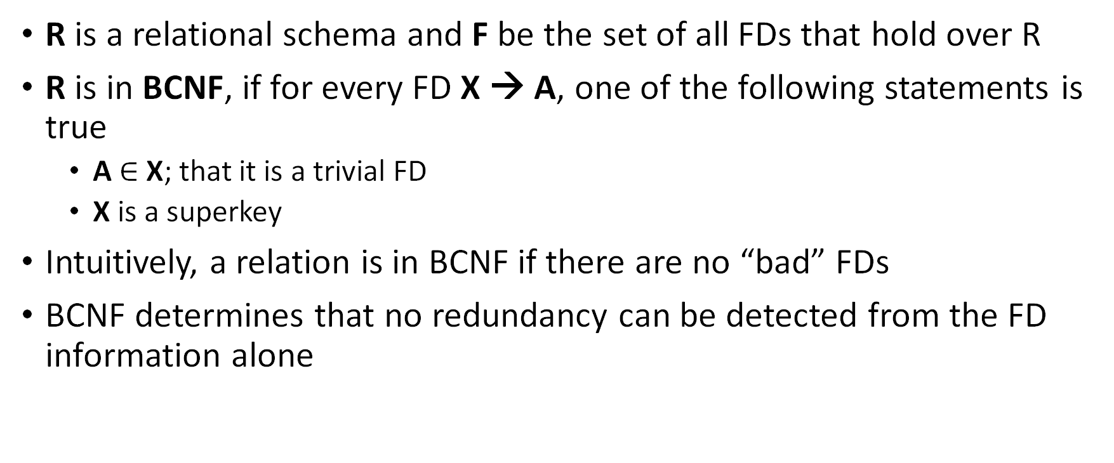
BCNF – Formal Definition
R is a relational schema and F be the set of all FDs that hold over R
R is in BCNF, if for every FD X → A, one of the following statements is true
A $∈$ X; that it is a trivial FD
X is a superkey
Intuitively, a relation is in BCNF if there are no “bad” FDs
BCNF determines that no redundancy can be detected from the FD information alone

Slide 12
BCNF Illustration
Given FD X→ A
What will be the value of ??
Is this relation in BCNF?
X | Y | A
x | y1 | a
x | y2 | ??

Slide 13
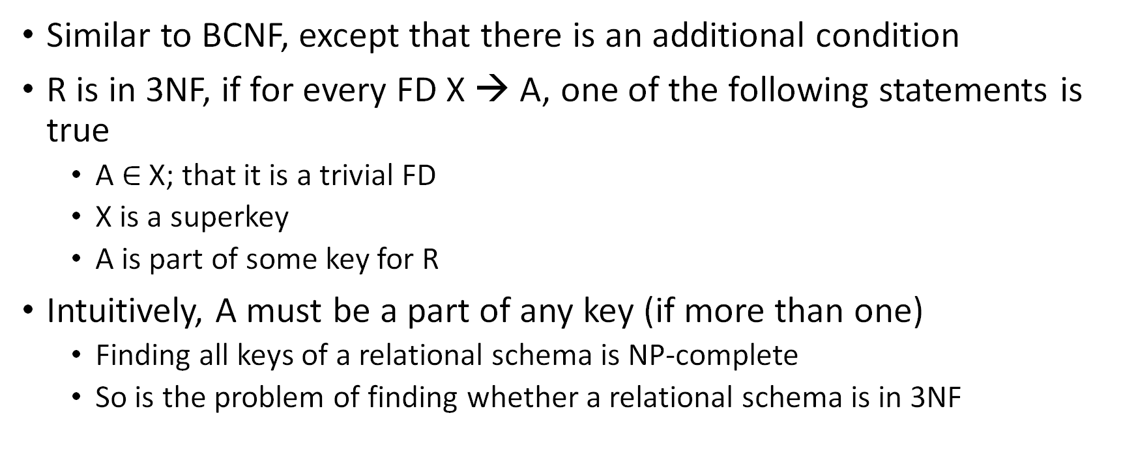
Third Normal Form (3NF) (1/2)
Similar to BCNF, except that there is an additional condition
R is in 3NF, if for every FD X → A, one of the following statements is true
A $∈$ X; that it is a trivial FD
X is a superkey
A is part of some key for R
Intuitively, A must be a part of any key (if more than one)
Finding all keys of a relational schema is NP-complete
So is the problem of finding whether a relational schema is in 3NF

Slide 14
Third Normal Form (3NF) (1/2)
Suppose a FD X → A violates 3NF. Two possibilities
X is a proper subset of a key (Partial Dependency)
X is not a proper subset of any key (Transitive dependency)
K
A
X
X
K
A
K
X
A

Slide 15
BCNF versus 3NF
If R is in BCNF, it’s obviously in 3NF.
If R is in 3NF, some redundancy is possible.
Thus, 3NF is indeed a compromise relative to BCNF when BCNF not achievable
Lossless-join, dependency-preserving decomposition of R into a collection of 3NF relations is always possible

Slide 16
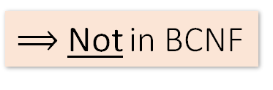
Ex: BCNF
Is this table in BCNF?
Name | SIN | PhoneNumber | City
Fred | 123-45-6789 | 604-555-1234 | Vancouver
Fred | 123-45-6789 | 604-555-6543 | Vancouver
Joe | 987-65-4321 | 908-555-2121 | Burnaby
Joe | 987-65-4321 | 908-555-1234 | Burnaby
{SIN} → {Name,City}
This FD is bad because it is not a key
What is the key?
{SIN, PhoneNumber}
$⟹$Not in BCNF

Slide 17
Ex: BCNF
Name | SIN | City
Fred | 123-45-6789 | Vancouver
Joe | 987-65-4321 | Burnaby
{SIN} → {Name,City}
This FD is now good because it is the key
SIN | PhoneNumber
123-45-6789 | 604-555-1234
123-45-6789 | 604-555-6543
987-65-4321 | 908-555-2121
987-65-4321 | 908-555-1234
Now in BCNF!
Is there some algorithm to convert to convert a relation scheme to BCNF?

Slide 18
BCNF Decomposition Algorithm
BCNFDecomp(R): Find X s.t.: X⁺ ≠ X and X⁺ ≠ [all attributes]
if (not found) then Return R
let Y = X⁺ - X, Z = (X⁺)^{C} decompose R into R1(X ∪ Y) and R2(X ∪ Z)
Return BCNFDecomp(R1), BCNFDecomp(R2)

Slide 19
BCNF Decomposition Algorithm
BCNFDecomp(R): Find a non-trivial bad FD: X → Y
if (not found) then Return R
let Y = X⁺ - X, Z = (X⁺)^{C} decompose R into R1(X ∪ Y) and R2(X ∪ Z)
Return BCNFDecomp(R1), BCNFDecomp(R2)
X is not a key, i.e.,
X⁺ ≠ [all attributes]

Slide 20
BCNF Decomposition Algorithm
BCNFDecomp(R): Find a non-trivial bad FD: X → Y
if (not found) then Return R
let Y = X⁺ - X, Z = (X⁺)^{C} decompose R into R1(X ∪ Y) and R2(X ∪ Z)
Return BCNFDecomp(R1), BCNFDecomp(R2)
If no “bad” FDs found, in BCNF!

Slide 21
BCNF Decomposition Algorithm
BCNFDecomp(R): Find a non-trivial bad FD: X → Y
if (not found) then Return R
Split R into X⁺ and X ⋃[remaining attributes] decompose R into R1(X ∪ Y) and R2(X ∪ Z)
Return BCNFDecomp(R1), BCNFDecomp(R2)
One table is X⁺
X⁺

Slide 22
BCNF Decomposition Algorithm
BCNFDecomp(R): Find a non-trivial bad FD: X → Y
if (not found) then Return R
Split R into X⁺ and X ⋃[remaining attributes] decompose R into R1(X ∪ Y) and R2(X ∪ Z)
Return BCNFDecomp(R1), BCNFDecomp(R2)
The other table is
X ⋃ (R – X⁺)

Slide 23
BCNF Decomposition Algorithm
BCNFDecomp(R): Find a non-trivial bad FD: X → Y
if (not found) then Return R
Split R into X⁺ and X ⋃ [rest attributes]
Return BCNFDecomp(R₁), BCNFDecomp(R₂)
Proceed recursively until no more “bad” FDs!

Slide 24
Example
Student | Course | Room
Mahesh | MA518 | C1-101
Paes | MA518 | C1-101
Sindhu | MA518 | C1-101
.. | .. | ..
Course → Room
X⁺
X ⋃ (R-X⁺)
Student | Course
Mahesh | MA518
Paes | MA518
Sindhu | MA518
.. | ..
Course | Room
MA518 | C1-101
CS348 | C2-101

Slide 25
Exercise - 2
BCNFDecomp(R): Find a non-trivial bad FD: X → Y
if (not found) then Return R
Split R into X⁺ and X ⋃[rest attributes]
Return BCNFDecomp(R₁), BCNFDecomp(R₂)
R(A,B,C,D,E)
{A} → {B,C}
{C} → {D}

Slide 26
Exercise - 2
R(A,B,C,D,E)
R(A,B,C,D,E)
{A}⁺ = {A,B,C,D} ≠ {A,B,C,D,E}
{A} → {B,C}
{C} → {D}
R₁(A,B,C,D) {C}⁺ = {C,D} ≠ {A,B,C,D}
R₁₁(C,D)
R₁₂(A,B,C)
R₂(A,E)

Slide 27
Ex: 19.5 (From book)
The relations given below is obtained through decomposition of the relation with attributes ABCDEFGHI. For each (sub)relation: (a) State the strongest normal form that the relation is in. (b) If it is not in BCNF, decompose it into a collection of BCNF relations.
1. R1 (A,C,B,D,E), A →B, C → D
Key: ACE
1NF
The FDs A→ B and C→ D violate BCNF, so decompose into (AB) and (ACDE). Further decompose ACDE to (CD) and (ACE)

Slide 28
Ex: 19.5 (From book)
The relations given below is obtained through decomposition of the relation with attributes ABCDEFGHI. For each (sub)relation: (a) State the strongest normal form that the relation is in. (b) If it is not in BCNF, decompose it into a collection of BCNF relations.
2. R2(A,B,F), AC → B, B → F
Key: AB
1NF
The FDs B→ F violate BCNF, so decompose into (BF) and (AB)

Slide 29
Ex: 19.5 (From book)
The relations given below is obtained through decomposition of the relation with attributes ABCDEFGHI. For each (sub)relation: (a) State the strongest normal form that the relation is in. (b) If it is not in BCNF, decompose it into a collection of BCNF relations.
3. R3(A,D), D → G, G → H
Key: AD
BCNF

Slide 30
Ex: 19.5 (From book)
The relations given below is obtained through decomposition of the relation with attributes ABCDEFGHI. For each (sub)relation: (a) State the strongest normal form that the relation is in. (b) If it is not in BCNF, decompose it into a collection of BCNF relations.
4. R4(D, C,H, G), A →I, I → A
BCNF

Slide 31
Ex: 19.5 (From book)
The relations given below is obtained through decomposition of the relation with attributes ABCDEFGHI. For each (sub)relation: (a) State the strongest normal form that the relation is in. (b) If it is not in BCNF, decompose it into a collection of BCNF relations.
5. R5(A,I,C,B)
BCNF

Slide 32
Summary
1NF: Eliminate Repeating Groups - Make a separate table for each set of related attributes, and give each table a primary key
2NF: Eliminate Redundant Data - If an attribute depends on only part of a multi-valued key, remove it to a separate table
3NF: Eliminate Columns Not Dependent On Key - If attributes do not contribute to a description of the key, remove them to a separate table
BCNF: Boyce-Codd Normal Form - If there are non-trivial dependencies between candidate key attributes, separate them out into distinct tables

Slide 33
Practice Exercises
Ex: 19.2 - 19.4

