Slide 1
Physical Database Design and Tuning
Part I
Instructor: Ashok Singh Sairam
ashok@iitg.ac.in

Slide 2
Announcements
Final Project Presentations: 10th and 17th November 2021
Quiz 2: 3-Nov-2021
Syllabus: SQL Queries and Schema Refinement

Slide 3
Lecture plan
Logical versus Physical optimization
Database workload
Index
How are indexes build?
Clustered vs. Unclustered index
Issues in selecting index

Slide 4
Query Processing Steps
SQL query
SQL Parser
Logical Optimization
Query
optimization
Physical Optimization
Query Execution
Disk

Slide 5
Logical Optimization
Find the optimal logical plan
Selection Pushdown
Projection Pushdown
π_{ename}
σ_{dept = ‘Toy’}
⨝
Dept
Emp

Slide 6
Logical Optimization
Find the optimal logical plan
Selection Pushdown
Projection Pushdown
π_{ename}
π_{ename}
⨝
σ_{dept = ‘Toy’}
σ_{dept = ‘Toy’}
⨝
Dept
Emp
Dept
Emp

Slide 7
Physical Optimization
Find the optimal physical plan
How to implement the join? On which attributes should we build indexes? …
π_{ename}
π_{ename}
(Nested loop)
⨝
(Hash Join)
⨝
V.S.
(Scan & write to T)
(Scan & write to T)
σ_{dept = ‘Toy’}
σ_{dept = ‘Toy’}
Dept
Emp
Dept
Emp
(File Scan)
(File Scan)
(File Scan)
(File Scan)

Slide 8
Physical Database Design: Introduction
Physical database design must be guided by the nature of the data and its intended use
Understand the typical workload that the database must support
Workload description and user’s performance requirements form the basis of physical database design

Slide 9
Database Workload
Workload description include
List of queries, their frequency
List of updates and their frequency
Further for each query, identify
Relations accessed
Attributes retained in select clause
Attributes with selection or join conditions expressed
Similarly, for each update identify
Attributes with selection or join conditions expressed
Type of update (INSERT, DELETE or UPDATE)
Fields modified by the update

Slide 10
Decisions to Make
What indexes should we create?
Which relations should have indexes?
Should we build several indexes?
What field(s) should be the search key?
For each index, what kind of an index should it be?
Clustered or unclustered
Sparse or Dense
How to perform the relational algebra operations – join, projection,..
Let us first try to understand a little more about indexes

Slide 11
Index
An additional file, that allows fast access to records in the data file given a search key (note this key is different from primary key)
The index contains (key, value) pairs:
The key = an attribute value (e.g., employee ID or name)
The value = a pointer to the record
An index can store the full rows it points to (primary index) or secondary index, which are pointers to the primary index
We’ll mainly consider secondary indexes

Slide 12
Example 1: Index on empid
Data File
Index
10 | Jiannan | 34 | 45,000
20 | Martin | 28 | 35,000
10
20
30
40
50
60
70
80
30 | … | … | …
40
50
60
70
80

Slide 13
Example 2: Index on age
Data File
Index
10 | Jiannan | 34 | 45,000
20 | Martin | 28 | 35,000
30
40
25
26
34
28
28
47
30 |  | 40 | …
40 |  | 26
50 |  | 25
60 |  | 28
70 |  | 30
80 |  | 47

Slide 14
Index Organization
Common indexes:
B+ trees
Hash tables
Specialized indexes
R-trees
Inverted index
…

Slide 15
B+-Tree
A B⁺-tree is a rooted tree satisfying the following properties:
All paths from root to leaf are of the same length
Each node that is not a root or a leaf has between [n/2] and n children.
A leaf node has between [(n–1)/2] and n–1 values
The search-keys in a node are ordered
K₁ < K₂ < K₃ < . . . < K_{n–1}

Slide 16
B+ Tree Example
K = 30?
30 < 80
80
30 in [20,60)
20 |  | 60
100 |  | 120 |  | 140
30 in [30,40)
10 |  | 15 |  | 18
20 |  | 30 |  | 40 |  | 50
60 |  | 65
80 |  | 85 |  | 90
Not all nodes pictured
To the data!
10
12
15
20
28
30
40
60
63
80
84
89

Slide 17
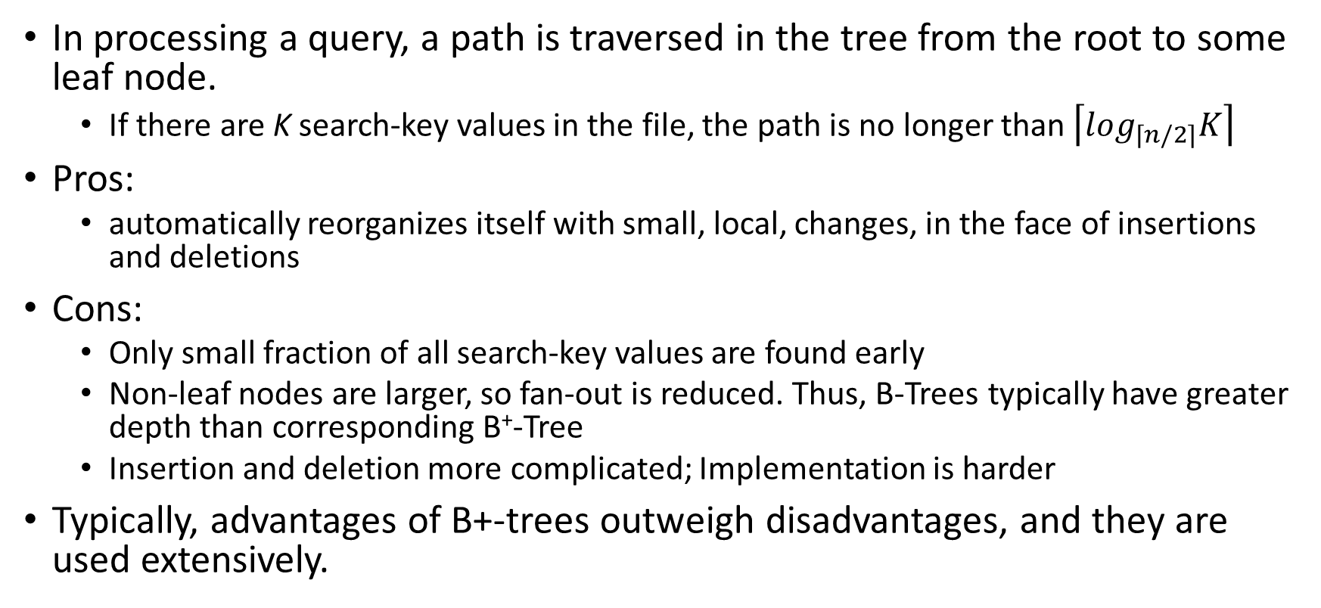
B+ Tree
In processing a query, a path is traversed in the tree from the root to some leaf node.
If there are K search-key values in the file, the path is no longer than $\left\lceil \log_{\left\lceil n/2\right\rceil }K\right\rceil$
Pros:
automatically reorganizes itself with small, local, changes, in the face of insertions and deletions
Cons:
Only small fraction of all search-key values are found early
Non-leaf nodes are larger, so fan-out is reduced. Thus, B-Trees typically have greater depth than corresponding B⁺-Tree
Insertion and deletion more complicated; Implementation is harder
Typically, advantages of B+-trees outweigh disadvantages, and they are used extensively.

Slide 18
Hashing
Bucket: a unit of storage containing one or more records (a bucket is typically a disk block)
The bucket of a record is directly obtained from its search-key value using a hash function
Hash function h is a function from the set of all search-key values K to the set of all bucket addresses B.
Hash function is used to locate records for access, insertion as well as deletion.
Records with different search-key values may be mapped to the same bucket; thus entire bucket has to be searched sequentially to locate a record.

Slide 19
Bucket 0
10 | Jiannan | 34 | 45,000
20 | Martin | 28 | 35,000
Bucket 1
30 |  | 40 | …
40 |  | 26
Bucket 2
50 |  | 25
60 |  | 28

Slide 20
Hashing Index: Pros and Cons
Pros: Minimal space overhead
Cons: Extra level of indirection to find desired record
Expected type of queries
Hashing is generally better at retrieving records having a specified value of the key.
If range queries are common, B+ Tree is to be preferred

Slide 21
Clustered Index
Clustering index sorts the records of the table according to a particular key value (key here refers to the fields of the data file used for sorting)
The table data can be sorted in only one way, so there can be only one clustered index per table
The database automatically creates a clustered index on the primary key constraint
For example, the empid is the key of Emp,
the employee records will be stored
sorted in order of their empid
30
10 |  | 20 |  | 30 |  | 40
50 |  | 60 |  | 70 |  | 80
10
20
30
40
50
60
70
80
Clustered

Slide 22
Non-Clustered Index
Non-clustered index stores the data and indices at different location. The index contains pointers to the data location
Can have many non-clustered index per table as the index is stored in different location
The example shows a non-clustered
index on the age field of the
Emp table
30
Index File
20 |  | 52 |  | 28 |  | 61
35 |  | 34 |  | 40 |  | 45
Data file
20
34
28
52
45
61
40
35
Unclustered

Slide 23
Dense Index
Ordered index (such as clustered index) can be of two types – Dense Index and Sparse Index
Dense Index: there is an index record for every search key value in the database. Make searching faster but require more space to store index records
10
20
30
40
10 | Jiannan | 34 | 45,000
20 | Martin | 28 | 35,000
30 | Tina | 25 | 40,000
40 | Shyam | 43 | 50,000

Slide 24
Sparse Index
Sparse index- index records are not created for every search key value
Applicable when records are sequentially ordered on search-key
To locate a record with search-key value K we:
Find index record with largest search-key value < K
Search file sequentially
Pros: Less space and less maintenance overhead for insertions and deletions.
Cons: slower than dense index
10
30
10 | Jiannan | 34 | 45,000
20 | Martin | 28 | 35,000
30 | Tina | 25 | 40,000
40 | Shyam | 43 | 50,000

Slide 25
Creating Indexes in SQL
Emp(empid, ename, age, sal)
CREATE INDEX idx_age ON Emp(age);
View indexes on a table
SHOW INDEXES FROM Emp;
Delete an index
ALTER TABLE Emp DROP INDEX idx_age;

Slide 26
Index Selection
One approach:
Consider most important queries in turn.
Determine which plan the optimizer would choose given the current indexes, and see if better plan is possible with an additional index.
If so, create it.
Before creating an index, must also consider the impact on updates in the workload!
Trade-off: indexes can make queries go faster, updates slower. Require disk space, too.

Slide 27
Issues in Index Selection (1/3)
Attributes mentioned in a WHERE clause are candidates for index search keys.
Range conditions are sensitive to clustering
Exact match conditions don’t require clustering
Try to choose indexes that benefit as many queries as possible.
NOTE: only one index can be clustered per relation!
So choose it based on important queries that benefit the most from clustering!!

Slide 28
Issues in Index Selection (2/3)
Multi-attribute search keys should be considered when a WHERE clause contains several conditions.
If range selections are involved, order of attributes should be carefully chosen to match the range ordering.
Such indexes can sometimes enable index-only strategies for important queries.
For index-only strategies, clustering is not important!

Slide 29
Issues in Index Selection (3/3)
B+ tree index is preferable since It supports both range as well we exact match queries
Hash index is better in the following situations
Needed to support equality query but no range queries
Index is intended to support index nested loops join (We will discuss nested loops join in the next lecture)

Slide 30
Basic Index Selection Guidelines
Consider queries in workload in order of importance
Consider relations accessed by query
No point indexing other relations
Look at WHERE clause for possible search key
Try to choose indexes that speed up multiple queries

Slide 31
Example 3
Consider a simple query
Relations involved: Emp and Dept
Both conditions in where clause involve equalities
Thus we should build hash indexes on the attributes involved (follows from our index selection guideline)
SELECT E.ename, D.mgr
FROM Emp E, Dept D
WHERE E.dno=D.dno AND D.dname=‘Toy’

Slide 32
Example 3 (contd)
SELECT E.ename, D.mgr
FROM Emp E, Dept D
WHERE E.dno=D.dno AND D.dname=‘Toy’
It is clear that we should build hash index on the dname attribute of Dept
What about the equality E.dno = D.dno, should we build a (hash) index on the dno attribute of both Emp and Dept?
To answer this question, consider the evaluation plan
The plan is to first select the records from Dept with dname = ‘Toy’
For each qualifying Dept record, find the matching Emp tuples
Thus we should build an index on the dno attribute of Emp

Slide 33
Example 4:
This is an example on range query
The BETWEEN operator is used to find employees whose salary ranges between 10000 ≤ E.sal AND E.sal ≤ 20000
SELECT E.ename, D.mgr
FROM Emp E, Dept D
WHERE E.sal BETWEEN 10000 AND 20000
AND E.hobby=‘Stamps’ AND E.dno=D.dno

Slide 34
Example 4:
This is an example on range query
The BETWEEN operator is used to find employees whose salary ranges between 10000 ≤ E.sal AND E.sal ≤ 20000
Both selections (salary and hobby) are on Emp
SELECT E.ename, D.mgr
FROM Emp E, Dept D
WHERE E.sal BETWEEN 10000 AND 20000
AND E.hobby=‘Stamps’ AND E.dno=D.dno

Slide 35
Example 4:
This is an example on range query
The BETWEEN operator is used to find employees whose salary ranges between 10000 ≤ E.sal AND E.sal ≤ 20000
Both selections (salary and hobby) are on Emp
B+ Tree on E.sal could be used as it a range query
SELECT E.ename, D.mgr
FROM Emp E, Dept D
WHERE E.sal BETWEEN 10000 AND 20000
AND E.hobby=‘Stamps’ AND E.dno=D.dno

Slide 36
Example 4:
This is an example on range query
The BETWEEN operator is used to find employees whose salary ranges between 10000 ≤ E.sal AND E.sal ≤ 20000
Both selections (salary and hobby) are on Emp
B+ Tree on E.sal could be used as it a range query
E.hobby is an exact match, hash index would help
SELECT E.ename, D.mgr
FROM Emp E, Dept D
WHERE E.sal BETWEEN 10000 AND 20000
AND E.hobby=‘Stamps’ AND E.dno=D.dno

Slide 37
Example 4:
This is an example on range query
The BETWEEN operator is used to find employees whose salary ranges between 10000 ≤ E.sal AND E.sal ≤ 20000
Both selections (salary and hobby) are on Emp
B+ Tree on E.sal could be used as it a range query
E.hobby is an exact match, hash index would help
Should also build a hash index on dno attribute of Dept
SELECT E.ename, D.mgr
FROM Emp E, Dept D
WHERE E.sal BETWEEN 10000 AND 20000
AND E.hobby=‘Stamps’ AND E.dno=D.dno

Slide 38
Summary
Physical database design chose an efficient implementation plan for each operator in the relation algebra
Depends on the nature of data and database workload
Decision to make – “What indexes should we create?”
Indexing : an additional file for fast access to records
Index organization : B+ Tree, hash
Clustered and Unclustered index
Clustered Index can be of two types – dense and sparse Index Selection Guidelines

