Slide 1
Internet Applications
Instructor: Ashok Singh Sairam
ashok@iitg.ac.in

Slide 2
Lecture Plan
Functional components of Internet Application
Application Architecture
Service Oriented Architecture
Client-Server Architecture
Client Server Architecture
1-tier vs 2-tier vs 3-tier
Practical 3-tier architecture

Slide 3
Components of Data-Intensive Systems(1)
Three separate types of functionality:
Data management - physical storage layer for data persistence; Manages access to DB or file system;

Slide 4
Components of Data-Intensive Systems(2)
Three separate types of functionality:
Application Logic – Makes logical decisions and calculations
Data management - physical storage layer for data persistence; Manages access to DB or file system;

Slide 5
Components of Data-Intensive Systems(2)
Three separate types of functionality:
Presentation – The user interface; Translate tasks and results to a view the user can understand
Application Logic – Makes logical decisions and calculations
Data management - physical storage layer for data persistence; Manages access to DB or file system;

Slide 6
Application Architecture
Two broad types
Service Oriented Architecture (SOA)
Microservices
Client-server architecture

Slide 7
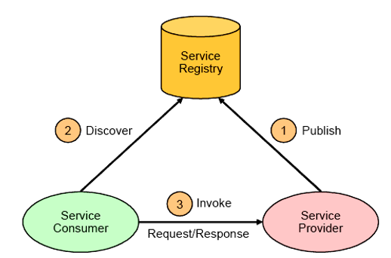
Service-oriented Architecture (SOA)
Components on network arranged according to services they offer
Application functionality provided and consumed as sets of services
Services can be
published to a service broker/registry
discovered by querying the registry
service consumer directly
request service from service provider
Loose coupling between provider
and consumer

Slide 8
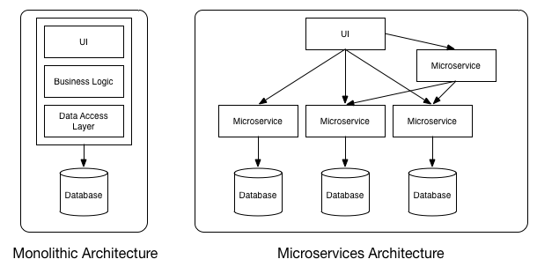
Microservices
Difference between SOA and microservices is in the style of implementation
More fine-grained
implementation of
SOA
Create a highly
decoupled
architecture

Slide 9
Client-Server Architecture
Clients and servers have distinct roles
Clients request service
Servers provide service
More tightly coupled between client and server
Different variants of client-server architecture
Single-tier
Two-tier
Three-tier

Slide 10
Single-Tier Architecture (1)
Client, server and database all reside in the same machine
User access the database through terminals
Advantages:
Easy maintenance and administration
Disadvantages:
Users need to login in to the machine to access the database
Centralized computation of all of them is too much for a central system
Client
Application Logic
DBMS

Slide 11
Client-Server Architecture (2)
Work division: Thin client
Client implements only the graphical user interface
Server implements business logic and data management
Client
Network
Application Logic
. . .
DBMS
Client

Slide 12
Client-Server Architecture (3)
Work division: Thick client
Client implements both the graphical user interface and the business logic
Server implements data management
Client
Network
Application Logic
DBMS
. . .
Client
Application Logic

Slide 13
Thick client disadvantage (1)
Disadvantages of thick clients:
No central place to update the business logic

Slide 14
Thick client disadvantage (2)
Disadvantages of thick clients:
No central place to update the business logic
Security issues: Server needs to trust clients
Access control and authentication needs to be managed at the server
Clients need to leave server database in consistent state
One possibility: Encapsulate all database access into stored procedures

Slide 15
Thick client disadvantage (3)
Disadvantages of thick clients:
No central place to update the business logic
Security issues: Server needs to trust clients
Access control and authentication needs to be managed at the server
Clients need to leave server database in consistent state
One possibility: Encapsulate all database access into stored procedures
Does not scale to more than several 100s of clients
Large data transfer between server and client
More than one server creates a problem: x clients, y servers: x * y connections

Slide 16
Three-Tier Architecture
The presentation-tier (web browser), the application logic and the data management are all separated
They can essentially reside in separate servers
Client
Network
Network
Application
Logic
DBMS
. . .
Client

Slide 17
Three-Tier Architecture
The presentation-tier (web browser), the application logic and the data management are all separated
They can essentially reside in separate servers
Client
Network
Network
Application
Logic
DBMS
. . .
Client
Web browser

Slide 18
Advantages of the Three-Tier Architecture (1)
Heterogeneous systems
Tiers can be independently maintained, modified, and replaced
Thin clients
Only presentation layer at clients (web browsers)
Integrated data access
Several database systems can be handled transparently at the middle tier
Central management of connection

Slide 19
Advantages of the Three-Tier Architecture (2)
Scalability
Replication at middle tier permits scalability of business logic
Software development
Code for business logic is centralized
Interaction between tiers through well-defined APIs: Can reuse standard components at each tier

Slide 20
Practical Three-Tier Architecture
Browser
Web Server
Database Server
HTML
Request
Call Database
(SQL)
D
O
M
Static
Files
Parse
Response
Apache
MySQL
HTML
Response
PHP
Code
Return
Data

Slide 21
HTTP - Hypertext Transfer Protocol
The dominant Application Layer Protocol on the Internet
Invented for the Web - to retrieve HTML, Images, Documents, etc.
Extended to handle data in addition to documents - RSS, Web Services, etc.
Basic Concept: Make a connection - Request a document - Retrieve the document - Close the connection

Slide 22
Uniform Resource Identifiers (URI)
Uniform naming schema to identify resources on the Internet
A resource can be anything:
index.html
mysong.mp3
picture.jpg
It has three parts
http://www.iitg.ac.in/ashok/MA518/index.php
Protocol Host document

Slide 23
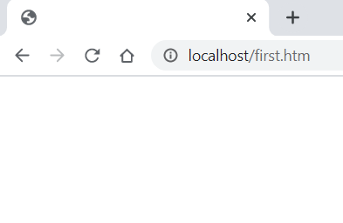
Web Server
80
Network
Browser

Slide 24
Web Server
80
Network
Setup connection
Browser
Click

Slide 25
Web Server
Request
GET first.htm HTTP/1.1
User-agent: Mozilla/5.0
Accept: text/html, image/gif …
80
Network
Browser

Slide 26
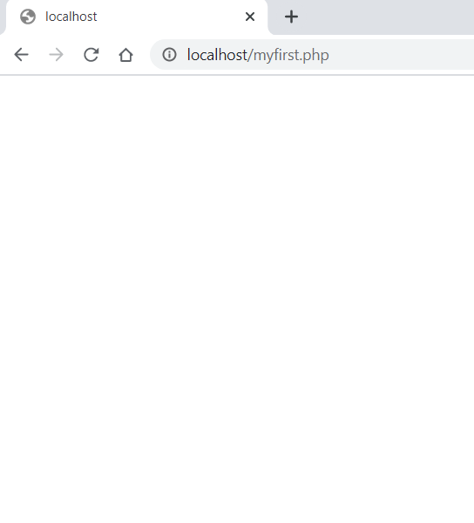
Web Server
Response
Request
HTTP/1.1 200 OK
Date: Fri 30 Aug 2021 …
Server: Apache/2.4.46
Last Modified: ..
Content length: ..
Connection: closed
<html>
<head>
First HTML file
</html>
<body>
……
GET first.htm HTTP/1.1
User-agent: Mozilla/5.0
Accept: text/html, image/gif …
80
Network
Browser
Browser
Click

Slide 27
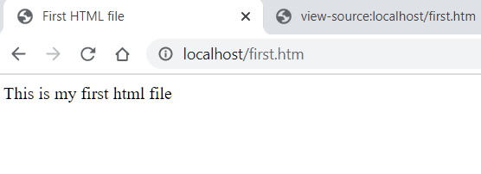
Web Server
Response
Request
HTTP/1.1 200 OK
Date: Tue 08 Sep 2020 …
User-agent: Mozilla/5.0
Accept: text/html, image/gif …
<html>
<head>
First HTML file
</html>
<body>
……
GET first.htm HTTP/1.1
User-agent: Mozilla/5.0
Accept: text/html, image/gif …
80
Network
Browser
Browser
Parse/Render
Click

Slide 28
Practical Three-Tier Architecture (revisited)
Browser
Web Server
Database Server
HTML
Request
Call Database
(SQL)
D
O
M
Static
Files
Parse
Response
Apache
MySQL
HTML
Response
PHP
Code
Return
Data

Slide 29
Summary
Internet Application Architecture
Client-Server Architecture
Three-Tier
Practical three-tier architecture
Browser
Web server - Apache
Database server - MySQL

Slide 30
Thank You

