Slide 1
Internet Applications
PHP Basics
Instructor: Ashok Singh Sairam
ashok@iitg.ac.in

Slide 2
Lecture Plan
Variables
Datatypes
Operators
  Mathematical/General operators
  Comparison operators
  Logical operators
  Control structures Loops, Output statements
Casting
File Operations

Slide 3
Why PHP?
PHP: PHP Hypertext Pre-processor
Widely used in Web Application Development
Universal language for the Web
Extends HTML pages by adding server executed code segments to HTML pages
  Output of PHP is merged into HTML
  It is a server side scripting language
Connect to database and run SQL queries

Slide 4
About PHP
Syntax inspired by C
  Curly braces, semicolons, no significant whitespace
Syntax inspired by Perl
  Dollar sign to start variable names, associative arrays
Extends HTML to add segments of PHP within an HTML file
White space is generally ignored (not in strings)
Code block: { //code here }

Slide 5
Starting with PHP
All PHP commands are enclosed within special start and end tags:
When the code is executed, PHP converts the code inside the “<?php” and “?>” tags to regular HTML code!
Everything outside these tags is ignored by PHP and returned as is
<?php
…PHP code…
?>

Slide 6
The first PHP Program
Start the web server
Write a html code (using a text editor, say notepad+, atom, sublime etc)
  Ex:
  <!DOCTYPE html>
  <html>
  <h1>
  My first PHP program
  </h1>
  </html>
Save the file, say first.php in the folder htdocs
Run the code: http://localhost/first.php

Slide 7
Extend a little more
<h1> My first PHP program </h1>
<p>
<?php
echo “Hello world\n”;
?>
</p>

Slide 8
Handling errors
Look out for the configuration file
  Use phpinfo to locate the configuration file
  C:\mamp\conf\php7.4.1\php.ini
Set display errors on
display_errors=on
display_startup_errors=on
Restart the server

Slide 9
Variables in PHP
PHP variables must begin with a “$” sign followed by a letter or underscore, followed by any number of letters/numbers/underscores
There is no need to declare the variable
Implicit type casting of the variable
Case-sensitive ($Foo != $foo != $fOo)
Global and locally-scoped variables
  Global variables can be used anywhere
  Local variables restricted to a function or class
https://www.php.net/manual/en/language.variables.basics.php

Slide 10
Data types
There are 4 basic data types
  Boolean – Specifies a TRUE or FALSE value, $click = true;
  Integers – can be defined as, $age=8;
  Floating point – fractional numbers, $pi=3.14;
  Strings - Sequence of characters. May be enclosed in either double quotes or single quotes.
    More about Strings in the next slide
The data type of a variable can be retrieved by the function gettype($variable_name)

Slide 11
Strings
A string is a sequence of characters
String literals can use single or double quotes
In single quoted strings, variable values are not expanded
Function inside double quotes will not be executed
Concatenation is “.”
$age = 37;
$stringTest = 'I am $age years old'; // output: I am $age years old
$stringTest = “I am $age years old”; // output: I am 37 years old
$conc = “is ” . “a ” . “composed ” . “string”;
echo $conc; // output: is a composed string

Slide 12
Comments
Multiple ways to add comments in PHP
  echo ‘This is a test’; \\ C++ style comment
  /* C style multline
    comment */
  Echo ‘Another type of comment’; # Shell-style comment

Slide 13
Expressions
Mathematical operators: + - / *%
Implicit type conversion
<?php
$result = “6” + 7;
echo “$result”; // Output is 13
?>
“6” is converted to an integer because the operands of “+” is numeric
Notes:
“

Slide 14
Mathematical operators
Operator | Meaning
= | Assignment
+ | Addition
- | Subtraction
/ | Division
% | Division, returns modulus
. | String concatenation
++,--, +=,-=,…. | Side-effect assignment

Slide 15
Comparison operators
Operator | Meaning
== | Equal to
=== | Equal to and of same type
!= | Not equal to or Not of same type
<> | Not equal to
<, <=, >, >= | Less than, Less than equal to etc.
?= | Ternary operator, test if value is true or false

Slide 16
Logical operators
Operator | Meaning
&& | Logical AND
|| | Logical OR
xor | Logical XOR
! | Logical NOT

Slide 17
Operator precdence
Precdence | Operator
1 | !
2 | *, /, %
3 | +, -, .
4 | <, <=, >, >=
5 | ==, !=, ===, !==
6 | &&
7 | ||

Slide 18
Ex: Equal to operators
$x=99; // Integer Value
$y=‘99’// String value
// Compare $x and $y
if ($x == $y)
echo 'Same content';
else
echo 'Different content';
// Compare $x and $y
if ($x === $y)
echo 'Data type and value both are same';
else
echo 'Data type or value are different';
Output: Same Content
Output: Data type of value are different

Slide 19
Ex: Ternary operator
logical test ? value if true : value if false
<?php
sub calculate_overtime {
my $hours = shift;
return $hours > 8 ? 10 * 100: 8 * 100;
}
?>

Slide 20
Control Structures:
Conditional-if : if – else -
Multiway: If-elseif-else
<?php
if (conditional test)
{
do this;
}
else
{
do this;
}
?>

Slide 21
Loops
while
do-while
for(;;)
foreach
break – Breaking out of a loop; Terminates the loop statement and transfers execution to the statement immediately following the loop.
continue – End the current iteration, jump to the top of the loop and start next iteration

Slide 22
Ex: Loops
<?php
$num = 11;
$upper = 10;
$lower = 1;
while ($lower <= $upper)
{
echo ($num*$lower)”\n”;
$lower++;
}
?>
<?php
$num = 11;
$upper = 10;
$lower = 1;
do {
echo ($num*$lower)”\n”;
$lower++;
} while ($lower <= $upper)
?>

Slide 23
Casting
Casting refers to the conversion of a particular variable’s data type to another data type
Operator defines how operands will behave unlike other programming languages, where operands define how an operator behaves
Implicit typecasting: conversion done by compiler itself. No need for user to mention a specific type conversion
Explicit typecasting: user cast a variable to a particular data type according to requirement
$string = “7”;
$num = int (string);

Slide 24
Variables and Casting
Implicit type casting
Function isset() is used to test if a variable is set
$A=1;
$B=“2”;
$C=$A + $B; // Integer operation
$D=$A . $B;// String concatenation
$A=1;
If (isset($A))
echo ‘Variable $A is set”,”\n”;
If (isset($B))
echo ‘Variable $B is not set”;

Slide 25
Casting Examples
PHP converts expression values silently and aggressively.
  division forces operands to be floating point
  concatenation converts operands to strings
$a = 56; $b = 12;
$c = $a / $b;
echo "C: $c\n";
$d = "100" + 36.25 + TRUE;
echo "D: ". $d . "\n";
echo "D2: ". (string) $d . "\n";
$e = (int) 9.9 - 1;
echo "E: $e\n";
$f = "sam" + 25;
echo "F: $f\n";
$g = "sam" . 25;
echo "G: $g\n";

Slide 26
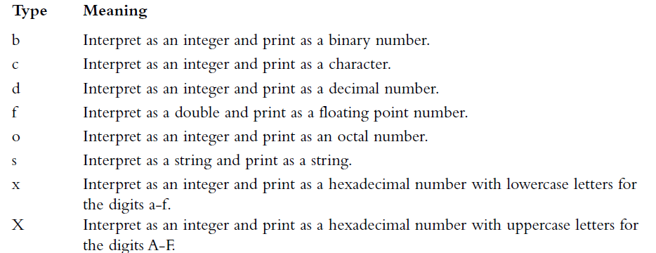
Output statements
printf() and sprint() functions are supported same as that of C
echo vs. printf()
echo “Total amount of order is $total”;
printf(“Total amount of order is %s”,$total);

Slide 27
File Operations – fopen(), fclose(), feof()
Opening a file
  $fp = fopen("myfile.txt", "r");
  fopen if unable to open the file, it returns 0.
Closing a File: fclose($fp);
The feof function is used to determine the end of file
if ( !($fp = fopen("myfile.txt", "r") ) )
exit("Unable to open the input file.");
if ( feof($fp) )
echo "End of file<br>";

Slide 28
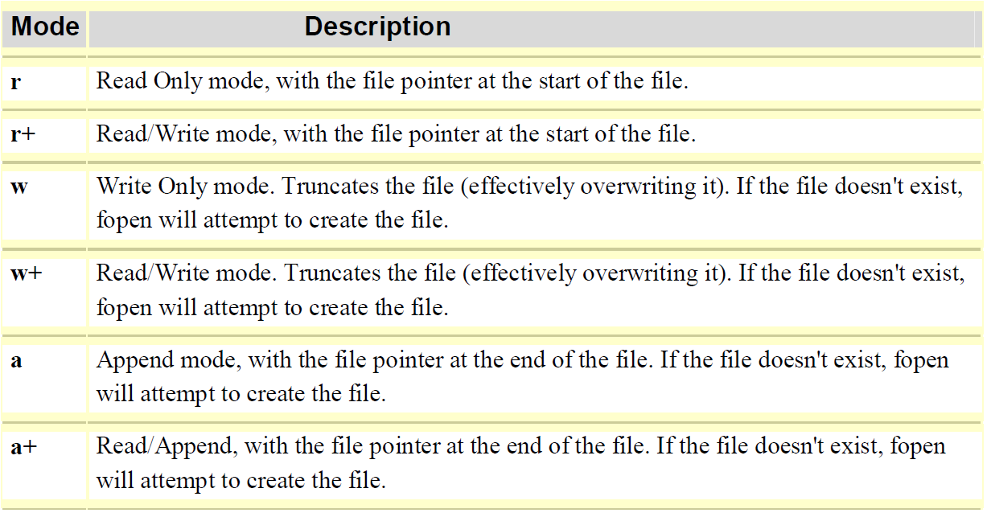
File modes

Slide 30
Reading from a file
fgets($fp,length); //Read one line at a time, default length value 1024
fgetc($fp); // Read one character at time
fscanf($fp, "%s %s %d", $name, $title, $age);
  Read one word at a time
fread(): read an entire file
  filesize(): returns file size
$listFile = "myfile.txt";
$buffer = fread($fp,filesize($listFile));

Slide 31
Writing to a file
fwrite(file, txt, length)
  File: file pointer
  txt: string to be written
  Length: maximum number of bytes to be written (optional)
  returns the number of bytes written
$fp= fopen("gfg.txt", "w");
fwrite($fp,”Hello World”);

Slide 32
<!doctype html>
<html>
<head>
Demonstration of file operations
</head>
<body>
<?php
if (!($fp=fopen("marks.txt","w")))
exit("Unable to open file for writing!");
echo fwrite($fp,"MA518, 8\n");
echo fwrite($fp,"MA513, 7\n");
fclose($fp);
$fp=fopen("marks.txt","r") or die("Unable to open file for reading!");
echo "<br>";
while(!feof($fp)) {
echo fgets($fp) . "<br>";
}
fclose($fp);
?>
</body>
</html>

Slide 33
Summary
PHP basics
  All PHP codes must be enclosed within <?php PHP Code ?>
  Variables : start with $ followed by character or _
  Datatypes : Boolean, Integer, Floating point and Strings
  Operators
    Mathematical/General operators : *. /, %, +, -, =, .,++,--, +=, -= ….
    Comparison operators : ==, !=, <>, ===, !==, <=, <, >, >=, ?:
    Logical operators : &&, !!, xor, !
  Control structures, Loops, Output statements
  Casting : Implicit and Explicit
  File Operations

Slide 34
Thank You

