Slide 1
Database Design Entity Relationship Model
Instructor: Ashok Singh Sairam
ashok@iitg.ac.in
Notes:
7 Steps in software development: planning (resource allocation), requirement analysis, design (data structures, s/w architecture used), Implementation, testing, installation (user training), maintenance.

Slide 2
Steps in Database Design (1)
Requirement Analysis: understand what data is to be stored

Slide 3
Steps in Database Design (2)
Requirement Analysis: understand what data is to be stored
Conceptual Database Design: high level description of the data to be stored – Entity Relationship (ER) Model

Slide 4
Steps in Database Design (3)
Requirement Analysis: understand what data is to be stored
Conceptual Database Design: high level description of the data to be stored – Entity Relationship (ER) Model
Logical Database Design: select a DBMS to implement and convert the conceptual design to a database schema

Slide 5
Steps in Database Design (4)
Requirement Analysis: understand what data is to be stored
Conceptual Database Design: high level description of the data to be stored – Entity Relationship (ER) Model
Logical Database Design: select a DBMS to implement and convert the conceptual design to a database schema
Schema Refinement – identify problems and refine
Physical Database design – Understand expected workloads and make provisions accordingly (build indexes etc)
Security Design

Slide 6
Review Data Model
Data Model
Schema
Layers in Database Application Development
: Description of how data is stored and processed
: Description of collection of data using a particular data model
View 1
View 2
View 3
Conceptual Schema
Physical Schema

Slide 7
Overview of Database Design
Conceptual design: (ER Model)
What are the entities and relationships in the enterprise?
What information about these entities and relationships should we store in the database?
What are the integrity constraints or business rules that hold?
A database `schema’ in the ER Model can be represented pictorially (ER diagrams).
Can map an ER diagram into a relational schema.

Slide 8
Entity
Entity: Real-world object distinguishable from other objects. An entity is described (in DB) using a set of attributes.
Entity Set: A collection of similar entities. (same attributes)
Each attribute associated with a domain(set of permitted values)
For name, the domain can be a the set of 20 character strings
name
empid
sal
Employees

Slide 9
Types of attribute (1)
Single-valued: An atomic or single-valued attribute can only take on a single value.
Example: marital status of a person is either married or single
Composite attribute: are assembled
using other atomic attributes
Example: Attribute name can compose
of first, middle and last name
Marital_status
Middlename
Firstname
Lastname
Name

Slide 10
Types of attribute (2)
Multivalued attribute: May have one or more values for a particular entity
Example: Location as the attribute of an organization
Derived attribute: an attribute whose value is calculated (derived) from other attributes
need not be physically stored within the database; instead, it can be derived by using an algorithm
For example, an employee’s age
Location

Slide 11
Key
Key: Minimal set of attributes which uniquely identify an entity in the set
Candidate key: set of keys, one of them is designated as the primary key
Assume that each entity set contains at least one key
We will again discuss key in details later

Slide 12
Relationship (1)
Relationship: Association among two or more entities.
The relationship is uniquely determined by the keys of its entities
E.g., Attishoo works in Pharmacy department.
name
dname
empid
sal
did
budget
Employees
Works_In
Departments

Slide 13
Relationship (2)
Relationship can have attributes
E.g. Attishoo works in Pharmacy department since January 2018
If the same employee works in some other department at different time
the relationship CANNOT capture
since
name
dname
empid
sal
did
budget
Employees
Works_In
Departments

Slide 14
Relationship Set
Relationship Set: Collection of similar relationships.
An n-ary relationship set R relates n entity sets E₁ ... E_{n}; each relationship in R involves entities e₁ϵ E₁, ..., e_{n} ϵ E_{n}
Same entity set could participate in different relationship sets, or in different “roles” in same set.

Slide 15
More examples of relationships
Entity sets that participate in a relationship need not be distinct
name
since
name
dname
empid
sal
empid
sal
did
budget
Employees
Employees
Works_In
Departments
supervisor
subordinate
Locations
Reports_To
address
capacity

Slide 16
Types of relationship
One-to-one relationship(1:1) One instance in the (parent) entity refer to one and only one instance in the related (child) entity
One-to-many relationship(1:N) One instance in the (parent) entity refer to one or more instance in the related (child) entity
Many-to-many relationship(M:N) One instance of the first entity (parent) can relate to many instances of the second entity (child), and one instance of the second entity can relate to many instances of the first entity
1-to-1
1-to Many
Many-to-Many

Slide 17
Key constraints
Consider Works_In: An employee can work in many departments; a dept can have many employees. (no constraints)
Consider another relationship called Manages between Employees and Departments
In contrast, each dept has
at most one manager, an
example of key constraint
on Manages.
Employees
Works_In
Departments
since
name
dname
empid
sal
did
budget
Employees
Manages
Departments

Slide 18
Arrows in relationships (1)
What does the arrow mean ?
Given a department, we can
uniquely identify its manager
Some departments may have no manager
Draw an arrow from the entity set with key constraint to the relationship
Bold arrow
Each department has exactly
one manager
Employees
Manages
Departments
Employees
Manages
Departments

Slide 19
Arrows in relationships(2)
Arrows in multiway relationships
given a store, can determine who
shopped there and the product they bought
each store sells one product and to
one person, ever
Product
Purchase
Store
Person

Slide 20
Participation Constraints
Does every department have a manager?
If so, this is a participation constraint: the participation of Departments in Manages is said to be total (whereas Employees is partial, since every employee will not be a manager).
Every Departments entity must appear in an instance of the Manages relationship.
since
since
name
name
dname
dname
did
did
budget
empid
sal
budget
Employees
Manages
Departments
Works_In
Total Participation
since

Slide 21
Cardinality constraints
Each entity set participates in a relationship set with a minimum (min) and a maximum (max) cardinality
Express cardinality constraints by drawing either a directed line ( ) signifying one or an undirected line ( ) signifying many between the relationship set and the entity
Alternative: Structural constraint
cardinalities are pairs of non‐negative integers (n, N) such that n ≤ N, where N means "any number“
Minimum cardinality: 0 (participation optional); 1 (participation mandatory)
Maximum cardinality: 1 (each entity instance associated at most with a single instance of the relationship); N (each entity instance associated with many instances of the relationship).

Slide 22
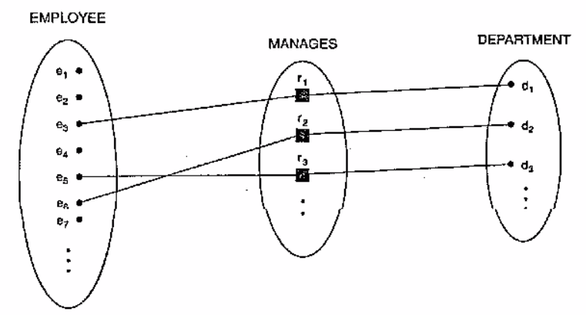
Each department has a manager
Each person resides in a city
A tourist can go on 1 or more voyages
(0,n)
(1,1)
Employees
Manages
Departments
(1,1)
(0,n)
Person
Residence
City
(1,n)
(0,n)
Tourist
Reservation
Voyage

Slide 23
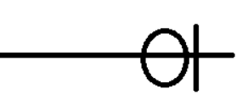
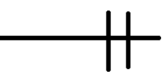
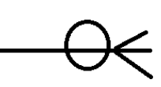

Crow’s foot notation
Crow’s feet is a common method of indicating cardinality
Symbol | Meaning
 | One
 | Many
Symbol | Meaning
 | Zero or one
 | One and only one
 | Zero or many
 | One or many

Slide 24
Weak Entities
A weak entity can be identified uniquely only by considering the primary key of another (owner) entity.
Owner entity set and weak entity set must participate in a one-to-many relationship set (one owner, many weak entities).
Weak entity set must have total participation in this identifying relationship set.
name
ssn
lot
cost
pname
age
Employees
Policy
Dependents

Slide 25
Summary of ER Symbols
Symbol | Meaning
 | Attribute
 | Key attribute
 | Multivalued attribute
 | Composite attribute
 | Derived attribute
Symbol | Meaning
 | Entity
 | Weak Entity
 | Relationship
 | Identifying Relationship

Slide 26
Thank You

