Slide 1
ER Model Examples
Instructor: Ashok Singh Sairam
ashok@iitg.ac.in

Slide 2
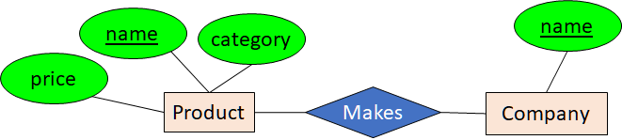
Review (1)
Entity – Real world distinguishable object
Attributes – entity set has attributes
domain of attributes
key/primary key
Relationship – association between entities
Degree
Types
Roles
Person
Product
name
category
price
Product

Slide 3
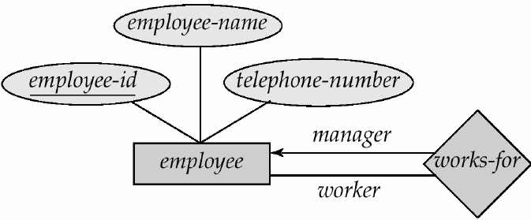
Review (2)
One-to-one:
1
2
3
a
b
c
d
Role:
1
2
3
a
b
c
d
Many-to-one:
1
2
3
a
b
c
d
One-to-many:
Many-to-many:
1
2
3
a
b
c
d

Slide 4
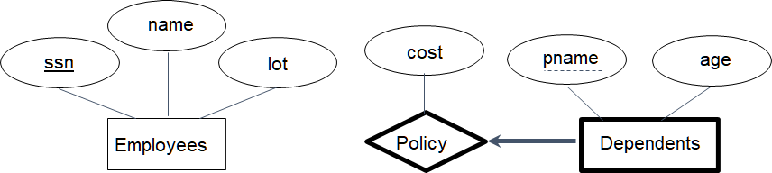
Review (3)
makes
Product
Company
Participation Constraints
Each product made by at most one company.
Some product made by no company?
Weak Entity set
identified uniquely by considering the primary key of another entity.
Attribute of weak entity called
discriminator
makes
Product
Company
Each product made by exactly one company

Slide 5
Example 1 (a)
A university database contains information about professors (identified by social security number, or SSN) and courses (identified by courseid). Professors teach courses; each of the following situations concerns the Teaches relationship set. For each situation, draw an ER diagram that describes it (assuming no further constraints hold).
Professors can teach the same course in several semesters, and each offering must be recorded

Slide 6
Example 1 (a)
A university database contains information about professors (identified by social security number, or SSN) and courses (identified by courseid). Professors teach courses; each of the following situations concerns the Teaches relationship set. For each situation, draw an ER diagram that describes it (assuming no further constraints hold).
Professors can teach the same course in several semesters, and each offering must be recorded

Slide 7
Example 1(b)
A university database contains information about professors (identified by social security number, or SSN) and courses (identified by courseid). Professors teach courses; each of the following situations concerns the Teaches relationship set. For each situation, draw an ER diagram that describes it (assuming no further constraints hold).
Professors can teach the same course in several semesters, and only the most recent such offering needs to be recorded (Assume this condition applies in all subsequent questions)
Notes:
https://app.diagrams.net/

Slide 8
Example 1(b)
A university database contains information about professors (identified by social security number, or SSN) and courses (identified by courseid). Professors teach courses; each of the following situations concerns the Teaches relationship set. For each situation, draw an ER diagram that describes it (assuming no further constraints hold).
Professors can teach the same course in several semesters, and only the most recent such offering needs to be recorded (Assume this condition applies in all subsequent questions)
Notes:
https://app.diagrams.net/

Slide 9
Example 1(c)
A university database contains information about professors (identified by social security number, or SSN) and courses (identified by courseid). Professors teach courses; each of the following situations concerns the Teaches relationship set. For each situation, draw an ER diagram that describes it (assuming no further constraints hold).
Every professor must teach some course

Slide 10
Example 1(c)
A university database contains information about professors (identified by social security number, or SSN) and courses (identified by courseid). Professors teach courses; each of the following situations concerns the Teaches relationship set. For each situation, draw an ER diagram that describes it (assuming no further constraints hold).
Every professor must teach some course

Slide 11
Example 1(d)
A university database contains information about professors (identified by social security number, or SSN) and courses (identified by courseid). Professors teach courses; each of the following situations concerns the Teaches relationship set. For each situation, draw an ER diagram that describes it (assuming no further constraints hold).
Every professor teaches exactly one course (no more, no less)

Slide 12
Example 1(d)
A university database contains information about professors (identified by social security number, or SSN) and courses (identified by courseid). Professors teach courses; each of the following situations concerns the Teaches relationship set. For each situation, draw an ER diagram that describes it (assuming no further constraints hold).
Every professor teaches exactly one course (no more, no less)

Slide 13
Example 1(e)
A university database contains information about professors (identified by social security number, or SSN) and courses (identified by courseid). Professors teach courses; each of the following situations concerns the Teaches relationship set. For each situation, draw an ER diagram that describes it (assuming no further constraints hold).
Every professor teaches exactly one course (no more, no less), and every course must be taught by some professor

Slide 14
Example 1(e)
A university database contains information about professors (identified by social security number, or SSN) and courses (identified by courseid). Professors teach courses; each of the following situations concerns the Teaches relationship set. For each situation, draw an ER diagram that describes it (assuming no further constraints hold).
Every professor teaches exactly one course (no more, no less), and every course must be taught by some professor

Slide 15
Example 1(f)
Now suppose that certain courses can be taught by a team of professors jointly, but it is possible that no one professor in a team can teach the course. Model this situation, introducing additional entity sets and relationship sets if necessary

Slide 16
Example 1(f)
Now suppose that certain courses can be taught by a team of professors jointly, but it is possible that no one professor in a team can teach the course. Model this situation, introducing additional entity sets and relationship sets if necessary

Slide 17
Whats wrong with these examples?
Purchase
1.
Product
Person
Notes:
1. Person buys only one product, then out

Slide 18
Whats wrong with these examples?
Purchase
1.
2.
Product
Person
President
Country
Person

Slide 19
Whats wrong with these examples?
Purchase
1.
2.
3.
Product
Person
President
Country
Person
date
Product
Purchase
Store
personAddr
personName

Slide 20
Example 2
A company database needs to store information about employees (identified by ssn, with salary and phone as attributes), departments (identified by dno, with dname and budget as attributes), and children of employees (with name and age as attributes).
Employees work in departments;
each department is managed by an employee;
a child must be identified uniquely by name when the parent (who is an employee; assume that only one parent works for the company) is known.
We are not interested in information about a child once the parent leaves the company.
Draw an ER diagram that captures this information (only major attributes shown).

Slide 21
Works in
DNO
Dname
SSN
Salary
(0,N)
(0,N)
Phone
Departments
Employees
Manages
(1,1)
(0,N)
(0,N)
dependent
budget
(1,1)
Children
cname

Slide 22
Thank You

