Slide 1
Database Design Entity Relationship Model
Instructor: Ashok Singh Sairam
ashok@iitg.ac.in

Slide 2
Lecture Plan
Class Hierarchy
Aggregation
Design choices
Entity versus Attribute
Relationship versus Entity
Binary/Ternary Relationship? Aggregation?

Slide 3
Class Hierarchy
Classify the entities in an entity set into subclasses
Subclass = special case Inheritance
Attributes: union of classes involved
Inherits all attributes of parent class plus the
attributes of the subclass
Fewer instances, more attributes (usually)
One‐one relationship between classes
A ISA B, every A entity is also a B entity
The Employees entity set may have
two subclasses : Hourly_Emps
and Contract_Emps
name
empid
Employees
sal
hourly_wages
hours_worked
ISA
contractid
Hourly_Emps
Contract_Emps

Slide 4
Class Hierarchy – Specialization or Generalization
Class hierarchy can be viewed in one of the two ways
Specialized subclasses: Process identifying subsets of an entity set that share some distinguishing characteristics
Generalized class: Process of identifying common characteristics of a collection of entity set and creating a new entity set

Slide 5
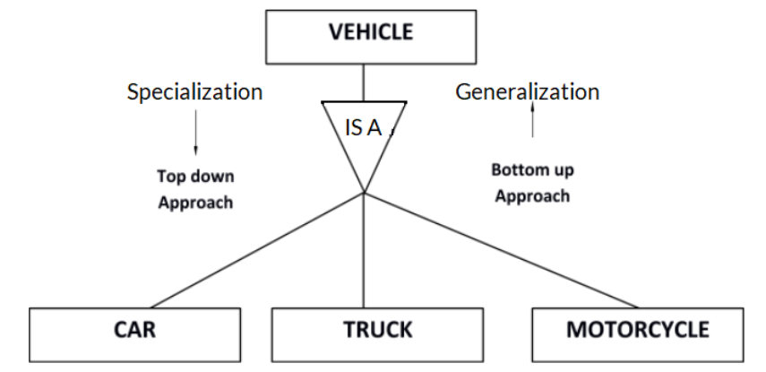
Example: Class Hierarchy – Specialization or Generalization

Slide 6
Class Hierarchy: Constraints
Constraints with respect to ISA hierarchy
Overlap constraints: Same entity in two subclasses.
Example: Joe is both a hourly_emp as well as contract_emp
Covering constraints: Entities in the subclass collectively include all the entities in the superclass.
Example: Every employee have to be either a hourly_emp or contract_emp

Slide 7
Why Class Hierarchy?
Two reasons for using ISA
To add descriptive attributes specific to a subclass.
The attribute hourly_wages does not make sense for contract_emps
To identify entities that participate in a relationship.
For example senior_emps can be a subclass of Employees. We wish to define a relationship that only senior_emps can be Managers of a department

Slide 8
Aggregation
Used to model relationship between a collection of entities and relationships
allows us to treat a relationship set as an entity set for purposes of participation in (other) relationships
Introduce a new feature called aggregation
Identified by a dashed box

Slide 9
Ex: Aggregation (1)
Let us understand this with an example
Department identified by did, budget and dname
Project have project id and budget
Projects have start date
Department sponsors project
Record the date since the department sponsored the project

Slide 10
Ex: Aggregation (2)
Department identified by did, budget and dname
Project have project id and budget
Projects have start date
Department sponsors project
Record the date since the department sponsored the project
Department assign employees (emp_id, ename, salary) to monitor the sponsorship
Record the date till when the employee is employed to monitor the project
Employee monitors the entire sponsorship not only the project

Slide 11
Aggregation versus Ternary
Can we use a ternary relationship instead of aggregation?
until attribute records the date till when the employee is appointed to monitor the sponsorship
since attribute records the start date of the project sponsorship
Replace the aggregation with ternary relationship possible if until attribute was absent?
Employees
Sponsor2
Projects
Depts
since
Choice between aggregation and ternary will depend on whether the relationship set relates to an entity set or a second relationship set

Slide 12
Ex: Aggregation – Putting it together
name
empid
sal
Departments sponsor projects
Record the start date of project
Employees
Department assign employees to monitor the sponsorship
Record the date till when the employee is employed to monitor the project
Monitors
until
Employee monitors the entire sponsorship not only the project
Introduce a new feature called aggregation
Identified by a dashed box
started_on
since
dname
pid
pbudget
did
budget
Projects
Sponsors
Departments

Slide 13
Conceptual Design Using the ER Model
Design choices:
Should a concept be modeled as an entity or an attribute?
Should a concept be modeled as an entity or a relationship?
Identifying relationships: Binary or ternary? Aggregation?
Constraints in the ER Model:
A lot of data semantics can (and should) be captured.
But some constraints cannot be captured in ER diagrams.

Slide 14
Entity vs. Attribute (1)
Identify a property as an attribute or entity?
For example, should address be an attribute of Employees or an entity (connected to Employees by a relationship)?
Depends upon the use we want to make of the property and the semantics of the data
CASE I:
If the property can take on several values. For example several addresses per employee, address must be an entity (since attributes cannot be set-valued).
If the semantics need to be preserved. For example structure (city, street, etc.) is important, we want to retrieve employees in a given city, address must be modeled as an entity (since attribute values are atomic).

Slide 15
Entity vs. Attribute (2)
from
to
CASE II: When we want to record several values of the descriptive attributes for each instance of this relationship.
For example, consider Works_In4. Does not allow an employee to work in a department for two or more periods.
Similar to the problem of wanting to record several addresses for an employee: Accomplished by introducing new entity set, Duration.
name
dname
empid
sal
did
budget
Employees
Works_In4
Departments
name
dname
empid
sal
did
budget
Employees
Works_In4
Departments
from
Duration
to

Slide 16
Another example
Students (roll no) drink different soft drinks (sname) that are manufactured by a company (cname)
Which of the two is a good design?
sname
Students
Drink
SoftDrink
sname
Students
Drink
SoftDrink
cname
Roll No
Manf
Good Design
Company
cname

Slide 17
Entity vs. Relationship
since
dbudget
Manager gets a separate discretionary budget for each dept. managed
name
dname
empid
sal
did
budget
Employees
Manages2
Departments
What if a manager gets a discretionary budget that covers all managed depts?
name
empid
sal
since
dname
Redundancy: dbudget stored for each dept managed by manager.
Misleading: Suggests dbudget associated with department-mgr combination.
Employees
did
budget
Manages2
Departments
ISA
This fixes the
problem!
Managers
dbudget

Slide 18
Binary vs. Ternary Relationships (1)
name
empid
sal
pname
age
Consider the ER diagram
Many-to-many relationship between employees, dependents and policies
Suppose we have the following additional requirement
Policy cannot be jointly owned by two or more employees
Every policy must be owned by some employee
A dependent is uniquely identified by jointly taking pname in conjunction with policyid
Employees
Covers
Dependents
Bad design
Policies
policyid
cost

Slide 19
Binary vs. Ternary Relationships (2)
name
pname
age
This example illustrates a case when two binary relationships are better than one ternary relationship.
empid
sal
Dependents
Employees
Purchaser
Beneficiary
Better design
Policies
policyid
cost

Slide 20
Binary vs. Ternary Relationships (3)
Another example in the other direction: Three entity sets – Parts, Suppliers and Departments. A supplier can supply some parts to a department
No combination of binary relationships is an adequate substitute:
S “can-supply” P, D “needs” P, and D “deals-with” S does not imply that D has agreed to buy P from S.
How do we record qty?
qty
Supplier
Covers
Departments
Parts

Slide 21
Summary
Class hierarchy – Identify the subclass in a class; ISA relationship
Two reasons: Add attributes to subclass; identify entities that can participate in a relationship
Aggregation – Model relationship between entity and a second relationship set; identified by dashed box
Design Choices
Entity vs. Attribute: Define as entity when the object take on different values; want to preserve the semantics; and record attributes for each instance of the relationship
Entity vs. Relationship: Relationship set has more than one attribute which cannot be uniquely related to an entity
Binary/Ternary/Aggregation:

Slide 22
Thank You

