Slide 1

Secure File Sharing System Using Proxy Re-encryption
Presented By: Sameer Khan

Slide 2
Introduction
Sharing files securely is challenging in today’s digital world. Traditional encryption methods offer robust security but often fall short in terms of usability and flexibility, particularly when it comes to sharing encrypted data with multiple users
We introduce a Secure File Sharing System that leverages Proxy Re-Encryption (PRE) and cloud storage to address these challenges.
By combining the security benefits of encryption with the cloud-based storage, the system provides a solution that is both secure and user-friendly.
The proposed system provide the secure sharing of encrypted files without the need for direct key exchange or exposing sensitive data.

Slide 3

Proxy Re-encryption
Proxy re-encryption (PRE) is a cryptographic technique that was first introduced by Blaze et al. in 1998.
It enables a semi-trusted proxy, who holds a Re-encryption key, to convert a ciphertext encrypted using Alice's public key, into another ciphertext that can be decrypted using Bob's public key.
The proxy doesn't gain any knowledge about the encrypted messages it's handling.
Proxy re-encryption schemes are similar to traditional symmetric or asymmetric encryption schemes, with the addition of two functions:
Delegation – The message recipient (keyholder) can generate a re-encryption key based on their secret key and the key of the delegated user.
Transitivity – Allow ciphertext to be re-encrypted an unlimited number of times.

Slide 4
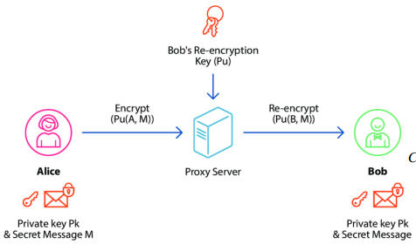
Proxy Re-encryption
Data Owner (Alice):
Initially, Alice encrypts her file using her private key (Pk) and a secret message (M). where Pu(A) is Alice’s public key, and M is the message or file content.
Proxy Server:
Once the file is encrypted, it is uploaded to a cloud-based proxy server. It facilitates the PRE process without ever decrypting the file.
Data User (Bob):
To share the encrypted file with Bob, Alice provides the proxy server with Bob’s re-encryption key (Pu). The proxy server uses this key to re-encrypt the file for Bob, which Bob can decrypt using his private key.

Slide 5
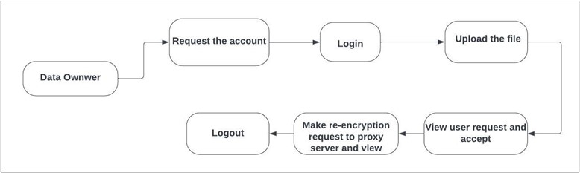
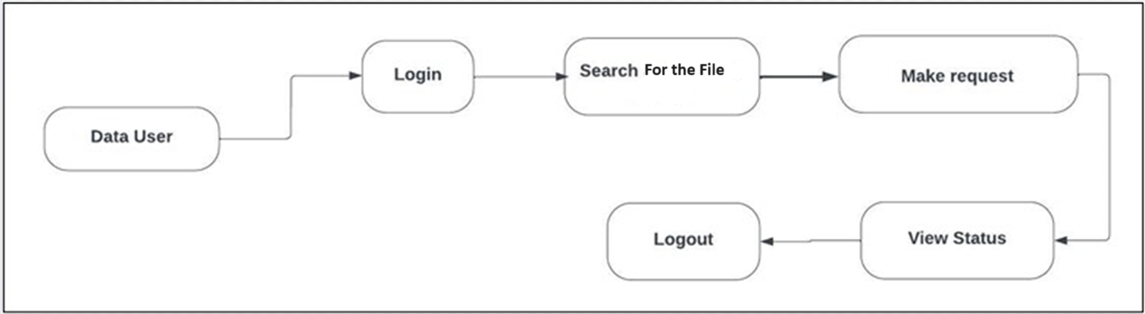
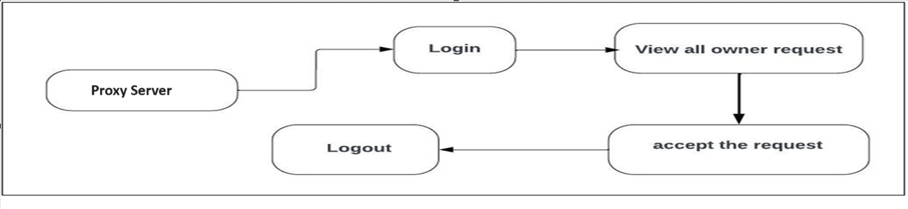
Proposed system

Slide 6
Related Work
Opuni-Boachie et al. introduced a proxy re-encryption approach to secure data sharing in IoT environments, they used identity-based encryption and blockchain technology to encrypt the data and store it in the cloud.
Pareek and Purushothama B.R. presented a keyaggregate proxy re-encryption (KAPRE) system that emphasizes the efficiency of predefined access control policies for outsourced data. Their work allows someone to decrypt the data without the need for secure transmissions.
Manzoor et al. developed a blockchain-based marketplace for IoT data sharing that employs an efficient PRE scheme for secure and anonymous data transfer. This approach eliminates the need for a trusted third party by establishing dynamic smart contracts directly between data producers and consumers.

Slide 7
Conclusion
Project successfully demonstrates the practical implementation of a secure file-sharing web application using JSP and SQL.
The system leverages the robustness of Proxy Re-Encryption to ensure that files shared between users are secure and private.
Our application provides a practical and user-friendly solution for secure, private, and convenient file sharing in the digital age.

