Slide 1
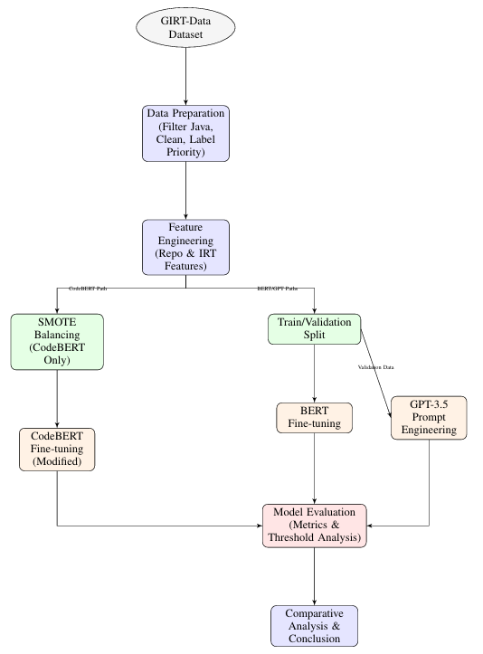
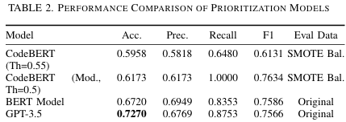
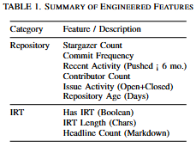
Prioritizing Bug Issue Reports in GitHub: A Comparative Study of Transformer Models
Presented by: Sameer Khan
Supervised by: Abbas Heydarnoori
Introduction & Problem
Approach Diagram
Methods
Why Does This Matter?
Problem: GitHub hosts millions of issues; manual prioritization is slow, inconsistent, and costly. Critical bugs get delayed.
Need: Automated, reliable methods are needed to help developers focus on high-priority issues efficiently.
Goal: Evaluate modern transformer models (specialized vs. general vs. LLM) for this task.
What Did We Compare?
CodeBERT: Fine-tuned (code-specialized model)
BERT: Fine-tuned (general language model)
GPT-3.5: Few-shot prompt engineering (LLM)
Task: Classify GitHub issues (Java repos) as High/Low priority using text (IRTs) and metadata.
How Did We Do It?
Dataset: GIRT-Data (Java repos with IRTs).
Features:
IRT (IRT_raw_markdown)
Repo Metadata (Stars, Commits, Contributors, Age, Activity)
IRT Metadata (Length, Headlines, Has_IRT)
Models & Training:
CodeBERT/BERT: Fine-tuned
GPT-3.5: Few-shot prompting with text + key features.
Evaluation: Accuracy, Precision, Recall, F1-Score on validation set.
Results
Highest Accuracy: GPT-3.5 (Prompting) of 72.7%.
Highest Recall/F1: Modified CodeBERT (on balanced data) of 1.0.
Best Balance (Prec/Rec/F1): BERT Model.
Main Takeaway
GPT-3.5 achieved the best accuracy (72.7%) on the original, unbalanced data.
Standard BERT showed the strongest balance on the original data.
Modified CodeBERT reached 100% Recall and the highest F1-Score (76.3%), ideal if missing critical bugs is unacceptable.
Choose model based on need: Accuracy (GPT) vs. Recall (CodeBERT+SMOTE) vs. Balance (BERT).
Conclusion & Future Work
Shows promising directions for using modern AI to effectively automate bug prioritization
Explore other models (RoBERTa, LLMs) & fine-tuning LLMs.
Enhance features (sentiment, user history, code metrics).
Real-world integration & evaluation with developer feedback.

