Slide 1
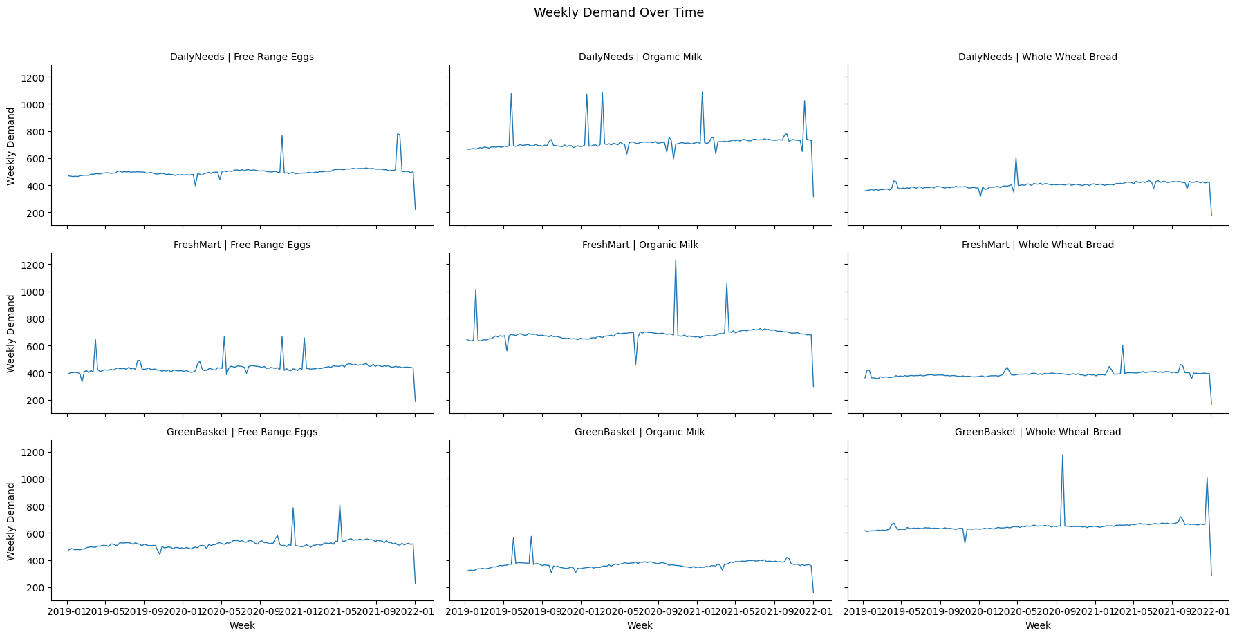
8-Week Demand Forecasting - Reducing Stock-Outs and Write-Offs
What Drives Demand
• Promotions cause up to 2x demand spikes
• Demand is stable — no strong trend over 2019–2021
• Organic Milk is the most volatile product
• Whole Wheat Bread is the most predictable
Model Performance
• Algorithm: Facebook Prophet
• Forecast horizon: 8 weeks ahead
• Average error: 59.7 units/week (MAE)
• 24% more accurate than naive baseline
• Best performer: GreenBasket | Organic Milk (MAE: 31.5)
With 8-week forecasts, stock can be ordered before shortages occur.
Promotion weeks are flagged in advance so buffer stock is ready
directly reducing both stock-outs and write-offs.
Data: Jan 2019 – Sep 2021 | 3 supermarkets | 3 SKUs | 9 combinations

