Slide 1
Product Price Tracker
By:
Shaik Mohammed Sameer ( 1602-20-737-168)
Shoaib AleemUddin ( 1602-20-737-170)
Vinayaka Prateek ( 1602-20-737-164)

Slide 2
ABSTRACT:
With the rapid advancements in the Electronic Commerce sector, modern
consumers are becoming increasingly aware of the prospects of the various pricing
strategies, which have made their purchase decisions more sophisticated.
So we made a simple price tracker using python that regularly compares the prices of your favorite stuff on amazon or Flipkart and sends you a customized notification email at your registered email to tell you if the prices fell down below the desired price. This uses python and implements beautiful soup to scrap data from websites, smtplib to send mail, tkinter to make GUI, time and requests modules and libraries.
It helps users to save time as they don't need to manually open the amazon or flipkart and check drop in price every day, they just need to copy the URL of product and add to tracker and input desired price, as soon as price drops user gets notified and can buy product before everyone else does. It would also help to consider factors like product demand, minimum margins, cost within local and international markets, and more.
Instead of manually monitoring your competitors’ pricing and other product-related data, you can use price tracking software to do it automatically. It frees you a significant amount of time you can spend on other productive tasks.

Slide 3
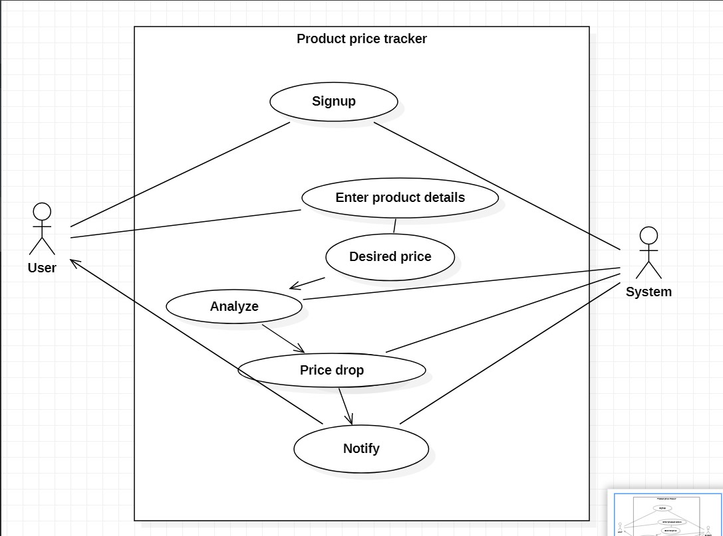
USE CASE DIAGRAM:

Slide 4
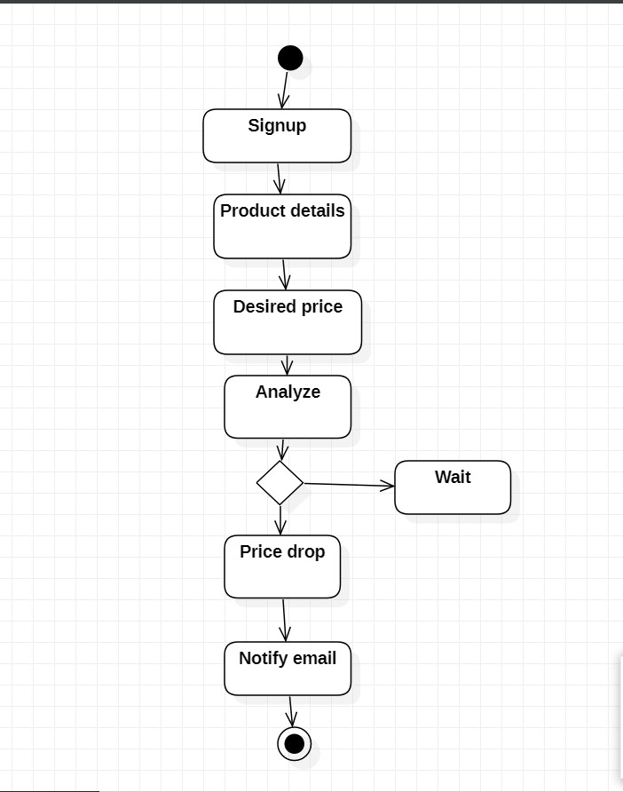
ACTIVITY DIAGRAM::

Slide 5
TECHNOLOGY USED:
IDLE USED:
VS code
Hardware Requirements
512 MB RAM
2GB HDD
CORE i3/i5
LIBRARIES USED:
tkinter
requests
Smtplib
Beautifulsoup
MAIN METHODS:
Amazon()
Flipkart()
Sendmail()
Check_internet()

Slide 6
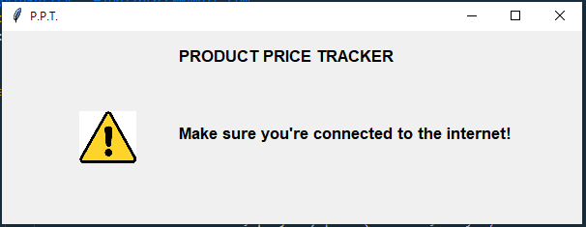
EXECUTION::
1. If no internet connection

Slide 7
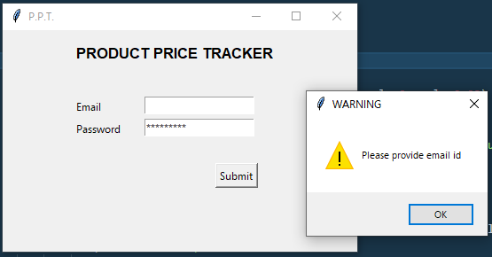
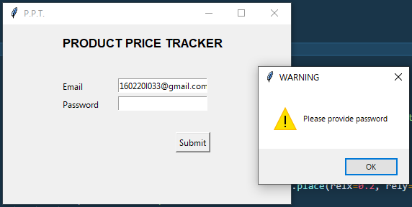
2. With no email
3.With no password

Slide 8
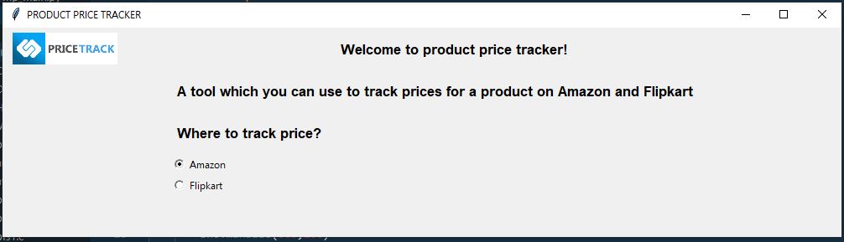
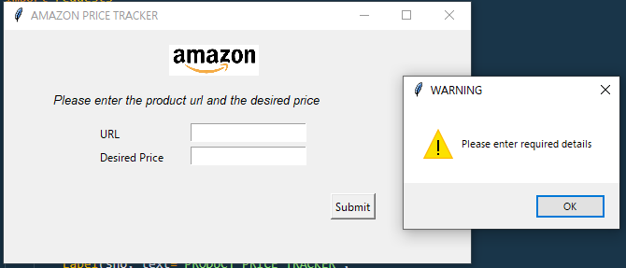
4. Selecting Amazon
4a. Not giving URL or price

Slide 9
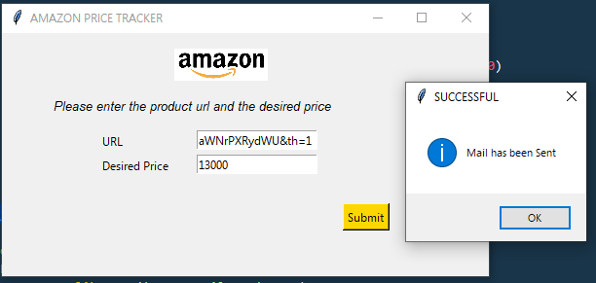
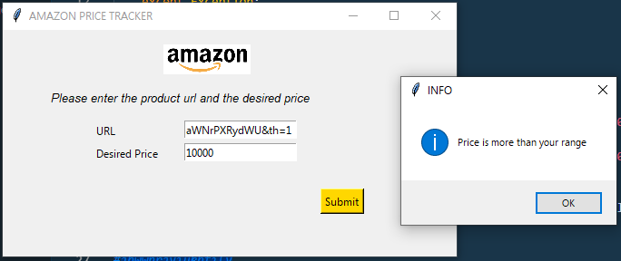
4b. If price < desired price:
4c. If price > desired price:

Slide 10
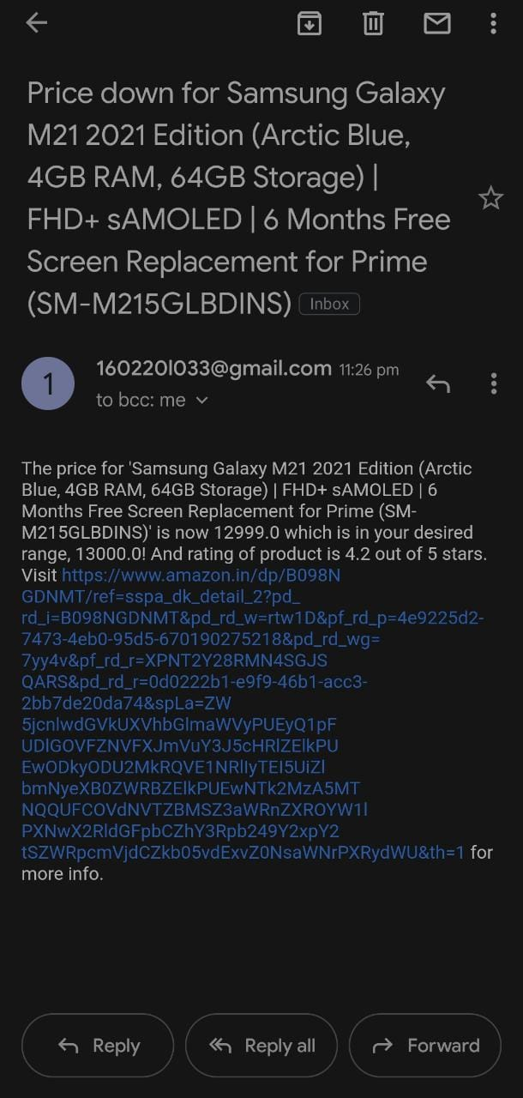
4d. AMAZON EMAIL demo

Slide 11
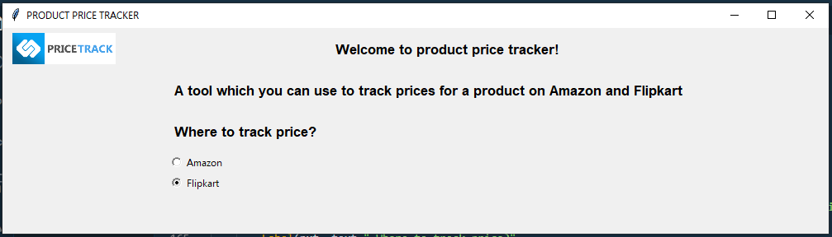
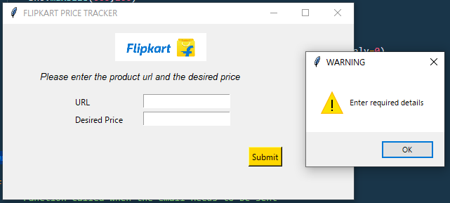
5.Selecting Flipkart
5a. Not giving URL or price

Slide 12
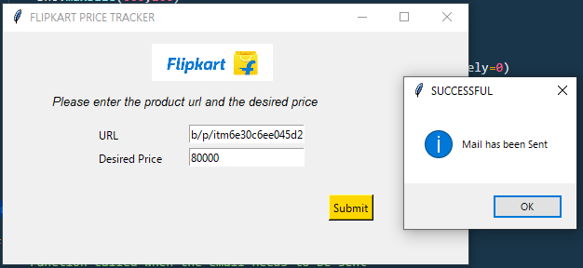
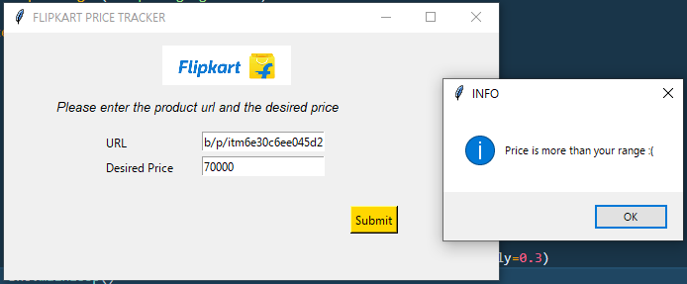
5b. If price < desired price
5c. If price > desired price

Slide 13
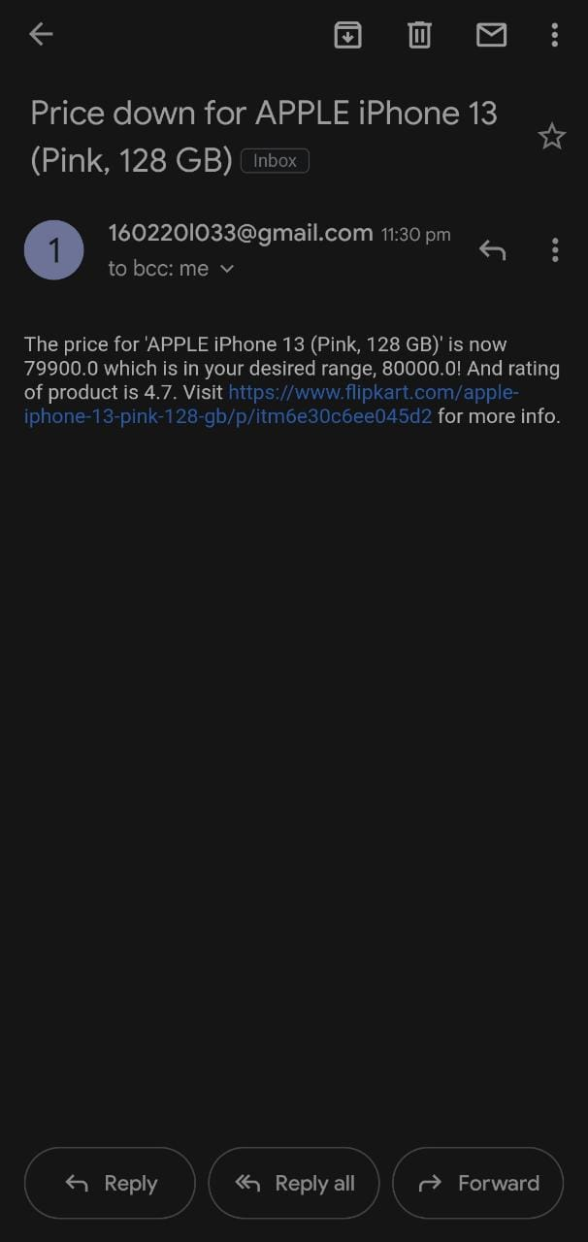
5d. FLIPKART EMAIL demo

Slide 14
CONCLUSION:
Product Price Tracker is a tool that is used to track the price fluctuations of product and sends
notification in case of a price drop below desired price. This indicates that automated price
tracking solutions are more efficient, feasible, accurate, timely method. The return of investment
by using an automated price tracking tool is quick, simple, and immediately evident. While manual
tracking gets the job done, for the most part, on a very small scale, it is far too limited and is being
outrun by the modern exploits of technology.
Therefore, instead of checking the product details every now and then we can easily track
product data by using this simple tool.
FUTURE WORK:
Add more e-commerce sites
Creating a database to store its data for every run
Graphical statistics for better understanding
Sending alert through an sms (using sinchsms library)
Add price history chart
Develop a chrome extension or an App
Make the whole UI easier to use

Slide 15


