Slide 1


SMART INDIA HACKATHON 2025
TITLE PAGE
N
Problem Statement ID - SIH25021
Problem Statement Title- AI based development of Laser based QR Code marking on 'track fittings on Indian Railways.
Theme- Transportation & Logistics
PS Category- Software/Hardware
Team ID-
Team Name-NextGenCoders

Slide 2
IDEA TITLE:AI‑Ready Railway Identity, QR, and Ops Visibility
NextGen
Coders
Proposed Solution:
➡️ Hardware – Laser-etched QR codes for permanent ID ➡️ Software – Mobile app + platform for data access & tracking ➡️ AI Engine – Predictive insights & automated quality control
How It Addresses the Problem:
➡️ Digital Traceability – Identification & accountability ➡️ Proactive Safety – AI predicts failures, preventive maintenance ➡️ Streamlined Operations – Integration with UDM/TMS for automated management
Uniqueness & Innovation:
➡️ Digital Passport – Permanent and unalterable tracking ➡️ Dynamic QR Codes – Real-time data updates ➡️ Predictive AI – Anticipates problems ➡️ Integrated System – Scalable hardware + software

Slide 3
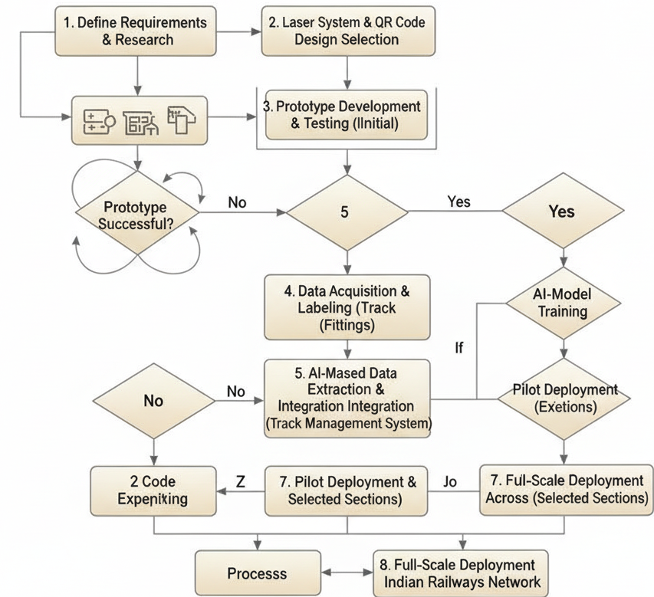
TECHNICAL APPROACH
NextGenCoders
Technologies & Components:
➡️ Hardware - Fiber Laser Marking Machine, Mobile Scanners ➡️ Backend – Python, Node.js, Flask,Express.js ➡️ Mobile App – JavaScript, Dart, React Native, Flutter ➡️ AI/ML – TensorFlow, PyTorch, Scikit-learn ➡️ Database – MongoDB, Firebase

Slide 4
FEASIBILITY AND VIABILITY
NextGenCoders
➡️ Feasibility –
Scalable technologies (QR codes, AI,
mobile apps).
Integration with UDM/TMS possible via APIs for real-time updates.
➡️ Challenges –
QR code durability under extreme weather/handling.
Training staff for adoption across regions.
➡️ Strategies –
Tamper-proof laser marking, offline mobile app support.
Phased rollouts with hands-on staff training.
➡️ Innovation –
First-of-its-kind UDM/TMS integration for predictive maintenance.
Combines AI + QR tracking for safety & efficiency.

Slide 5
IMPACT AND BENEFITS
NextGenCoders
Potential Impact on Target Audience:
➡️ Single-scan Verification & Proactive Safety –
Real-time UDM/TMS + AI histories,
QR scanning for early defect/recall detection,
reducing risks and downtime.
➡️ Audit-ready & Secure Access –
Digital traceability speeds GRN/approvals,
reduces disputes,
ensures only authorized staff can update records.
Benefits of the Solution: ➡️ Social & Economic –
Safer journeys,
transparent vendor-to-track traceability,
lower maintenance/inventory costs,
faster GRN/payments.
➡️ Environmental –
Longer part life,
paperless processes,
fewer field visits,
reducing waste and emissions.

Slide 6
RESEARCH AND REFERENCES
NextGen
Coders
NIST SP 800-63 (Digital identity, 2-step verification): 🔗https://pages.nist.gov/800-63-3/
GS1 EPCIS 2.0 (Event-based supply chain traceability): 🔗 https://www.gs1.org/standards/epcis
EN 50126 / IEC 62278 Railway RAMS – Safety, Reliability:🔗 https://en.wikipedia.org/wiki/EN_50126
Indian Railways RDSO (Standards): 🔗 https://rdso.indianrailways.gov.in
CRIS (Centre for Railway Information Systems – IT/TMS):🔗 https://cris.org.in

