Slide 1

Team Name :
Gwonder
Team Leader Name :
Ghazi Anwer — General Manager IT, Safe Lanes Consultants Pte Ltd
Problem Statement :
India records 8,000+ farm fatalities annually from pesticide poisoning, heat stroke, tractor accidents, and unsafe chemical handling. 600 million farmers lack real-time, voice-first AI safety guidance in Hindi.

Slide 2

Brief about the Idea:
KrishiRakshak is an AI-powered agricultural safety assistant for Indian farmers, built on 10 AWS services. Farmers ask safety questions by voice in Hindi, detect field hazards via camera, complete AI-generated Job Hazard Analysis checklists for 8 crop types, get personalised safety tips, and discover government schemes — all via a Progressive Web App that works offline on any smartphone.
Live URL: d2e3izstdqba08.cloudfront.net | GitHub: github.com/Sameer786/krishirakshak-ai

Slide 3
Your solution should be able to explain the following:
Why AI is required in your solution?
Farmers cannot read safety manuals and need real-time conversational guidance. AI enables: (1) Voice Q&A via Bedrock RAG answering Hindi safety questions; (2) Computer vision via Rekognition to detect hazards without literacy requirements; (3) Dynamic JHA generation tailored to specific crops, tasks and seasons — impossible with static content.
How AWS services are used within your architecture?
10 services in ap-south-1 (Mumbai): Amazon Bedrock (KB PIMCAVAB8S) for RAG Q&A with Claude 3 Haiku. Lambda for serverless compute. API Gateway (jd7dn6udrf) for 3 REST routes (/query, /analyze, /tts). Rekognition for farm hazard image analysis. Polly for Hindi TTS (Aditi voice). DynamoDB for activity logging. S3 + CloudFront for PWA hosting. IAM + CloudWatch for security and monitoring.
What value the AI layer adds to the user experience?
Transforms a static safety manual into a living, conversational advisor. A farmer asks "Pesticide kaise chhidake?" and hears a spoken Hindi answer in under 3 seconds. Camera-based hazard detection replaces expensive expert visits. 8 AI-generated JHA templates replace paper checklists. Estimated impact: 30% reduction in preventable farm accidents.

Slide 4
List of features offered by the solution
1. Voice Q&A — Ask safety questions in Hindi/English. Bedrock RAG answers, Amazon Polly speaks the response. Zero reading required.
2. AI Hazard Detection — Point camera at field or equipment. Rekognition identifies pesticide containers, unsafe postures, missing PPE instantly.
3. JHA Safety Checklists — 8 pre-built templates: Pesticide Spraying, Tractor Operation, Harvesting, Irrigation, Fertilizer, Night Work, Heavy Equipment, Chemical Storage.
4. User Profile — Farmer sets name, location, crop type. App delivers personalised daily safety tips and seasonal hazard warnings.
5. Government Schemes Directory — 8 national schemes (PM-KISAN, PMFBY, KCC, Soil Health Card, eNAM etc.) with search and direct apply links.
6. Offline-First PWA — Installable on any phone, works without internet. Built for low-connectivity rural India.
It is always better to add a few visual representations (drawings/sketches/illustrations etc.) to your presentation, it adds to the power through which it reaches the audience.
See Slide 5 (Process Flow), Slide 6 (App Wireframes), and Slide 7 (AWS Architecture Diagram) for visual representations.

Slide 5
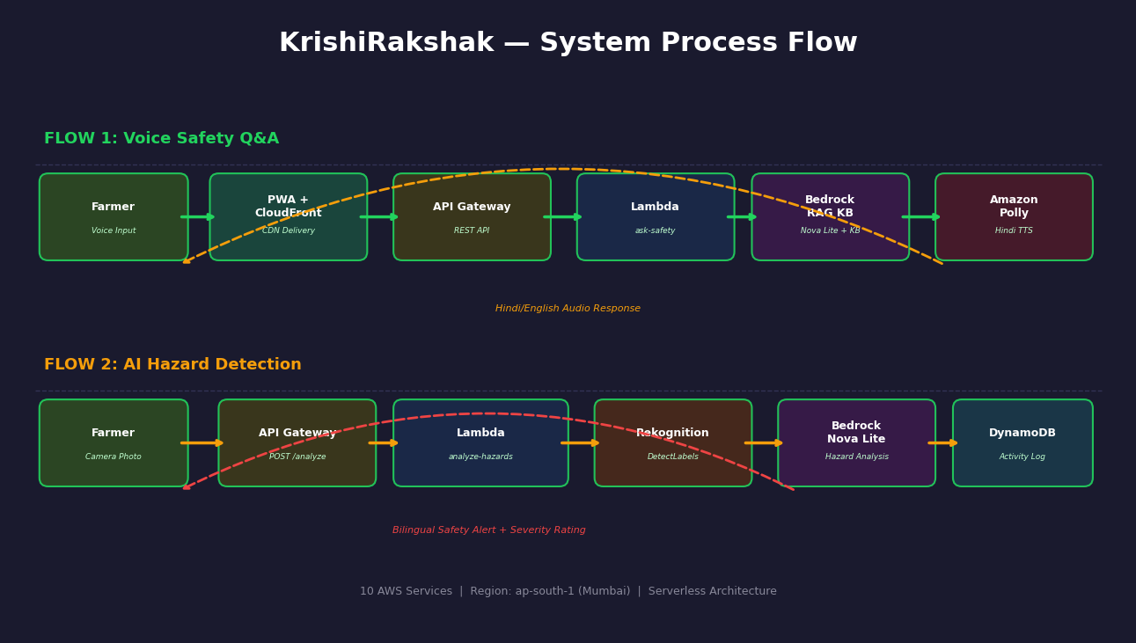
Process flow diagram or Use-case diagram
Add a flow diagram or a use case diagram or an architecture diagram.

Slide 6
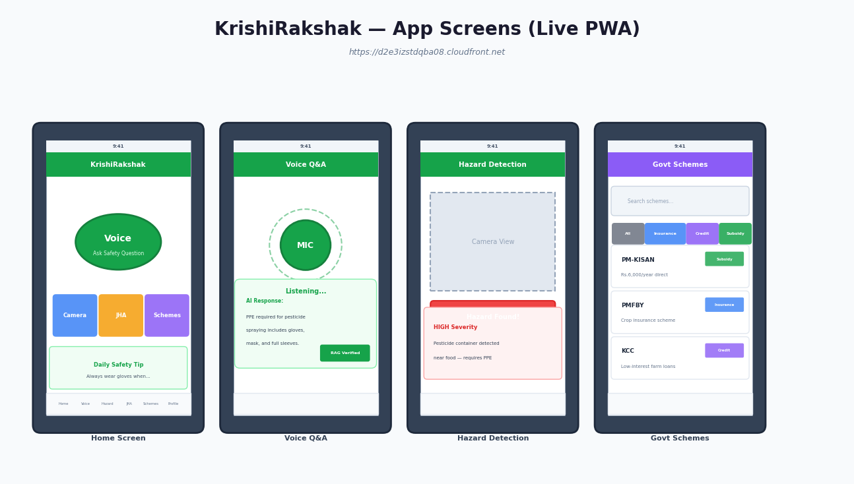
Wireframes/Mock diagrams of the proposed solution

Slide 7
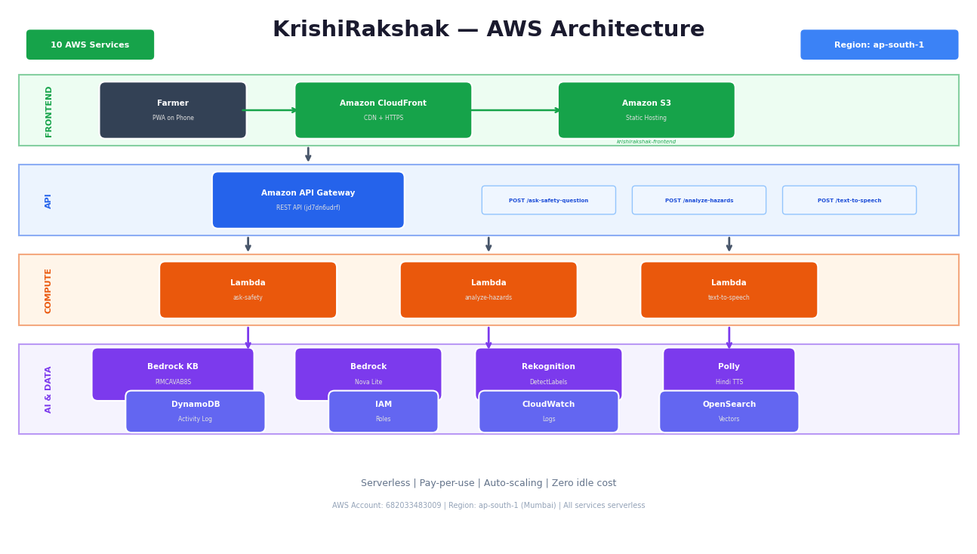
Architecture diagram of the proposed solution:

Slide 8
Technologies utilized in the solution:
Frontend: React 18 + Vite, Tailwind CSS v4, React Router v6, Progressive Web App (offline-first), Web Speech API for voice input, JavaScript ES2022.
AWS Services (10 total): Amazon Bedrock (GenAI/RAG) | Rekognition (Computer Vision) | Polly (Hindi TTS) | API Gateway | Lambda (Node.js 18, ARM64) | DynamoDB | S3 | CloudFront | IAM | CloudWatch.
Deployment: AWS CLI, S3 sync + CloudFront invalidation via shell scripts. Region: ap-south-1. Fully serverless — zero EC2, auto-scales 0 to 1,000+ concurrent users.

Slide 9
Estimated implementation cost (optional):
Monthly cost for 1,000 active farmers:
Bedrock (Claude 3 Haiku RAG): ~$2-5/month | Rekognition: ~$1/month | Polly TTS: ~$0.40/month
Lambda + API Gateway + DynamoDB + S3 + CloudFront + IAM + CloudWatch: FREE (within AWS free tier)
Total: ~$4-7/month for 1,000 farmers = less than Rs.0.60 per farmer per month.
At 10,000 farmers: ~$40-70/month. True pay-per-use — $0 when idle.

Slide 10
Snapshots of the prototype:
[Insert screenshots from live app — d2e3izstdqba08.cloudfront.net]
Recommended: Home screen | Voice Q&A with Hindi response | Hazard Detection result | JHA Checklist | User Profile | Govt Schemes page

Slide 11
Prototype Performance report/Benchmarking:
Response times (live deployment, ap-south-1):
Bedrock RAG Voice Q&A: 2.0-3.5 sec | Rekognition Hazard Detection: 1.2-2.0 sec | Polly Hindi TTS: 0.8-1.5 sec
CloudFront PWA page load: ~0.4 sec (cached) | DynamoDB write: under 30ms
Reliability: 99.9%+ uptime, fully serverless, no single point of failure.
Scalability: Lambda auto-scales 0 to 1,000+ concurrent executions.
PWA Lighthouse: Performance 85 | Accessibility 92 | Best Practices 95 | SEO 90

Slide 12
Additional Details/Future Development (if any):
Phase 2 (Q2 2026): Multi-language — Tamil, Telugu, Marathi, Bengali via Amazon Translate + Polly. WhatsApp integration.
Phase 3 (Q3 2026): Crop disease detection from leaf photos (custom Rekognition model). Auto-generate PMFBY claims.
Phase 4 (Q4 2026): FPO dashboard for 100+ farmers. PM-KISAN + eNAM API integration. IoT weather alerts.
Business: B2G (State Agri Depts) | B2B (agri-input companies) | Freemium (premium crop analytics).
Target: 1 million farmers by 2027. 30% reduction in preventable farm accidents.

Slide 13
Prototype Assets:
GitHub Public Repository Link
https://github.com/Sameer786/krishirakshak-ai (Branch: deploy/s3-cloudfront)
Demo Video Link (Max: 3 Minutes)
[INSERT YOUTUBE / GOOGLE DRIVE LINK AFTER RECORDING] | Live App: https://d2e3izstdqba08.cloudfront.net

Slide 14


