Slide 1


Bapuji Educational Association (Regd.)
_{BAPUJI POLYTECHNIC SHABANUR}
_{Davangere - 577004}
OPTICAL CHARACTER RECOGNITITION USING MACHINE LEARNING TECHNIQUE
_{Presented By:}
MOHAMMED FAIZAN K 335CS20025
GOUD SUNNY SHRAVAN 335CS20015
MOHAMMED SAMEER 335CS20026
DHARSHAN HM 335CS20011
_{Under the Guidance of:}
Smt. Uma Devi H , B.E. M.I.S.T.E
_{(HOD CS&E)}

Slide 2
OPTICAL CHARACTER RECOGNITION
AI-Enabled OCR software

Slide 3
Table of contents
01
02
03
04
Introduction
05
Data Collection & Analysis
Research Problem Stat
06
Result & Improvements
Technology Equiped
07
Conclusion
Research Methedology
08
Meet Our Team

Slide 4
01
Introduction
AI-Enabled OCR software

Slide 5
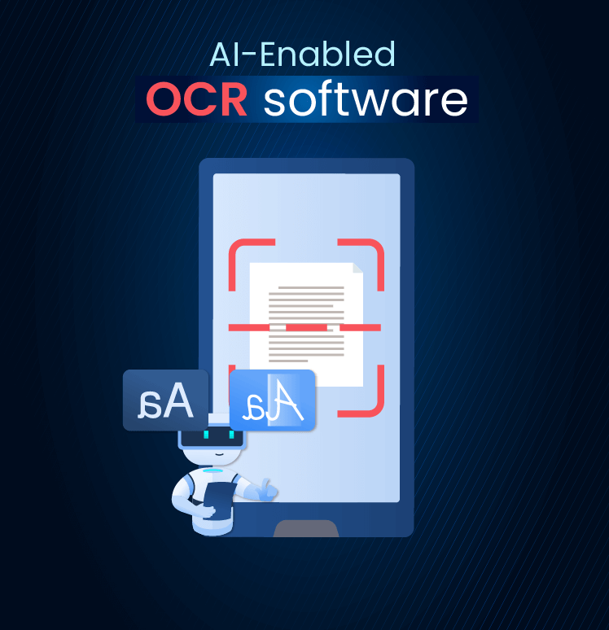
01
Introduction
Optical Character Recognition (OCR) is the electronic conversion of text images into machine-readable text.
OCR is a technology that enables the conversion of printed or handwritten text into machine-readable and editable digital data.
We are dedicated to revolutionizing data management through efficient and accurate OCR capabilities.

Slide 6
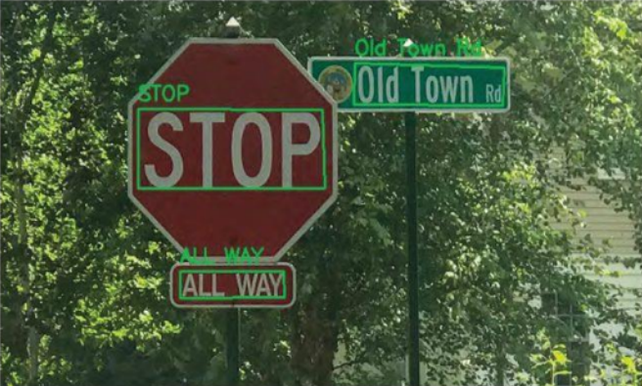
01
Introduction
System Overview
The overall system overview of the proposed system is as described in this picture.
Text Recognition from sign boards

Slide 7
02
Research Problem Statement
AI-Enabled OCR software

Slide 8
02
Research Problem Statement
The traditional methods was the need for manual data entry. Every document or piece of text had to be transcribed by hand, which was time-consuming, labor-intensive, and prone to errors.
OCR systems need optimization for efficient processing and analysis of large-scale document collections, considering factors like speed, scalability, and resource utilization.
OCR systems should be capable of performing real-time text recognition and extraction, enabling applications like augmented reality, live translation, and instant document analysis.
OCR systems need to provide a user-friendly interface and seamless integration capabilities with other software applications and systems, ensuring esy of use and compatibility with existing workflows.

Slide 9
03
Technology Equipped
AI-Enabled OCR software

Slide 10
03
Technology Equipped
1. OpenCV
3. Pytesseract
Computer Vision library for image processing and object detection.
Google’s Tesseract OCR engine to extract text from images.
2. Argparse
4. Pyttsx3
Python library for parsing the command-line arguments.
Python library for efficient Text-to-Speech synthesis.

Slide 11
04
Research Methodology
AI-Enabled OCR software

Slide 12
04
Research Methodology
The working of the Text Recognition System can be summarized in the following steps:
Software Execution: When the user runs the program, the specified input image is taken as input.
Image Pre-processing: The input image undergoes pre-processing to enhance its quality and remove noise.
Character Recognition: The pre-processed image is processed to recognize the characters present.
You can describe the topic of the section here

Slide 13
04
Research Methodology
Display of Recognized Characters: The recognized characters are displayed on the console and images as well, accompanied by bounding boxes.
Sequential Word Speech: The recognized characters are spoken word by word, with
Two voice options are defined : a Male voice and a Female voice.
This represents an overview of the system's functioning and its architecture for text recognition.
You can describe the topic of the section here

Slide 14
Flow Chart
1. Image Input
3. Text Recognition
2. Image Processing
4. Text Output
5.Text-to-Speech

Slide 15
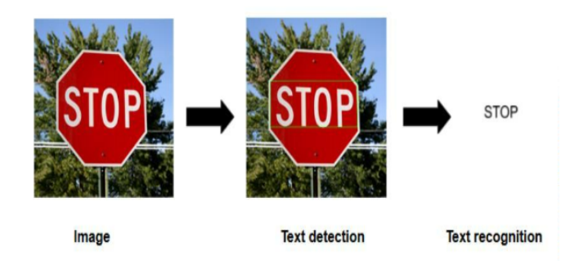
04
Research Methodology
SYSTEM ARCHITECTURE
The overall system design of the proposed system is as described in this picture.
Text Recognition from sign board

Slide 16
05
Data Collection & Analysis
AI-Enabled OCR software

Slide 17
05
Data Collection & Analysis
Instrument for Data Collection
The instruments required for data collection in text recognition using OCR (Optical Character Recognition) are as follows::
Scanners or Cameras: High-quality scanner or camera is essential to capture clear and detailed images of documents for accurate OCR analysis.
OCR Software: OCR software analyzes images to extract text. The choice of software depends on factors like language, font type, and document type, with various commercial and open-source options available.
Human Evaluators: Human evaluators review and correct OCR results for improved accuracy, especially for handwritten or unique fonts. They also annotate text and assess OCR output quality.

Slide 18
06
Results & Improvements
AI-Enabled OCR software

Slide 19
06
Result & Improvements
The following are Results and Improvements of OCR Project:
The OCR project successfully extracted and converted scanned or photographed text into digital text.
The OCR software achieved high accuracy for clear and well-defined text with standard fonts.
Challenges were encountered in accurately recognizing handwritten text or non-standard fonts, resulting in lower accuracy.
We dare to Improve accuracy for recognizing handwritten text and non-standard fonts by incorporating advanced machine learning algorithms and training the OCR model on diverse datasets.

Slide 20
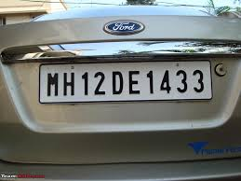
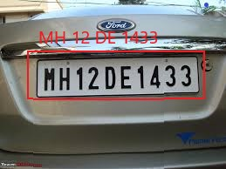
OCR RESULTS - 01
Before Case
After Case

Slide 21
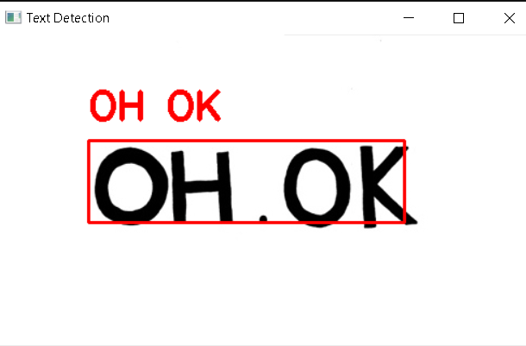

OCR RESULTS - 02
Before Case
After Case

Slide 22
07
Conclusion
AI-Enabled OCR software

Slide 23
07
Conclusion
We conclude that our project is successfully working and capable of performing real-time text recognition and extraction.
As estimated our project has 90%+ accuracy and remaining 10% will depends on quality of the image
Future work should focus on improving OCR accuracy and efficiency.
Advancing OCR technology involves overcoming challenges and exploring new applications and integrations.
Ongoing research and development will transform information processing and storage through OCR.

Slide 24
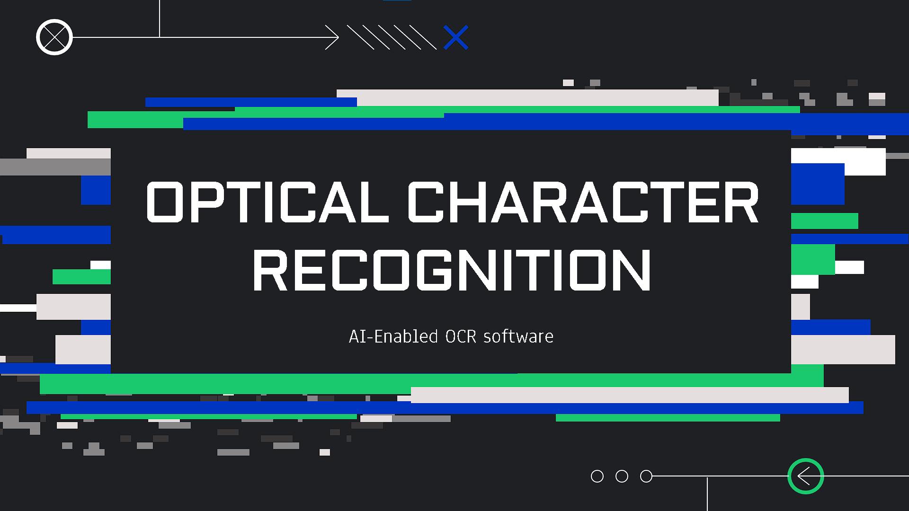
Meet Our Team
GAUD SUNNY SRAVAN
MOHAMMED FAIZAN K
MOHAMMED SAMEER
DARSHAN HM

Slide 25


Thanks!

