Slide 1
Department Of Information Technology
ARUNAI ENGINEERING
COLLEGE
CODE : 5104

Slide 2

Batch No:3
Presented by:
V.Aishwarya sri
R.Dhanalakshmi
G.Gopika
D.Kiruthiga
A.Sameera
MENTORED BY
K.Haripriya

Slide 3
DISASTER RECOVERY WITH IBM CLOUD VIRTUAL SERVER

Slide 4
AGENDA :
Introduction
Design Thinking
Problem
Solution
Coding
Explanation
Conclusion

Slide 5
INTRODUCTION
Data replication and computer processing in an off-premises location unaffected by the accident are essential to disaster recovery. A firm has to restore lost data from a second location where the data is backed up when servers fail due to a natural disaster, equipment failure, or cyberattack.

Slide 6
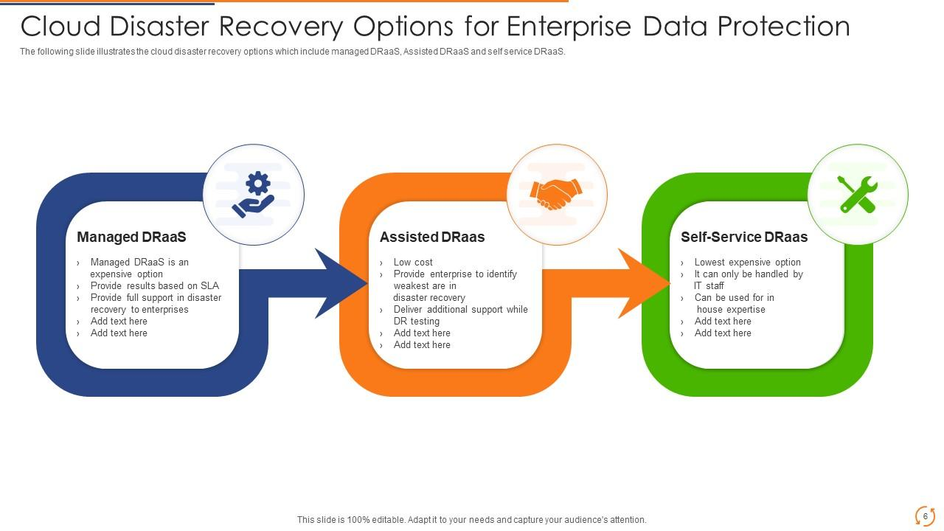
DESIGN THINKING Empathize: Understand the needs and challenges of IBM's cloud clients in disaster recovery. Define: Clearly define the problem and identify key stakeholders. Ideate: Brainstorm innovative solutions, considering data replication, backup, and failover strategies. Prototype: Create and test mock-ups or proof-of-concept designs. Test: Conduct real-world testing and gather feedback for refinement. Implement: Develop and deploy the chosen disaster recovery solutions, ensuring integration with IBM's cloud services.

Slide 7
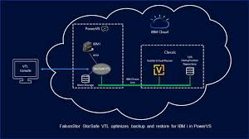
PROBLEM
Data Loss:
Data stored in the cloud can be vulnerable to loss due to hardware failures, data corruption, or accidental deletions
Downtime:
Unexpected outages can disrupt services, resulting in downtime and revenue loss
Security Breaches:
Cyberattacks or unauthorized access can compromise data integrity and availability

Slide 8
SOLUTION
Data Backups :
Regularly backup data to secure storage in the cloud or a different geographic region. IBM Cloud offers services like IBM Cloud Object Storage for this purpose
High Availability (HA) :
Implement high availability solutions using IBM Cloud's load balancers and redundancy features to ensure services remain accessible even during hardware failures
Disaster Recovery Plan (DRP) :
Develop a comprehensive DRP that includes strategies for data recovery and service restoration. IBM Cloud provides services like IBM Resiliency Orchestration to automate and streamline recovery processes.
Geographic Redundancy :
Deploy resources in multiple geographic regions to ensure data and services can be quickly restored if one region experiences a disaster
Security Measures :
Enhance security through IBM Cloud's built-in security services and follow best practices for access control, encryption, and threat detection

Slide 9
CODING
import networkx as nx
import matplotlib.pyplot as plt
# Create a directed graph to represent cloud resources and dependencies
cloud_graph = nx.DiGraph()
# Define cloud resources and their dependencies
cloud_graph.add_node("Web Server")
cloud_graph.add_node("Application Server")
cloud_graph.add_node("Database Server")
cloud_graph.add_edges_from([ ("Web Server", "Application Server"),
("Application Server", "Database Server"),])

Slide 10
# Simulate a successful disaster recovery scenario (e.g., failover to a backup server)
cloud_graph.add_node("Database Server Backup")
cloud_graph.add_edge("Application Server", "Database Server Backup")
# Check if there's a backup or failover strategy in place
if "Database Server Backup" in cloud_graph:
print("Disaster recovery successful. Database Server Backup is available.")
else:
print("Disaster recovery failed. Implement a backup or failover strategy.")
# Visualize the cloud graph (requires additional libraries and setup)
nx.draw(cloud_graph, with_labels=True, node_color="lightblue")
plt.show()
Output:
Disaster recovery successful. Database Server Backup is available

Slide 11
EXPLANATION
Importing Libraries:
The program begins by importing the necessary libraries: networkx for creating and manipulating graphs and matplotlib.pyplot for graph visualization.
Creating a Directed Graph:
It creates a directed graph called cloud_graph to represent cloud resources and their dependencies. In this case, there are three nodes: "Web Server,“ "Application Server," and "Database Server.“
Simulating Disaster Recovery:
The program simulates a successful disaster recovery scenario by adding a new node called "Database Server Backup" to the graph. This simulates a failover to a backup server.An edge is created from the "Application Server" to the "Database Server Backup" to indicate that the application server now uses the backup database server in the recovery scenario.
Visualizing the Graph:
Finally, the program attempts to visualize the cloud resource graph using nx.draw. However, please note that this part of the code requires additional libraries and setup, which are not shown in this snippet. Overall, the program provides a basic simulation of a disaster recovery scenario in a cloud environment with a graphical representation of the resource dependencies.

Slide 12
Conclusion
In conclusion, disaster recovery in cloud computing is a critical aspect of ensuring business continuity and data integrity. It involves creating strategies and mechanisms to recover from various disasters, such as hardware failures, data corruption, or service outages, in a cloud-based environment. Key components include data backup, replication, automated failover, and rapid recovery to minimize downtime. Disaster recovery plans should be regularly tested and updated to adapt to evolving cloud technologies and security threats, ultimately safeguarding organizations against disruptions and data loss.In conclusion, disaster recovery in cloud computing is a critical aspect of ensuring business continuity and data integrity. It involves creating strategies and mechanisms to recover from various disasters, such as hardware failures, data corruption, or service outages, in a cloud-based environment. Key components include data backup, replication, automated failover, and rapid recovery to minimize downtime. Disaster recovery plans should be regularly tested and updated to adapt to evolving cloud technologies and security threats, ultimately safeguarding organizations against disruptions and data loss.

Slide 13
“
WE WERE OBLIGED
FOR THIS
OPPORTUNITY…
”

