Slide 1

Solving the Complaint Surge
A Data-Driven Journey for AppPoint
22 May, 2025

Slide 2
The Problem We Faced
User complaints on App Point’s photo editing apps are increasing, risking app ratings and user retention.
Negative Impact on user experience & app store ratings

Slide 3



How We Investigated
1400+ complaints analyzed from App Point.
Data fields: App, Complaint Type, Subscription, Device, Date.
Analysis focused on app-wise, complaint-wise.

Slide 4
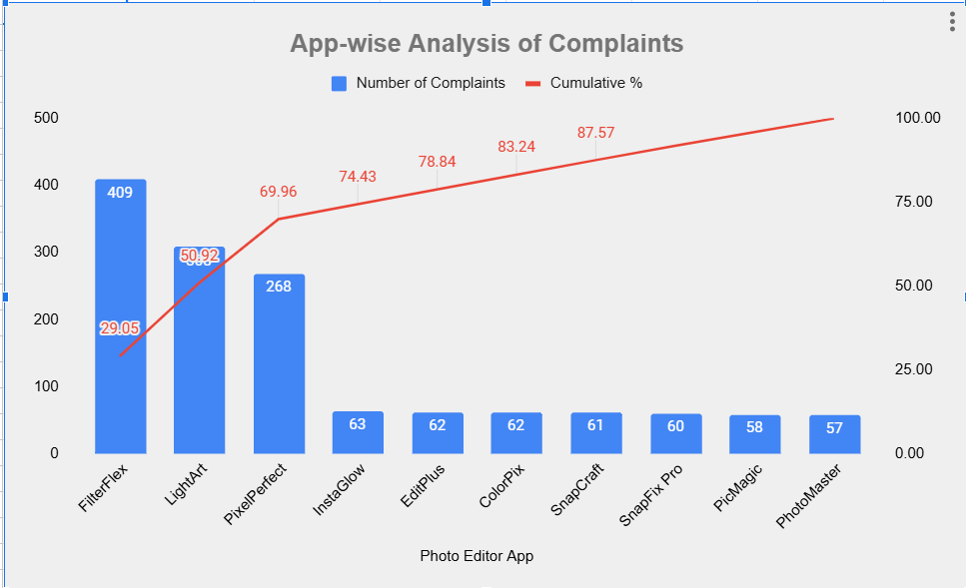
What We Found
A Pareto Pattern = 70.25% Complaints just from 3 Apps

Slide 5
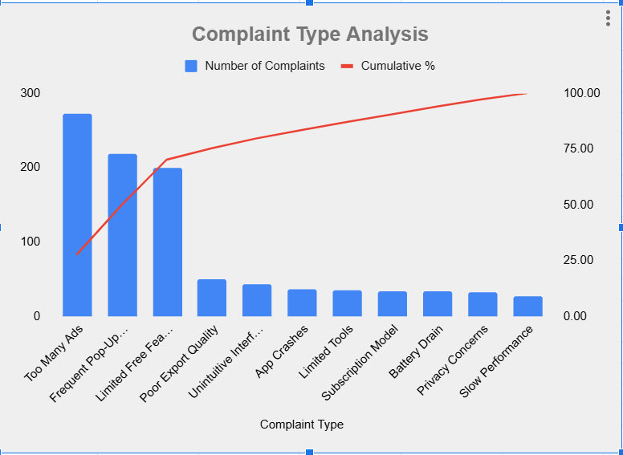
What We Found
For these three apps, 70.25% of complaints stem from 3 main issues
Too Many Ads
Frequent Pop-Up for upgrades
Limited Free Features

Slide 6

Final Insights
App-wise Analysis
FilterFlex, LightArt and PixelPerfect collectively account for 69.96% of all customer complaints highlighting a major problem with these Apps.
.
Complaint-Type Analysis
For these three apps, 70.25% of complaints stem from 3 main issues Too Many Ads, Frequent Pop-Ups for Upgrades and Limited Free Features.

Slide 7
What We Recommend
Redesign user experience for top 3 apps.
Reduce aggressive pop-ups and ad interruptions.
Improve accessibility of features for free users.

Slide 8
Thank you

