Slide 1
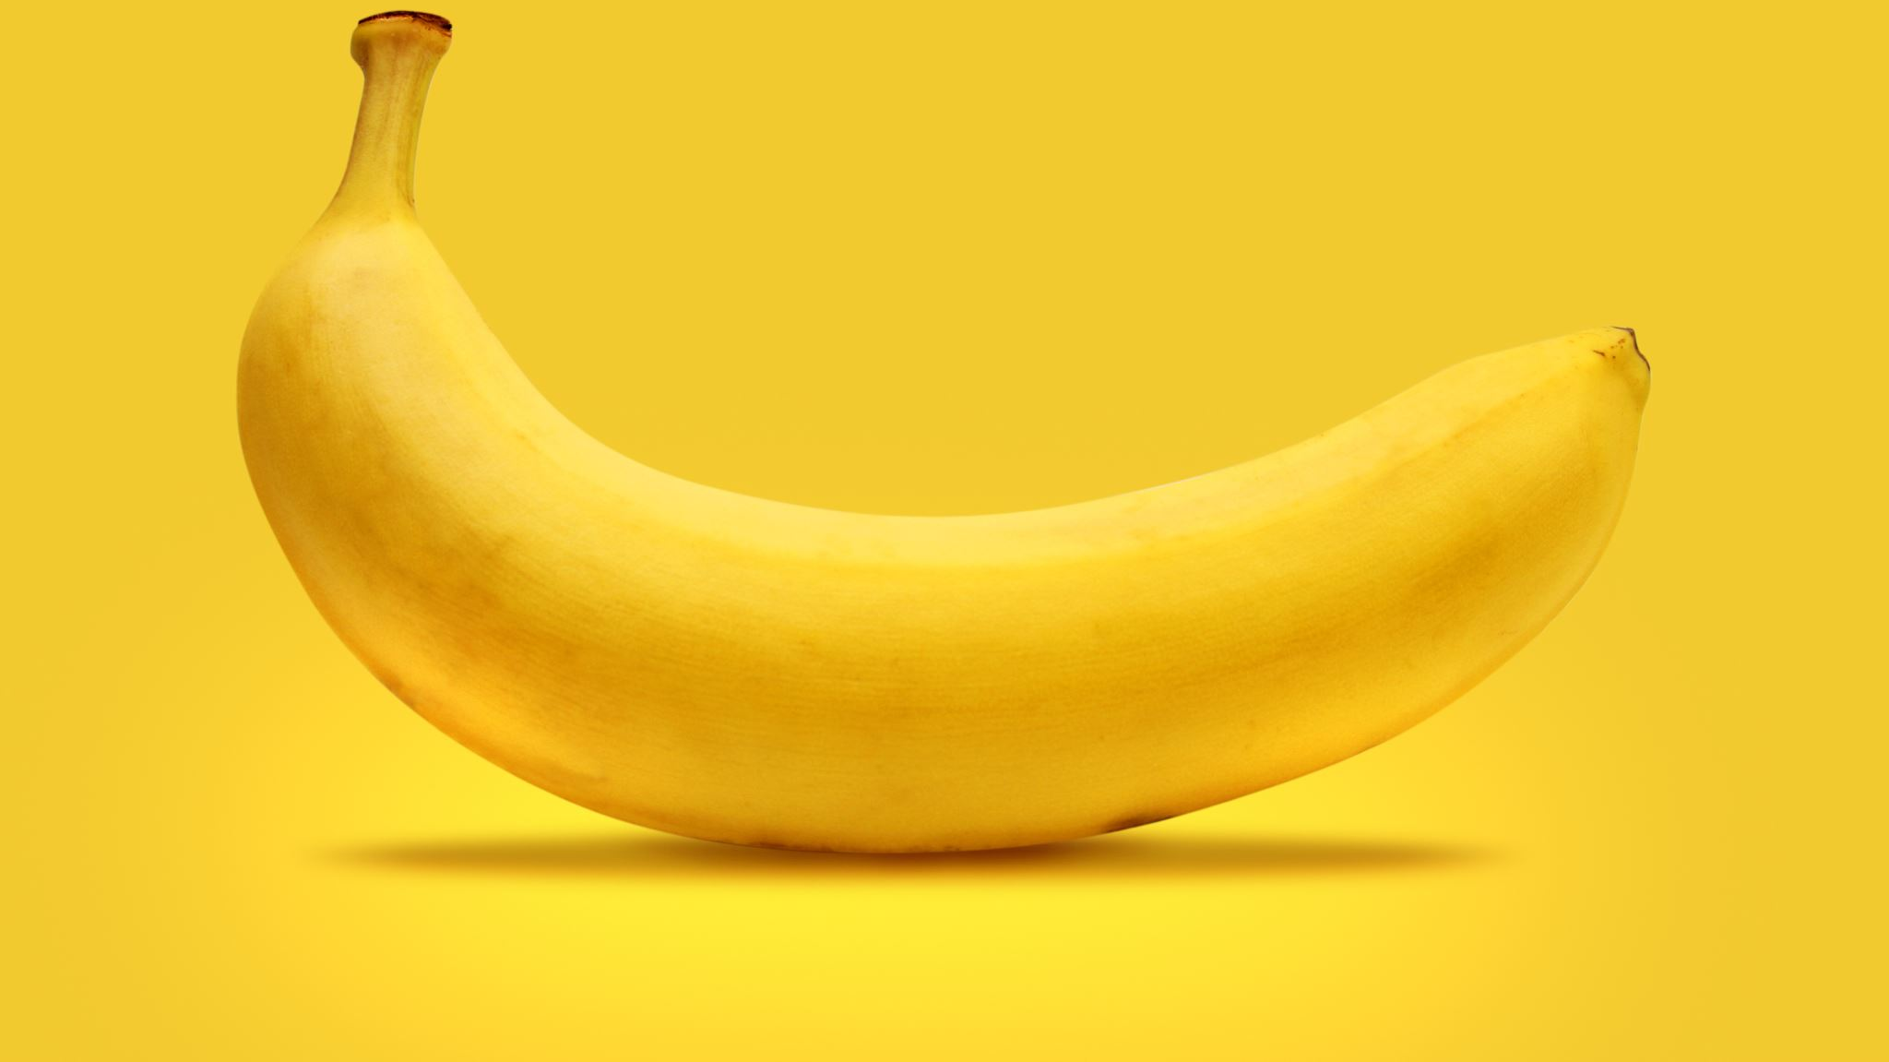
NANO BANANA INTEGRATION WITH N8N AGENT

Slide 2
What is Nano Banana?
Google's Nano Banana is an advanced AI image editing model introduced as part of the Gemini 2.5 Flash Image suite by Google DeepMind. Launched in August 2025.
Edit Images with Text: Modify photos by describing changes in natural language. For instance, you can prompt it to "turn this selfie into a cinematic studio portrait" or "add a soft shadow underneath the shoes."
Maintain Character Consistency: Ensure that subjects remain consistent across different poses, lighting, and environments, preserving their likeness in various edits.
Blend Multiple Images: Combine elements from different photos to create unique, unified compositions.
Real-World Reasoning: Apply real-world logic to edits, such as adjusting lighting or shadows to match the scene's context.

Slide 3
NANO BANANA REAL TIME USE CASE
1️⃣ Marketing & Advertising
Personalized Campaigns: Create custom visuals for target audiences quickly using text prompts. Example: A retail brand can generate seasonal product banners or ads automatically with different themes. Generate multiple variants of images to test which design performs better in ads. 2️⃣ E-commerce & Retail
Product Image Enhancement: Automatically clean, retouch, or stylize product photos for catalogs. Virtual Try-Ons: Generate realistic previews of apparel, accessories, or makeup on users using AI-generated images. 3️⃣ Media & Entertainment
Film & Animation Previews: Generate concept art or storyboards from simple prompts.
Video Thumbnails & Posters: Create multiple thumbnail options for movies, shows, or YouTube videos efficiently. 4️⃣ Social Media & Influencer Marketing
Content Generation: Create consistent, high-quality images for posts or campaigns.
Trendy Challenges & Campaigns: Tools like Nano Banana can automate image-based challenges, such as “Hug My Younger Self,” driving engagement. 5️⃣ Design & Creative Agencies
Rapid Prototyping: Quickly visualize ideas for clients without starting from scratch.
Consistency Across Campaigns: Maintain character or theme consistency across multiple campaigns and platforms. 6️⃣ Real-Time Industrial Applications
Fashion & Apparel: AI-generated designs for fabrics or new product concepts.
Automotive & Manufacturing: Simulate how products look under different conditions (lighting, angles, environments). Architecture & Interior Design: Generate realistic renderings of spaces based on text descriptions.
7️⃣ Benefits for Organizations
Faster Production: Reduces the time required for image creation.
Cost Savings: Minimizes the need for large design teams for routine visual tasks.
Innovation: Supports creative experimentation without physical constraints.
Scalability: Can generate hundreds of visuals in minutes for global campaigns.

Slide 4
Explore more about Nano Banana
https://aistudio.google.com/models/gemini-2-5-flash-image
People & Portraits
“A smiling boy wearing a red cap in a green park, photo style.”
“A cartoon picture of a girl reading a book under a tree on a sunny day.”
Animals & Pets
“A puppy wearing sunglasses on the beach, funny and cute.”
“A baby panda eating bamboo in a forest, realistic photo.”
Fantasy & Creative
“A big castle floating in the clouds with waterfalls, magical and colorful.”
“A flying car above a future city with glowing lights, sci-fi style.”
Nature & Travel
“A snow mountain with a small wooden house, peaceful and quiet.”
“The Eiffel Tower at night with fireworks in the sky.”
Posters with Text
“A bright poster with the words ‘Happy Birthday’, balloons and cake.”
“A festival poster with the words ‘Music Night 2025’, neon colors, party style.”

Slide 5
Prompts with Image
Upload your image -- Transform the characters in this picture into 1/7 scale collectible figurines, placed on a real desk with a computer, AI model setup, and toy packaging in the background. Make the figurines highly detailed and realistic, accurately capturing facial expressions, clothing, and accessories. Include realistic lighting, shadows, and reflections to integrate them naturally into the environment. Style the scene like a premium, commercial collectible photoshoot—vibrant, photorealistic, and cinematic—with subtle props such as notebooks, keyboard, and coffee cup. Make the composition visually striking and engaging enough to go viral on social media
Using the nano-banana model, create a 1/7 scale commercialized figurine of the characters in the picture, in a realistic style, in a real environment. The figurine is placed on a computer desk. The figurine has a round transparent acrylic base, with no text on the base. The content on the computer screen is the brush modeling process of this figurine.Next to the computer screen is a BANDAl-style toy packaging box printed with the original artwork., The packaging features two-dimensional flat illustrations. Please turn this photo into afigure.Behind it, there should be a Model packaging box with the character from this photo printed on it. In front of thebox.on a round plastic baseplace the fiqure version of thephoto I gave you. I'd like the PVC material to be clearlyrepresented. It would be even better if the background is indoors.
Upload 2 image ( image & black jacket) -- write this prompt -- Blend the two images so that I am wearing the jackets, making it look like I am actually wearing them. Match colors, lighting, shadows, and textures to make the result photorealistic and cinematic. Remove any glasses or specs, and ensure facial features are natural and seamlessly integrated with the jackets. Make the image look like a high-quality fashion photograph with realistic depth and reflections

Slide 6
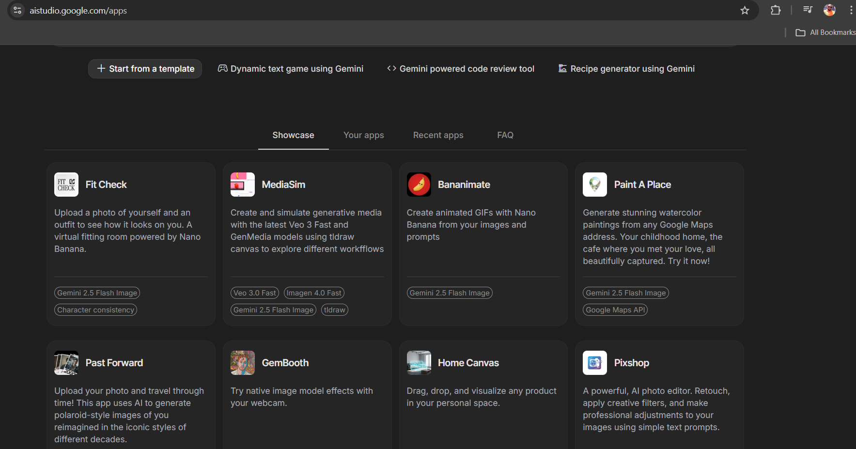
Nano Banana using Google AI Studio

Slide 7
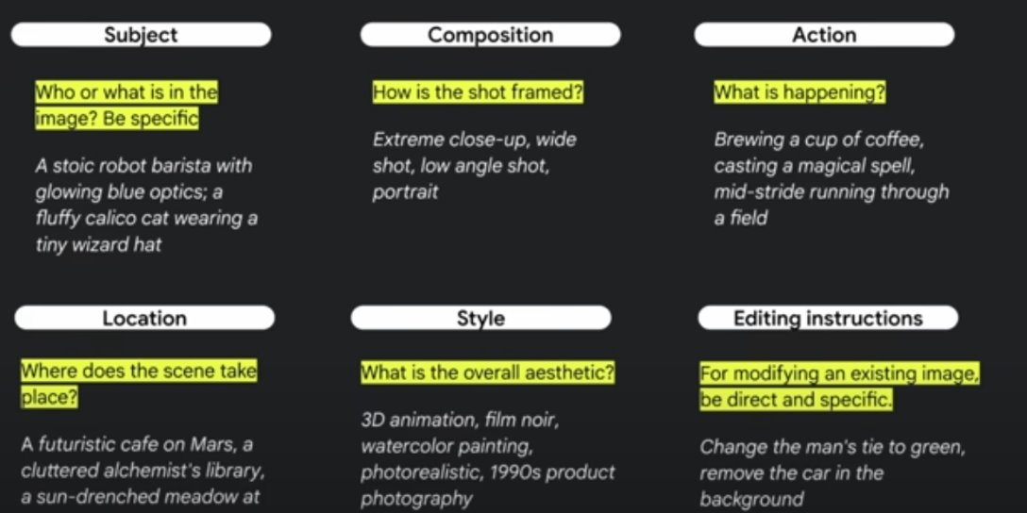

Slide 8
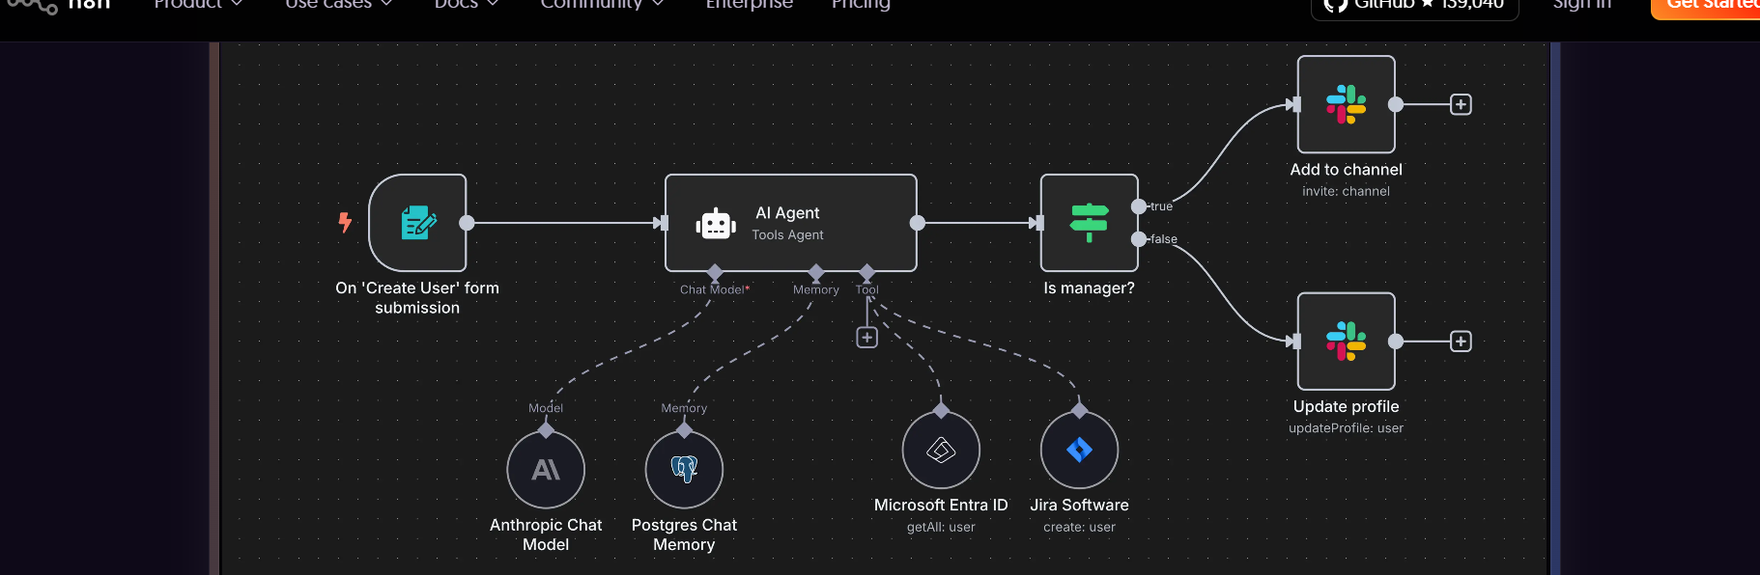

About N8N
N8N is a workflow automation platform that uniquely combines AI capabilities with business process automation, giving technical teams the flexibility of code with the speed of no-code.

