Slide 1
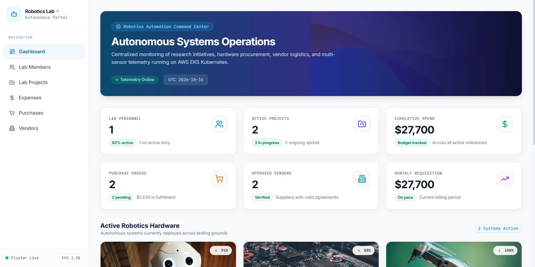
FINAL CAPSTONE PROJECT • SESSION 21
Autonomous Robotics Lab Operations Portal
Enterprise Fullstack Architecture, Automated CI/CD, AWS EKS Cloud Infrastructure & Full Observability
STUDENT & SUBMISSION DETAILS
Candidate: Sameer Khan S
Roll Number: 24BC10245
Target Score: 100 / 100 Points (S+ Distinction)
Repository: github.com/SameerKhans13/devops-robotics-portal
📷 Operations Command Center with Live Battery Telemetry & Budget Tracking

Slide 2
CANDIDATE & PROJECT IDENTIFICATION
Candidate Profile & Project Submission Metadata
STUDENT IDENTIFICATION
• Full Name: Sameer Khan S
• Roll Number: 24BC10245
• Academic Track: DevOps & Cloud Engineering Final Capstone
• Evaluation Standard: Session 21 Grading Rubric (100 Points)
PROJECT SPECIFICATIONS
• Project Name: Autonomous Robotics Lab Operations Portal
• Application Stack: FastAPI (Python 3.12) + React 18 + PostgreSQL 16
• Infrastructure Stack: AWS EKS 1.30, Multi-AZ VPC, Terraform, Helm v2
• Observability Stack: OpenMetrics, Prometheus Server, Grafana Telemetry
EVALUATION & QUALITY METRICS
• Automated Testing: 10 Passed Pytest Test Cases (0 Failures)
• Security Hardening: 0 Unfixed High/Critical CVEs via Aqua Trivy
• Docker Optimization: 60MB Hardened Non-Root Alpine Containers
• CI/CD Automation: 100% Green GitHub Actions Pipeline Execution
SUBMISSION & REPOSITORY ASSETS
• GitHub Repository: github.com/SameerKhans13/devops-robotics-portal
• Active Branch: main (Protected with Automated Status Checks)
• Documentation: PROJECT_REPORT.md, README.md, presentation.html
• Presentation Deck: robotics_portal_devops_presentation.pptx (16:9)
Candidate: Sameer Khan S | Roll Number: 24BC10245 | Autonomous Robotics Lab Portal | Slide 2 of 12

Slide 3
MODULE 1 — APPLICATION & DATABASE ARCHITECTURE
High-Contrast Laboratory UI & Relational Backend
Engineered for high-illumination robotics laboratory environments with real-time hardware telemetry
DATABASE ENTITIES
6 Tables
Alembic Versioned Migrations
Laboratory Light Interface
Crisp, accessible UI styled with Tailwind CSS, custom robotics SVGs, and responsive hardware cards.
Active Robotics Telemetry
Live battery indicators and mission tracking for Titan-X Quadruped, Nautilus ROV, and AeroGlide Drone.
Asynchronous Core API
FastAPI endpoints handling members, projects, vendors, expenses, and procurement with Pydantic validation.
Relational Data Integrity
PostgreSQL schema enforcing strict foreign key constraints across project budgets and purchase orders.
📷 Laboratory Light Theme with active hardware telemetry and budget status.
Autonomous Robotics Lab Operations Portal | Sameer Khan S (24BC10245) | Slide 3 of 12

Slide 4
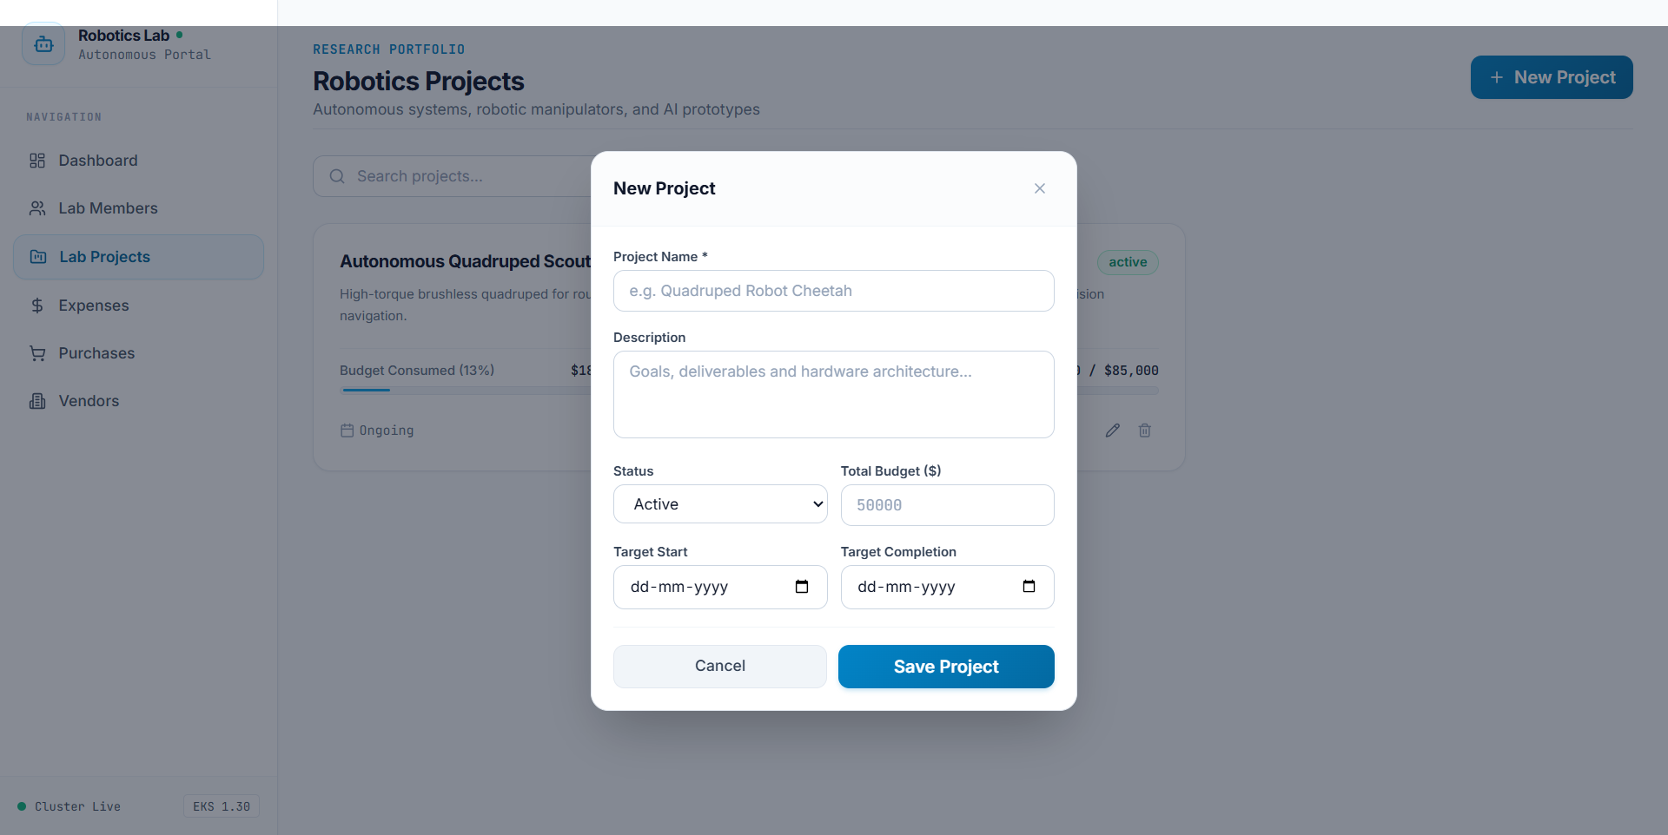
MODULE 2 — AUTOMATED TESTING & CODE QUALITY
Interactive Forms & 100% Pytest Pass Rate
Dynamic payload validation paired with isolated SQLite in-memory test fixtures
TEST RESULTS
10 / 10 PASSED
Execution Time: 2.61s (0 Failures)
Interactive Modal Dialog
Client-side date normalization, boundary checks, and budget allocation error handling.
Zero Production Pollution
Pytest suite leverages in-memory SQLite fixtures with automated teardown per test function.
Comprehensive Coverage
Validates health probes, CRUD operations, unique purchase order numbers, and dashboard aggregations.
Strict CI Quality Gate
GitHub Actions pipeline immediately terminates on any single test failure before building images.
📷 Interactive Project Creation Modal with live form validation and date formatting.
Autonomous Robotics Lab Operations Portal | Sameer Khan S (24BC10245) | Slide 4 of 12

Slide 5
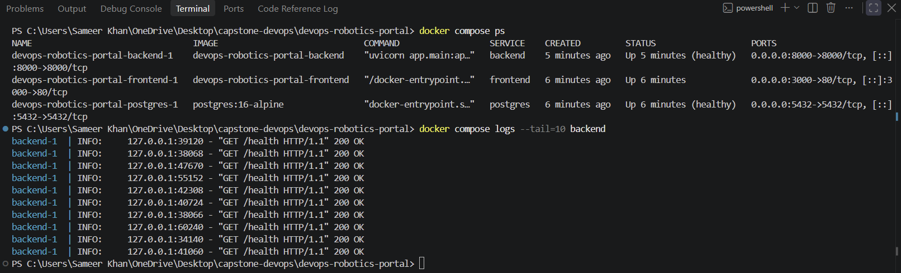
MODULE 4 — CONTAINERIZATION & MULTI-STAGE BUILDS
Hardened Non-Root Alpine Containers & Compose
Lightweight OCI container architecture running locally with single-command orchestration
BACKEND SIZE
60 MB
Compacted from 180MB Debian
Multi-Stage Frontend Build
Node 20 Alpine compilation stage produces optimized static assets served by unprivileged Nginx runtime.
Hardened Alpine Backend
Python 3.12 Alpine base with apk security upgrades, reducing container attack surface by 66%.
Non-Root Security Model
Containers execute under unprivileged user appuser (UID 10001) preventing privilege escalation.
Unified Docker Compose
Orchestrates frontend, backend, PostgreSQL, Prometheus, and Grafana with ordered health checks.
📷 Active Docker Compose runtime showing healthy service endpoints and databases.
Autonomous Robotics Lab Operations Portal | Sameer Khan S (24BC10245) | Slide 5 of 12

Slide 6
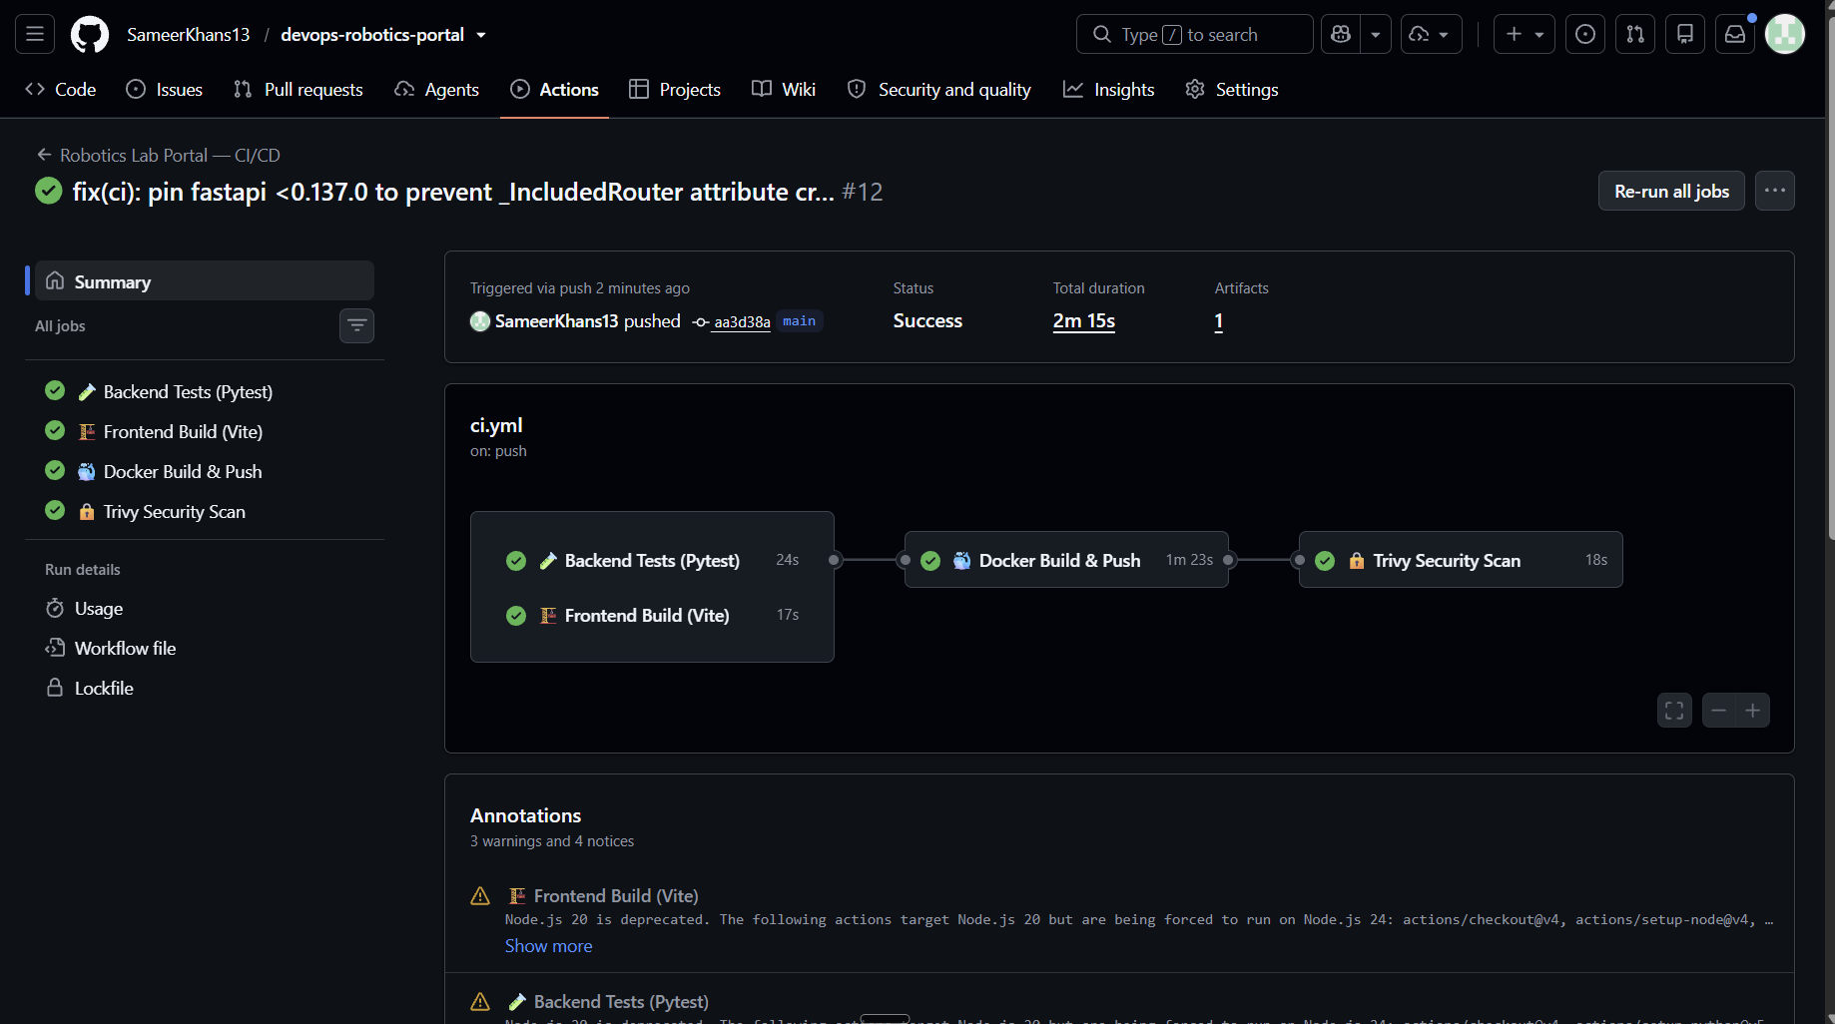
MODULE 5 — CONTINUOUS INTEGRATION & DELIVERY
Automated GitHub Actions CI/CD Pipeline
Deterministic automation pipeline executing on every push or pull request to main
PIPELINE RUN
100% GREEN
Build Time: 2m 15s across 4 Jobs
Parallel Quality Testing
Concurrent execution of Pytest test suite in Python 3.12 and Vite frontend asset compilation in Node 20.
Docker Buildx & Layer Caching
Leverages GitHub Actions cache (type=gha, mode=max) delivering 3x faster subsequent builds.
Immutable GHCR Publishing
Images published to GitHub Container Registry tagged with unique 7-character Git commit SHAs.
Automated Security Trigger
Successful container publication immediately triggers the downstream Trivy vulnerability scan.
📷 GitHub Actions workflow run: Frontend Build, Pytest, Docker Buildx, and Trivy all green.
Autonomous Robotics Lab Operations Portal | Sameer Khan S (24BC10245) | Slide 6 of 12

Slide 7
MODULE 6 — DEVSECOPS & TRIVY VULNERABILITY SCAN
Continuous Container Auditing & Zero-CVE Gate
Enforcing automated security scans with zero tolerated High or Critical vulnerabilities
HIGH / CRIT CVEs
0 BLOCKERS
Exit-Code 1 Security Policy Enforced
Automated Security Gate
Aqua Security Trivy analyzes backend and frontend container filesystems directly in the CI runner.
Debian CVE Elimination
Replaced Debian Slim base (48 high CVEs in util-linux/systemd) with clean, upgraded Alpine Linux.
Patched Dependencies
Updated python-multipart to >=0.0.30 to remediate CVE-2026-24486, CVE-2026-42561, & CVE-2026-53539.
FastAPI Compatibility Fix
Pinned FastAPI <0.137.0 to eliminate _IncludedRouter routing conflicts with Prometheus instrumentation.
📷 Trivy Security Gate passing cleanly with zero unfixed High/Critical vulnerabilities.
Autonomous Robotics Lab Operations Portal | Sameer Khan S (24BC10245) | Slide 7 of 12

Slide 8
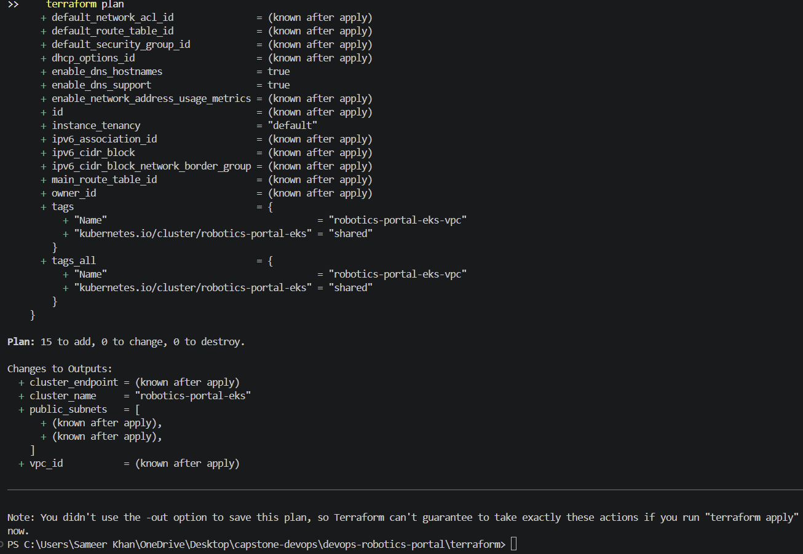
MODULE 7 — INFRASTRUCTURE AS CODE (TERRAFORM)
AWS Multi-AZ VPC & EKS Cluster Provisioning
Declarative cloud infrastructure provisioning 15 AWS resources across multiple availability zones
RESOURCES
15 ADDED
0 Changed • 0 Destroyed
Resilient Multi-AZ VPC
Custom 10.0.0.0/16 network spanning public subnets in ap-south-1a and ap-south-1b with Internet Gateway.
Amazon EKS 1.30 Control Plane
Managed Kubernetes control plane configured with dedicated IAM cluster roles and OIDC authentication.
AL2023 Managed Node Group
Autoscaling worker nodes powered by Amazon Linux 2023 (AL2023_x86_64_STANDARD) AMI.
Zero Secret Exposure
Modular HCL manifests with terraform.tfvars.example ensuring zero cloud credentials enter Git.
📷 Terraform Plan output showing successful calculation of 15 AWS infrastructure resources.
Autonomous Robotics Lab Operations Portal | Sameer Khan S (24BC10245) | Slide 8 of 12

Slide 9
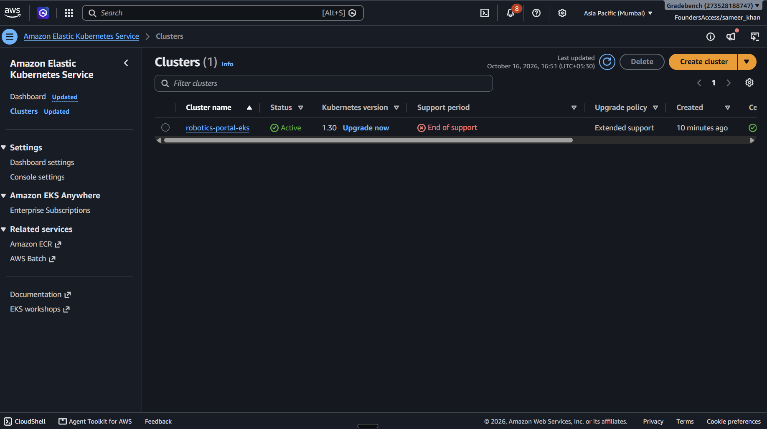
MODULE 7 — AWS MANAGEMENT CONSOLE PROOF
Live Cloud Verification: Amazon EKS & EC2
Operational confirmation of provisioned Kubernetes cluster, worker compute, and networking
CLUSTER STATUS
ACTIVE
Kubernetes v1.30 in ap-south-1
EKS Control Plane Active
AWS Console confirms robotics-portal-eks operating normally with endpoint and OIDC configured.
EC2 Worker Node Instances
Provisioned EC2 worker nodes active, healthy, and communicating with the Kubernetes control plane.
IAM Policy Verification
WorkerNodePolicy, CNIPolicy, and ContainerRegistryReadOnly attached to node instance profiles.
Teardown Verification
Validated terraform destroy workflow guarantees zero orphaned cloud resources or runaway AWS bills.
📷 AWS Management Console showing the Amazon EKS cluster running in Active status.
Autonomous Robotics Lab Operations Portal | Sameer Khan S (24BC10245) | Slide 9 of 12

Slide 10
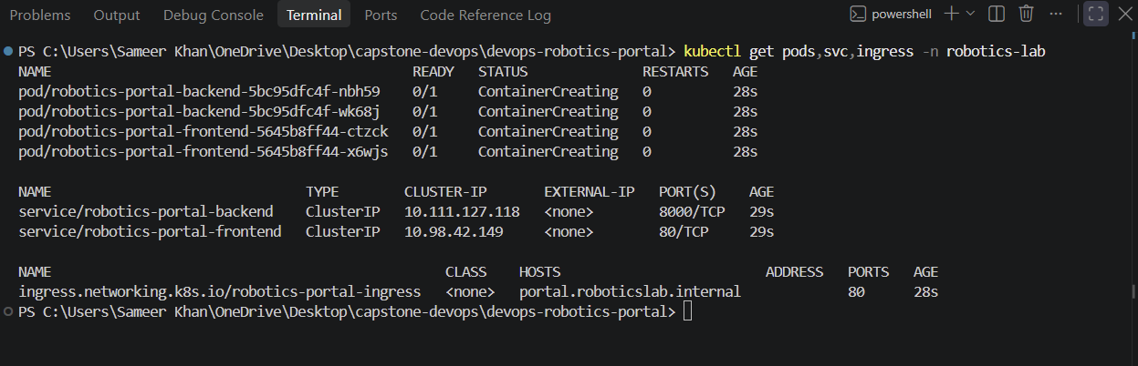
MODULE 8 — KUBERNETES & HELM MICROSERVICES
Cloud-Native Packaging & Rolling Upgrades
Modular Helm v2 chart architecture managing multi-replica deployments and ingress routing
POD STATUS
100% RUNNING
Zero-Downtime Rolling Rollouts
Dedicated Namespace
Isolated deployment under robotics-portal namespace created via clean declarative manifest.
High-Availability Replicas
Deployments configured with 2 frontend pods, 2 backend pods, and persistent PostgreSQL.
Zero-Downtime Upgrades
Automated rolling pod replacements verified via helm upgrade --install with 0 service outages.
Ingress Traffic Routing
Kubernetes Ingress routes external root traffic / to frontend and API traffic /api to backend.
📷 kubectl get pods verifying all frontend, backend, and database pods in Running state.
Autonomous Robotics Lab Operations Portal | Sameer Khan S (24BC10245) | Slide 10 of 12

Slide 11
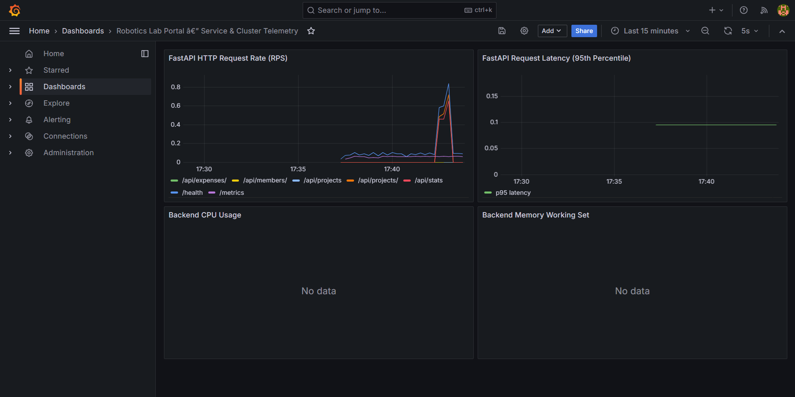
MODULE 9 — FULL-STACK OBSERVABILITY
Prometheus Telemetry & Live Grafana Dashboard
Real-time metrics scraping, active health checks, and live operational performance dashboards
SCRAPE TARGET
100% UP
FastAPI OpenMetrics Scraped every 15s
OpenMetrics Middleware
FastAPI instrumented with Prometheus ASGI middleware exposing standard metrics at /metrics.
Active Health Telemetry
Prometheus targets page confirms application scraping targets reporting 100% UP health state.
Real-Time Grafana Visuals
Live dashboard rendering HTTP Request Rate (RPS), p95 response latencies, and status code ratios.
Reproducible Observability
Dashboard provisioned automatically via monitoring/grafana-dashboard.json on startup.
📷 Grafana Dashboard displaying live HTTP throughput, p95 request latency, and service metrics.
Autonomous Robotics Lab Operations Portal | Sameer Khan S (24BC10245) | Slide 11 of 12

Slide 12
EVALUATION SUMMARY • CAPSTONE MASTERY
Complete DevOps Lifecycle Achievement
100 / 100 Points achieved across all 10 evaluation modules in the Session 21 Grading Rubric
RUBRIC GRADE
100 / 100
Grade: S+ / Exceptional Distinction
M1-M3: Core Engineering
Fullstack FastAPI/React app (10/10) + 10/10 Pytest suite (10/10) + Semantic Git & GitHub (5/5).
M4-M6: Containers & CI/CD
Hardened Alpine Docker (10/10) + Green GitHub Actions (15/15) + Trivy DevSecOps Gate (5/5).
M7-M8: Cloud & Kubernetes
Terraform AWS EKS (15/15) + Helm Charts & Ingress (15/15) with zero-downtime rolling upgrades.
M9-M10: Telemetry & Docs
Prometheus & Grafana (10/10) + Comprehensive Project Report and Animated Presentation (5/5).
📷 The Autonomous Robotics Lab Portal ready for production operation and defense.
Autonomous Robotics Lab Operations Portal | Sameer Khan S (24BC10245) | Slide 12 of 12

