Slide 1

Emertxe Information Technologies (P) Ltd
IOT based Home Automation Solution
Project Guide: JAYALAXMI N. DHANYAL
Presented by: SAMEER RABINDRA PANDA
4th year B.E. in Electronics and Computer Science, Pillai HOC College Of Engineering And Technology

Slide 2
TOPICS LEARNT DURING INTERNSHIP
C Programming
Keywords
Basic data types --- int, char, float, double, void Operators
Conditional constructs and Looping concepts Arrays
Pointers Functions --- Built-in and User defined functions
Storage Classes Pre-processor directives and header files

Slide 3
TOPICS LEARNT DURING INTERNSHIP
C++ Programming
OOP concepts
Introduction to IoT Definition of IoT IoT Architecture
Introduction to Embedded systems Definition Types of Embedded systems Components of Embedded systems
Peripherals LED
Arduino Uno
CLCD -- 14 pins description of CLCD
ADC --- Use of ADC in Arduino

Slide 4
Peripherals required for the Project
LDR Sensor
To read the sensor values and based on the reading vary the brightness of LED(Garden lights).
Temperature System
It consists of heater, cooler, LM35 (temperature sensor). We can read the temperature from the temperature sensor
Serial Tank
We can read the volume of the water in the tank through serial communication

Slide 5
WHAT IS IOT?
The Internet of Things (IoT) is the network of physical objects that contain embedded technology to communicate and sense or interact with their internal states or the external environment.
These devices range from ordinary household objects to sophisticated industrial tools. With more than 7 billion connected loT devices today, experts are expecting this number to grow to 22 billion by 2025.
By means of low-cost computing, the cloud, big data, analytics, and mobile technologies, physical things can share and collect data with minimal human intervention. In this hyper connected world, digital systems can record, monitor, and adjust each interaction between connected things. The physical world meets the digital world-and they cooperate.

Slide 6
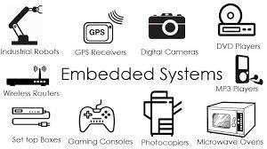
WHAT IS EMBEDDED SYSTEM?
Any combination of hardware and software which is intended to do a specific task can be called an Embedded System
It has 3 parts; software, firmware and hardware.
Unlike computers, embedded systems perform few specific limited tasks.
Embedded Devices have peripherals such as Serial Communication Interfaces (SCI), Synchronous Serial Communication Interface, Universal Serial Bus (USB), Multi Media Cards (SD cards, Compact Flash) etc.

Slide 7
PROJECT REQUIREMENTS
Control garden lights on basis of sunlight intensity: Lesser the sunlight brighter the garden lights
Temperature system control: Switch heater and cooler ON or OFF remotely. Switch heater OFF automatically if temperature indoors exceeds 35' C.
Water tank control: Switch inlet and outlet valve ON or OFF remotely. Switch inlet valve OFF automatically if the tank fills up. Switch inlet valve ON automatically if volume of tank drops below 2000L

Slide 8
REQUIREMENTS
HARDWARE REQUIREMENTS
:
ARDUINO UNO
ETH-W5500
PCF-8574
SOFTWARE REQUIREMENTS
ARDUINO IDE : To code PICSIMLAB: For simulation
NULL MODEM EMULATOR : To configure ports of serial remote tank
Blynk IOT app : Cloud server
TEMPERATURE SENSOR •
LCD HD44780
LDR SENSOR
LED

Slide 9
ARDUINO UNO
Arduino UNO is based on an ATmega328P microcontroller.
It is easy to use compared to other boards, such as the Arduino Mega board, etc. The board consists of digital and analog Input / Output pins (I/O), shields, and other circuits.
The Arduino UNO includes 6 analog pin inputs, 14 digital pins , a USB connector, a power jack, and an ICSP (In-Circuit Serial Programming) header.
It is programmed based on IDE, which stands for Integrated Development Environment. It can run on both online and offline platforms

Slide 10
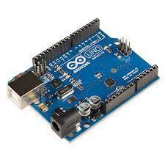

Slide 11
ETH W5500
The W5500 chip is a Hardwired TCP/IP embedded Ethernet controller that provides easier Internet connection to embedded system.
W5500 enables users to have the Internet connectivity in their applications just by using the single chip in which TCP/IP stack, 10/100 Ethernet MAC and PHY embedded.
Supports Power down mode.
Supports Wake on LAN over UDP . Supports High Speed Serial Peripheral Interface(SPI MODE 0,3).

Slide 12
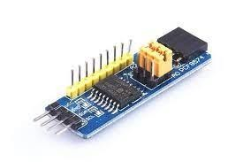
PCF 8574
The PCF8574 is a silicon CMOS circuit
It provides general purpose remote I/O expansion for most
microcontroller families via the two-line bidirectional bus (12C).
The device consists of an 8-bit quasi-bidirectional port and an I2C-bus interface.

Slide 13
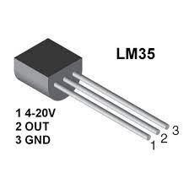
TEMPERATURE SENSOR
A Temperature sensor is an electronic device that measure the temperature of its environment and converts the input data into electronic data to record, monitor, or signal Temperature changes.

Slide 14
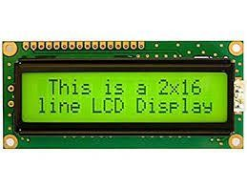
LCD
LCD HD44780 is dot-matrix liquid crystal display controller and
driver LSI displays alphanumeric and symbols .
It can be configured to drive a dot-matrix liquid crystal display under the control of a 4 or 8-bit microprocessor.

Slide 15
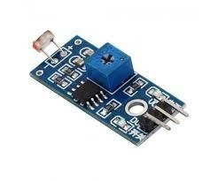
LDR SENSOR
An LDR is a component that has a (variable) resistance that changes with the light intensity that falls upon it. This allows them to be used in light sensing circuits .
The resistance of a Photo resistor decreases with increasing incident light intensity. In other words, it exhibits photoconductivity.

Slide 16
Abstract:
Home Automation using Arduino (picsimlab)and Blynk application.
Controlling Garden Lights based on whether it is a Day or Night.
Controlling fans and heater based on whether it is a Hot or Cold and also sending respective notifications to LCD and application.
Controlling water level of the tank based on its capacity and also sending respective notifications to LCD and application.

Slide 17
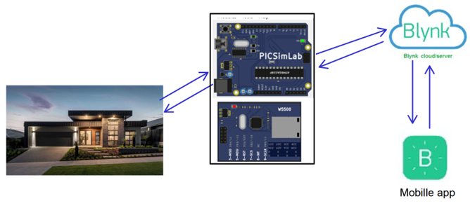
Functional Requirements

Slide 18
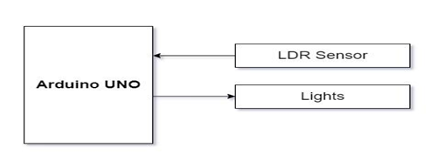
Garden lights control
Description :
Read the LDR sensor value, based on the reading from LDR, vary the brightness of the LED, which resembles controlling garden lights based on the availability of sunlight.

Slide 19
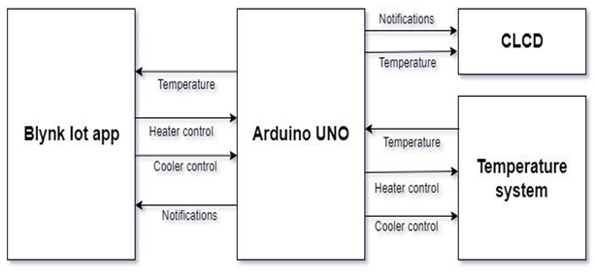
Temperature Control System
Description :
The temperature control system consists of a heating resistor, an LM35 temperature sensor, and a cooler. Which resembles the temperature control system at home. Read the temperature from the temperature sensor LM35 and display it on the CLCD. Control the temperature of the system by turning ON/OFF the heater and cooler through the Blynk IOT mobile app .

Slide 20
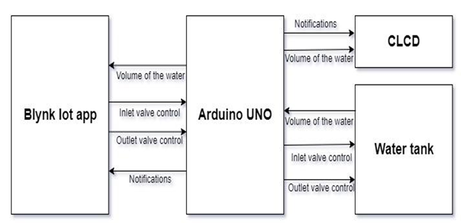
Water tank inlet and outlet valve control
Description :
Read the volume of the water in the tank through Serial Communication and display it on the CLCD, control the volume of the water in the tank by controlling the inlet and outlet valve, by sending commands through serial communication. Display the volume of water in the tank on the CLCD.

Slide 21
User Interfaces
BLYNK Application
Blynk was designed for the Internet of Things. It can control hardware remotely, it can display sensor data, it can store data, visualize it and do many other cool things.
Widgets on Mobile blynk application:
Button widgets to control heater, cooler, inlet valve , outlet valve.
Gauge widgets to display temperature or volume of the water in the tank on the mobile application

Slide 22
Threshold control
When the heater is ON if the temperature rises above 35 degree celsius then heater should turn OFF automatically and message “Temperature is more than 35 degree celsius Turning OFF the heater” should be displayed on the virtual terminal, “HT_R OFF” on CLCD.
When the water in the tank is full, turn off the inlet valve automatically and display “water level is full water inflow disabled”.

Slide 23
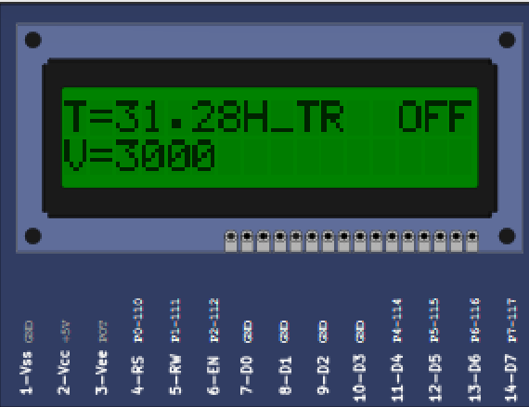
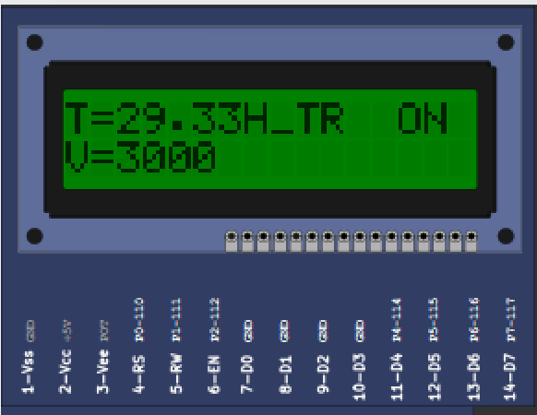
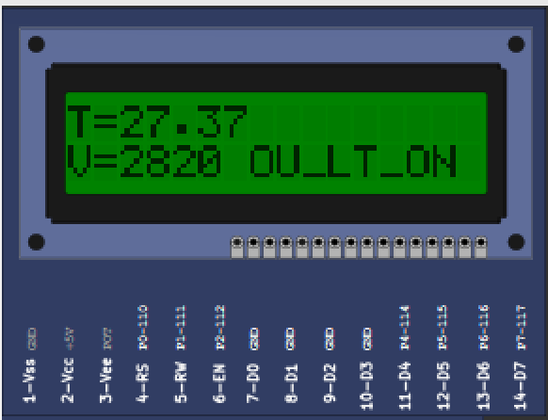
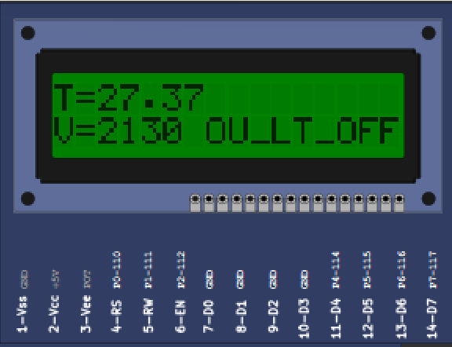
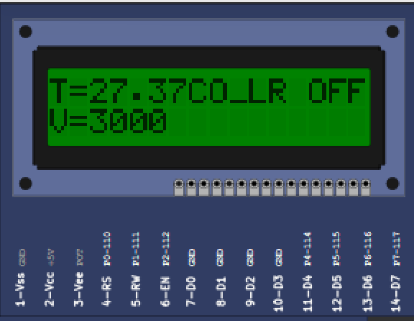
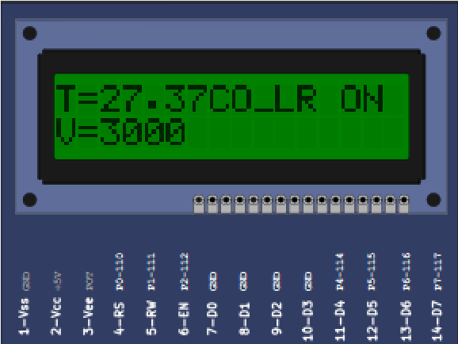
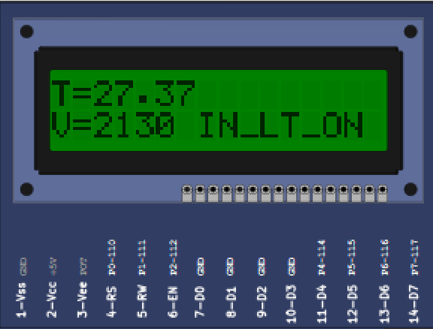
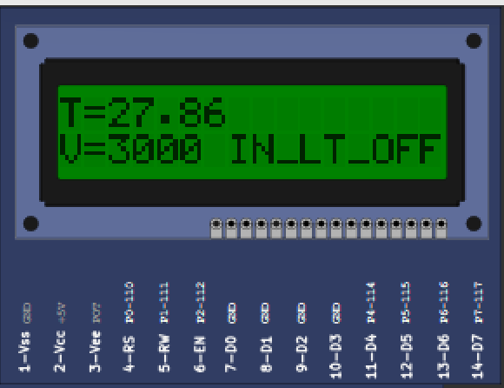
Notifications:

Slide 24
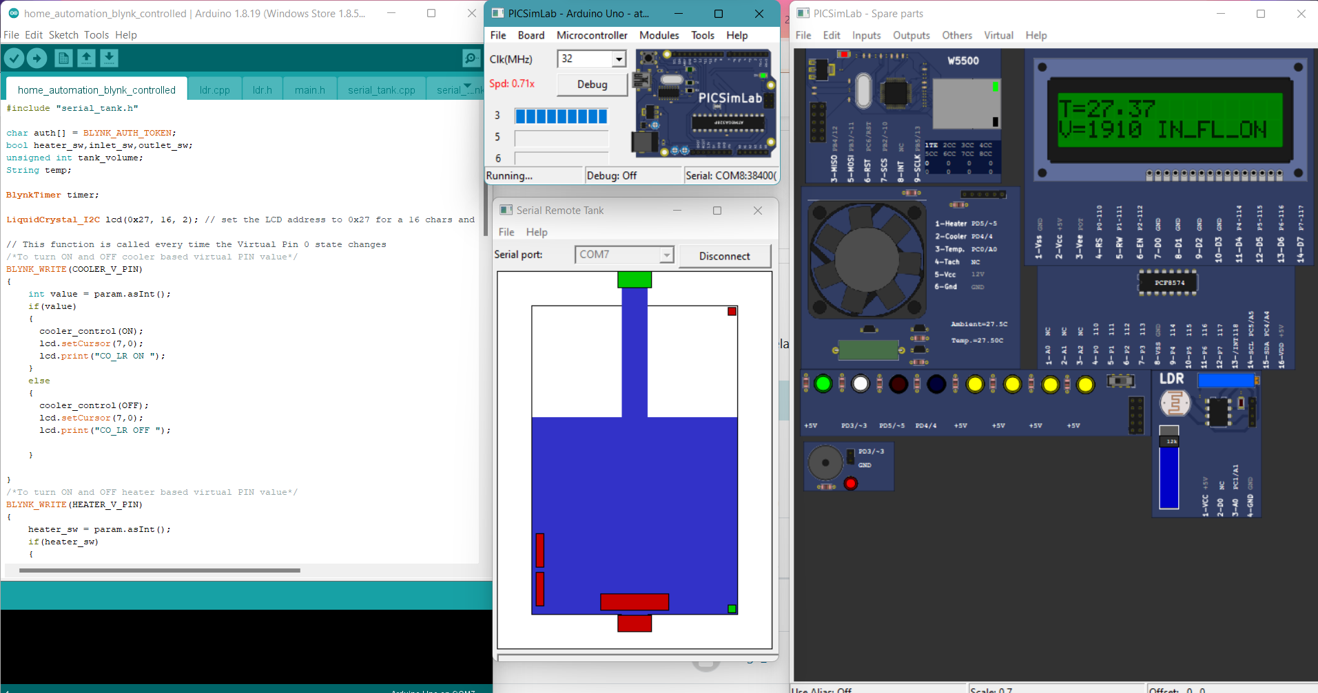
Project images:

Slide 25
Conclusion
Using BLYNK Iot application and Picsimlab simulator, simulated home automation, where LED, temperature system, Serial tank - resembles Light, Heater, Cooler and Water tank in real time.
CLCD acts like a dash board used for displaying the events, Widgets from Blynk Iot app like button widgets are used to control heater, cooler and inlet valve, outlet valve.
Gauge widgets to display the temperature and volume of the water.

