Slide 1

Fraudulent Website Detection using Machine Learning Techniques
Team Members:
Mohan Nallapu, 2147289
Harsha Bollina, 2149598
Silvister Reddy, 2148356
Sameer Khan, 2146936

Slide 2
Contents
Introduction and Background
Objective
Approach
Dataset
Feature selection
Machine learning Models
Future scope

Slide 3
Introduction & Background
Phishing is the commonly used social engineering and cyber attack.
Through such attacks, the phisher targets naïve online users by tricking them into revealing confidential information, with the purpose of using it fraudulently.
In order to avoid getting phished,
1. Users should have awareness of phishing websites.
2. Have a blacklist of websites which requires knowledge of website being detected as phishing.
3. Detect them in early appearance, using machine learning and deep neural network algorithms.
In this project, We are using machine learning based method which is proven to be most effective than the other methods to detect phishing attacks on websites.

Slide 4
Objective
The objective of this project is to train machine learning models and deep neural nets on the dataset created to predict phishing websites.
Both phishing and benign URLs of websites are gathered to form a dataset and from them required URL and website content-based features are extracted.

Slide 5
Approach
Importing dataset which is in the form of csv file using python libraries.
Analyze and perform pre-processing on the dataset by using Exploratory Data Analysis techniques and also knowing about the features present in the dataset.
Divide the dataset into training and testing tests.
Run selected machine learning and deep neural network algorithms like Decision Tree, SVM, Random Forest, Autoencoder on the dataset.
Write a code for displaying the evaluation result considering accuracy metrics.
Compare the obtained results for trained models and specify which is better.

Slide 6
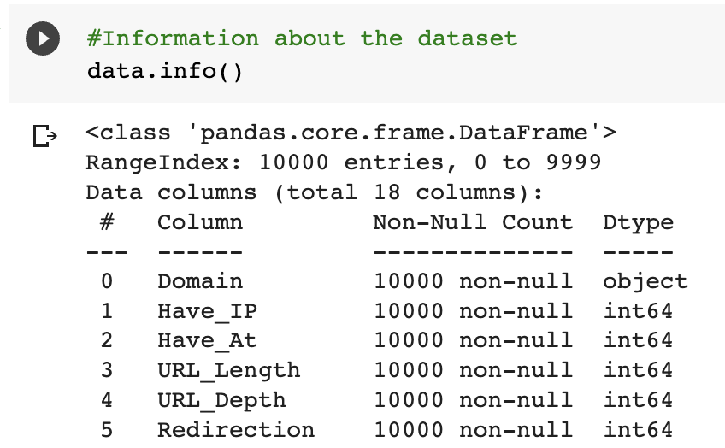
Dataset (5.urldata.csv)
This dataset contains 1000 rows and 18 columns (as extracted features on which we will apply our machine learning algorithms).
The following 17 features as shown below in the snippet are being used to classify our dataset.
Sample Data:

Slide 7
Features Selection
All together 17 features are extracted from the dataset:
Address Bar based Features, Domain based Features, HTML & JavaScript based Features.
Address Bar based Features considered are:
1. Domain of URL 2. IP Address in URL. 3. ‘@’ Symbol in URL
4. Length of URL 5. Depth of URL 6. ‘http/https’ in Domain name.
Domain based Features considered are:
1. DNS Record 2. Age of Domain
3. Website Traffic 4. End Period of Domain
Cont.…

Slide 8
Features Selection
HTML and JavaScript based Features considered are:
1. Iframe Redirection
2. Disabling Right Click
3. Status Bar Customization
4. Website Forwarding

Slide 9
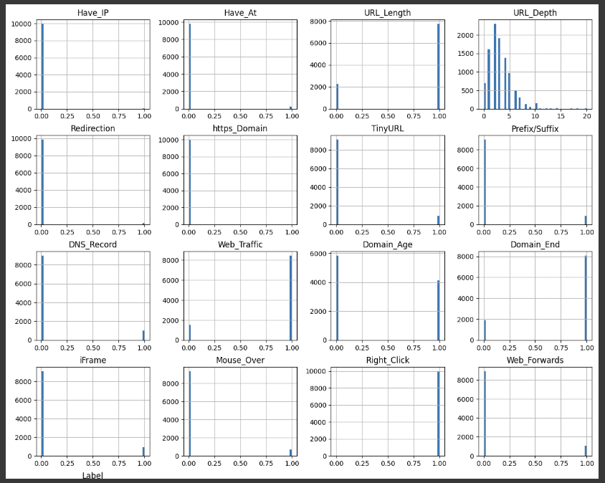
Features Distribution

Slide 10
Machine Learning Models
This is a supervised machine learning task.
There are two major types of supervised machine learning problems, called classification and regression.
This data set comes under classification problem, as the input URL is classified as phishing (1) or legitimate (0).
The machine learning models (classification) considered to train the dataset in this notebook are:
1. Decision Tree 2. Random Forest 3. Multilayer Perceptron 4. XGBoost 5. Autoencoder Neural Network

Slide 11
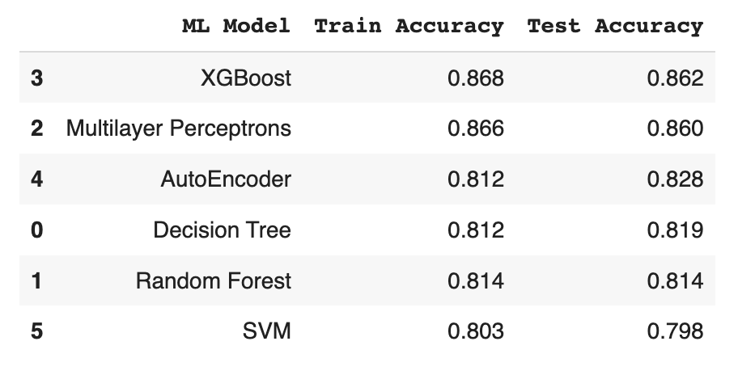
Model Evaluation
These models are evaluated and considered metric as accuracy.
Below Figure shows the training and test dataset accuracy by the respective models:
From the above, it is clear that XGBoost model gives better performance. The model is saved for further usage.

Slide 12
Conclusion & Future Scope
• Working on this project is very knowledgeable and worth the effort.
• Through this project, one can know a lot about the phishing websites and how they are differentiated from legitimate ones.
This project can be taken further by creating a browser extensions of developing a GUI.
These should classify the inputted URL to legitimate or phishing with the use of the saved model.

Slide 13
Thank You !.....

