Slide 1

QUEUE

Slide 2


Slide 3

WHAT IS QUEUE?
-A Queue is defined as a linear data structure that is open at both ends and the operations are performed in First In First Out (FIFO) order.
WHY IS QUEUE IMPORTANT?
- Managing requests on a single shared resource such as CPU scheduling and disk scheduling. Handling hardware or real-time systems interrupts. Handling website traffic. Routers and switches in networking.

Slide 4
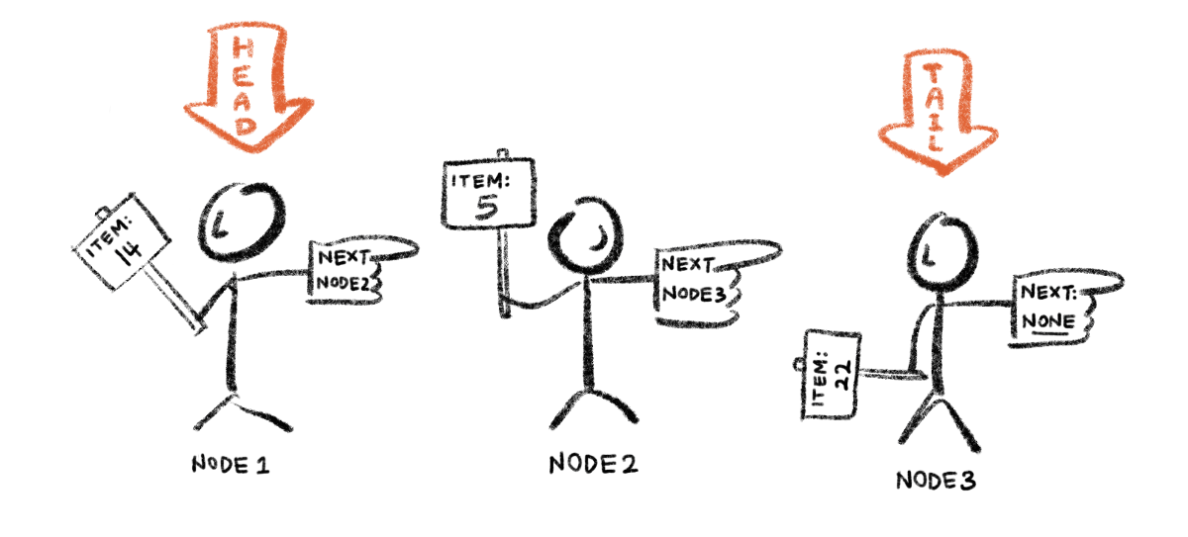
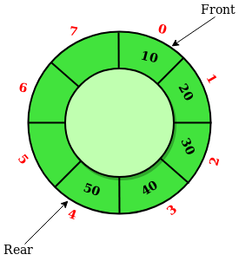
TYPES OF QUEUE:
Simple Queue or Linear Queue
Circular Queue
Priority Queue
Double Ended Queue (or Deque)
Simple Queue
-A simple queue is the most basic queue. In this queue, the enqueue operation takes place at the rear, while the dequeue operation takes place at the front: Its applications are process scheduling, disk scheduling, memory management, IO buffer, pipes, call center phone systems, and interrupt handling.
Circular Queue
-There was one limitation in the array implementation of Queue. If the rear reaches to the end position of the Queue then there might be possibility that some vacant spaces are left in the beginning which cannot be utilized. So, to overcome such limitations, the concept of the circular queue was introduced.

Slide 5
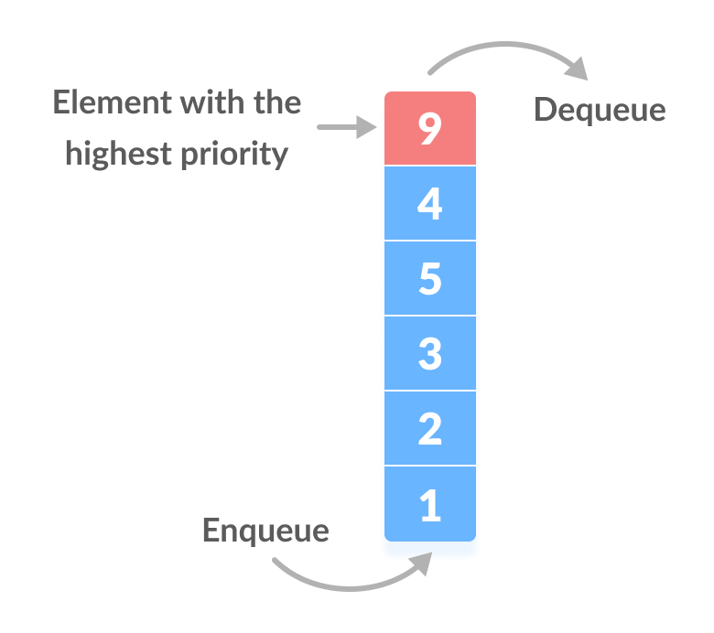
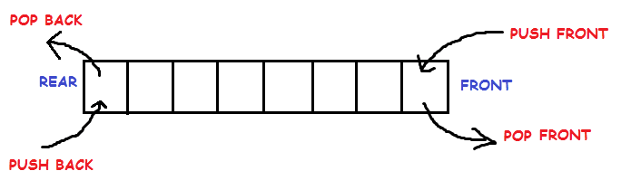
Priority Queue
-A priority queue is a type of queue that arranges elements based on their priority values. Elements with higher priority values are typically retrieved before elements with lower priority values.
In a priority queue, each element has a priority value associated with it. When you add an element to the queue, it is inserted in a position based on its priority value. For example, if you add an element with a high priority value to a priority queue, it may be inserted near the front of the queue, while an element with a low priority value may be inserted near the back.
Deque
-The deque stands for Double Ended Queue. Deque is a linear data structure where the insertion and deletion operations are performed from both ends. We can say that deque is a generalized version of the queue.
Though the insertion and deletion in a deque can be performed on both ends, it does not follow the FIFO rule.
.

Slide 6
ALGORITHM::
Enqueue Operation
Queues maintain two data pointers, front and rear. Therefore, its operations are comparatively difficult to implement than that of stacks.
The following steps should be taken to enqueue (insert) data into a queue −
Step 1 − Check if the queue is full.
Step 2 − If the queue is full, produce overflow error and exit.
Step 3 − If the queue is not full, increment rear pointer to point the next empty space.
Step 4 − Add data element to the queue location, where the rear is pointing.
Step 5 − return success.
Dequeue Operation
Accessing data from the queue is a process of two tasks − access the data where front is pointing and remove the data after access. The following steps are taken to perform dequeue operation −
Step 1 − Check if the queue is empty.
Step 2 − If the queue is empty, produce underflow error and exit.
Step 3 − If the queue is not empty, access the data where front is pointing.
Step 4 − Increment front pointer to point to the next available data element.
Step 5 − Return success.

Slide 7
LINKED LIST

Slide 8
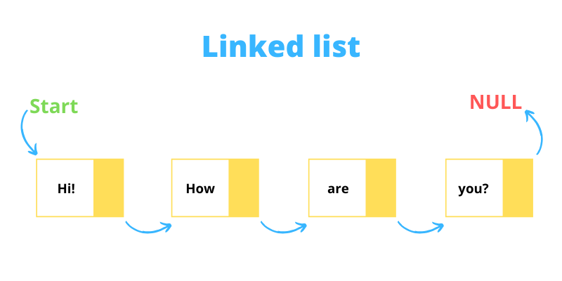

Slide 9
WHAT IS LINKED LIST?
-A linked list is a sequence of data structures, which are connected together via links.Linked List is a sequence of links which contains items. Each link contains a connection to another link. Linked list is the second most-used data structure after array.
WHY IS LINKED LIST IMPORTANT?
- Linked lists offer some important advantages over other linear data structures. Unlike ,array they are a dynamic data structure, resizable at run-time. Also, the insertion and deletion operations are efficient and easily implemented.

Slide 10
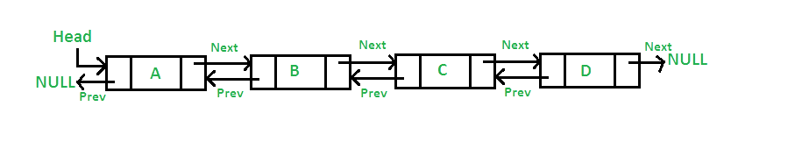
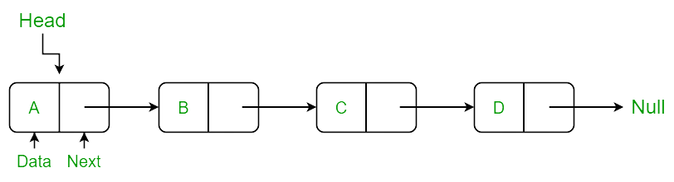
There are four key types of linked lists:
Singly linked lists.
Doubly linked lists.
Circular linked lists.
Circular doubly linked lists.
Singly linked list
- Singly linked list can be defined as the collection of ordered set of elements. The number of elements may vary according to need of the program. A node in the singly linked list consist of two parts: data part and link part. Data part of the node stores actual information that is to be represented by the node while the link part of the node stores the address of its immediate successor.
Doubly linked list
-Doubly linked list is a complex type of linked list in which a node contains a pointer to the previous as well as the next node in the sequence. Therefore, in a doubly linked list, a node consists of three parts: node data, pointer to the next node in sequence (next pointer) , pointer to the previous node (previous pointer).

Slide 11
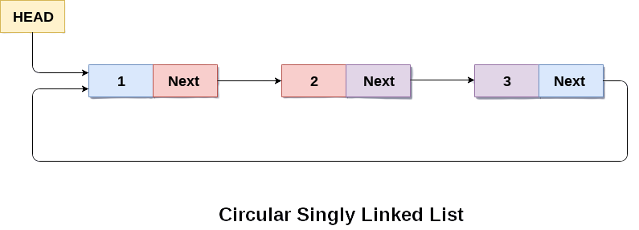
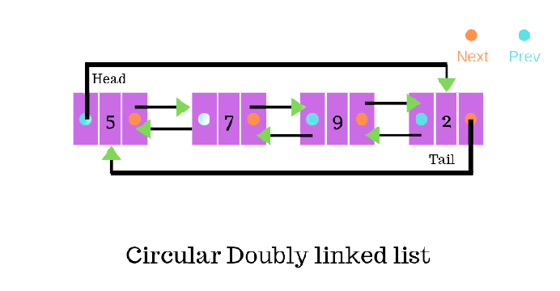
Circular Singly linked list
-A circular Singly linked list, the last node of the list contains a pointer to the first node of the list. We can have circular singly linked list as well as circular doubly linked list.
We traverse a circular singly linked list until we reach the same node where we started. The circular singly liked list has no beginning and no ending. There is no null value present in the next part of any of the nodes.
Circular doubly linked list
-Circular doubly linked list is a more complexed type of data structure in which a node contain pointers to its previous node as well as the next node. Circular doubly linked list doesn't contain NULL in any of the node. The last node of the list contains the address of the first node of the list. The first node of the list also contain address of the last node in its previous pointer.

Slide 12
ALGORITHM::
Traverse a Linked List:
Step 1: [INITIALIZE] SET PTR = HEAD
Step 2: Repeat Steps 3 and 4 while PTR != NULL
Step 3: Apply process to PTR -> DATA
Step 4: SET PTR = PTR->NEXT
[END OF LOOP]
Step 5: EXIT
Inserting Elements to a Linked List:
Insert At Beginning-
Step 1: IF AVAIL = NULL
Write OVERFLOW
Go to Step 7
[END OF IF]
Step 2: SET NEW_NODE = AVAIL
Step 3: SET AVAIL = AVAIL -> NEXT
Step 4: SET NEW_NODE -> DATA = VAL
Step 5: SET NEW_NODE -> NEXT = HEAD
Step 6: SET HEAD = NEW_NODE
Step 7: EXIT

Slide 13
Insert At End:
Step 1: IF AVAIL = NULL
Write OVERFLOW
Go to Step 10
[END OF IF]
Step 2: SET NEW_NODE = AVAIL
Step 3: SET AVAIL = AVAIL -> NEXT
Step 4: SET NEW_NODE -> DATA = VAL
Step 5: SET NEW_NODE -> NEXT = NULL
Step 6: SET PTR = HEAD
Step 7: Repeat Step 8 while PTR -> NEXT != NULL
Step 8: SET PTR = PTR -> NEXT
[END OF LOOP]
Step 9: SET PTR -> NEXT = NEW_NODE
Step 10: EXIT

Slide 14
Insert After An Element:
Step 1: IF AVAIL = NULL
Write OVERFLOW
Go to Step 12
[END OF IF]
Step 2: SET NEW_NODE = AVAIL
Step 3: SET AVAIL = AVAIL -> NEXT
Step 4: SET NEW_NODE -> DATA = VAL
Step 5: SET PTR = HEAD
Step 6: SET PREPTR = PTR
Step 7: Repeat Steps 8 and 9 while PREPTR -> DATA != NUM
Step 8: SET PREPTR = PTR
Step 9: SET PTR = PTR -> NEXT
[END OF LOOP]
Step 1 : PREPTR -> NEXT = NEW_NODE
Step 11: SET NEW_NODE -> NEXT = PTR
Step 12: EXIT

Slide 15
Deleting Elements from a Linked List:
Delete From Beginning-
Step 1: IF HEAD = NULL
Write UNDERFLOW
Go to Step 5
[END OF IF]
Step 2: SET PTR = HEAD
Step 3: SET HEAD = HEAD -> NEXT
Step 4: FREE PTR
Step 5: EXIT
Delete From End-
Step 1: IF HEAD = NULL
Write UNDERFLOW
Go to Step 8
[END OF IF]
Step 2: SET PTR = HEAD
Step 3: Repeat Steps 4 and 5 while PTR -> NEXT != NULL
Step 4: SET PREPTR = PTR
Step 5: SET PTR = PTR -> NEXT
[END OF LOOP]
Step 6: SET PREPTR -> NEXT = NULL
Step 7: FREE PTR
Step 8: EXIT

Slide 16
Delete After A Node-
Step 1: IF HEAD = NULL
Write UNDERFLOW
Go to Step 10
[END OF IF]
Step 2: SET PTR = HEAD
Step 3: SET PREPTR = PTR
Step 4: Repeat Steps 5 and 6 while PREPTR -> DATA != NUM
Step 5: SET PREPTR = PTR
Step 6: SET PTR = PTR -> NEXT
[END OF LOOP]
Step 7: SET TEMP = PTR
Step 8: SET PREPTR -> NEXT = PTR -> NEXT
Step 9: FREE TEMP
Step 10 : EXIT

Slide 17
Search:
Step 1: [INITIALIZE] SET PTR = HEAD
Step 2: Repeat Steps 3 and 4 while PTR != NULL
Step 3: If ITEM = PTR -> DATA
SET POS = PTR
Go To Step 5
ELSE
SET PTR = PTR -> NEXT
[END OF IF]
[END OF LOOP]
Step 4: SET POS = NULL
Step 5: EXIT

Slide 18
Thank You

