Slide 1

New York Times Bestseller Analysis
Sameer Singh Rawat, LMU

Slide 2
Overview
Dataset - The data will comprise of the book titles and their respective summary. This will be generated by NYT api.
Sentiment analysis will be done on the summary.
Topic modelling will be done on the summary but since summaries only describe in short detail, the descriptions will be fetched by google book api and topic modelling will be done on both.
Recommendation - the columns such as authors, genres will be fetched through api and content based recommendation will be done based on the book user has already read.

Slide 3
Dataset
Dataset will comprise of the books that has featured as NYT bestseller at the start of each month of 2023.
Dataset will contain the information about the books such as their author, genres, short description( referred as summary), detailed description (referred as description).
The difference between summary and description of random three can be seen in the figure on the next slide.
Since summary seems to focus on solely the story of the book it is wise to perform sentiment analysis on them while description is more elaborative in size it seems better to do topic modelling on description.

Slide 4
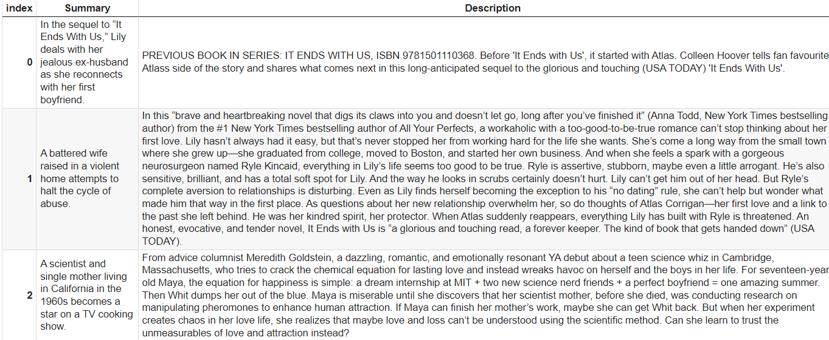
Summary VS Description

Slide 5
Sentiment Analysis
Sentiment analysis will be done by state of art model BERT and also through a trained from scratch RNN model.
RNN model is trained on the X(Twitter) dataset taken from kaggle. The dataset is divided into 80:20 train and test.
This model gives a test set accuracy of about 80%.
The predictions of sentiments of summary of total dataset with BERT model and RNN can be seen in the form of count plot in the next slide.
RNN seems to struggle with classifying the sentiment of summaries in black and white,mostly outputting grey(neutral). While BERT mostly classifies the books to be of positive sentiment.(Figure on the next slide)

Slide 6
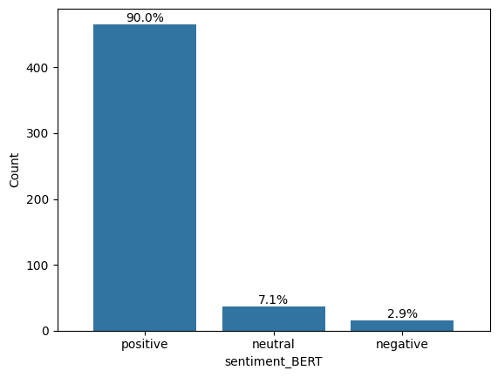
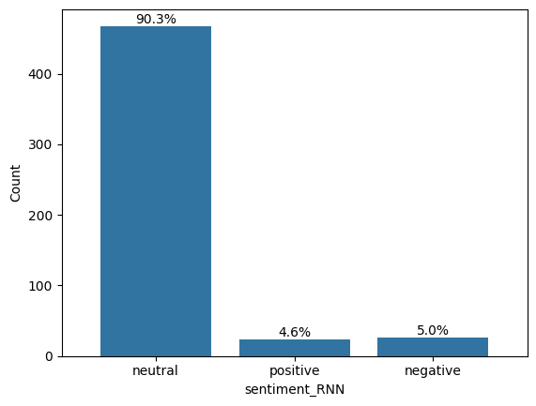
BERT VS RNN

Slide 7
Topic Modelling
It will determine the topics around which people like to read stories.
Again this will be done by state of art model BERTopic and a model implemented from scratch making use of Latent Dirichlet Allocation(LDA).
Topics derived from BERTopic will be displayed on the recommended book as keywords.
Topic modelling will also be done by LDA from scratch and the concept of how LDA is trained will be discussed (yet to be done)
Discussion on both the approaches will be done.

Slide 8
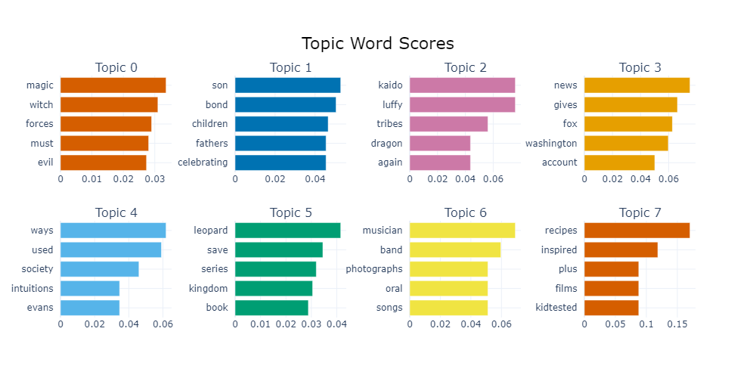
BERTopic on summaries (short description)
Probable themes - fantasy(Topic 0), family(Topic 1),politics(Topic 3), art(Topic 6)

Slide 9
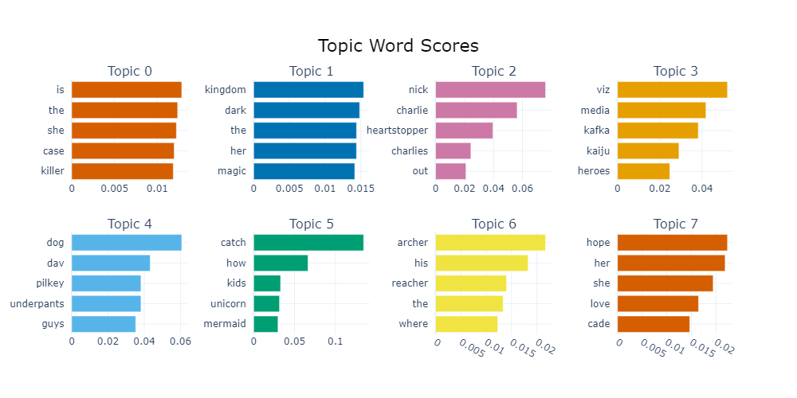
BERTopic on description
Probable themes - crime(Topic 0), fantasy(Topic 1),kafka(Topic 3), fantasy+children (Topic 6), positive sentiments such as love and hope(Topic 7)

Slide 10
Recommender system
In the final stage, we make a content based recommendation.
Steps
1. Make feature vectors combining the columns of genres, author, description for each book and treat it as a content.
2. When a new book is entered the feature vector is formed for this new book by using google books api
3. Finally the book that is most closest match to the entered book is recommended.
NOTE - CountVectorizer is used for encoding the feature vector. And cosine similarity for finding the closest match.

Slide 11
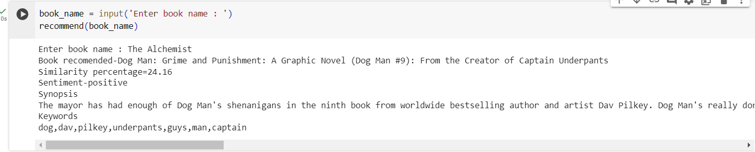
Output demo
Similarity percent calculated by cosine similarity.
Sentiment - as predicted by BERT
Keywords - as suggested by BERTopic
Addition - the final model will be deployed in cloud using hugging face space and streamlit. Image of the recommended book will also be displayed.

Slide 12
Thank you!

