Slide 1
Enhancing Text Retrieval Pipelines
Sameer Singh Rawat
code - https://github.com/SameerR007/contrastive_learning

Slide 2
Introduction

Slide 3
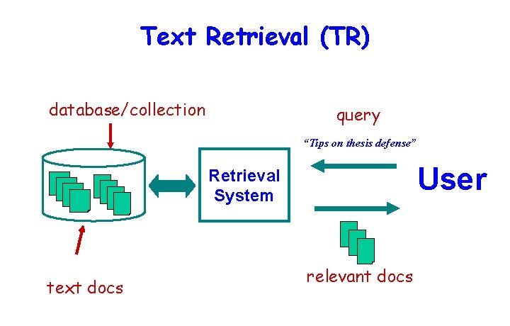
What is retrieval?
Retrieval refers to fetching similar documents compared to the query, from a large collection of documents.
Use cases - web search, retrieval augmented generation (RAG)
word retrieval will be used for text retrieval unless explicitly mentioned

Slide 4
Types of retriever based on architecture
Bi-encoder based - In this the query and the document are encoded separately and a similarity score is calculated based on these two embeddings.
Cross-encoder based - In this the query and the document are combined and a single joint embedding is calculated which is then passed onto a linear layer to predict the similarity score.
Bi-encoders are more efficient for large scale retrieval hence are used in retrievers while cross-encoders are more precise making them effective in reranking.
We will only be looking into bi-encoder ones.

Slide 5
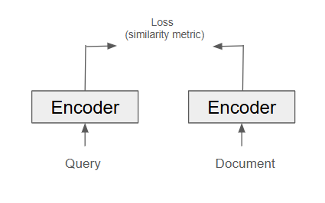
Components of retriever architecture
Encoder - encodes query and document.
Similarity metric - metric with which similarity is calculated between query and document embedding.
Loss function - loss function used to optimize the embeddings by updating encoder weights.
Approach - In this paper we experimented with different combination of these components to see their effect on retrieval.

Slide 6
Methods

Slide 7
Overview (1)
Based on different combinations of retriever components we trained three different models.
Model | Embeddings used | Similarity/Distance | Loss function
Baseline | BERT CLS token | cosine | infoNCE
Average | BERT final layer average | cosine | infoNCE
Hyperbolic | Hyperbolic | Lorentz | infoNCE+ α*entailment loss

Slide 8
Baseline model (1)
Embedding used - BERT CLS token
Similarity metric used - cosine similarity
Loss function used - infoNCE loss

Slide 9
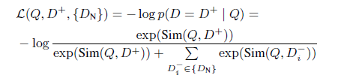
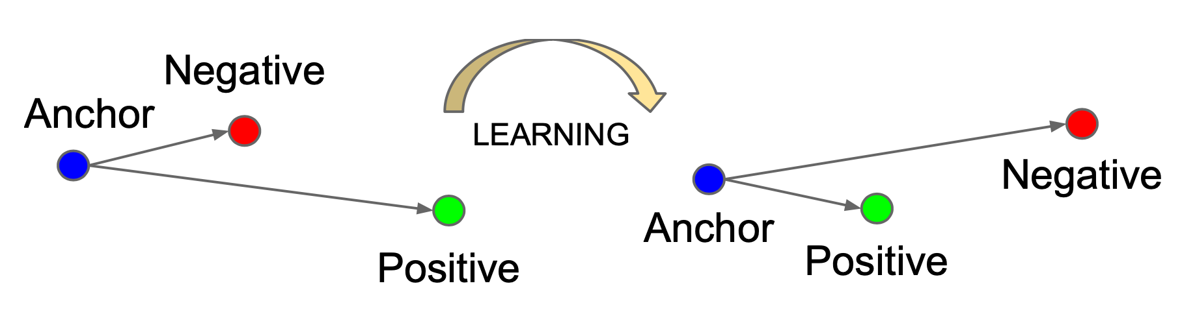
Baseline model (2)
infoNCE loss
where, D⁺ represents the document that is similar to the query (positive) and {D_{N}} is the set of negative documents that are not similar to the query (negatives)

Slide 10
Average model (1)
Embedding used - Average of BERT final layer tokens
Similarity metric used - cosine similarity
Loss function used - infoNCE loss
Note - same as baseline model except for embeddings used.

Slide 11
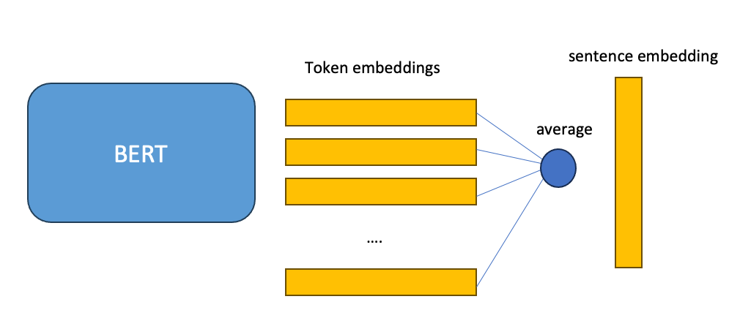
Average model (2)
Average of BERT final layer tokens

Slide 12
Hyperbolic model (1)
Embedding used - Hyperbolic embedding
Similarity metric used - negation of lorentz distance
Loss function used - infoNCE loss + α * entailment loss

Slide 13
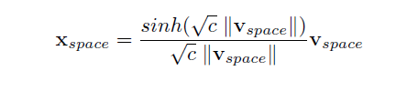
Hyperbolic model (2)
Hyperbolic embeddings
where, v_{space} is CLS token embedding from BERT and this is projected to hyperbolic space resulting in x_{space}

Slide 14



Hyperbolic model (3)
Lorentz distance
where,
<x,y>_{L} is inner product,
d_{L}(x,y) is lorentz distance, and
c is a hyperparameter

Slide 15
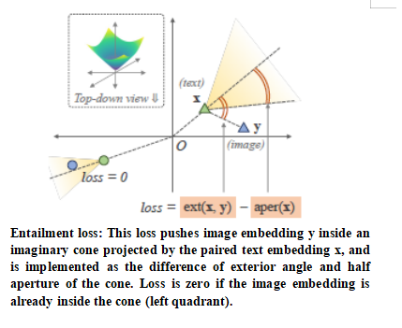
Hyperbolic model (4)
Entailment loss - It enforces a hierarchical relationship between the query and the positive document (see figure below, from Desai et al., 2023).

Slide 16
Evaluation

Slide 17
Implementation details (1)
Data - trained on MS macro dataset
Positives per query - 1
Negatives per query - 5
Total epochs - 3
Batch size - 32
α = 0.1 (?)
LoRA fine-tuning (prevents overfitting)
Evaluation metric used - Mean Reciprocal rank (MRR)
alpha is the entailment loss weightage in hyperbolic model loss where loss = infoNCE + α * Entailment loss

Slide 18
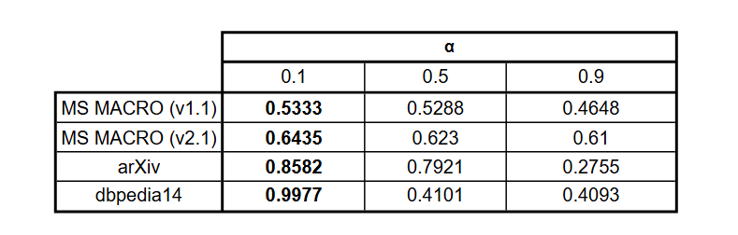
Implementation details (2)
Choice of α
We perform training and evaluation on four datasets with α = 0.1, 0.5 and 0.9
MRR dips as we increase the value of α. This can suggest that in hyperbolic model, our primary minimization objective should be contrastive loss with only a small weightage given to the minimization of entailment loss.

Slide 19
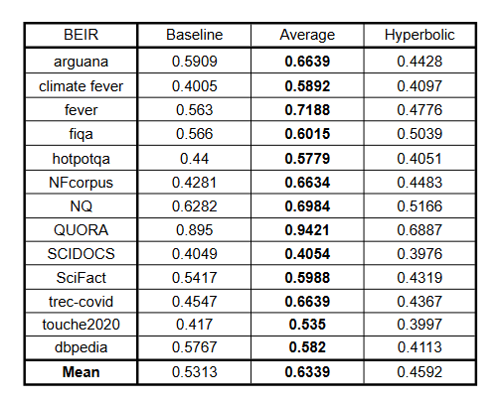
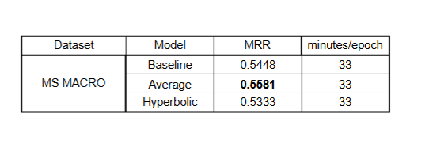
Results (1)
Results on MS macro dev set and BEIR dataset (OOD)
Average model performs well as compared to the other models, so letting all the tokens in the last hidden layer represent the document leads to substantially better results.

Slide 20
Results (2)
Corrupted Queries - Evaluation in real word scenario
A query might not be precisely written by the user due to several reasons such as typo, vagueness, language barrier.
It is essential to test retrieval under such circumstances.
Method - We corrupt queries by randomly choosing its words and injecting typos in them or replacing them with synonyms. Following this we evaluate the model’s performance.

Slide 21
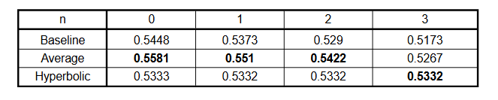
Results (3)
Corrupted Queries - Evaluation on MS macro dev set
here, n are the number of words corrupted in the query
Two key take away -
Performance of models declines with increase in corrupt words
Performance of hyperbolic model is more robust with corrupt data

Slide 22
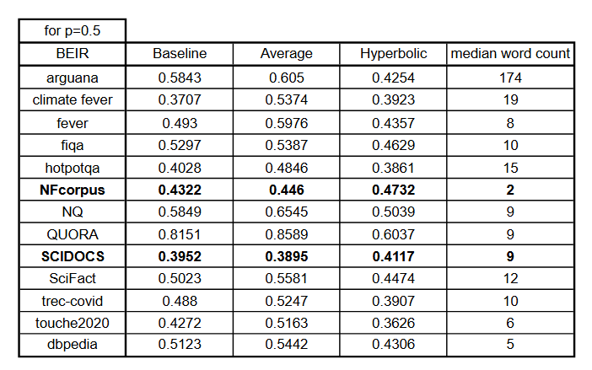

Results (4)
Corrupted Queries - Evaluation on BEIR dataset
Hyperbolic model can outperform for certain datasets in noisy settings
Mean percentage decrease in MRR with and without corruption across all 13 datasets is most for average and least for hyperbolic model (?)
p=0.5 denotes randomly chosen half of the words (except stopwords) are corrupted

Slide 23
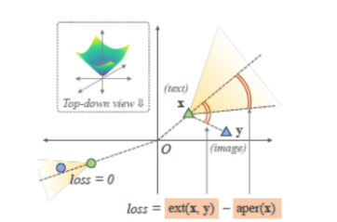
Results (5)
Corrupted Queries - Why average model performs bad and hyperbolic model performs better
In average model all the tokens (even the corrupted ones) have a say in representation.
Corruption makes query more general => General queries are positioned closer to origin in hyperbolic space=> more chance of positive to be inside the cone
Eg - Temperature of California? (specific)
Temperature of xxx? (general)

Slide 24
Discussion
We derive three insights from this work -
1. In hyperbolic model loss optimization only small weightage should be given to entailment loss with contrastive learning as primary objective.
2. For clean queries, taking into account all the embeddings to represent the document performs better than relying solely on CLS token for representation, without any tradeoff in training time.
3. For noisy settings, hyperbolic model can outperform the euclidean based models since it can utilize its hierarchical learning to capture vague and general concepts better.
Further works can include - training on corrupt data, analyzing how much of each corruption factor like typos, synonym replacement contribute to MRR decrease.

Slide 25
References
Ma, X., Wang, L., Yang, N., Wei, F., & Lin, J. (2023). Fine-tuning LLaMA for multi-stage text retrieval. arXiv. https://arxiv.org/abs/2310.08319
Lingling Xu, Haoran Xie, Zongxi Li, Fu Lee Wang, Weiming Wang, and Qing Li. 2023. Contrastive Learning Models for Sentence Representations. ACM Trans. Intell. Syst. Technol. 14, 4, Article 67 (August 2023), 34 pages. https://doi.org/10.1145/3593590
Desai, K., Nickel, M., Rajpurohit, T., Johnson, J., & Vedantam, R. (2024). Hyperbolic image-text representations. arXiv. https://arxiv.org/abs/2304.09172
Pal, A., van Spengler, M., D'Amely di Melendugno, G. M., Flaborea, A., Galasso, F., & Mettes, P. (2024). Compositional entailment learning for hyperbolic vision-language models. arXiv. https://arxiv.org/abs/2410.06912
Desai, U., Tamilselvam, S., Kaur, J., Mani, S., & Khare, S. (2020). Benchmarking popular classification models' robustness to random and targeted corruptions. arXiv. https://arxiv.org/abs/2002.00754

Slide 26
Thank you!

