Slide 1
Memory Association Task
FlowChart For Code

Slide 2
CFD Face Directory
1989 Most Popular Names
Filter Gender/Race Cohorts (n=20)
Arrays of 100 most popular male and female names
MATLAB
Copy-paste Arrays into JS

Slide 3
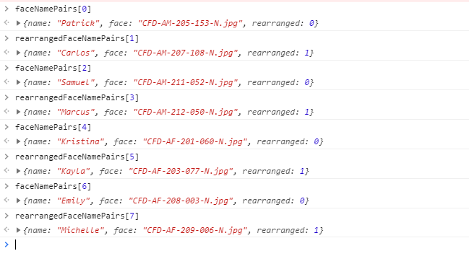
Strategy for generating rearranged face-name pairs and, for recall phase, a set with equal number of intact and rearranged
Generate rearranged based on intact array, but offsetting the index of name and face by two
Use odd/even number rules to return a hybrid array of intact + rearranged
Even and 0 (In JS index starts from 0)= Intact
Odd = Rearranged
Proof that this strategy results in a balanced hybrid array (intact+rearranged), with no duplicating faces or names !

