Slide 1
03072021 Results
Further Analysis of Batch 1 Results

Slide 2
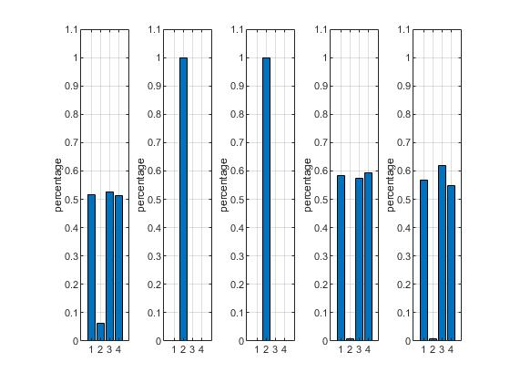
Basic Performance on Memory Task
Each graph corresponds with a different subject.
So, subjects 2 and 3 clearly did not do the task.
Within each graph,
Column 1: Correct/(correct+incorrect)
Column 2:
[Null-Response]/[all Responses]
Column3:
Success, but just for Rearranged Stim
Column4:
Success, but just for Intact Stim

Slide 3
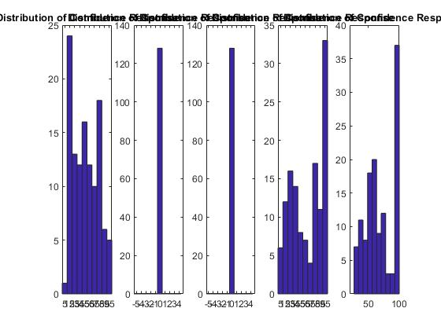
Distribution of Confidence Responses
Once again, each graph corresponds with a different subject.

Slide 4
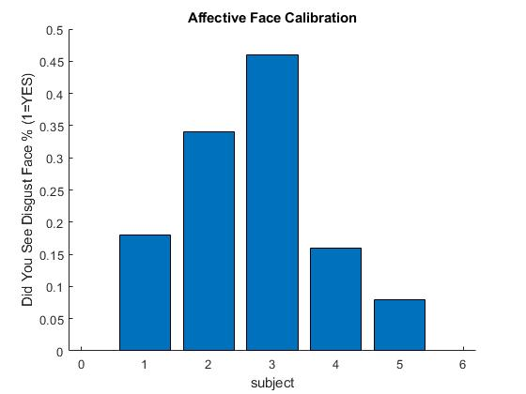
Calibration: “Did you see a Disgust Subject?”
Once again, note that subjects 2 and 3 basically did not do the task.

