Slide 1
10/11/2020 Update
Masked Face Experiment

Slide 2
Jobs
Status | Job
Done | Import faces from KDEF repository, programmatically filter repository and create relevant folders [‘neutralFaces’,’disgustFaces’]
Done | Manually remove overexposed images from above folders
Done | In cue phase of trial, randomly alternate between neutral and disgust face, and…
Done | …randomly select neutral/disgust face out of larger pool of faces (also making sure that neutral faces for cue and backwards mask are non-identical)
Done | Implement “success” data attribute (if subjectKeyPress==cueImage)
Done | Iterate through a flexible number of trials
Done | Import to Cognition.Run, make Elizabeth a collaborator
Done | Backup on Git/share github repository with lab – ask Elizabeth where to post repository in Basecamp, create new Basecamp Project?
Done | Create experiment with variable cue duration times (16,33,55ms), would be good to find the threshold for conscious perception given our novel online presentation
Done | Add data parameters: StimDurationSetting, Trial, and TrialPhase for more streamlined analysis
Not Done | Create phase-scrambled faces (confirm KDEF face-directory with Elizabeth, and phase-scrambling technique) -Point: further mask the the cue (less contrast as opposed to transition of white screen to cue). Phase-scramble the CUE-FACE.
Not Done | Begin pilot analysis of excel file (in which language? – ask Elizabeth)

Slide 3
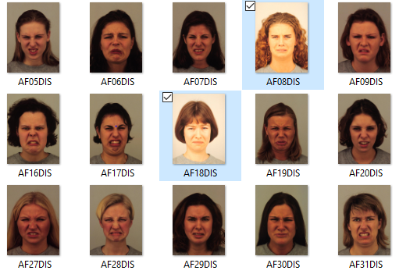
Examples of Faces I removed from folder

Slide 4
Cognition.Run
https://mm69nwfwja.cognition.run – to simply run the experiment
Add Elizabeth as collobarator ! – use this link https://www.cognition.run/tasks/1410/collaborators/create

Slide 5
Git Repository
https://github.com/SameerSabharwalSiddiqi/JSPsychMaskingExperiment

