Slide 1
11/09/2020 Update

Slide 2
Status | Task
Done | “Fool-Proof” Task in Cognition.Run with Video Tutorial and Streamlined Informed Consent/Directions Page. The Imperative For This: Since cue_duration time is variable, we should expect robust performance at higher durations. But if lazy MTURK Workers simply assume that cueFace = last/”always_neutral_face,” then our psychometric curves will not be robust. For this same reason, we should Implement Incentives Reserve task for MTURK masters (if we don’t get enough hits, we can relax admission criteria, but that is a better problem than having “too much bad data”).
Done | Do Dry-Run of task to accomplish three goals: Get my own psychometric curve → inform which cue_duration time we use on MTURK workers Check to see if the cue_duration_times that we set vary significantly with the actual cue_duration_times recorded by the computing system. Get a general sense of the amount of time the task takes (e.g., second per trial), to inform what our total number of trials will be and minutely rate will be.
Done | Add encouragement blurb once worker has completed 50% of trials ‘You’re doing great! Only 100 more trials to go.’
Done | Basic Analysis Code. Also: fixed bug where cue_duration time was not being recorded
Done | Ideate
Ask Chua | Permission to sign-onto chua@lab to respond to emails sent my MTURK workers b
Beginning | Start Thinking About the Memory Component

Slide 3
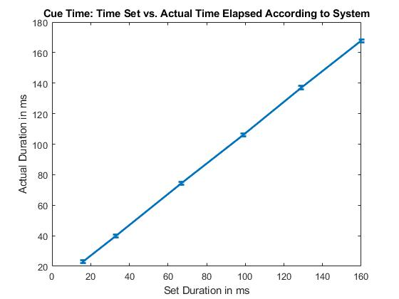
How “off” is the actual cue_duration time from the time that we set it to be?
Variation seems to be low – on the order of <1ms. Values on next slide.
I am using in-built MATLAB function to calculate 95% confidence intervals assuming normal distribution of this continuous data.

Slide 4
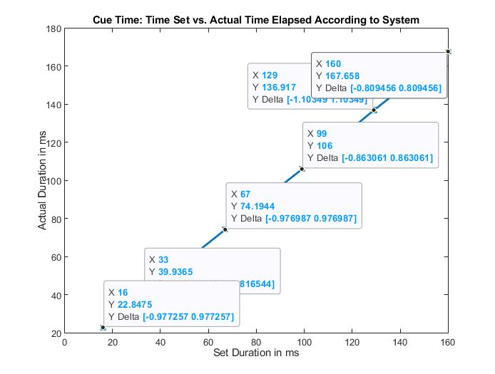
Time Set (X) | Avg. Time Actually Displayed (Y) | Offset ~(Y-X)
16 | 22.85 | +7
33 | 39.94 | +7
67 | 75.19 | +8
99 | 106 | +7
129 | 136.92 | +8
160 | 167.66 | +7
Observation: Actual display time exceeds set time by about 7.5 ms
Solution: Make all set times 7ms lower than the times we actually intend to use → Test
(Test especially to see if <20ms presentation is even possible).

Slide 5
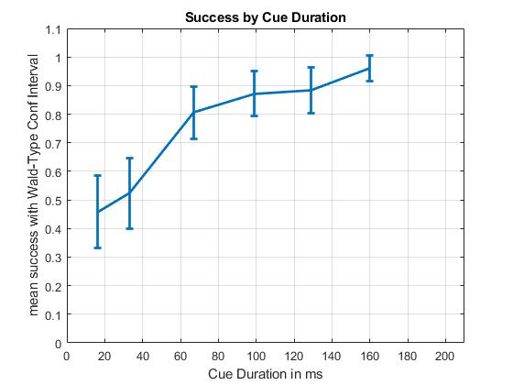
My Psychometric Plot (n=300 trials)
Observation: Add time_duration around 33-67ms as that seems to be the psychometric point
Conf Intervals for binomial data:
1.96*sqrt( (p*(1-p))/n)

Slide 6
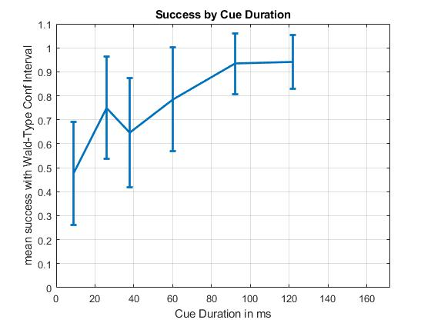
Run 2

