Slide 1

Data Visualization
Presented by – Sameer (B.Sc. Data Science, Sem 5)
Presented to –
Ms. Neema Jha

Slide 2
Introduction
Power BI is a robust business analytics tool by Microsoft, empowering organizations to visualize and share insights from their data. Seamlessly integrating with various data sources, Power BI transforms raw data into meaningful visualizations, fostering data-driven decision-making.

Slide 3

Components of Power BI
Power BI comprises three key components: Power BI Desktop for report creation, Power BI Service for cloud-based collaboration, and Power BI Mobile for on-the-go accessibility. This comprehensive ecosystem ensures a seamless user experience across platforms.

Slide 4
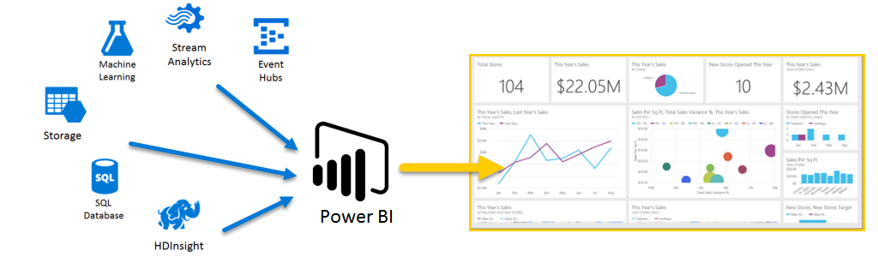
Connecting to Data
Power BI offers versatile data connectivity, allowing users to import data from various sources such as Excel, databases, and cloud services. Its intuitive interface simplifies the data preparation process, ensuring a smooth transition from raw data to actionable insights.

Slide 5
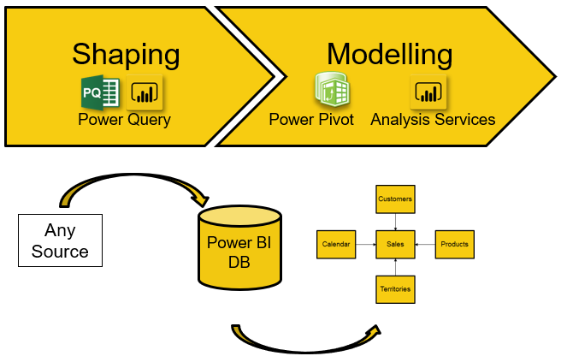
Data Modelling and Transformation
Efficient data modelling is pivotal in Power BI. With capabilities like relationships, calculated columns, and measures, users can create a cohesive data model. The Power Query Editor facilitates data transformation, ensuring data accuracy and relevance for analysis.

Slide 6
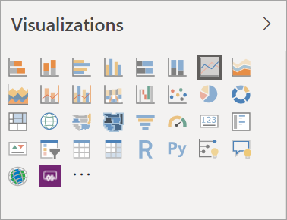
Visualization Tools
Compelling visualizations are the cornerstone of Power BI. The tool provides a rich library of charts, graphs, and maps, enhancing data representation. Users can customize visuals to suit specific needs, creating engaging and informative dashboards.

Slide 7
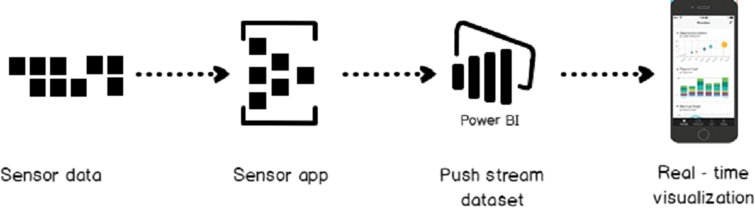
Real-Time Analytics
Power BI excels in real-time data analytics, enabling businesses to monitor key metrics instantly. By connecting to live data sources, organizations gain a competitive edge by making data-driven decisions promptly.

Slide 8
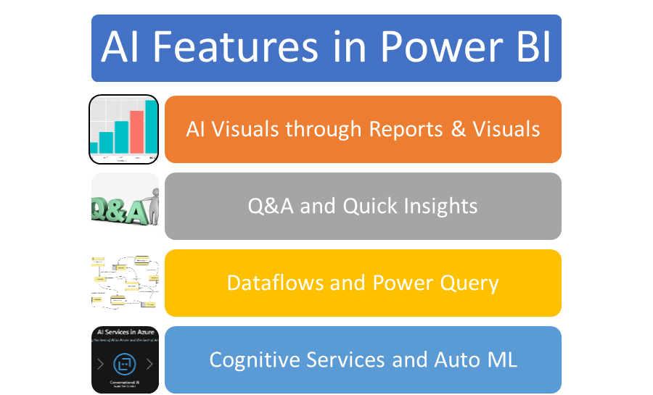
Power BI and Artificial Intelligence
The integration of AI capabilities within Power BI empowers users to uncover deeper insights. Features like AI visuals and natural language processing enhance data exploration, making it easier for users to derive meaningful conclusions.

Slide 9
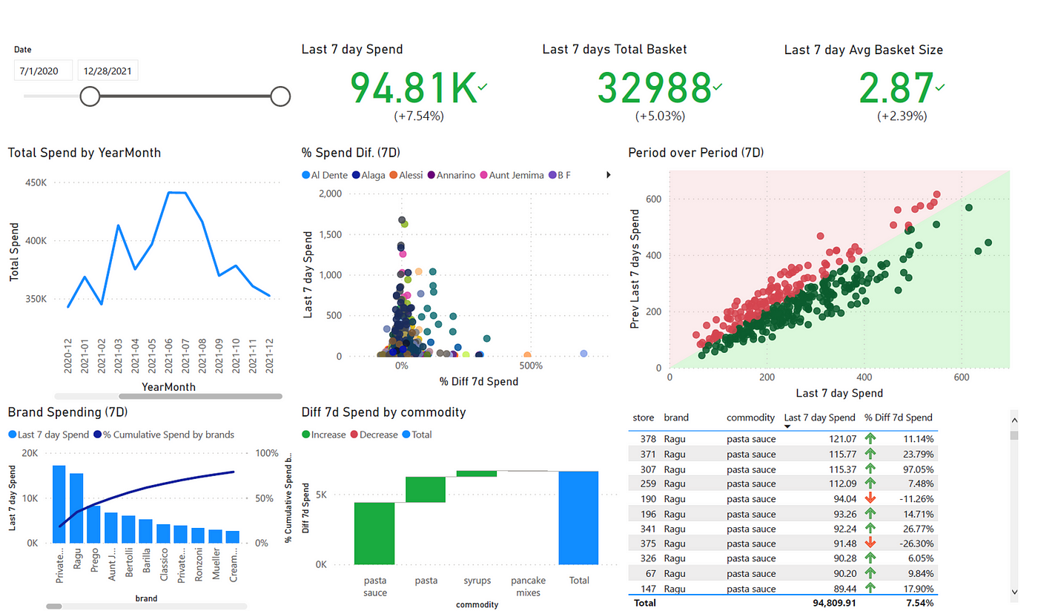
Power BI in Action - Sales Analytics
Consider a sales scenario where Power BI consolidates sales data from multiple channels. Visualizations like sales trends, regional performance maps, and product-wise analyses empower sales teams to strategize effectively and optimize their efforts.
Project link - Link

Slide 10
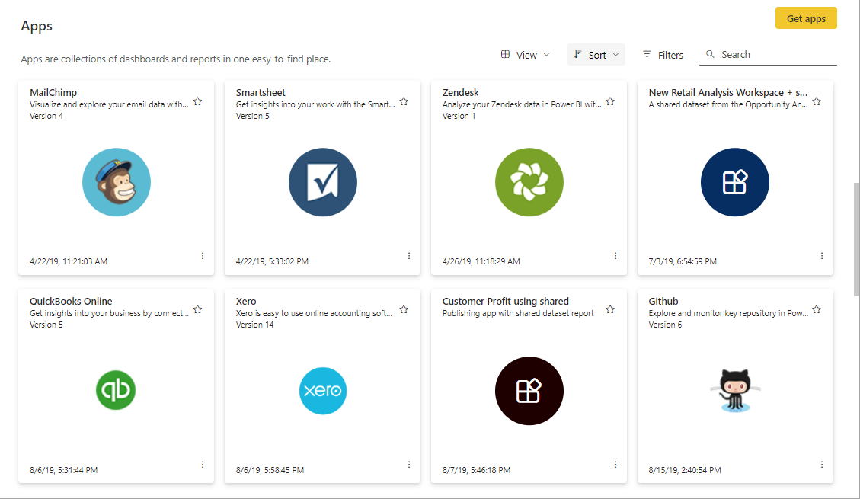
Power BI and Collaboration
Power BI's collaborative features enable teams to work together seamlessly. Users can share dashboards, reports, and datasets, fostering collaboration across departments. This shared environment enhances communication and ensures that everyone is on the same page.

Slide 11
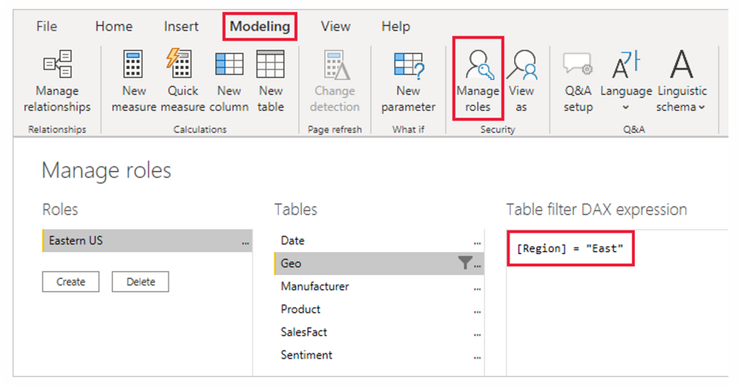
Security and Compliance
Power BI prioritizes data security and compliance, offering robust features for access control, encryption, and auditing. This ensures that sensitive business information is protected, and organizations adhere to regulatory requirements.

Slide 12
Conclusion
Power BI's versatility and user-friendly interface make it an indispensable tool for organizations aiming to harness the power of their data. Whether in sales, finance, HR, or supply chain, Power BI empowers businesses to thrive in an increasingly data-centric world.

Slide 13
THANK YOU

