Slide 1

Submitted by: ABDUL BASIT, SAMEER, BISMILLAH
Group Project
Implementation of Ceasar Cypher using NASM X86 ASSEMBLY

Slide 2
Introduction
Simple Substitution cipher
Shifts letters by fixed number.
Named after Julius Caesar
Example: A → E(shift = 4)
Notes:
The Caesar Cipher is a substitution cipher that shifts each letter in the alphabet by a fixed number. Julius Caesar used it to protect military messages. It's a basic form of encryption but introduces key cryptographic ideas like key-based transformation and character manipulation.

Slide 3
SIGNIFICANCE?
FIRST RECORDED CIPHER IN HISTORY
EASY TO UNDERSTAND
FOUNDATION FOR MODERN ENCRYPTION
GREAT FOR LEARNING CHARACTER ENCONDING
Notes:
Even though it's simple, the Caesar Cipher is important historically. It marks the beginning of cryptographic thought. It's still used in education to help students understand encoding, decoding, and key-based transformations, which are fundamental in cybersecurity.

Slide 4

Encryption Process
Shift letters Forward:
Shift characters based on the key: skip non-alphabet
Uses mod 26 to wrap:
There are a total of 26 letters
Example:
HELLO → KHOOR (Shift = 3)
Notes:
In encryption, we shift each letter forward in the alphabet based on the key (e.g., 3). If we go past 'Z', we wrap around using modulo 26. This makes the transformation cyclic. It's simple but effective for hiding a message at a basic level.

Slide 5


Decryption Process
REVERSE OF ENCRYPTION
USES THE SAME KEY
EXAMPLE:
KHOOR → HELLO
SHIFT = 3
SHIFT LETTERS BACKWARD
Notes:
Decryption works by reversing the encryption process. You use the same key but shift letters backward. For instance, K becomes H if the shift is 3. It's essential that both sender and receiver know the key to successfully decode the message.

Slide 6
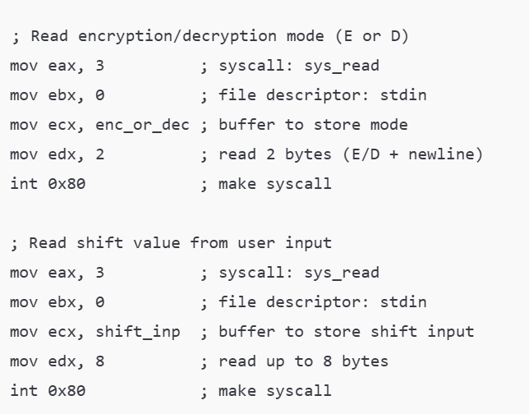
Input Handling In Assembly
READ MODE (E/D)
READ SHIFT VALUE (1-25)
READ INPUT TEXT
USES LINUX SYSCALLS (int 0x80)
Notes:
In the Assembly code, we start by getting inputs from the user:
Mode: Encrypt or Decrypt
Shift value: A number between 1–25
Text input: The actual message
We use Linux system calls like int 0x80 to handle input and output, storing values in memory for further processing.

Slide 7
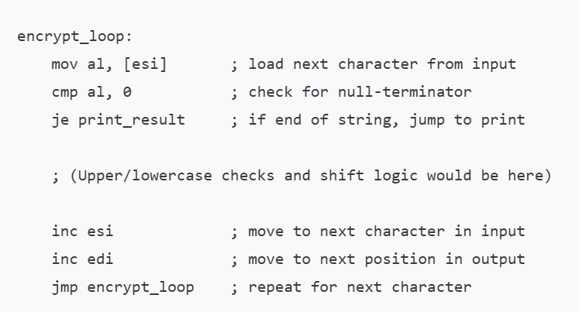
ENCRYPTION LOGIC IN ASSEMBLY
Loop through each character
Check if letter is upper/lowercase
Apply shift using mod 26
Store result in buffer
Notes:
This is the core loop of the Caesar Cipher. For each character:
Check if it’s a letter
Convert it to a position (A=0, B=1...)
Apply shift (add or subtract)
Use modulo 26 to wrap around
Convert back to ASCII
Store in result buffer
This logic is repeated for every letter until the end of the string.

Slide 8
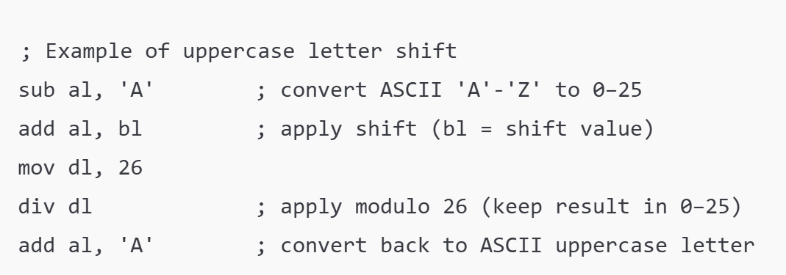
KEY CONCEPTS IN THE CODE
ASCII VALUE MANIPULATION
MODULAR ARITHEMETIC (mod 26)
REGISTERS AND MEMORY USAGE
SYSTEMATIC CALLS FOR I/O
Notes:
This implementation helps you understand:
How characters are stored and manipulated via ASCII values
How modular arithmetic keeps shifts within 'A'–'Z' and 'a'–'z'
How to use registers (like AL, BL, etc.) and memory buffers
How system calls like int 0x80 are used to interact with the user
It’s a hands-on way to learn both encryption and low-level programming.

Slide 9
CONCLUSION
Ceasar Cipher is simple yet powerful
Assembly teaches low-level logic
Reinforces cryptograph fundamentals
Great beginner Project
Notes:
To sum up, the Caesar Cipher might be basic, but it teaches a lot. Our implementation in Assembly gave us experience with:
System-level input/output
Loops and conditions
Cryptographic logic
It’s a great starting point for understanding both security and how computers process text at the lowest level.

