Slide 1

HELLO FRIENDS,
My name is sameer.

Slide 2
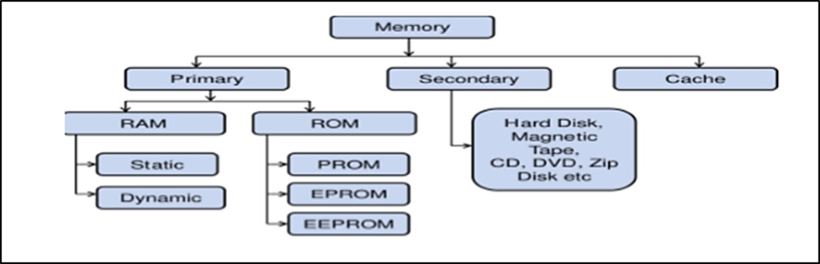
PRIMARY MEMORY (main memory)
What Is Primary Memory?
It’s the part of the computer
Memory.
It is essential component of a computer system.
Program and data are loaded into the primary memory before processing
C.P.U interacts directly with primary memory to perform read or write operations.

Slide 3
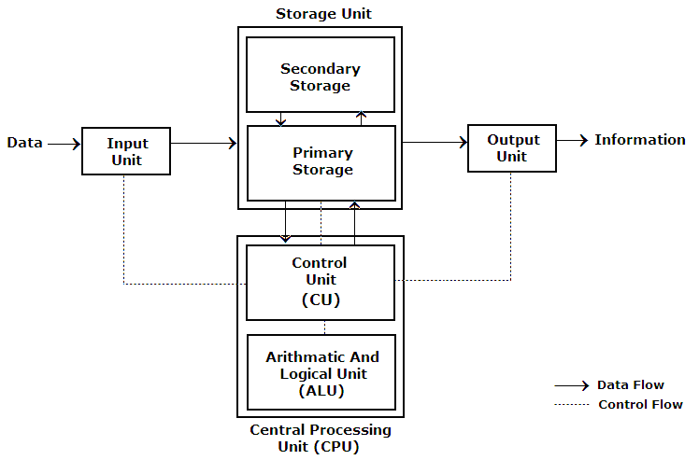
Features of primary memory?
A computer cannot run without primary memory.
Since the cpu can read or write the data to the memory they called as read write memories.
It can provide interface between cpu and secondary storage.

Slide 4
Information About Primary Memory.
It is has fast access time.
It is smallest in size.
It is directely communicate to cpu.
It is more expensive than secondary memory.
Volatile in nature expect rom.

Slide 5
PARTS OF PRIMARY MEMORY?
RAM (random access memory)
Ram is volatile memory
That temporarily stores
The file you are working on.
ROM (read only memory)
Rom is non-volatile memory , which mean the information is permanently stored on the chip.

Slide 6
Difference Between Ram And Rom
ROM
Rom data is permanent.
Data can’t be modified.
Data to be copied from rom to ram so, that can access its data.
Rom is slower than ram.
Rom Is cheap than ram.
RAM
ram data is volatile.
Data can be modified.
Cpu can access data stored on ram.
Ram is faster memory.
Ram is more expensive than rom

Slide 7
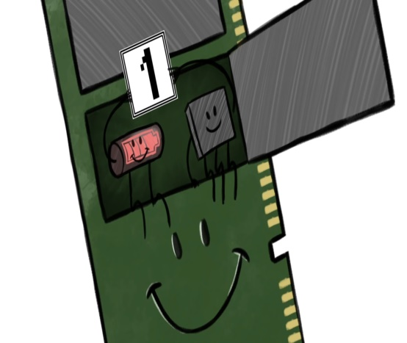
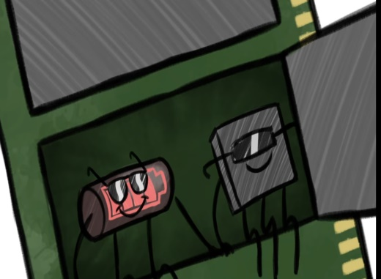
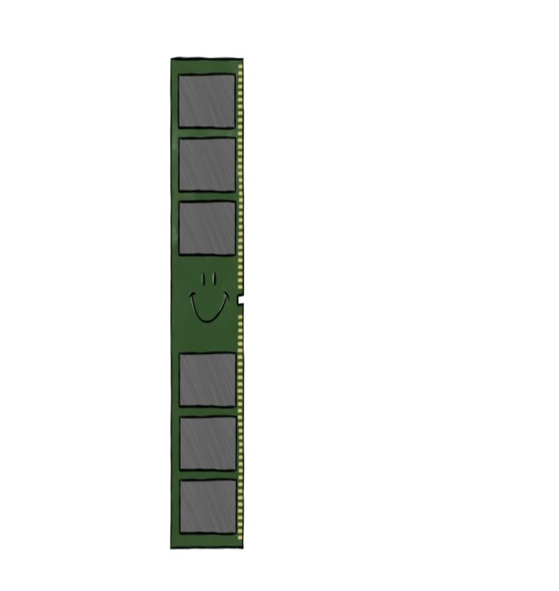
TYPE OF RAM
1.Static ram
2.Dynamic ram
DRAM(DYNAMIC RAM)
Dram stand for dynamic access memory.
Made up of capacitors &few transistors.
D.Ram store information only few millisecond even when power is supplied.

Slide 8
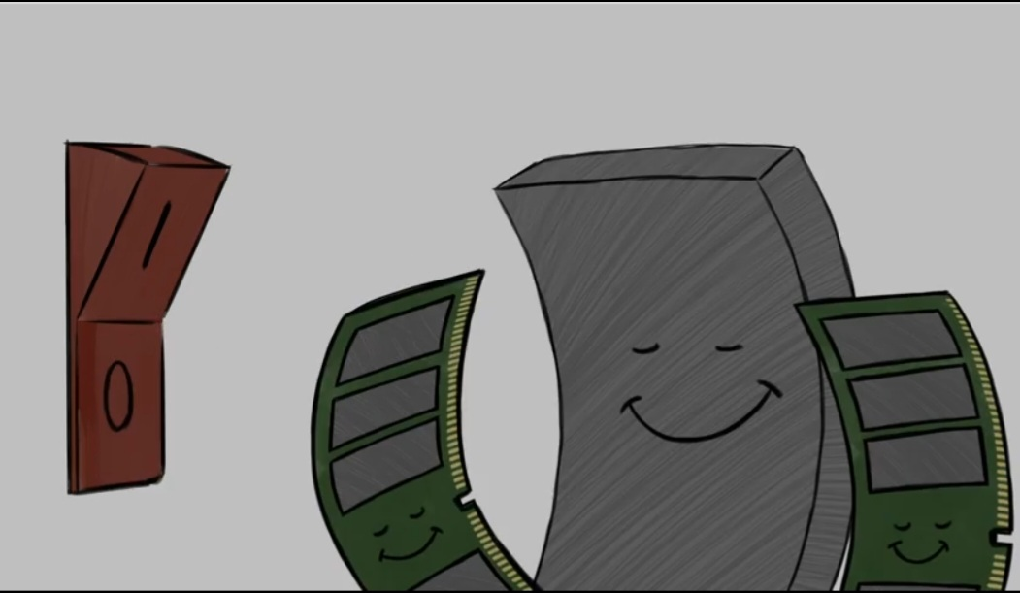
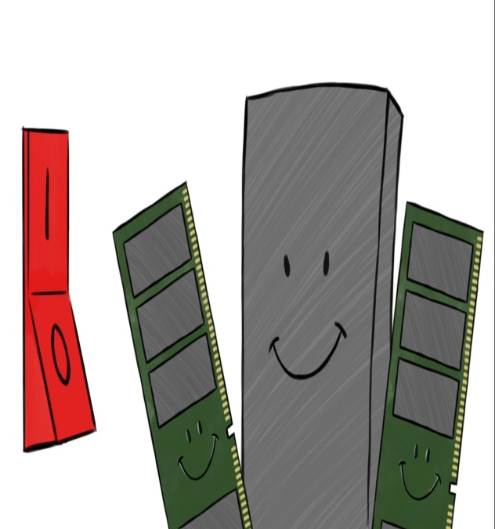
Static ram(sram)
Sram stand for static random access memory.
It is made up of cmos technology
It does not required periodic refresh cycle.
It has no need to refreshing circuit.
S.ram store the information as long as power supplied

Slide 9
Static Ram vs Dynamic Ram
Base | Static ram | Dynamic ram
Store information | S.ram store the information as long as power supplied. | D.Ram store information only few millisecond even when power is supplied.
Made up | Made up of flip-flop &many transistors. | Made up of capacitors &few transistors.
Bit store | Bit stored in the from of voltage. | Bit stored in the form of electric charge.
Refreshing circuit | It has no need to refreshing circuit. | It has need to refreshing Circuit.
Memory cell | For a single memory cell 6 transistors are used. | For a single memory cell one transistor is used.
power | Consume more power. | Consume less power.

Slide 10
BASE | Static ram | Dynamic ram
speed | Faster than dram | Slower than static ram
Expensive | More expensive than d.ram. | Less expensive than s.ram
Memory cell | Size of memory cell is larger | Size of memory cell is smaller.
density | It has low density(memory cell per area) | It has high density (memory cell per area)

Slide 11

Thank you of listen sincerely.

