Slide 1
Multi-Cloud Deployment Project

Slide 2
Project Title
Multi‑Cloud Distributed Application

Slide 3
Team
Multi‑Cloud Deployment Project

Slide 4
Problem Statement
Design a project that demonstrates a multi‑cloud strategy where different parts of an application are deployed across AWS, Azure, and GCP with load balancing, failover, and cloud‑agnostic deployments using Kubernetes or Terraform.

Slide 5
Solution
A distributed microservices application deployed across multiple cloud providers, using Kubernetes for orchestration and Terraform for IaC.

Slide 6
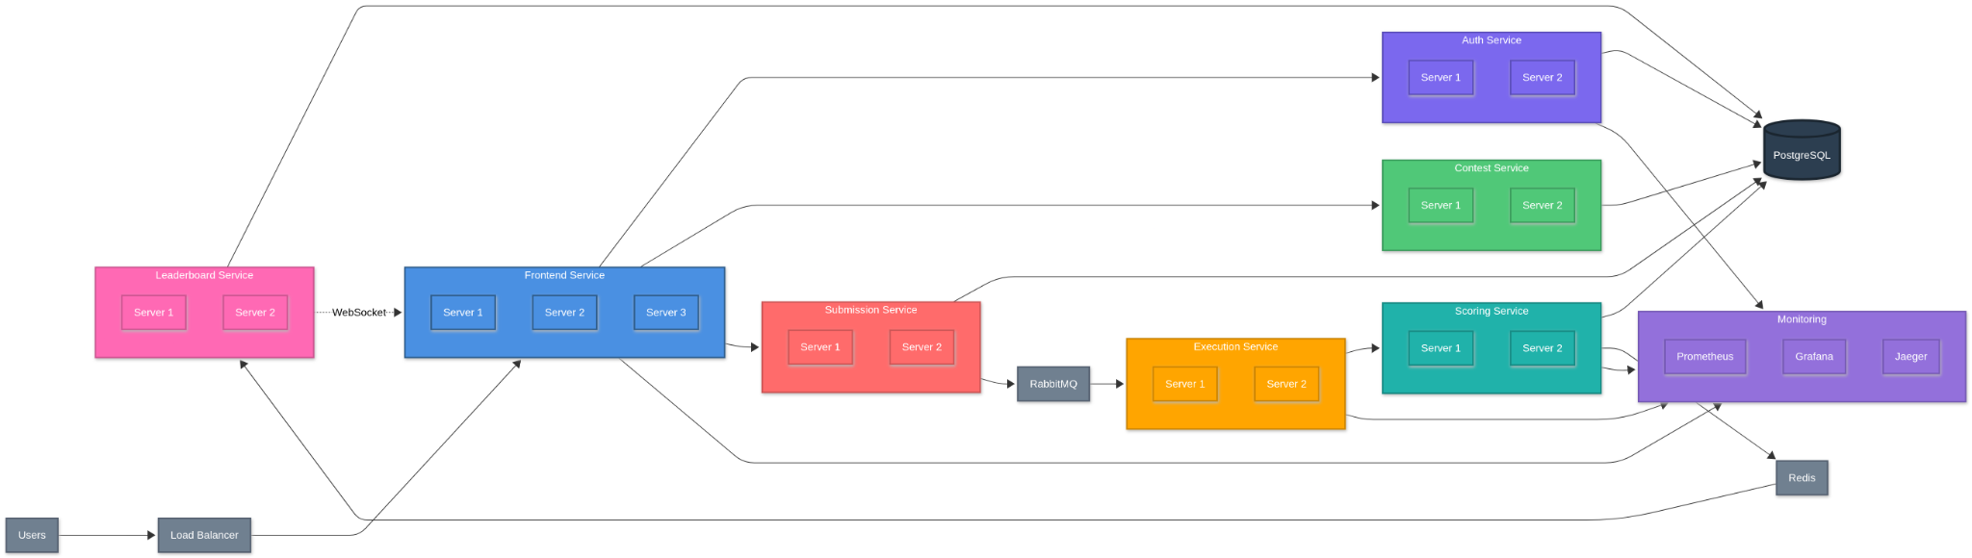
Architecture Overview

Slide 7
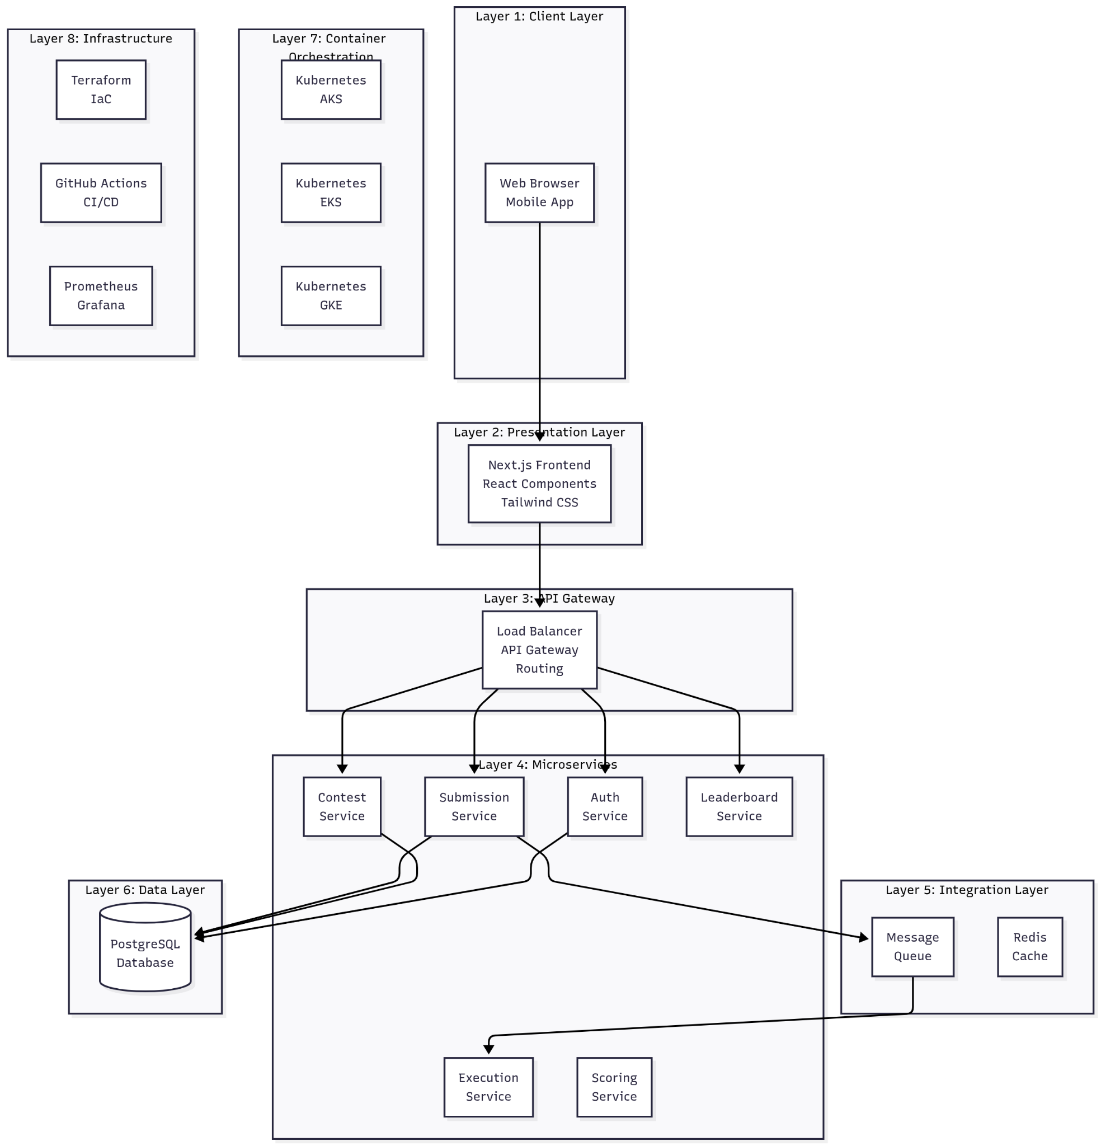
Layered Architecture

Slide 8
How the Product Works
Users interact with the frontend → Services distributed across AWS, Azure, and GCP → Data flows through compute, storage, and messaging layers → Output delivered.

Slide 9
How It Solves the Problem
Ensures high availability, failover, and cloud‑agnostic deployments while distributing workload across multiple cloud providers.

Slide 10
DevOps Flow
Code pushed → CI/CD Pipeline → Terraform applies infra → K8s deploys services → Monitoring ensures reliability and scaling.

