Slide 1
Transitioning Patients in the Last Hours and Days of Life from the Intensive Care Unit (ICU) to General Wards (Ref no. PCD 1167)
Phase 1:
Audit 1A: Knowledge Gap Analysis survey
Audit 1B: CCA documentation compliance assessment
Audit Lead:
Sameera Jahagirdar
Specialty Doctor
ICU
WMUH
Audit Team:
Unzillah Khan
JCF
ICU
WMUH
Audit team: Dr Monica Popescu¹, Dr Anna Bradley², Elaine Hardy³
1. Consultant and Clinical Lead, ICU, 2. Consultant, Specialist Palliative Medicine, 3. ICU Senior Nurse
Notes:
Speaker’s notes

Slide 2
Background:
Quality problem
Observed gaps in transitioning PILHDL* from ICU to wards
Inconsistent EOLC** care practices
Clinical incident
Anecdotal report of accidental cessation of essential medications during transitions
Guidelines
Intensive Care Society (ICS) recommendation 2.2.11 emphasizes discharging patients unlikely to die within 24-48 hours
Need to assess and improve adherence to this guideline in local practice
PILHDL*: Patients in Last Hours and Days of Life.
EOLC**: End of Life Care
Notes:
Speaker’s notes

Slide 3
Background:
QI initiative:
Opportunity to enhance patient-centered care during critical transitions
Aim to develop standardized protocols and toolkits for PILHDL transitions
Knowledge gap assessment:
Need to identify and address knowledge gaps among ICU healthcare professionals
Opportunity to improve staff competence in end-of-life care practices
Compliance evaluation:
Assess current compliance with Continuing Care Agreement (CCA) documentation
Identify areas for improvement in documentation practices
Notes:
Speaker’s notes

Slide 4
Aim:
1. Identify the knowledge gap (KGS) of the health care workers around transitioning of PILHDL from ICU to wards.
2. Assess compliance to use of Continuing Care Agreement (CCA) documentation for all PILHDL in the ICU
3. Develop a toolkit to facilitate transition of the PILHDL from ICU to Ward:
a. Communication: ICU staff – Family – Ward team
b. Documentation: Clinical teams, Family, Ward teams
c. PILHDL symptoms and medication management
Notes:
Speaker’s notes

Slide 5
Audit 1A: Knowledge Gap Survey
People Involved: Total staff members: 80
20 doctors
60 nurses and others
Time-frame:
May 2024 to August 2024
Sample size / population:
All ICU staff members were invited to participate in the survey.
How sample was identified: 57 respondents out of 80 total staff members
Data source: Online survey (Microsoft Forms)

Slide 6

Methodology
Designing a survey questionnaire based on:
Trust guidelines on Care of Patient in Last Hours & Days of Life
Intensive Care Society (ICS) recommendation 2.2.11
Survey questionnaire validation:
Comparative surveys: Swiss survey¹ & PCKQ-B²
In-house experts: Palliative care Specialist, ICU palliative care lead nurse

Slide 7
Methodology: - Survey questionnaire - Microsoft forms - 3 months response time - Questions type: Likert scale / multiple choice / true or false / open ended

Slide 8
What did we assess on KSA
Professional Demographics (Role / Work experience)
Involvement Frequency
Process Comprehension:
Recognising a dying patient
Communication with family
Specialist Palliative care team involvement
Ward team involvement
Exploring needs of dying patient
Individualized Care Plan Evaluation:
Cessing observations
Fluids administration
Mouthcare
Weaning oxygen
Family updates
Chaplaincy support
SC anticipatory medications
SC syringe pump
Self-Perceived Knowledge Assessment:
Awareness about other in-hospital support system
CCA documentation
SC syringe pump prescription
SPC involvement

Slide 9
Key findings:
Demographics
EOLC principles
Areas of good practice
Areas of improvement
Over all observations

Slide 10
Key findings: Demographics
Possible explanations of non-compliance:
Time constraints due to busy ICU schedules
Survey fatigue
Lack of awareness about the survey importance
Limited experience with end-of-life care transitions
Compliance rate 71.25%

Slide 11
Key findings: EOLC principles
98% strongly agree on the importance of recognizing dying patients
96% strongly agree on the importance of communicating with families
93% strongly agree on developing individualized care plans
Process Comprehension:
Recognising a dying patient
Communication with family
Liaising with teams
Family involvement in decision making
Specialist Palliative care team involvement
Ward team involvement
Exploring needs of dying patient
Individualised care plans development
Strong recognition of fundamental end-of-life care principles

Slide 12
Key findings: Areas of good practice
High awareness of the importance of family involvement (98% agree or strongly agree)
Strong emphasis on regular mouth care (95% agree or strongly agree)
Recognition of the importance of spiritual needs (95% agree or strongly agree)
Individualized Care Plan Evaluation:
Cessing observations
Fluids administration
Mouthcare
Weaning oxygen
Family updates
Spiritual needs
SC anticipatory medications
SC syringe pump

Slide 13
Key findings: Areas for improvement
Low familiarity with subcutaneous syringe pump prescribing on Cerner (42% aware)
Limited awareness of in-hospital support systems like Butterfly volunteers (56% aware)
Gaps in knowledge about the role of Specialist Palliative Care team in crisis pack medications (35% aware)
Self-Perceived Knowledge Assessment:
Awareness about other in-hospital support system
CCA documentation
SC syringe pump prescription
SPC involvement

Slide 14


Observations: overall
High level of agreement on core principles of end-of-life care
Knowledge gaps identified in specific areas, particularly regarding hospital systems and procedures

Slide 15
Well, this what We all said…
….let us see what we practiced…

Slide 16
Audit 1B: Assess compliance to use of Continuing Care Agreement (CCA) documentation for all PILHDL in the ICU
Methodology:
Permission from the Clinical Governance & registration of audit
One year four months patient data January 2023 – April 2024: n=92
Reviewed documentation of:
All patients for whom Palliative care decision was made
Compliance to the components of CCA documentation
Compliance to the principles of care of patients in last hours & days of life
Care transitioning from ICU to ward data

Slide 17
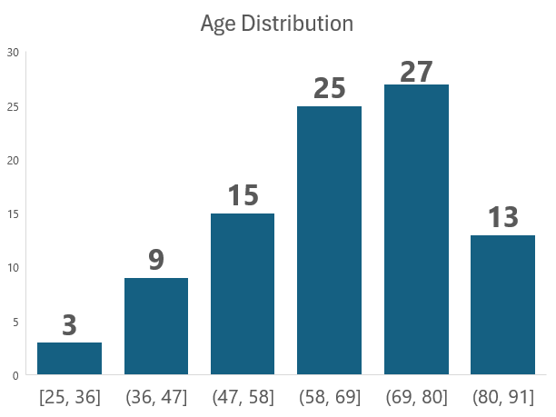
Demographics: Age & Gender

Slide 18
ICU Length of stay
ICU Length of Stay (days) | Number of Patients | Transitioned to Ward
0-3 | 23 | 0
4-7 | 17 | 0
8-13 | 16 | 0
14-30 | 20 | 4
31+ | 16 | 2
Total | 92 | 6
Key insights:
The decision to transition occurred in patients with stays ≥ 14 days
Potential for increased transitions: 36 patients had stays of 14 days or longer
Length of ICU stay + clinical + psych-social factors & our End-of-Life Care decisions

Slide 19
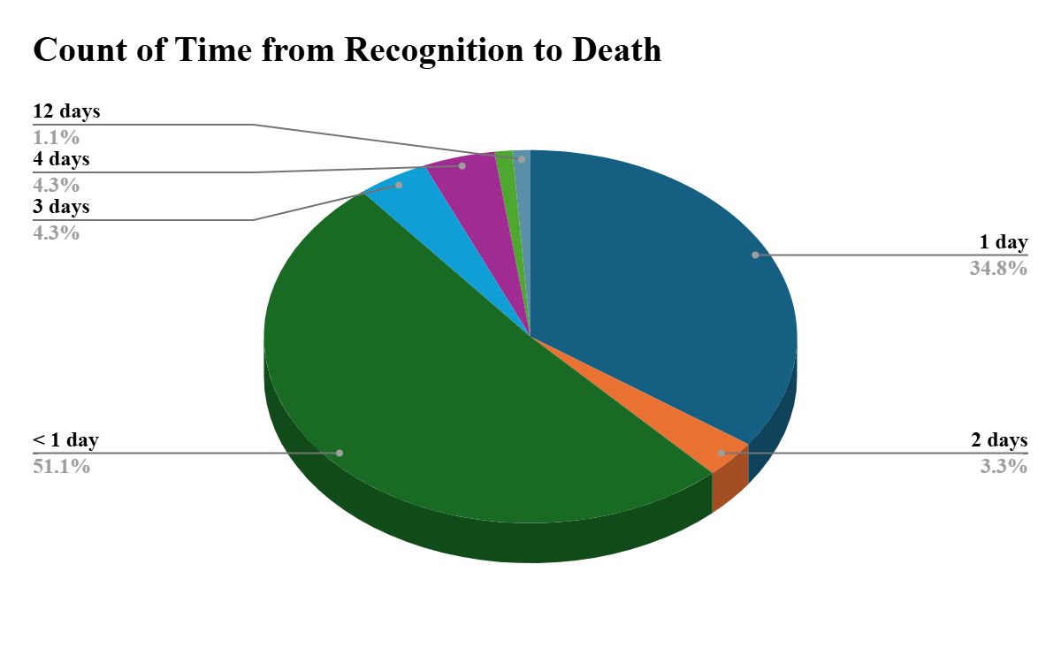
Care Metrics: How many we recognised dying?: 100%
Insights:
89.1% die within 24 hours of being recognized as dying.
Short timeframe emphasizes the need for rapid implementation of end-of-life care plans & consideration of transitions.
So which patients are okay to transition?

Slide 20
Care Metrics: Care Planning - Documentation
Key Insights:
Significant gap between recognizing dying patients and completing CCA
Low rate of CCA documentation & daily reviews indicates a critical area for improvement in end-of-life care planning.

Slide 21
Care Metrics: Care Planning - Documentation
Care Metrics | Yes | No
Spiritual needs discussed | 43 | 49
Family updated | 89 | 3
Key Insights:
Family involvement is high, suggesting good communication with relatives
Spiritual care needs more focus, with less than a third of patients having documented spiritual needs discussions.

Slide 22
Care Metrics: Symptom management & comfort measures
Key Insights:
While mouth care and fluids administration are well-documented
Room for improvement in ceasing observations & oxygen weaning
Low rate of ceasing observations may indicate a need for clearer guidelines on when to discontinue routine monitoring in end-of-life care

Slide 23
Care Metrics: SPC referrals
Key Insights:
SPC services are underutilized, with only about 1 in 5 patients receiving a referral
Short median time from referral to death (2 days) suggests late involvement of SPC, potentially limiting their impact

Slide 24
Care Metrics: Medication management
Key Insights:
Care transition demands starting SC medications

Slide 25
Care Metrics: Transitions of Care to the Ward
Key Insights:
All 6 transitioned patients had SPC referrals
5 out of 6 transitioned patients had longer ICU stays (14-112 days)
Very few patients are transitioned to ward care for end-of-life management.
Patients with longer ICU stays appear more likely to be transitioned, suggesting a potential criteria for earlier consideration of transitions

Slide 26
Knowledge Vs Practice: KSA & CCA-CAD comparison
Aspect of Care | KGS Findings (Staff Reported) | CCA-CAD Data Findings | Alignment/Contradiction | Learning Point
Recognition of Dying Patients | 95% of staff confident in recognizing dying patients | All 92 patients (100%) recognized as dying | Alignment | Maintain current training & practices for recognizing end-of-life stage
Care Planning and Documentation | 85% aware of CCA documentation importance, 60% report always completing it | Only 6.5% had CCA documentation, 4.3% had daily reviews | Contradiction | Investigate barriers to CCA documentation (implement reminders / streamline process to increase completion rates)

Slide 27
Knowledge Vs Practice: KSA & CCA-CAD comparison
Aspect of Care | KGS Findings | CCA-CAD Data Findings | Alignment/Contradiction | Learning Point
Symptom Management | 80% confident in managing end-of-life symptoms | Variable documentation: 13% ceasing observations 71.7% fluids 72.8% mouth care 44.6% oxygen weaning | Partial Alignment | Develop standardized protocols for symptom management Training on importance of documenting all aspects of care
Family Communication | 90% confident in communicating with families | 94.6% of cases had family updates documented | Alignment | Continue current practices Consider sharing successful communication strategies among staff

Slide 28
Knowledge Vs Practice: KSA & CCA-CAD comparison
Aspect of Care | KGS Findings (Staff Reported) | CCA-CAD Data Findings | Alignment/Contradiction | Learning Point
Spiritual Care | 40% confident in addressing spiritual care needs | 30.4% had spiritual needs discussion documented | Alignment, however, 40% confidence is low! | Provide additional training on spiritual care Consider involving chaplaincy services more routinely
Specialist Palliative Care (SPC) Referrals | 75% report knowing when to refer to SPC | Only 19.6% of patients received SPC referrals | Contradiction | Review & revise SPC referral criteria Provide education on benefits of early SPC involvement

Slide 29
Knowledge Vs Practice: KSA & CCA-CAD comparison
Aspect of Care | KGS Findings (Staff Reported) | CCA-CAD Data Findings | Alignment/Contradiction | Learning Point
Medication Management | 85% confident in end-of-life medication management, 70% prefer SC routes | 4.3% SC anticipatory meds, 5.4% SC syringe pump, 73.9% IV anticipatory meds | Contradiction | Implement protocols for SC routes Provide training on techniques of SC administration
Transitions to Ward-Based Care | 50% report considering ward transitions for stable patients | Only 6.5% of patients transitioned to ward care | Contradiction | Develop clear criteria for ward transitions Address logistical barriers Provide training on benefits of appropriate transitions

Slide 30
Recommendations
Category | Recommendation | Specific | Measurable | Achievable | Relevant | Time-bound
Education and Training | EOLC training program | Focus on areas of identified knowledge gaps. | Completion of training program. | Utilize internal resources and expertise. | Enhances staff competency in end-of-life care. | 6 months.
Process Improvement | Create a EOLC management Toolkit | Incorporate all key aspects identified in the survey Communication Documentation Clinical management | Completion and implementation of toolkit | Collaborate with relevant departments to develop the toolkit | Ensures consistency and quality in patient transitions. | 2 months.

Slide 31
Category | Recommendation | Specific | Measurable | Achievable | Relevant | Time-bound
Communication and Awareness | Information campaign about in-hospital support systems | Increase staff awareness of support systems. | Aim to increase awareness from 56% to 90%. | Use internal communication channels for the campaign. | Improves utilization of available support resources. | 1 month
Technology Utilization | Horizon Fellowship: Development of digital platform ( +/-Collaborate with the Cerner team) | Increase staff familiarity with the digital process | Aim to increase familiarity and utilization of digital platform | Seek leaverage & resources from Innovation team | Streamlines the process and reduces errors | 6 months
Continuous Improvement | Phase 2 Audit | Set a target of 10% improvement in all areas of identified gaps. | Survey Feedbacks Data interpretation from Cases | Use data analysed for further improvement | Ensures continuous evaluation and enhancement of end-of-life care practices. | 1-year

Slide 32
Learning points from the survey:
While core principles of end-of-life care are well understood, practical aspects of care transition need more focus
There's a need for better integration of palliative care principles and resources within the ICU setting
Technology and documentation processes present significant challenges and opportunities for improvement in end-of-life care management
Regular assessment of staff knowledge and practices is crucial for maintaining high-quality end-of-life care in the ICU

Slide 33

Action Plan: Horizon Fellowship

