Slide 1



Genesis Ideathon: Final Presentation
Team ID: GEN26-A0H-I166
Team Name: FixedHacks
Domain: Healthcare, Biotechnology & Human Well-being
Amrita Vishwa Vidyapeetham, Coimbatore Campus
Date: 11th October 2026

Slide 2
Presentation Outline
Problem Statement
Problem Understanding
Existing Gaps & Challenges
Our Proposed Solution
Technical Approach
Innovation & Uniqueness
Feasibility & Scalability
Cost for Product
Use Cases
Impacts and Benefits
Sustainable Development Goals
Individual Member Contribution

Slide 3

Problem Statement
How can higher education institutions identify student mental health distress proactively without data exploitation, ensuring total user privacy while seamlessly bridging students to institutional counselors during critical moments?

Slide 4
Problem Understanding
Target Audience: Undergraduate and postgraduate students, particularly hostel residents and quiet strugglers facing intense academic and social pressure.
Core Bottlenecks: Traditional student assistance models are entirely reactive; students hesitate to visit physical wellness centers due to social stigma.
Data Vulnerability: Public mental health apps and chatbots harvest user inputs for model training or commercial profiling, causing severe trust deficits.

Slide 5
Existing Gaps & Challenges
Reactive Frameworks: Wardens and mentors spot behavioral shifts too late, relying on ad-hoc personal observations.
The Privacy Dilemma: Anonymous apps protect student identity but prevent institutional counselors from intervening during serious crises.
Commercial LLM Risks: External chatbots lack human accountability, handle high-risk psychological distress weakly, and pose severe data privacy threats.
Unsolved Need: A campus-governed ecosystem that unifies effortless mood logging, risk-phrase evaluation, and secure escalation paths.

Slide 6
Our Proposed Solution
HAVEN Ecosystem: A secure, college-governed mobile app where student privacy is protected at all costs where data is never used for commercial learning or profiling.
Frictionless Check-In: Upon opening the app, users instantly log their day’s mood via quick options without navigating extra tabs.
Intelligent Risk Evaluation: Optional elaboration text is analyzed for
risk-scoring phrases. Low/moderate risks receive supportive guidance via safe LLM responses.
Immediate Human Intervention: High-risk scores instantly notify the campus counselor and hostel warden (if a hosteller), revealing detailed history exclusively to authorized professionals.

Slide 7
Technical Approach
HAVEN Mobile App Daily Mood Tap, Ex-pression Dashboard
Secure Institution Backend
Phrase Analysis, Risk Scoring Engine
Counselor & Warden Alert Decrypted View for High-Risk Escalation
Complete administrative control by the institution with strict zero data misuse policies.
Tech Stack
Frontend: Flutter / React Native
Backend: FastAPI (Python)
Database: Encrypted PostgreSQL
Security: Institution-Hosted Secure Servers

Slide 8
Innovation & Uniqueness
Institution Governance: Fully controlled by the college administration, eliminating third-party data harvesting and privacy breaches.
Zero-Friction Daily Logging: Instant mood selection on app startup maximizes compliance without feeling like a chore.
Smart Hybrid Triage: Safe LLM handling for mild distress coupled with automated, direct escalation to institutional counselors and wardens for critical risk levels.
Institution Governance: Fully controlled by the college administration, eliminating third-party data harvesting and privacy breaches.
Proactive Outreach vs. Passive Waiting: Unlike standard chatbots that wait passively for a user to type a prompt, HAVEN initiates care the moment the app opens with a frictionless daily check in reaching out to the user first.

Slide 9
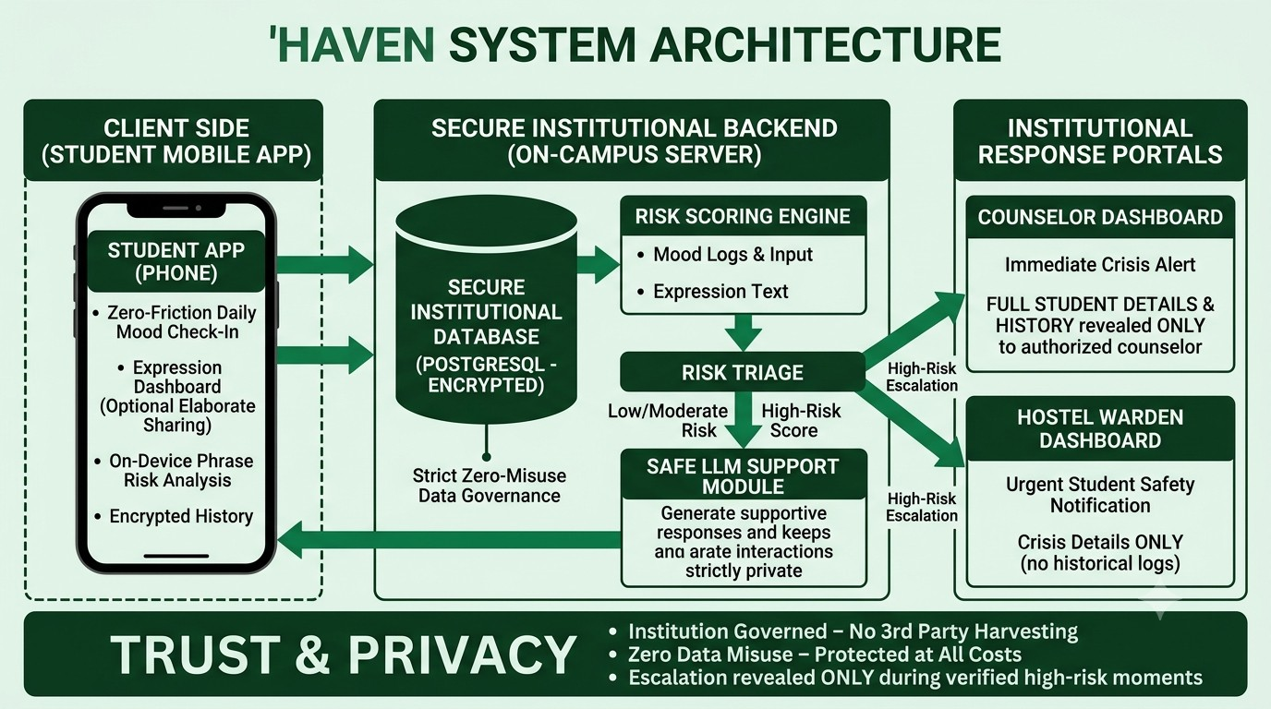
Feasibility & Scalability
Technical Feasibility: Built on open-source cross-platform frameworks (Flutter/React Native) with local encrypted databases on campus servers.
Resource Feasibility: Leverages existing college cloud infrastructure, keeping deployment and maintenance costs minimal.
Operational Escalation: Targeted risk-phrase scoring avoids false alarms and routes only verified high-risk cases directly to authorized human responders.

Slide 10
Cost for Product (Optional)
Development and implementation cost: Rs. 0 (leveraging open-source frameworks and existing institutional cloud resources).
Basic maintenance and server upkeep: Estimated at Rs. 1,500–3,000 per month.
Total estimated pilot budget: Rs. 6,000–12,000 for a 4-month campus rollout.

Slide 11
Use Cases (compulsorily 3 use cases must be there)
Use case 1 (Low Risk): A student logs a tired mood and writes a mild vent. The secure LLM offers comforting reflection, keeping interactions private and reassuring.
Use case 2 (Moderate Stress): Persistent low mood scores over several days trigger supportive check-ins and prompts encouraging a voluntary appointment with the campus counselor.
Use case 3 (High-Risk Crisis): Risk-phrase detection identifies severe emotional distress; an immediate alert is sent to the campus counselor and hostel warden with full details for rapid intervention.

Slide 12
Impacts and Benefits
For Students: Safe, confidential emotional outlet with guaranteed data protection and timely access to real human help.
For Institutions: Proactive crisis prevention, optimized resource allocation for counselors, and enhanced student welfare tracking.
For Society: Breaking mental health stigma on campuses through institutional accountability and trusted care networks.

Slide 13
Sustainable Development Goals (SDGs)
SDG Number | Target Number | Goal Name | Connection
SDG 3 | Target 3.4 | Good Health and Well-being | Promotes mental health and early intervention through secure digital support
SDG 4 | Target 4.a | Quality Education | Creates a safe, inclusive, and supportive campus learning environment

Slide 14
Individual Member Contribution
Member | Contribution or responsibility
Muppalla Rishvita | Use cases, documentation and presentation design
N Sai Sameera Ram | Problem research and literature review
Jiya P | Technical approach and risk-scoring architecture
Nandhana M. Menon | Solution design and privacy governance model

Slide 15
Yukti ID
Yukti ID
IR2026-1051099

