Slide 1

Now more than ever, your safety matters
Sameera Turupu Avinash Bondalapati Aditya Bhamidipati

Slide 2

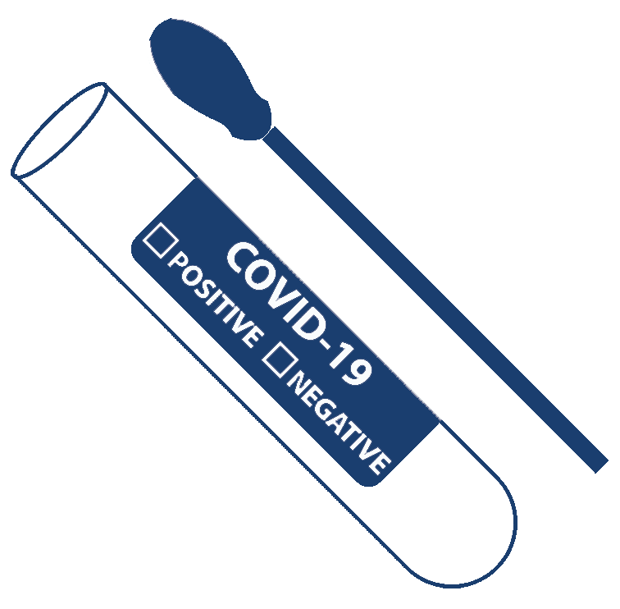

Intent
Hospital management during COVID
Organized registry of service requests
Treatment without hassle
COVID – self assessment
Make 2020 easy
Notes:
As the pandemic is growing, patients are worried if they can get a bedspace, PPE kits, Food, etc., One concern about the impact of COVID-19 on hospitals is ICU capacity. Real time allocation of beds, ICUs may save lives. So this app’s primary focus is hospital management.
At present data on real time hospital bed availability is not accessible to public. It is difficult to find a hospital bedspace and what gets even more challenging is the service requests to tend to. Every second counts!
A treatment without hassle and a timely self assessment, can provide confidence to the user and a sense of trust for the community which will make the rest of 2020 easy for us.

Slide 3

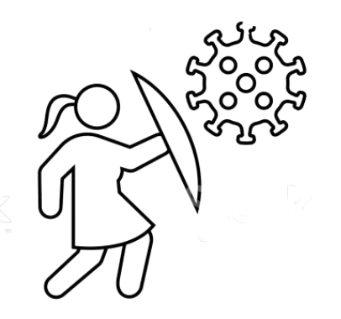



How do we do it?
Take a self assessment
01
Visit testing center to confirm
02
Register for a bed
03
Get your requests attended
04
Fight COVID ☺
05
Notes:
A self assessment is a set of questionnaire that helps to identity if user has COVID.
After the assessment, they can visit a nearby testing center to confirm.
Once the user is COVID positive, they can act fast by registering a bedspace for themselves at the nearby hospital.
Once they are allotted a bedspace and taken initial care of, they can request for additional resources like food, PPE kits, water etc., from the app itself.
Once a request is raised, the hospital management can consolidate the requests and tend to them in the order they arrive.
This keeps hospital management organized and helps the staff and patients to have their needs met with social distancing in practice as every request goes through the app only.
Following social distancing, acting fast and being compassionate to others, we can fight against COVID

Slide 4







Technology stack used

Slide 5

Demo

Slide 6
Future Work
Efficient resources planning using machine learning
Cleanliness notifications
Exposure notification to the user
Travel safety
Together we’ll flatten the curve
Notes:
Perform an analysis of the healthcare system capacity as compared to disease spread forecasts and efficiently plan resources. Perform Density-Based Spatial Clustering to find the hotspots and brace for the impact
Based on the user activity, suggest to perform some safe cleanliness practices.
Based on the proximity of user with others, provide a real time update on exposure to COVID to avoid the densely affected regions.
Determine safest paths through corona affected regions using online - sync and offline strategies.

