Slide 1
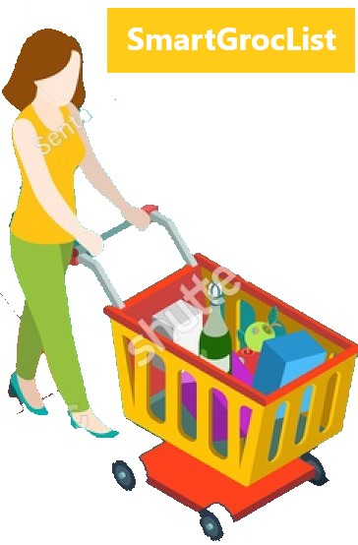
SMART GROC LIST
Buy Daily Groceries Smart Way

Slide 2
The Problem Statement
We tend to buy all groceries from a single store.
Not all items of our cart are discounted ☹
Yet we buy them… Loss Loss Loss

Slide 3
Our Idea!
Save
Money !
Plan
Smartly!
Buy
Smartly!
Be
Smarter!!!

Slide 4
Whom do we target?
We, Women!
We, Students!
Anyone else who wants to be smarter!

Slide 5
How do we do it?
Let us know the items to be bought
We suggest you the nearest stores and the list of items to be bought at each store
You save money!

Slide 6
What we implemented?
User enters the list of groceries
We compare each item’s price from various stores nearby, like Walmart, Kroger, Target etc.
We categorize the items with least prices at each store as sub lists
User buys the items and mark them as done!

Slide 7
Add-ons
Forgot any item? We remind you!
Our application identifies user’s buying patterns and suggests any missed items
Sub lists of buying suggestions is real-time data

Slide 8
Future Work
We plan to convert this web application to a cool mobile app!
We plan to implement OCR (Optical Character Recognition) – Text detection in images
Scan checklist from sticky notes, white-boards.
Scan bills to mark completed items.
Include radius filter to find nearest grocery stores – Saves Time!!
Mobile Notifications/Reminders when user is near the stores
Upload any image – We will suggest related items
For example, upload your dog’s image, we will suggest items like dog food.

Slide 9
Technology Stack
Bootstrap
JavaScript
JQuery
AJAX
Python
Flask
REST APIs
Machine Learning

Slide 10
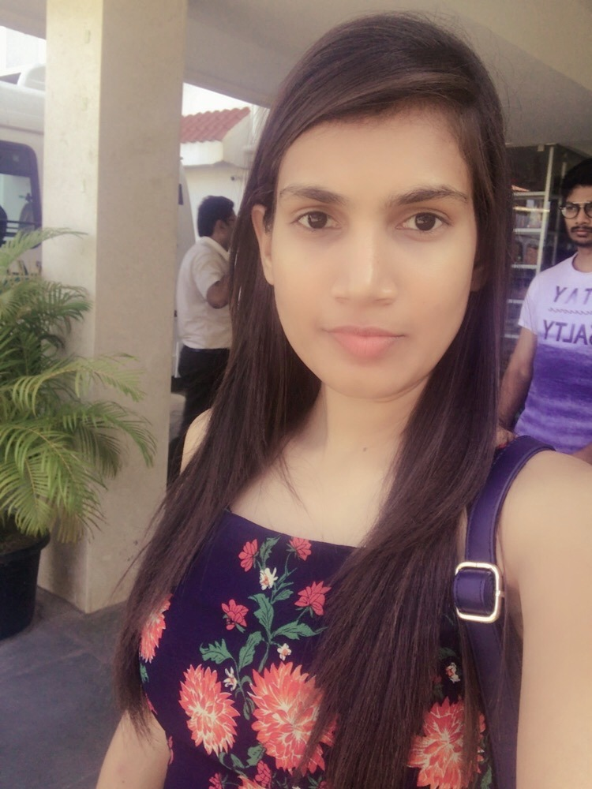

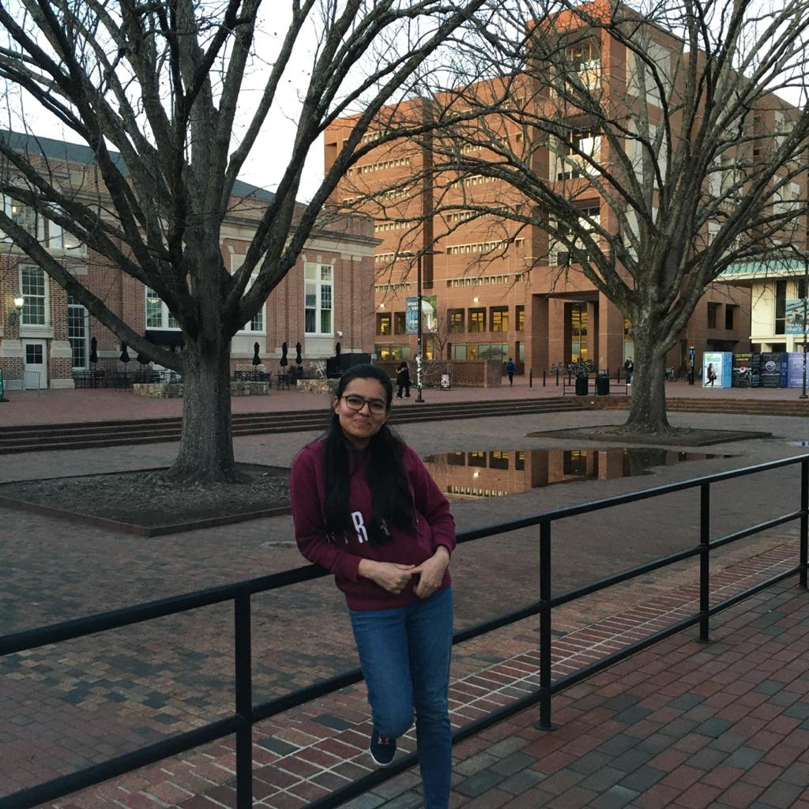
Our Team
Sameera Turupu
Umaraj Potla
Shafali

Slide 11
THANK YOU!

