Slide 1


Sentimental Analysis on YouTube
Sameera Turupu Aditya Bhamidipati
Master’s Computer Science
Georgia State University

Slide 2

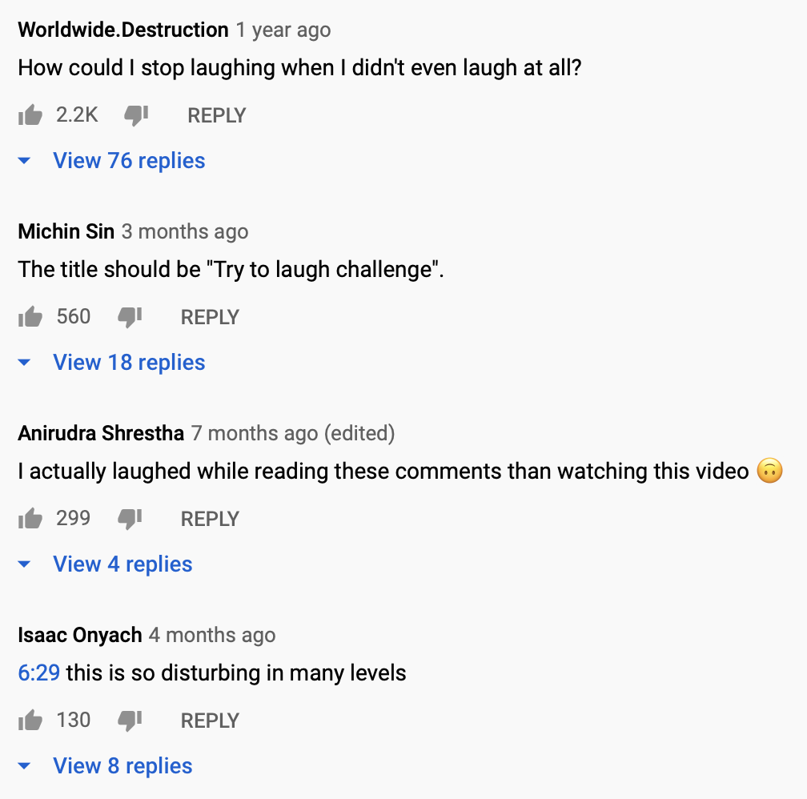

Motivation
Likes can be misleading which is why comments are also necessary for determining the polarity of a video
Tag is another measure of how popular a video is.
E.g., #funny, #dogs, #crazy
Notes:
Generally, the quality, relevance, and popularity of the video is maintained based on likes, dislikes, views and tags. Sometimes irrelevant and low-quality videos rank higher in the search result due to the number of views or likes, which seems untenable.
For example: in the image this video has 152k likes and is considered on of the most popular video but if you see the comments they are negative.
Tags play an important role especially for youtubers as they earn money from advertisers based on their views. They often ponder with the question “What type of videos should i make in order to get more user views?” and more specifically what should be the title and tags to attract users.
To minimize these issues, we present a sentimental data analysis approach to user comments and tags.

Slide 3


Next Steps
Introduction
Input description
Exploratory data analysis
Technology stack
Data Preprocessing
Architecture
Comment analysis
Data pipeline
Tag analysis
Collaborations

Slide 4
Introduction
YouTube is one of the world’s largest video sharing platforms, where videos are uploading continuously by the millions of users.
When we search for a speciﬁc video, sometimes irrelevant video appears due to popularity based on likes and views
Comments play a active role to the actual polarity
Search results are title and tag based
Notes:
YouTube is one of the world’s largest video sharing platforms, where videos are uploading continuously by the millions of users (companies, private persons, etc.).
When we search for a speciﬁc video through some keyword on one particular topic, the most popular video comes (which are rated based on views/likes by the users) ﬁrst in search panel based on that given keywords.
some problematic issues arise in searching, such as inconsistency, irrelevancy, etc.
Sentimental analysis on comments along with likes, dislikes and views helps to correctly classify the polarity of the video.
Search results mainly focus on title and tags, so analysis on tags will help increase the popularity of a video

Slide 5
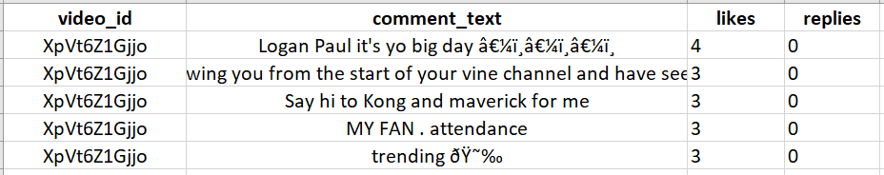
Data description
Rows: ~50000
Source: https://www.kaggle.com/datasnaek/youtube-new
Notes:
There are two kinds of data files, one includes comments and one includes video statistics.They are linked by the unique video_id field.
The headers in the comments file are:
video_id (Common id field to both comment and video csv files)
Comment_text
likes
replies
Number of Rows - 50,000

Slide 6
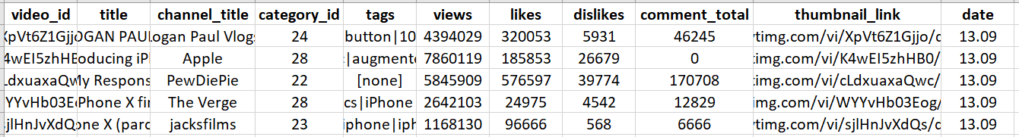
Data description contd..
Rows: ~50000
Source: https://www.kaggle.com/datasnaek/youtube-new
Notes:
The headers in the video file are:
video_id (Common id field to both comment and video csv files)
title
channel_title
category_id (Can be looked up using the included JSON files, but varies per region so use the appropriate JSON file for the CSV file's country)
tags (Separated by | character, [none] is displayed if there are no tags)
views
likes
dislikes
thumbnail_link
date (Formatted like so: [day].[month])

Slide 7
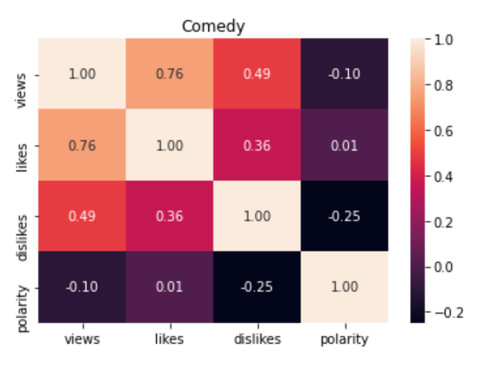
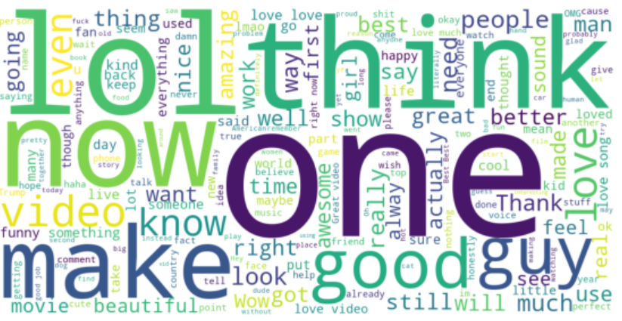
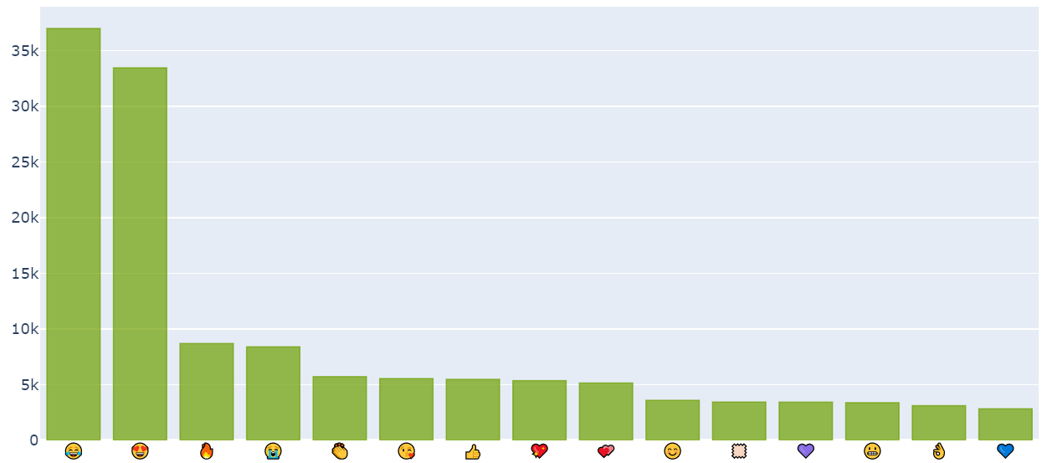

Exploratory data analysis
Notes:
Coming to the exploratory data analysis
Here is the word cloud for positive comment sentences as you can see the words lol, think etc are most used in the positive comments
We have also built a correlation matrix for each category like comedy, entertainment etc showing the correlation between likes, views, dislikes and polarity of the comments.
The values of the correlation coefficient can range from -1 to +1. The closer it is to +1 or -1, the more closely are the two variables related.
The positive sign signifies the direction of the correlation i.e. if one of the variables increases, the other variable is also supposed to increase.
Here views and likes are highly correlated whereas dislikes and polarity are least correlated which means the number of dislikes is not proportional to comments polarity for comedy category.
And then coming to the most used emoticons in the comments as we can see that “Face with Tears of Joy” emoji is mostly used and the “blue heart” emoji is the least one used.

Slide 8
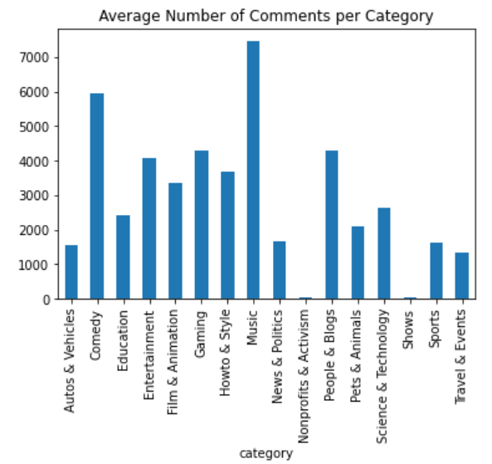
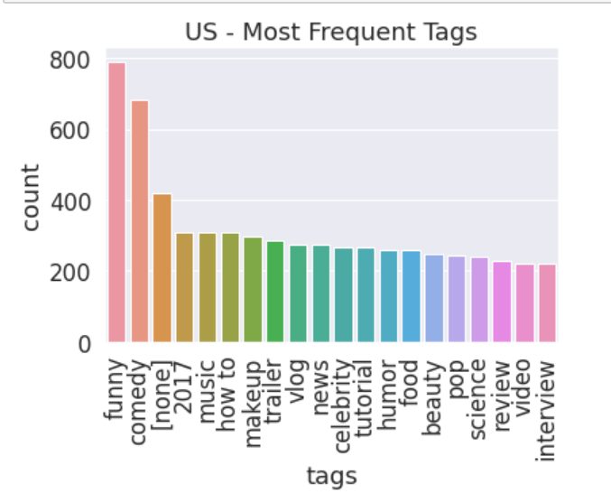
Exploratory data analysis contd..
Notes:
Here is an analysis on most frequent tags on US YouTube videos. As you can see, funny and comedy tags are highly used. Review and interview are least used tags on US Youtube videos.
An analysis on average number of comments per category states that Music videos have highest number of comments, Next comes comedy category. Also, Nonprofits and activism as well as shows have the least number of comments.

Slide 9





Technology Stack
Notes:
The technology stack we used are
Jupyter notebook
Apache Spark
Tableau - visulization
Python
Kaggle – data collection

Slide 10
Data preprocessing
Removing Punctuations, Numbers and Special Characters
Removing Short Words
Changing the text to lowercase
Tokenization - “This is a sample” -> [“This”, “is”, “a”, “sample”]
Lemmatization - example: “singing” -> “sing”
Notes:
As part of data preprocessing
We have removed punctuation marks, numbers and special characters using regular expression
Short words - words with length less 3 are also removed as they will mostly be stop words or abbreviations
Lowercase - made the text case insensitive for consistent processing
Tokenized the comment text - Tokenization is a step which splits longer strings of text into smaller pieces, or tokens.
Lemmatization is converting different forms of a single word to its root form.

Slide 11
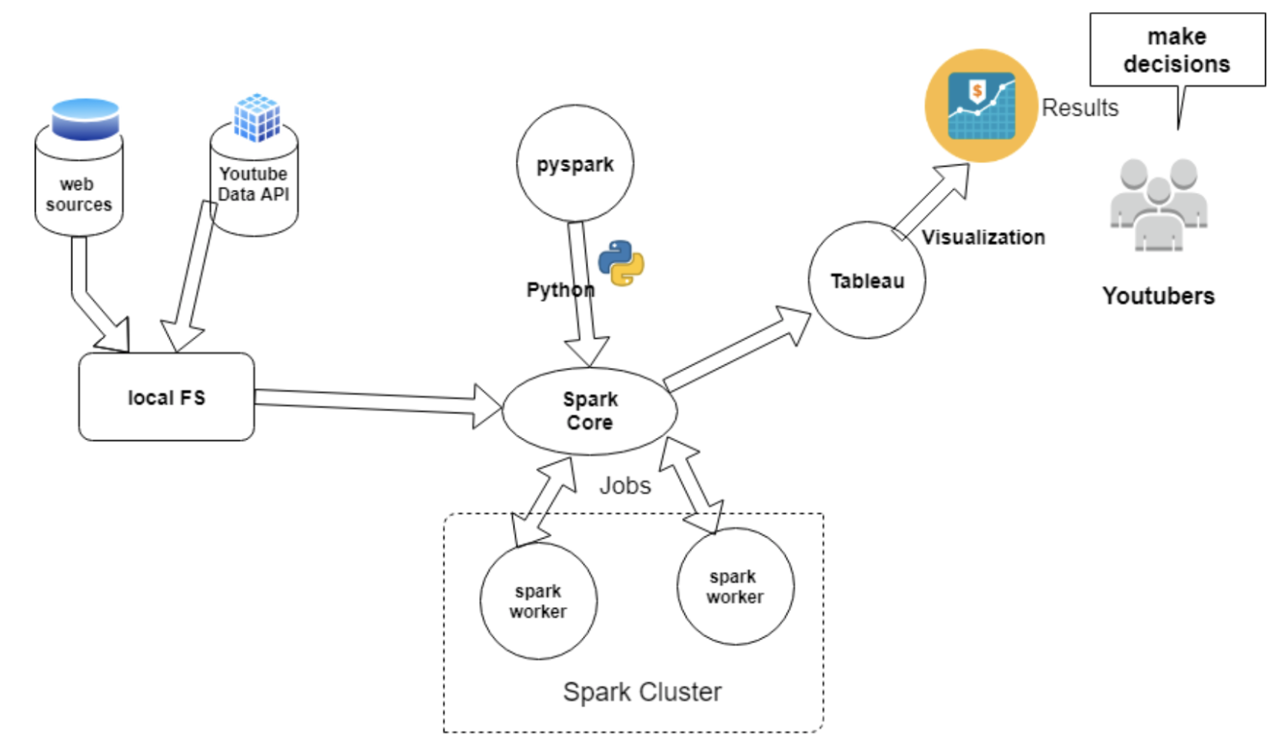
Architecture
Notes:
The data extracted from youtube api and kaggle data set are saved to local file system in KVM
Data from local system is loaded to spark engine using pyspark API (python)
Spark sends data and tasks ie map and reduce to worker nodes to do the parallel processing.
Spark sends output back to the local system
And then output is fed to matplotlib and tableau for visualizations and the results are used for decision making

Slide 12
Comment analysis
Input - Preprocessed data
TextBlob for finding the polarity of comments in RDD
Aggregated the total comments, likes, views and dislikes for a video using Spark SQL
Applied Multiclass Logistic Regression on analysed data using Spark ML
StringIndexer - label encoding
OneHotEncoderEstimator - categorical value represents the numerical value of the entry in the dataset.
VectorAssembler - takes multiple columns as input and outputs a single column
Accuracy - ~79%
Notes:
After preprocessing the data, this is given as input to RDD
We have used textblob, a python library for processing textual data (comments text)
It provides a simple API for diving into common natural language processing (NLP) tasks such as part-of-speech tagging, noun phrase extraction, sentiment analysis, classification, translation, and more
Collecting the data from RDD
Using Spark SQL joins(), we have aggregated USVideos and USComments files for the comments, likes, views and dislikes
We have applied multiclass logistic regression on analysed data using spark ML
The StringIndexer class performs label encoding and must be applied before the OneHotEncoder which in turn converts categorical variables into a form that could be provided to ML algorithms to do a better job in prediction. The categorical value represents the numerical value of the entry in the dataset.).
The VectorAssembler class takes multiple columns as input and outputs a single column whose contents is an array containing the values for all of the input columns.
Obtained an accuracy of 79%

Slide 13
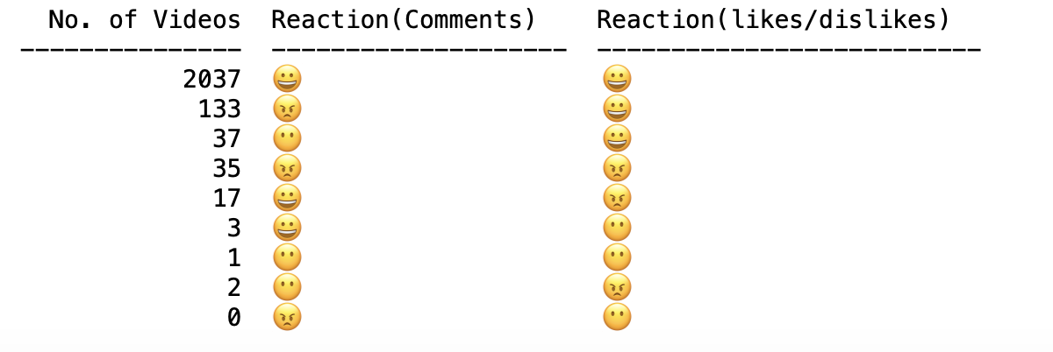
Comment Analyis Contd.
Notes:
Output of our analysis with respect to comments and reactions (likes/Dislikes)
Grinning Face emoticon is for a positive reaction
Face Without Mouth emoticon is for a neutral reaction
Angry Face emoticon is for negative reaction
For the majority of videos, The reaction with respect to comments and likes/dislikes is positive
For 133 videos though based on likes it is a positive videos, the comments state otherwise which is misleading
For 17 videos more number of dislikes state that the videos are negative but their comments state otherwise.

Slide 14
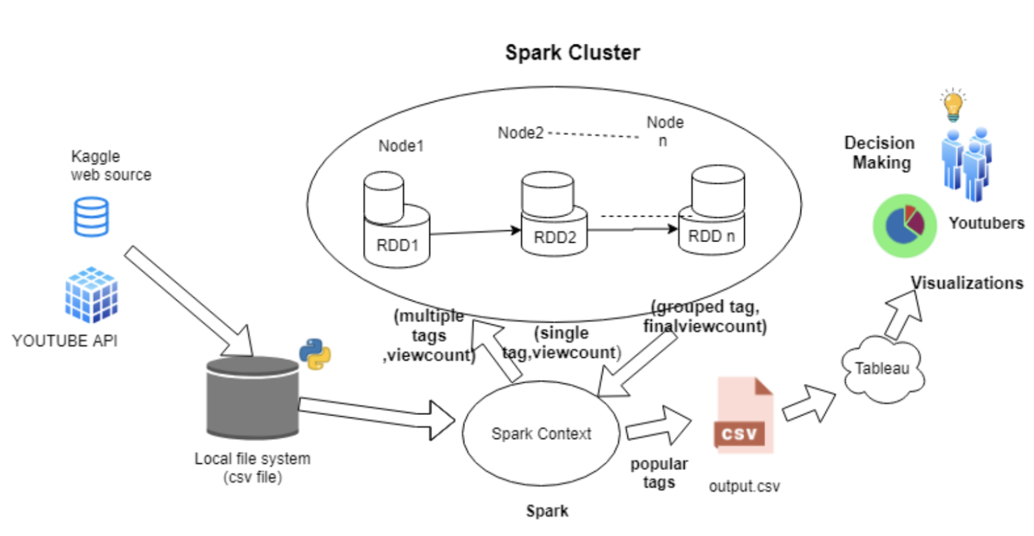
Data Pipeline for Tag Analysis
Notes:
Data collected from different sources are saved locally and fed to spark.
Spark transmits data into RDDs to its worker nodes. All the worker nodes execute their tasks and send the sorted output back to the local FS.
Outputs are visualized in tableau for decision making.

Slide 15
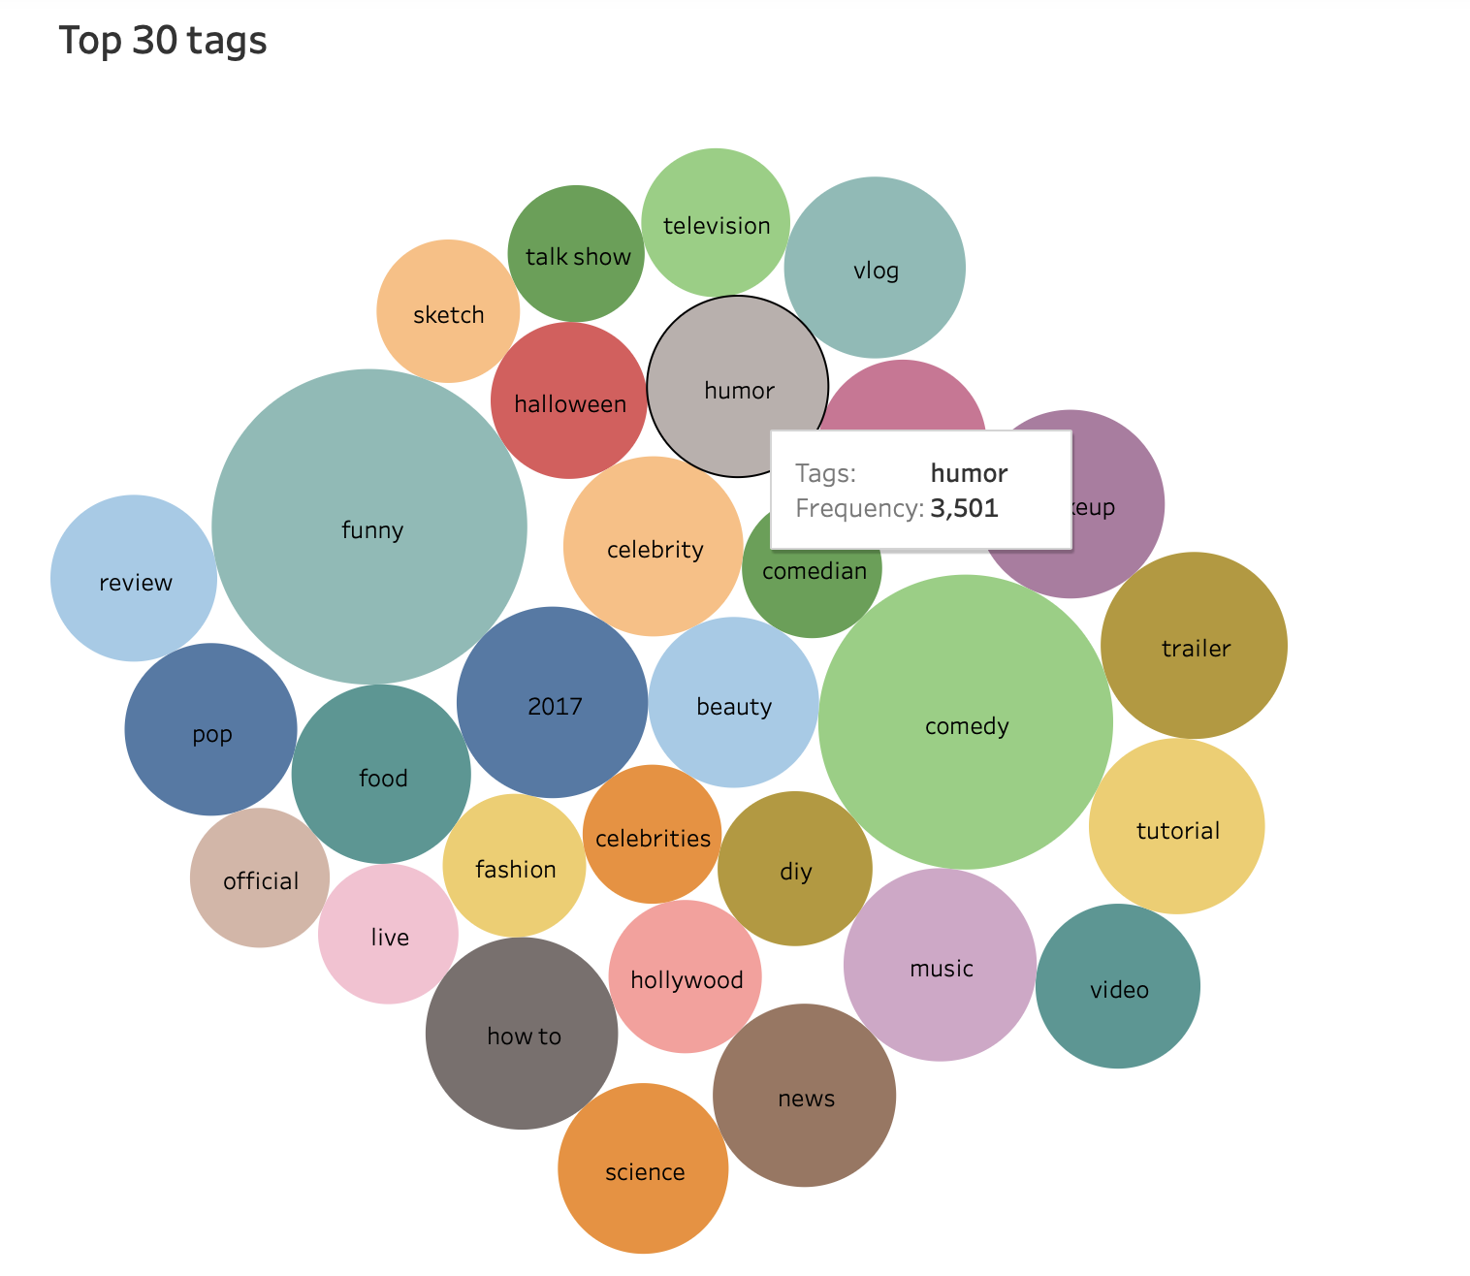
Tag Analysis
Notes:
We read data from local FS and select only tags and views columns into RDD
We then split tags by separator and associate each tag with view count and reduce by same key
We then applied log on views because they could sum to large values
Finally we sorted the top trending tags by view count and have written it to disk.
From the packed bubble visualization it is evident that during the time data is collected, comedy and funny videos grab the most user views. Any YouTubber can choose video content with the help of trend visualization.

Slide 16
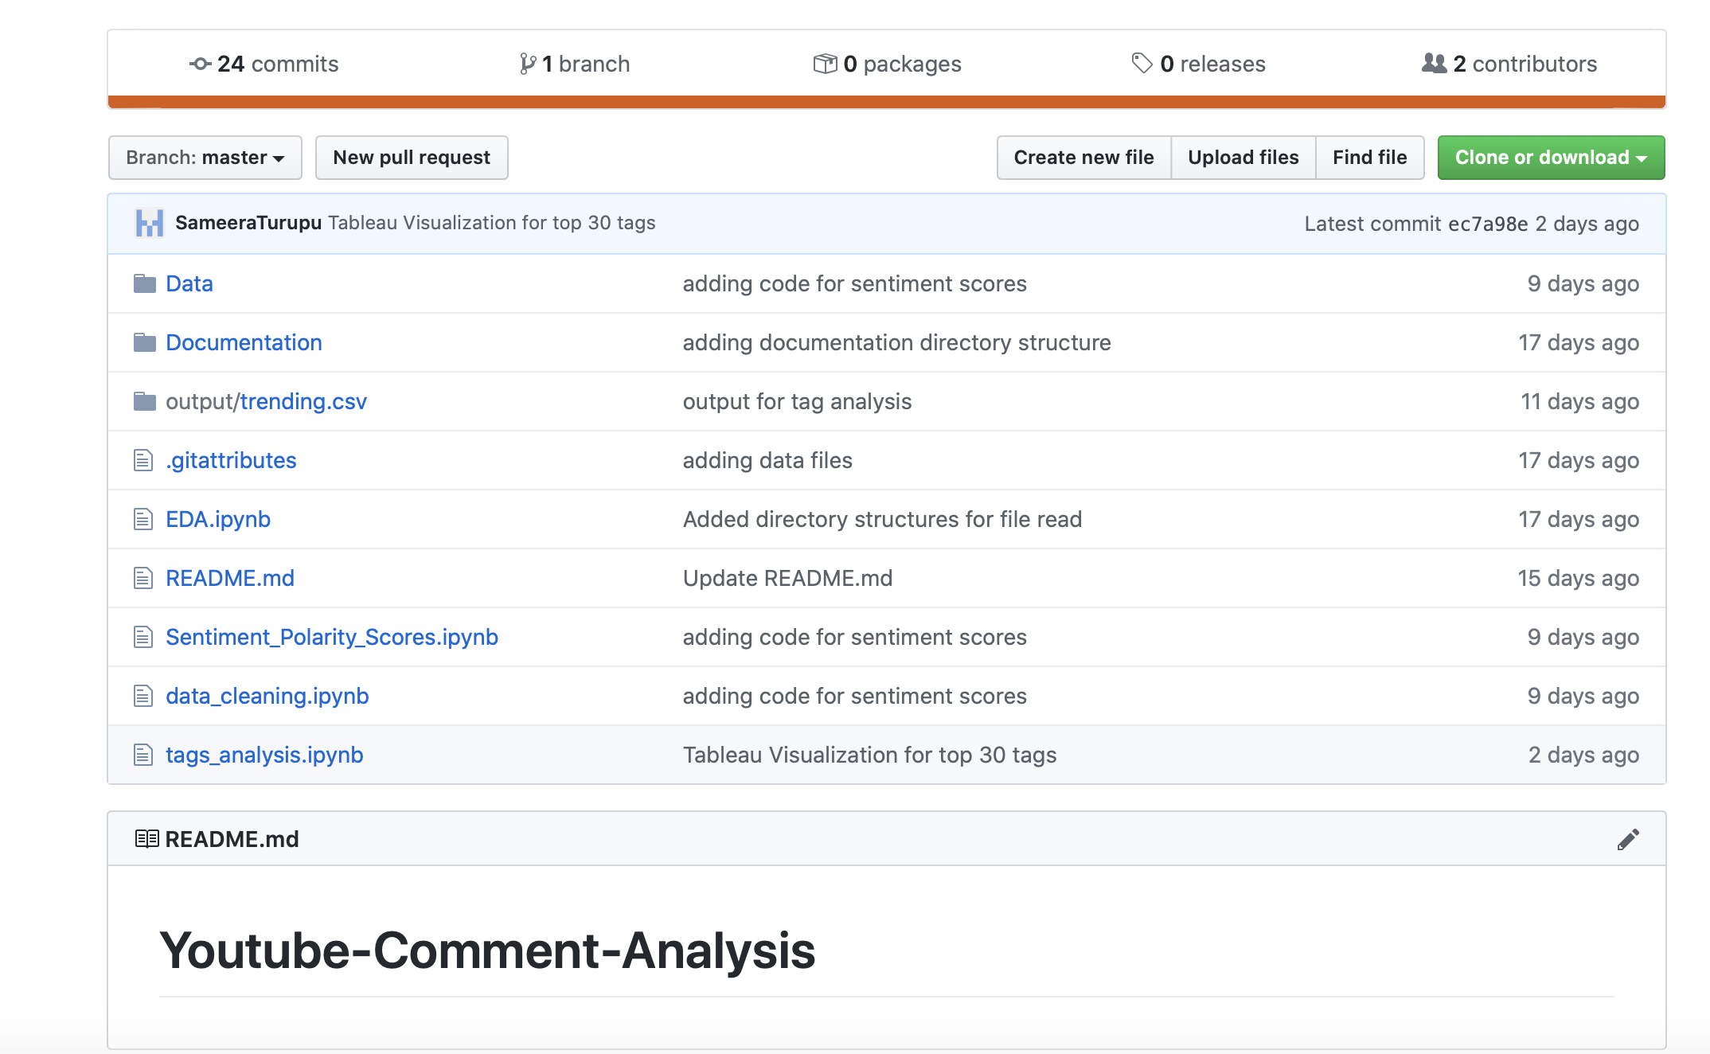
Github
Notes:
We have used Github as a version control system for collaboration and revisioning

Slide 17
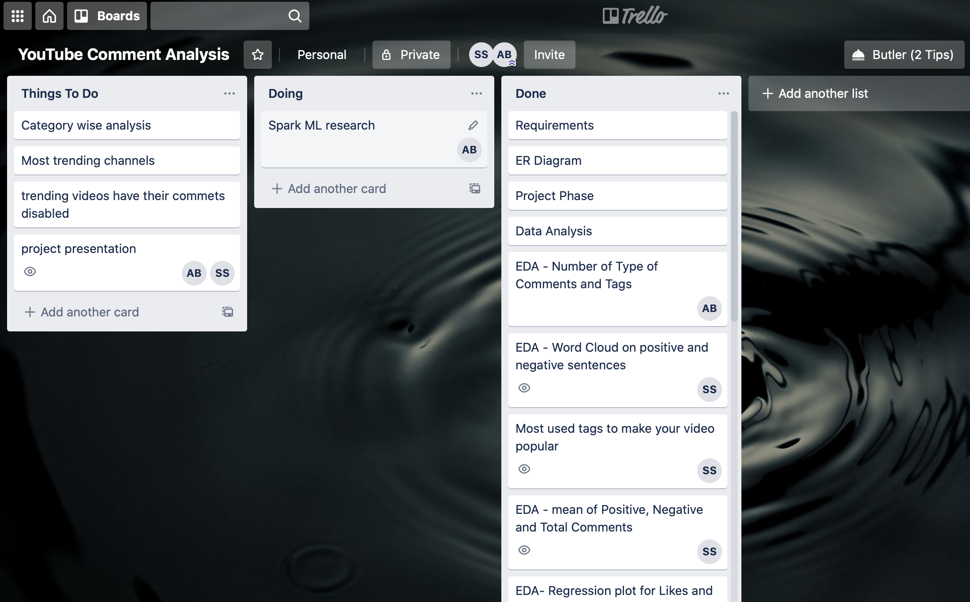
Trello
Board
Notes:
We have used the trello tool to define workflow, manage tasks and track the progress of work done by the team

Slide 18
Thank You

