Slide 1


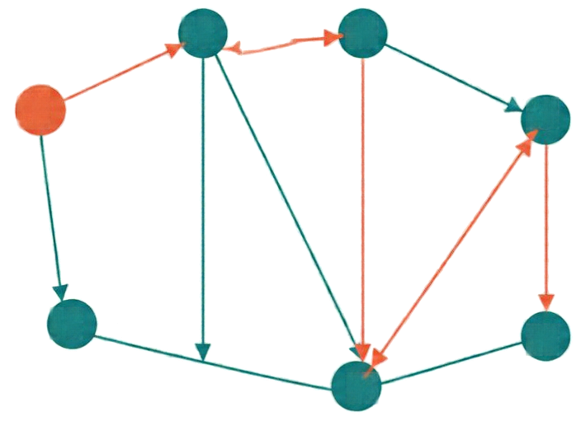

Dijkstra’s Algorithm:
Optimal Path Computation in Edge-Weighted Graphs
1
3
2
4
7
Single-Source Shortest Paths 📍 Greedy Optimality
Min-Heap Analysis 📍 Routing Applications
0
3
Design & Analysis of Algorithms (DAA)
2
4
CA-3 • Component 2
5
1
1
2
Sameer Karadbhajne
4
6
PRN 25070521291
SEC E(E2)
3
5
6
Generated using Canva
Source material attribution: NotebookLM

Slide 2

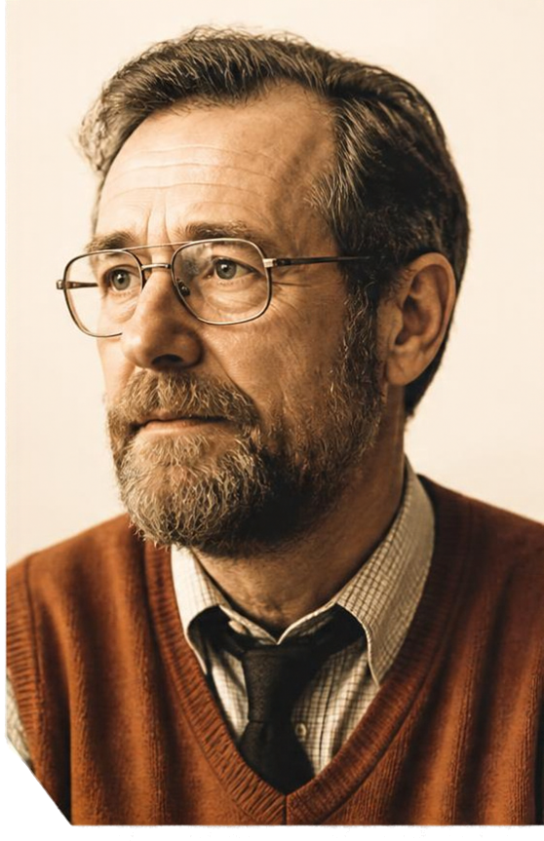


Historical Genesis
and SSSP Foundations
1956
Edsger W. Dijkstra conceived the algorithm
1959
Published after his initial work
20 minutes
Created to demonstrate the ARMAC computer at Mathematisch Centrum, Amsterdam
64 cities
Original demonstration used a simplified road network of major Dutch cities
SSSP PROBLEM
CORRECTNESS
KEY PRINCIPLES
RELATION TO BFS
Find minimum cumulative edge weight from a source to every other vertex in a weighted graph
Requires
non-negative
edge weights
for strict
correctness
Greedy choice
Bellman's Principle
of Optimality
BFS solves shortest paths in unweighted graphs; Dijkstra extends to weighted graphs with non-negative edges
SETTLED DISTANCES INCREASE MONOTONICALLY

Slide 3


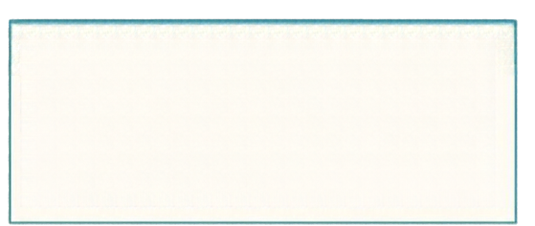



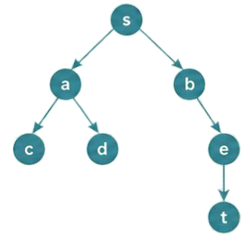
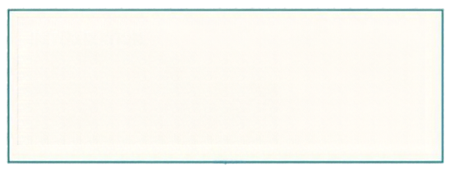

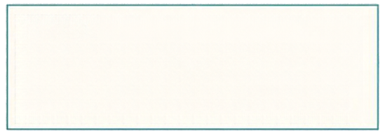

Edge Relaxation, Invariants, and Path Reconstruction
RELAXATION STEP
PATH RECONSTRUCTION
Tentative distances are upper bounds
on the true shortest distances.
if dist[u] + weight(u, v) < dist[v]
dist[v] ← dist[u] + weight(u, v)
prev[v] ← u
Follow prev[ ] links backward from target to source.
Time: O(V)
Relaxation tightens these bounds;
they only decrease until optimal.
INITIALIZATION
dist[s] = 0
dist[v] = ∞ for v ≠ s
prev[v] = UNDEFINED
Settled nodes have final shortest paths due to non-negative edge weights.
Predecessor links form a shortest path tree used to reconstruct any optimal path.
PROCESS
Pick u with minimum tentative distance
among unsettled nodes
Add u to settled set; relax all out-edges
The tree is acyclic and spans all reachable nodes.

Slide 4


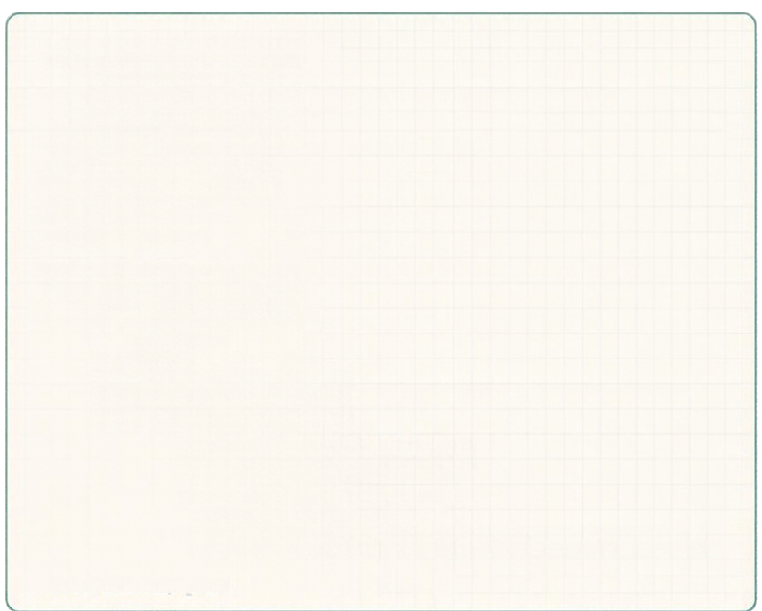

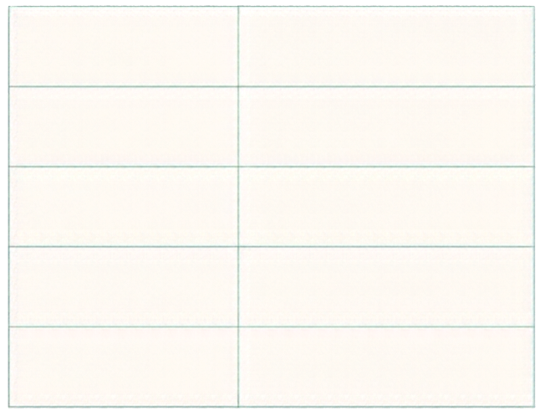
Data Structures and
Complete Readable Pseudocode
for each vertex v in V:
dist[v] = ω
prev[v] = UNDEFINED
Data structures used
Adjacency list
Stores (neighbor, weight) pairs for each vertex
dist[s] = 0
Q = MinPriorityQueue()
Q.insert(s, 0)
S = empty set
dist[]
Array of tentative distances
initialized to ∞
while Q not empty:
u = Qextract_min()
if u in S:
prev[]
Array of predecessors to
reconstruct paths
continue
S.add(u)
for each neighbor v of u:
if v not in S:
Min-priority queue Q
Supports extract_min and
decrease_key or duplicate inserts
alt= dist[u] + weight(u, v)
if alt < dist[v]:
dist[v] = alt
prev[v] = u
Q.insert(v, alt)
Settled set S
Holds vertices with finalized
shortest distances
# or decrease_key if supported
return dist, prev

Slide 5



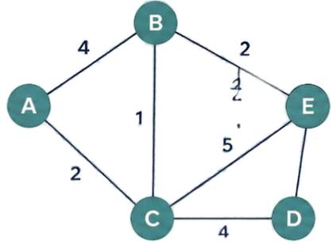
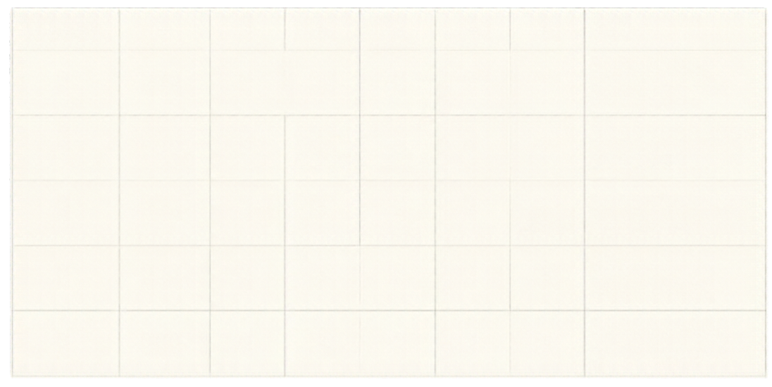
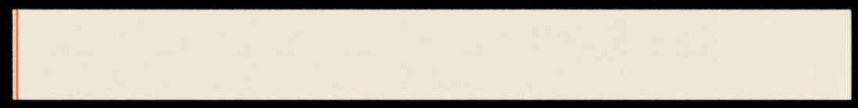
Exact Worked Example
Five-Vertex Graph | Source A
Step
Selected u
dist[A]
dist[B]
dist[C]
dist[D]
dist[E]
Action and settled set S
Initialization
0
σ
σ
σ
σ
S = {}
1
A (0)
0
4
2
σ
σ
Update B=4, C=2.
Settle {A}
2
C (2)
0
↓
2
6
7
Update B 4→3, D=6, E=7. Settle (A, C)
(4 → 3)
3
B (3)
0
3
2
6
5 ↓
Update B →-5, D stays 6.
Settle (A, C, B)
(7 → 5)
GRAPH
Vertices: A, B, C, D, E | Source: A
4
E (5)
0
3
2
6
5
No updates.
Settle {A, C, B, E}
FINAL SHORTEST PATHS
A=0
C=2
B=3
E=5
D=6
5
D (6)
0
3
2
6
5
All reachable settled.
S = {A, C, B, E, D}
Shortest distances from A: A=0, C=2, B=3, E=5, D=6
Paths: A, A → C, A → C → B, A → C → B → E, A → C → D

Slide 6



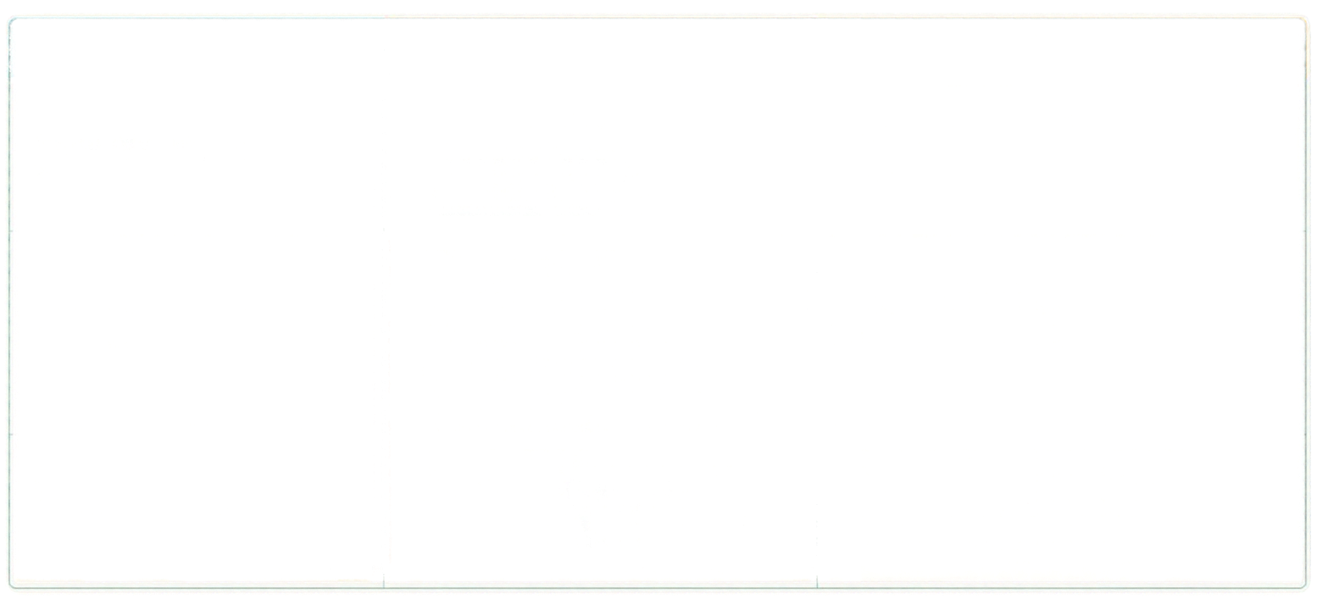


Three-Column Complexity and
Data Structure Trade-offs
DATA STRUCTURE
TIME COMPLEXITY
NOTES AND USE CASES
Unsorted Array /
Linear Scan
O(V² + E) = O(V²)
Extract-min: O(V)
Decrease-key: O(1)
Storage: O(V) auxiliary arrays
Ideal for dense graphs
(E ≈ V²)
O((V + E) log V)
Extract-min: O(log V)
Decrease-key: O(log V)
or laxy duplicate inserts
Storage: O(V + E) including adjacency list and heap entries
Binary
Min-Heap
Industry standard
for sparse graphs
O(E + V log V)
Extract-min: O(log V) amortized
Decrease-key: O(1) amortized
Complex pointers, large constants may slow practical use
Theoretically strongest but
less common in practice
Fibonacci Heap

Slide 7

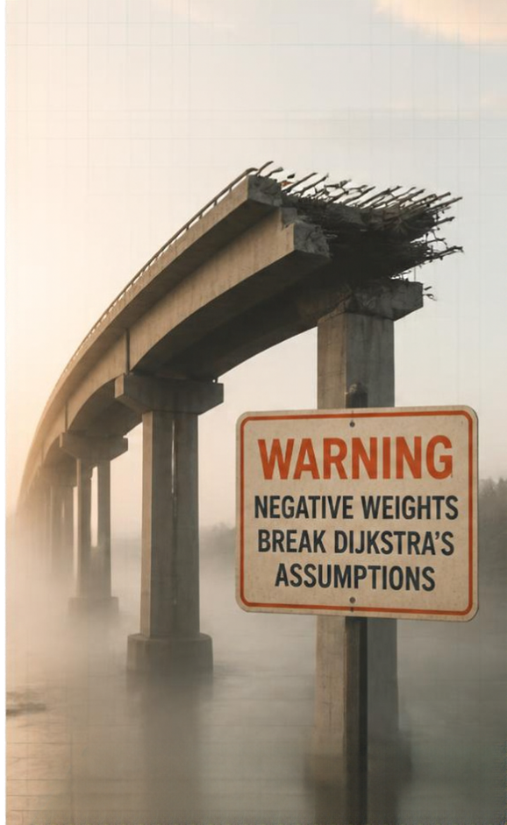

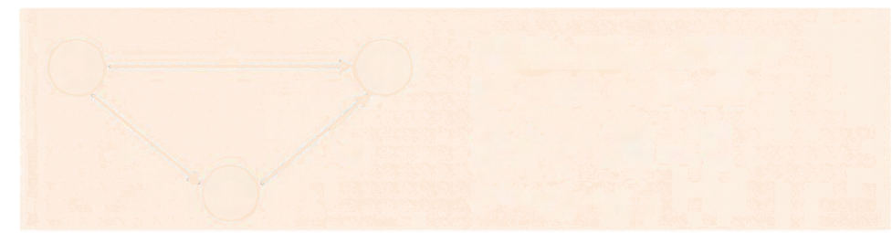
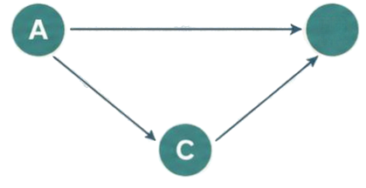


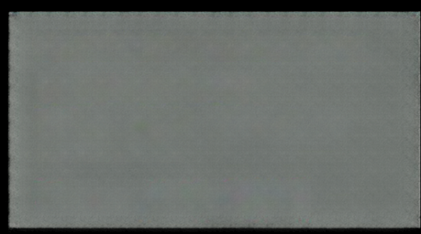
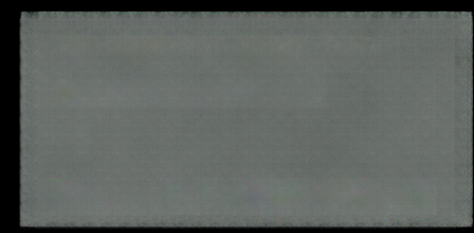

Negative Weights and Bellman–Ford Fallback
Dijkstra's greedy choice fails with negative edge weights.
3
B
Dijkstra settles B at 3 first, but path A→C→B costs
5 + (−4) = 1
5
−4
which is shorter.
Negative cycles make costs decrease without bound.
Bellman–Ford
Dijkstra (with binary heap)
Relaxes all E edges for V–1 iterations
Requires non-negative edge weights
Supports negative edges
Cannot detect negative cycles
Performs a Vth iteration to detect negative cycles
Time complexity: O(V•E)
Time complexity: O((V + E) log V)

Slide 8
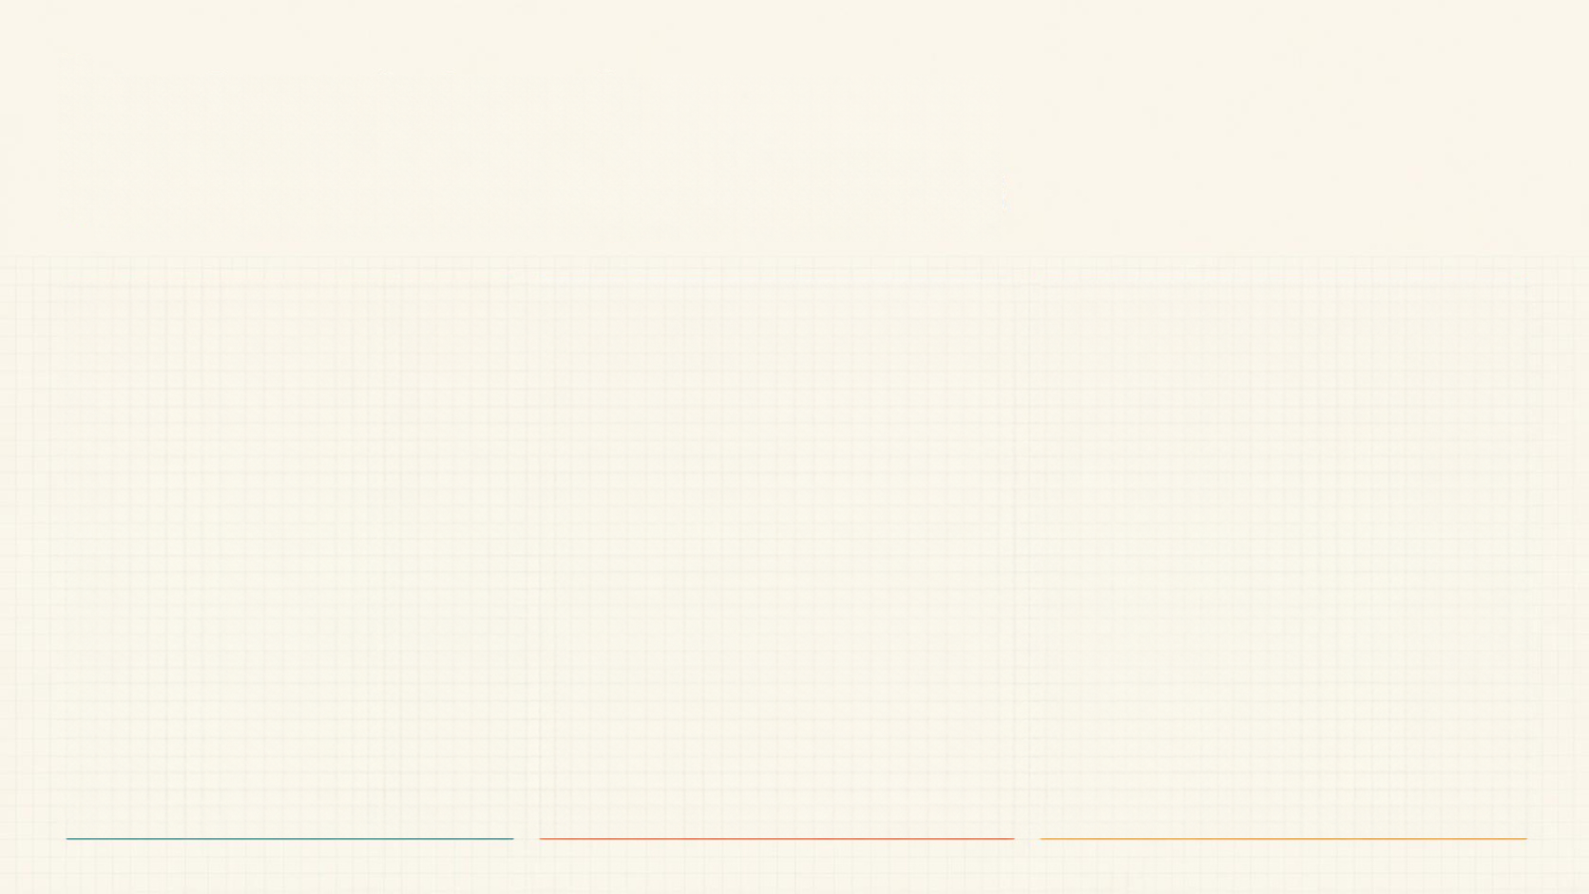






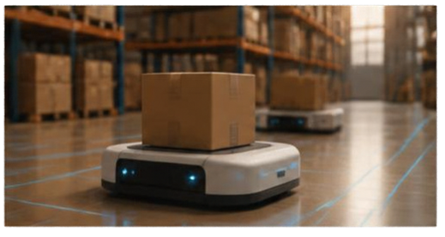
Industrial and
Real-World Applications
Computer Networking / Telecom
Geospatial Navigation
Robotics, AI, and Supply Chain
Protocols: OSPF and IS-15 compute
shortest path trees.
Platforms: Google Maps, OpenStreetMap
model road networks with travel-time weights.
Automated Guided Vehicles (AGVs) use
grid-based pathfinding.
Edge weights represent latency,
bandwidth, monetary or QoS cost.
Techniques: Contraction Hierarchies precompute shortcuts for fast routing; A* combines path cost with heuristic.
Uniform-cost search in state spaces.
Scheduling in flight, freight, and container logistics.
Dynamic rerouting after link failures.
Shortest connection paths in social graphs.
Adapts to dynamic traffic changing edge weights.

Slide 9
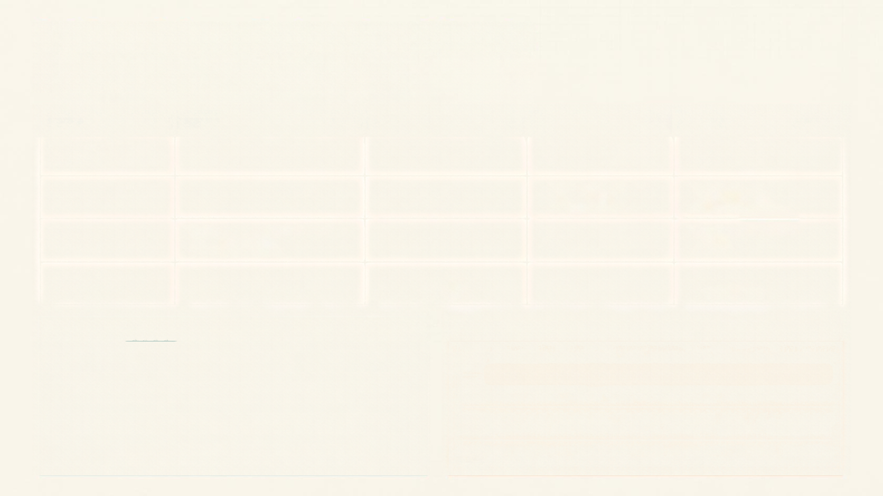

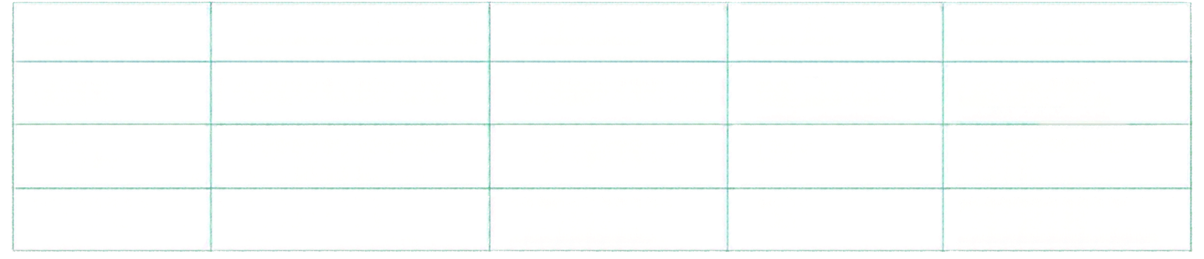

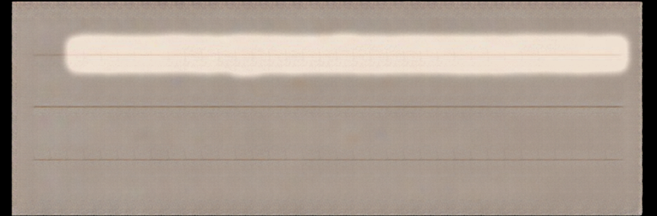



Algorithm-Selection Matrix and Key Takeaways
Algorithm
Problem Scope
Weight Constraint
Time Complexity
Best Use
BFS
Single-source, unweighted/unit costs
None (unit costs)
O(V + E)
Hop-count routing
Dijkstra
Single-source, weighted graphs
Non-negative weights w ≥ 0
O(V + E) log V) with binary min-heap
Weighted routing, OSPF, GPS, robotics
Bellman-Ford
Single-source, weighted graphs with negative edges
Negative edges allowed
O(V + E)
Negative-cycle detection, validation
Floyd-Warshall
All-pairs shortest paths
Arbitrary weights but no negative cycles
O(V³)
Dense graphs, all-pairs matrices, transitive closure
DECISION RULES
KEY TAKEAWAYS
Equal weights → BFS
01
Greedy optimality holds only for non-negative weights.
Sparse, non-negative weighted graph → Dijkstra + binary min-heap
02
Relaxation reduces upper bounds to true shortest distances.
Negative edges or negative-cycle detection → Bellman-Ford
03
Binary heaps perform efficiently on sparse graphs.
All-pairs on small/dense graph → Floyd-Warshall
04
Verify graph constraints before selecting an algorithm.

