Slide 1

The Codeway: The Interactive Coding Platform
Minor Project Presentation
Sameer Khan, Faculty no.: 24CAMSA104
Course: MCA (2nd year), Department of Computer Science, AMU

Slide 2
Introduction to The Codeway
The Codeway is a modern online coding platform built with MERN that uses Judge0 to run code smoothly.
All-in-One Environment
Enhanced Learning
DSA problem-solving challenges
Visual tools for learning data structures and algorithms
(DSA)
Engaging coding contests
AI-powered mock interviews (to help you practice
for real interviews)
Forum to ask and answer doubts together
Help from both other learners and AI

Slide 3
Addressing Current Platform Limitations
Existing coding platforms often fall short in providing a truly comprehensive and integrated experience for students.
Platforms like LeetCode, GeeksforGeeks, and Codeforces, while excellent, often lack:
This results in common student struggles:
Have to keep switching between many tools and websites
AI-powered interview preparation tailored to individual needs.
Can’t get hint to tricky coding questions
An integrated DSA Visualizer for conceptual understanding.
Not fully prepared for technical interviews in one place
Efficient, real-time doubt resolution mechanisms.

Slide 4




The Codeway: Our Integrated Solution
The Codeway is a single platform that helps with coding and interview preparation in one place.
Multi-Language Code Execution
Run code in many programming languages quickly and correctly.
Real-time Contests
Join coding competitions, see rankings, and practice your competitive coding skills.
AI-Powered Assistance
Get smart help for doubts, debugging, and practice interviews.
Personalized Analytics & Premium Features
Track your progress, get tips for improvement, and follow custom learning paths.

Slide 5

System Architecture Overview
he Codeway is built using strong and modern technologies to give users a smooth experience.
Payment Gateways
MERN Stack
User-facing frontend and API backend
Razorpay and Stripe processing
MERN Stack: React.js for dynamic frontend, Node.js and Express.js for a powerful backend, and MongoDB for flexible data storage.
Codeway System Architecture
Judge0 API: Ensures reliable and efficient code compilation and execution across multiple programming languages.
AI Assistance: Integration with OpenAI/LangChain for intelligent doubt resolution, debugging, and advanced interview simulations.
Payment Gateways: Secure transactions via Razorpay/Stripe for premium features.
AI Assistance
Judge0 API
OpenAI & LangChain integrations
Remote code execution and judging

Slide 6








Key Functionalities at a Glance
The Codeway provides a rich set of features designed to support every aspect of a student's coding journey.
Problem Management
Code Execution
Admin tools to add, manage problems and test cases.
Multi-language support powered by Judge0 API.
Contests
AI Assistance
Real-time participation, leaderboards, and competitive ranking.
Doubt bot, intelligent debugging, and resume-based mock interviews.
Role-Based Dashboards
DSA Visualizer
Tailored views for administrators and users.
Animations for Sorting, Graphs, Recursion, and more.
Collaboration
Premium Features
Integrated doubt forums for peer and AI discussions.
Monetization model with advanced analytics and AI tools.

Slide 7

Unique Selling Propositions
The Codeway distinguishes itself with innovative features that address critical gaps in the online coding education landscape.
AI-Based Interview Simulation
Interactive DSA Visualizer
Built-in Doubt Forum
Resume-Based Personalized Preparation
Seamlessly clarify doubts with both peer discussions and advanced AI assistance, ensuring no problem goes unsolved.
Practice with AI mock interviews, receiving instant feedback and tailored suggestions based on your resume and performance.
Gain deeper understanding of complex algorithms with step-by-step animations for sorting, graphs, trees, and recursion.
Receive customized practice plans and interview questions aligned with your resume and career aspirations.

Slide 8
Competitor Comparison
The Codeway stands out by integrating comprehensive features that go beyond what traditional platforms offer, creating a truly all-encompassing learning environment.
Leetcode
GFG
Codeforces
The CodeWay
Problem Solving
✔️
✔️
✔️
✔️
Contests
✔️
Limited
✔️
✔️
DSA Visualizer
❌
❌
❌
✔️
AI Interview Simulation
❌
❌
❌
✔️
Doubt Forum
❌
Partial
❌
✔️
Resume-Based Prep
❌
❌
❌
✔️
Premium AI Tools
❌
❌
❌
✔️

Slide 9




Our Robust Technology Stack
The Codeway is built with a carefully selected suite of modern and efficient technologies to ensure high performance, scalability, and an engaging user experience.
Frontend
Backend
Database
React.js for dynamic interfaces, Tailwind CSS for rapid styling.
Node.js and Express.js for robust server-side logic.
MongoDB (or PostgreSQL) for flexible and scalable data storage.
Code Execution
AI Integration
Payments
Judge0 API for secure and efficient code compilation.
LangChain and OpenAI APIs for intelligent features.
Razorpay / Stripe for secure and seamless transactions.
Deployment
Docker for containerization, Vercel/AWS for scalable hosting.

Slide 10
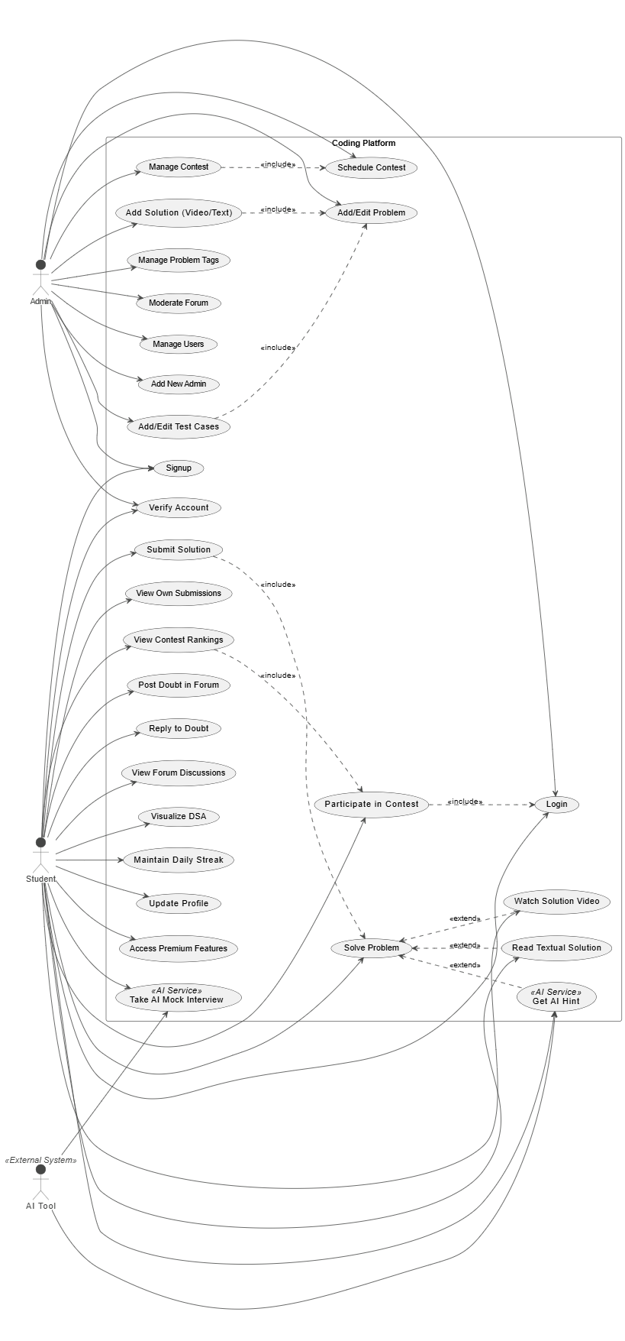
Use Case Diagram

Slide 11
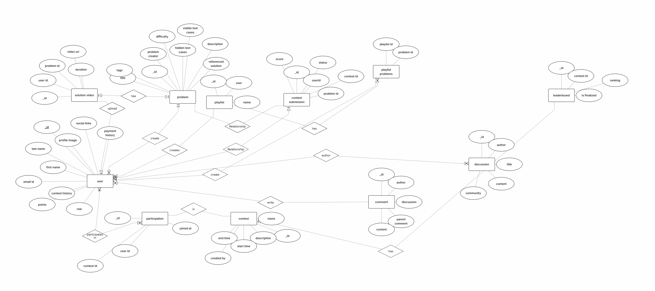
E-R Diagram

Slide 12
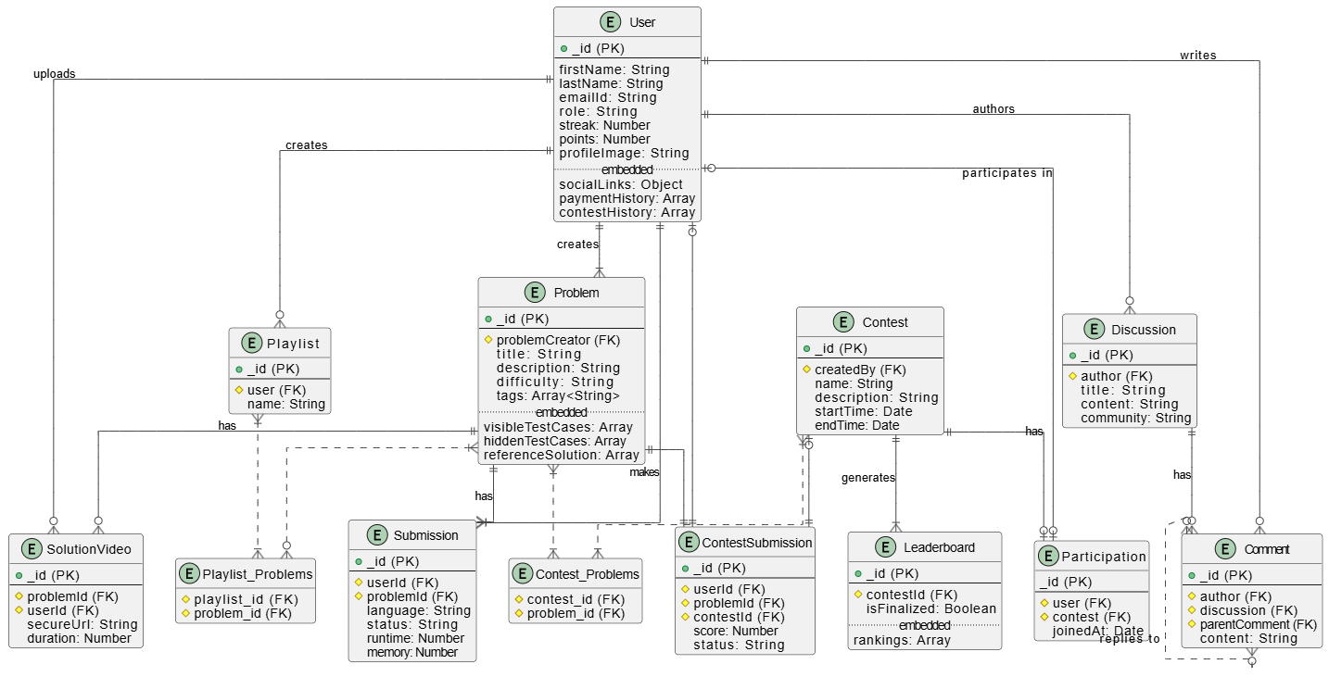
Class Diagram

Slide 13
Thank You

