Slide 1
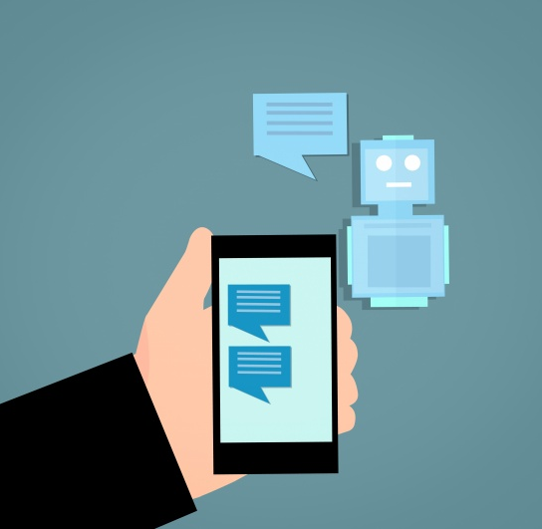
CUSTOM MESSAGING APPLICATION
Team Members:
Gowthami Bonu
Supriya Nulu
Sameer Raj
Vara Lakshmi Pujari
Seelam Navya Sahitya

Slide 2

CONTENTS
Introduction
About Project
Software requirement
Software Resources
UML Diagram
DFD
Conclusion

Slide 3

Introduction
Chatting is a method of using technology to bring people and ideas "together". The technology has been available for years but the acceptance it was quite recent.
Our project is an example of a chat server. It is made up two application the client application and server application.
To start chatting client should get connected to server where they can access two types of chatting, group and private one.

Slide 4

About Project
This is a Custom Messaging Application, where we can login to the application by giving id and password, and after successfully login server will provide active user list or group-name, so we can select with whom we want to chat. we can also share files with other users via server.

Slide 5
Software Requirement
Socket Programming
IPC
Process Synchronization
Multi-Threading
Valgrind
CPP-Unit

Slide 6
Software Resources
Cloud Machine
Linux
Operating System
Star UML

Slide 7
UML Diagram
Sequence Diagram
Use-Case Diagram
Class Diagram

Slide 8
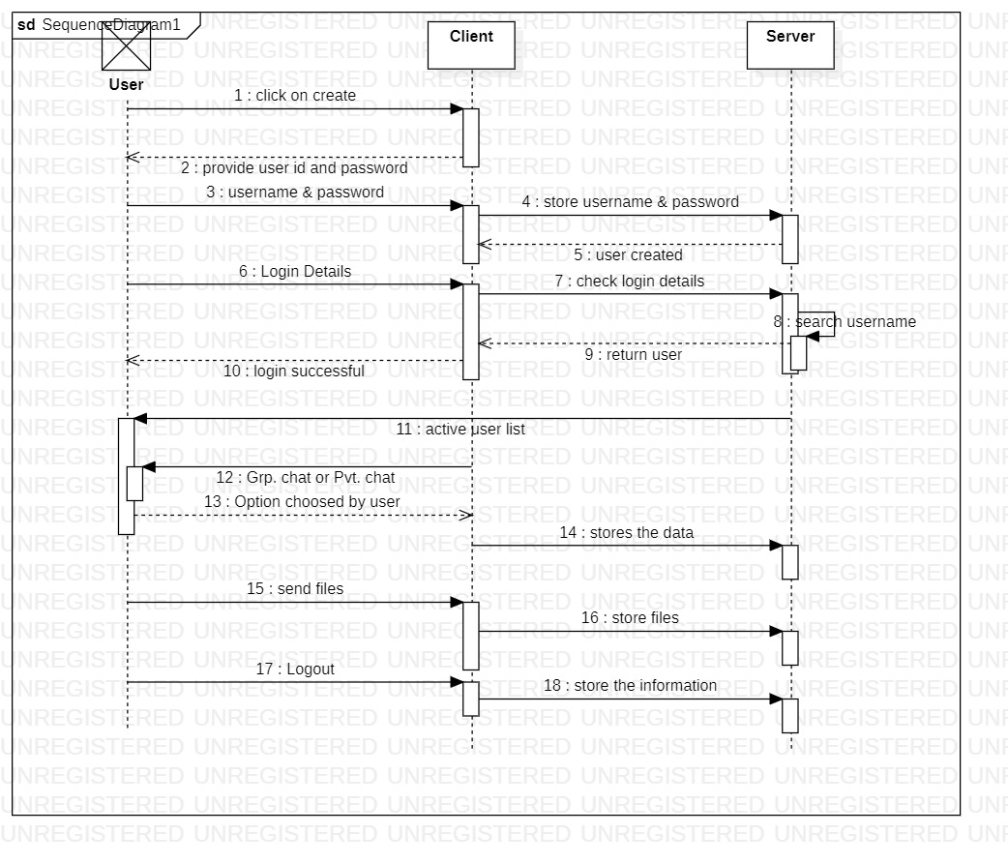
Sequence Diagram

Slide 9
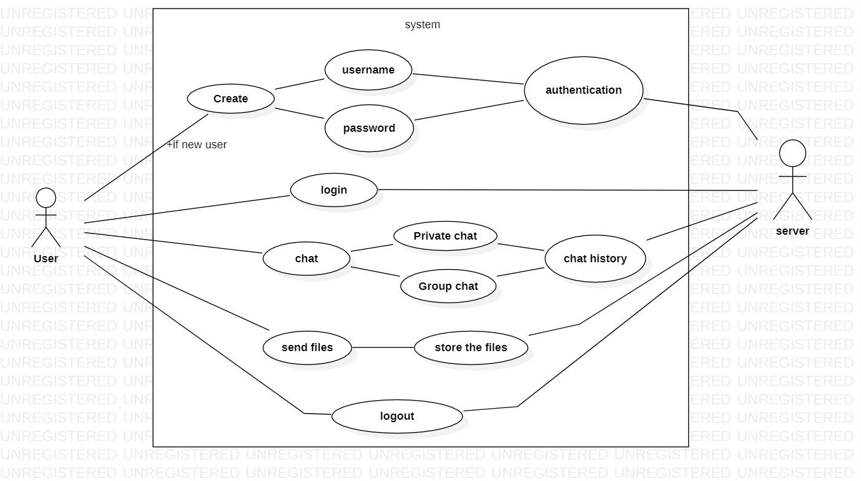
Use-Case Diagram

Slide 10
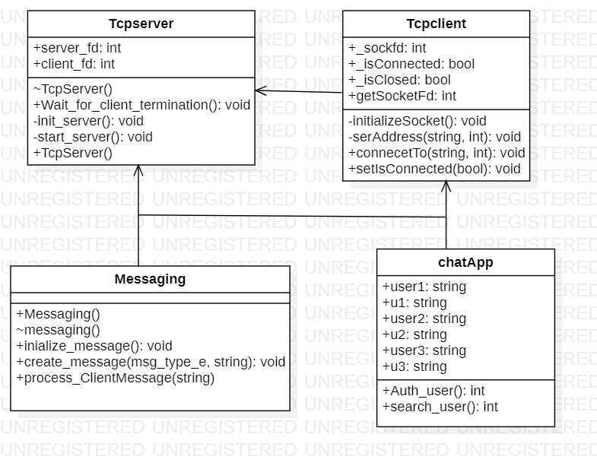
Class Diagram

Slide 11
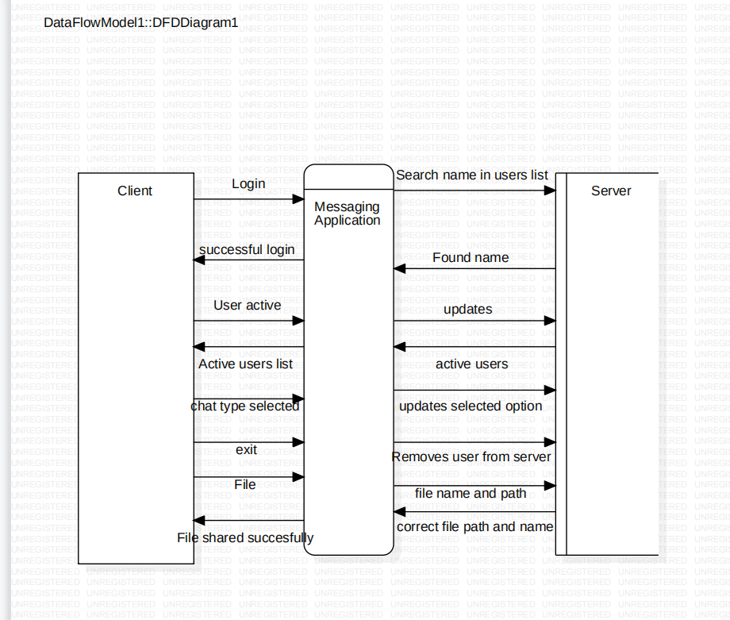
Data Flow Diagram (Level-0)

Slide 12
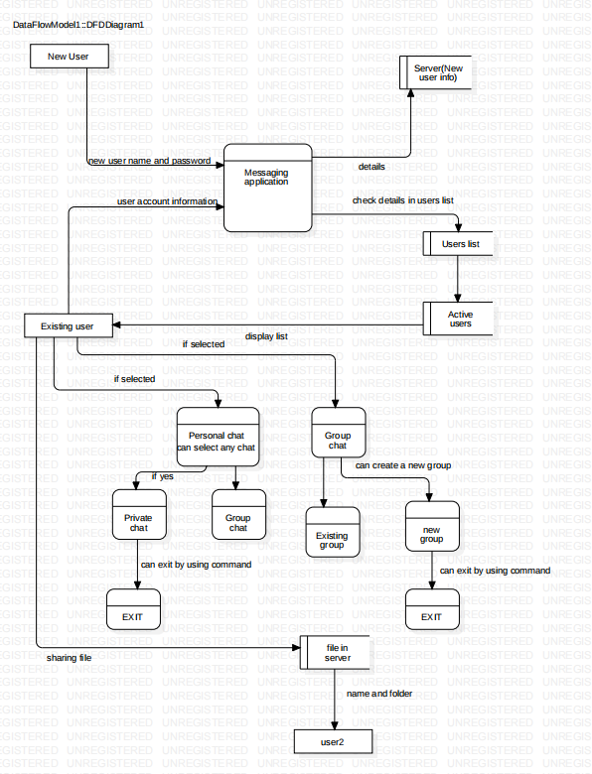
Data Flow Diagram (Level-1)

Slide 13
Conclusion
There is always a room for improvements in any apps. Right now we are just dealing with text communication.
There are several android apps which serve similar purpose as this project, but these apps were rather diﬃcult to use and provide confusing interfaces. A positive ﬁrst impression is essential in human relationship as well as in human computer interaction.
This project hopes to develop a chat service Application with high quality user interface. In future we may be extended to include features

Slide 14

Batch: Capg-93-CPP-Linux-B7

