Slide 1

Auto-Code-Check
Automated Security Reviews & Real-Time Discord-Style Collaboration Huddle
Designed for seamless developer teamwork, instant security scanning, and containerized cloud deployment.

Slide 2
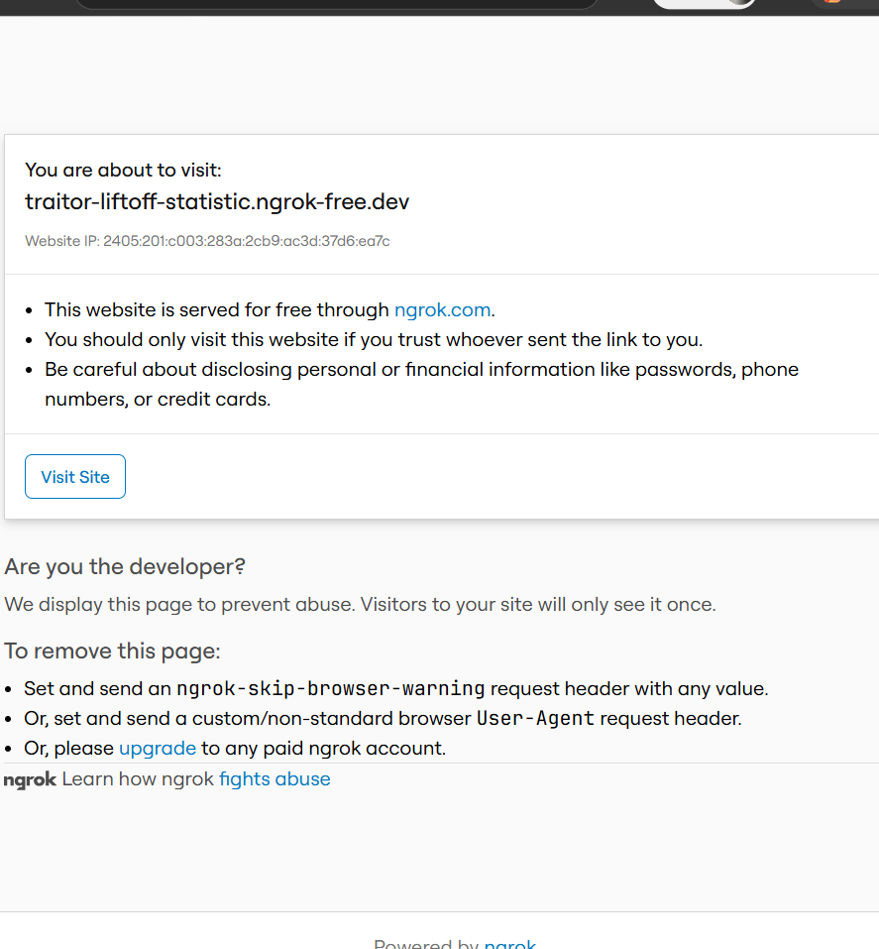
Project Tech Stack & Architecture
Backend Core
Django 4.2 with Channels ASGI (Daphne) for simultaneous HTTP APIs and WebSockets.
Frontend Client
Vite + React + TypeScript with sleek, premium custom styling for optimal speed.
Real-Time Communications
WebRTC implementation for multi-user voice/video huddles, and WebSockets for chat signaling.
Database & Hosting
PostgreSQL in production (Railway) and SQLite locally, configured dynamically through DATABASE_URL.

Slide 3
Holographic Scanner Logo & Fast Loader
Futuristic Tech Aesthetics
A glowing purple-cyan cybernetic shield vector logo designed for a security code auditing environment.
Concentric Scanning Rings
Circular holographic portal with double concentric dashed tech rings rotating in opposite directions.
Laser Scanner Overlay
A pulsing horizontal neon green laser bar sweeps vertically over the shield emblem to simulate a live code scan.
Fast Handshake Validation
Optimized animation load time from slow log scripts to a rapid 1.5s sequence (1.2s loading + 300ms verification).

Slide 4
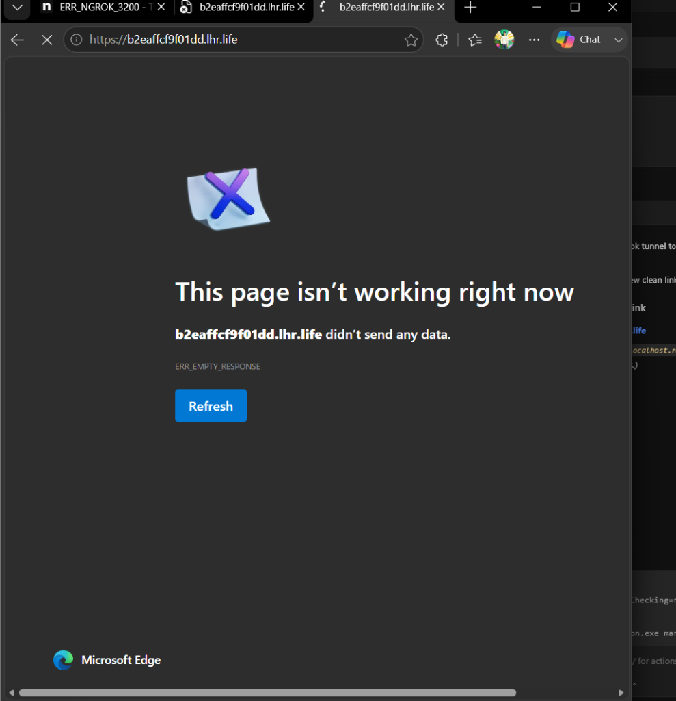
Discord-Style Collaboration Huddle
Unified Channels Sidebar
Discord-style navigation panel with Text Channels (#general, #discussion) and Voice Rooms (Lounge Huddle).
Multi-User Video & Audio
Fully integrated WebRTC media grid displaying live audio and video streams of connected huddle participants.
Integrated Chat Log
Real-time chat feed with custom user avatars, nicknames, timestamps, and message syncing.
Independent Layouts
A screen sharing toggle and media controller interface for seamless developer huddles.

Slide 5
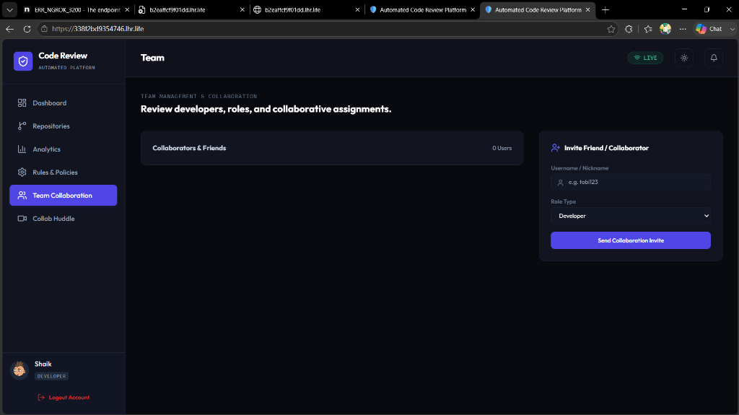
Reciprocal Collaboration & Side Notifications
Non-Blocking Side Popups
Incoming huddle calls slide in as clean, compact notifications from the right side, without blocking work.
Reciprocal Friendship Logic
Users must explicitly Accept a friend invitation to become reciprocal collaborators in the workspace.
Pending Requests Section
Allows managing incoming invitations on the Team tab (Accept/Decline) or viewing outgoing ones.
Auto-Join Functionality
Clicking 'Accept' on a call notification automatically joins both developers into the WebRTC voice/video huddle.

Slide 6
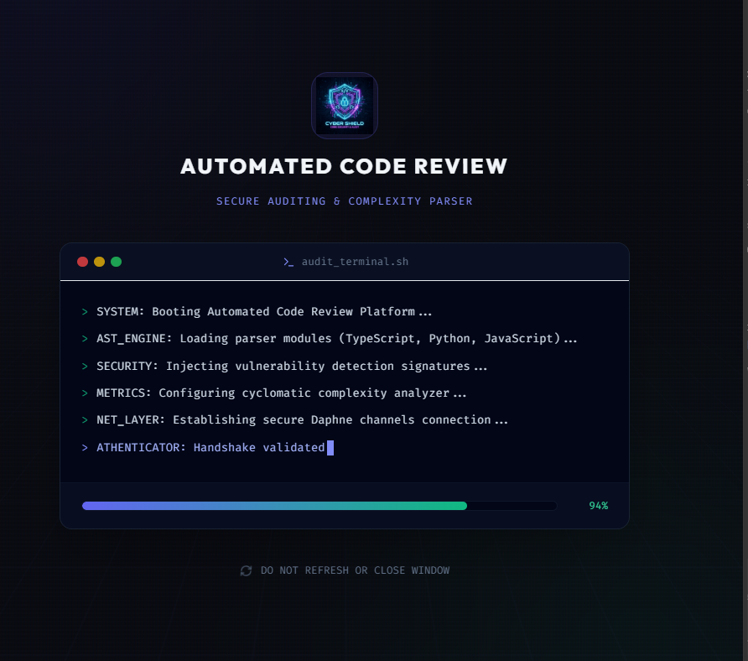
Git Integration & Cloud Deployment
GitHub Secret Scanning Bypass
Mock test credentials updated in reviews/virtual_repos.py to bypass GitHub's push protection blocker.
Orphan Branch Squashing
Cleaned Git history into a single clean commit to erase blocked commits containing old mock keys.
Containerized Architecture
Multi-stage Dockerfile containing React build and python Daphne ASGI server configuration.
Railway.app Cloud Hosting
Automatically rebuilds and deploys the production app when main is pushed to the GitHub repository.

