Slide 1


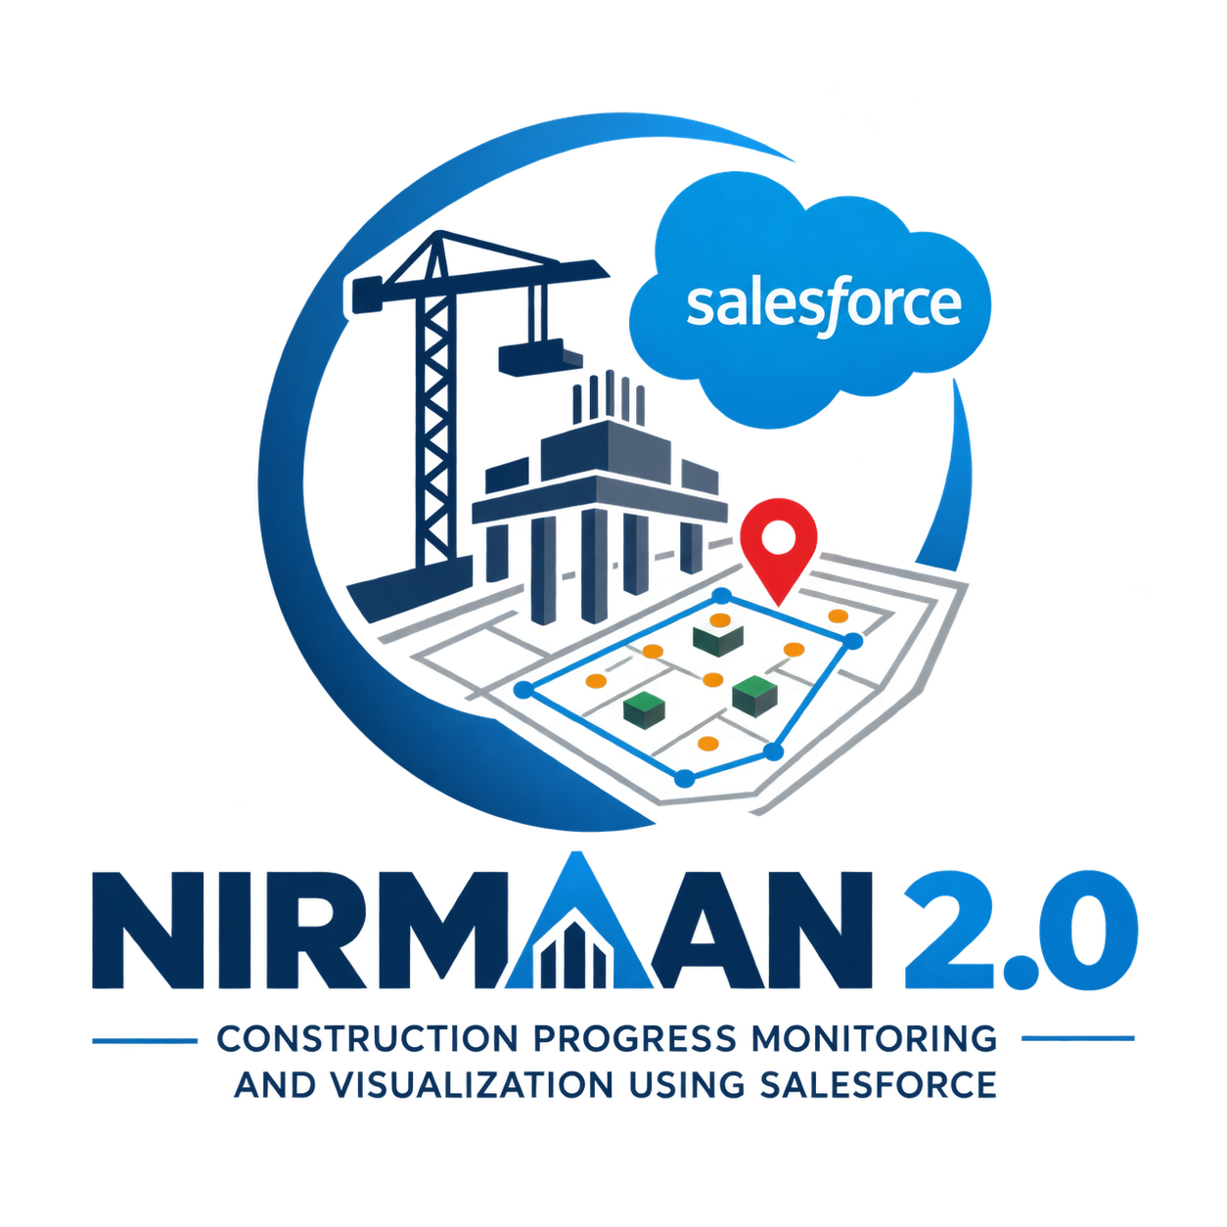
NIRMAAN 2.0
Construction Tracking &
Coordinate Visualization System
PROJECT PRESENTATION
Samir Srinath | B.Tech CSE (AI & ML)
Suresh Gyan Vihar University, Jaipur
Draft presentation — verify implementation status and test results before formal submission.
www.gyanvihar.org

Slide 2
Project Overview
A Salesforce-oriented system for organizing construction records and visualizing foundation geometry.
Centralized data
Coordinate capture
Visual workspace
Projects, construction packages, piles, rafts, and pedestals.
Store X/Y positions and raft vertices through a controlled editor.
Planned package-level 2D layout with filters and summary cards.
Project context: construction-tracking use case associated with NTPC Nabinagar Stage II.
www.gyanvihar.org
NIRMAAN 2.0 | PROJECT OVERVIEW
02

Slide 3
Problem Statement
Data consistency
Records must be scoped to the correct Construction Package.
Construction information spans packages, foundation elements, inspections, and progress records.
A record-only interface does not clearly show the spatial relationship between piles, rafts, and pedestals.
Missing coordinates or malformed geometry can make visual outputs incomplete or misleading.
A consistent engineering coordinate system and validation workflow are required.
Spatial context
Combine polygons and point markers in one plan view.
Data quality
Identify missing or invalid coordinates.
www.gyanvihar.org
NIRMAAN 2.0 | PROJECT OVERVIEW
03

Slide 4
Project Objectives
01
Structured data model
Organize projects, packages, piles, rafts, and pedestals.
02
Coordinate entry
Capture X/Y values and ordered raft vertices.
03
Interactive visualization
Plot structures on a shared 2D engineering canvas.
04
Filters and summaries
Scope by package and structure type; show counts.
05
Secure platform design
Use Salesforce sharing, permissions, and server-side validation.
www.gyanvihar.org
NIRMAAN 2.0 | PROJECT OVERVIEW
04

Slide 5
System Approach
Original use case
Salesforce-oriented version
Node.js
HTML, CSS, JavaScript, Tailwind CSS
MySQL data storage
Leaflet.js spatial view
Dashboards, filtering, reporting
Salesforce custom objects and fields
Apex server-side logic
Lightning Web Components
SVG engineering plan view
Salesforce reports, permissions, and app navigation
The final deployed state must be verified in the target Salesforce org.
www.gyanvihar.org
NIRMAAN 2.0 | PROJECT OVERVIEW
05

Slide 6
System Architecture
Lightning App / Construction Layout
Navigation, filters, summary cards, visualization
↓
Lightning Web Components
Coordinate editor, workspace UI, SVG interactions
↓
Apex Controller
Secure retrieval, validation, response shaping
↓
Salesforce Data Model
Projects, packages, piles, rafts, pedestals, progress/inspection
Security is enforced at the data-access layer; the UI is not a security boundary.
www.gyanvihar.org
NIRMAAN 2.0 | PROJECT OVERVIEW
06

Slide 7
Data Model
Nirmaan_Project__c
Construction_Package__c
Related structures
Top-level construction project.
Package grouping and area-level selection.
Piles, rafts, and pedestals.
Confirm field API names and relationships against the actual metadata.
Object | Key geometry data | Role
Pile__c | X, Y, pile identifier | Point marker
Raft__c | Corner count, Coordinates_JSON__c | Polygon
Pedestal__c | X, Y, grid reference | Distinct point marker
www.gyanvihar.org
NIRMAAN 2.0 | PROJECT OVERVIEW
07

Slide 8
Coordinate Data Design
Piles
Pedestals
Rafts
One X/Y coordinate pair per pile.
One X/Y coordinate pair per pedestal.
A variable number of ordered X/Y vertices forms a polygon.
Illustrative raft JSON structure
[
{"sequence": 1, "x": 100, "y": 100},
{"sequence": 2, "x": 200, "y": 100},
{"sequence": 3, "x": 240, "y": 160},
{"sequence": 4, "x": 160, "y": 220},
{"sequence": 5, "x": 80, "y": 160}
]
Vertex order matters: connect points sequentially and close the polygon. These values are examples, not construction measurements.
www.gyanvihar.org
NIRMAAN 2.0 | PROJECT OVERVIEW
08

Slide 9
Raft Coordinate Editor
1
2
3
4
5
Choose corners
Enter X/Y
Preview
Validate
Save
Select 3–20 corners.
Fill each point in sequence.
Review the polygon shape.
Check complete numeric pairs.
Persist validated JSON through Apex.
www.gyanvihar.org
NIRMAAN 2.0 | PROJECT OVERVIEW
09

Slide 10
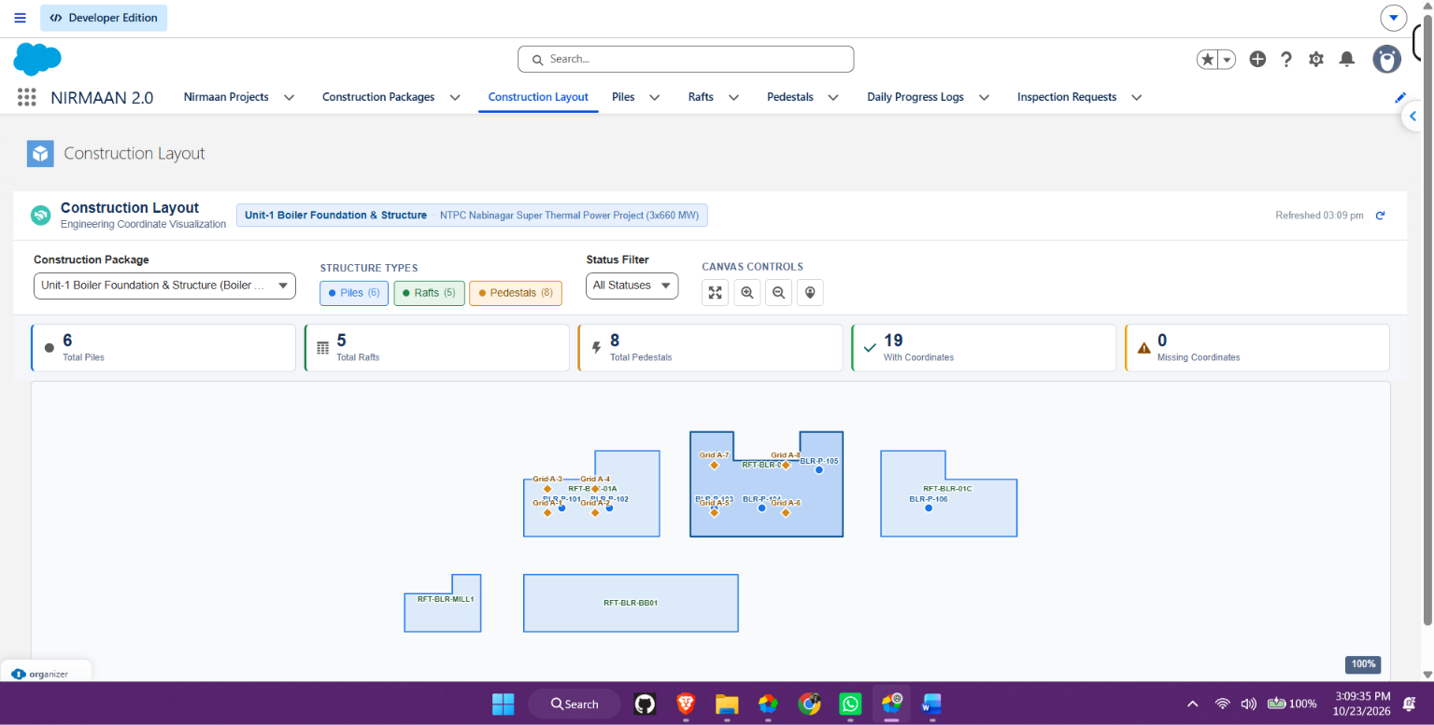
Construction Layout Workspace
www.gyanvihar.org
NIRMAAN 2.0 | PROJECT OVERVIEW
10

Slide 11
Filters and User Interaction
Package filter
Structure type
Status filter
Scopes queries and summaries to the selected package.
Toggle Piles, Rafts, and Pedestals independently.
Use actual status fields and values where available.
Fit to View and zoom controls help inspect the plan.
Selecting a marker highlights it and shows record details.
Filters update visualization and summary cards together.
Empty, loading, and error states should be distinct.
www.gyanvihar.org
NIRMAAN 2.0 | PROJECT OVERVIEW
11

Slide 12
Data Quality and Validation
Condition | Validation | Handling
Missing X/Y | Both values required | Count as missing; do not plot
Invalid raft JSON | Parse expected ordered array | Skip affected raft; report issue
Fewer than 3 vertices | Polygon requires at least 3 points | Do not render as valid geometry
Corner count mismatch | Declared count equals point count | Flag for correction
No matching records | No records for selected package | Show empty state
www.gyanvihar.org
One invalid record should not prevent the rest of the valid layout from rendering.
NIRMAAN 2.0 | PROJECT OVERVIEW
12

Slide 13
Security and Access Control
Least privilege
Users access only authorized data.
Use sharing-aware Apex and enforce object/field permissions.
Validate package IDs and supported filter parameters.
Query only the fields required by the interface.
Do not rely on tab visibility or client-side checks as data security.
Control raw raft JSON updates through the validated editor path.
Test users with different permission sets and record access.
Server validation
Validate inputs and saved geometry.
Safe operations
Keep secrets out of source and reports.
www.gyanvihar.org
13
NIRMAAN 2.0 | PROJECT OVERVIEW

Slide 14
Testing Plan
Geometry
Coordinates
Test 3-corner and 5-corner rafts.
Test negative, missing, invalid X/Y.
Filters
Isolation
Verify package and structure-type filters.
Exclude records from other packages.
Security
Navigation
Verify restricted user access.
Verify tab opens in NIRMAAN_2.
www.gyanvihar.org
Record actual pass/fail results only after running tests in the target org.
NIRMAAN 2.0 | PROJECT OVERVIEW
14

Slide 15
Risks and Mitigation
Risk | Impact | Mitigation
Inconsistent coordinate origin | Wrong relative positions | Confirm units, origin and orientation
Random sample records | Could be mistaken for real site data | Label samples; replace before use
Malformed geometry | Raft cannot be rendered | Validate on save; isolate invalid records
Large record volume | Slow loading/rendering | Scope by package and measure performance
Permissions/configuration | Missing data or unavailable tab | Verify field access and app navigation
www.gyanvihar.org
NIRMAAN 2.0 | PROJECT OVERVIEW
15

Slide 16
Implementation Status and Next Steps
Data model
Coordinate editor
Combined viewer
Existing Salesforce objects and package relationships are the foundation.
UI refined; verify save behavior with representative data.
Implement and verify page, filters, and live-record visualization.
Recommended next steps
1. Complete constructionLayoutViewer LWC and secure Apex retrieval.
2. Add/activate Construction Layout in NIRMAAN_2 navigation.
3. Test with known coordinates and sample packages.
4. Run Apex tests and metadata validation.
5. Capture screenshots and update the report with verified results.
www.gyanvihar.org
NIRMAAN 2.0 | PROJECT OVERVIEW
16

Slide 17
Conclusion
NIRMAAN 2.0 brings construction records and engineering geometry into a structured Salesforce workflow.
Structured
Spatial
Actionable
Packages and foundation records.
Shared X/Y plan-view geometry.
Filters, details, and data-quality indicators.
Thank you
Verify implementation claims against the deployed org before formal presentation.
www.gyanvihar.org

