Slide 1

A Larsen & Toubro
Group Company
LTM
Hack2Future
Microsoft
LTM x Microsoft Hackathon Partnership
Glass Box AI Agentic Claims Processing - POC Submission

Slide 2
AI Eites Team
Sameet Dandawate
Prasad
Utkarsh
Rahul
Suraj
Abhijit
 | Description
Team Name | AI Elites
Chosen Challenge Statement | Business Challenge 2 - Insurance: Agentic Claims Processing (Personal Auto)
Idea Name | Glass Box AI - agentic claims processing where every AI decision is explained in plain English
Problem Statement | Insurance claims are slow, manual, and opaque. Build an agentic AI system that processes auto claims end-to-end - fast, accurate, and fully explainable.
LTM
Microsoft
©LTM | Privileged and Confidential
2

Slide 3
Technical Architecture
 | Description
Architecture Overview | Four layers, end to end: Channels (React app - web/mobile - with embedded Copilot Studio chat "Sara", plus Email/Teams/SMS) -> Agents (Intake, Extraction, Policy, Validation, Adjudication, Explanation) -> Service layer (Power Automate flows; agents never touch the database directly) -> Data + AI (Dataverse, Azure OpenAI GPT-4.1, Azure AI Search, Document Intelligence). Every agent writes a plain-English Decision_Rationale row BEFORE acting - the Glass Box. Hosted end-to-end on Azure. Diagram on the next slide.
Core Components (Microsoft Technology / Services Touched) | Copilot Studio (Sara - FNOL intake) - Power Automate (GetPolicy, CreateClaim, LogDecision, GetClaimAudit, MasterOrchestration) - Dataverse (9 tables incl. Decision_Rationale audit) - Azure OpenAI GPT-4.1 (photo-damage vision + adjudication + explanations) - Azure AI Search (policy RAG) - Azure AI Document Intelligence - Azure Communication Services (real email; Teams/SMS) - React SPA hosted on Azure Functions (custom handler serves the app + API) - External data: NOAA + NHTSA live, 6 sandbox adapters (ISO, NICB, CARFAX, DMV, KBB, telematics)
Security & Compliance | Microsoft Entra ID SSO (mock in sandbox) - Azure Functions Managed Identity -> Dataverse (no stored secrets) - Dataverse role-based access + row ownership - Encryption in transit and at rest - Immutable plain-English audit row per AI decision -> Colorado SB21-169 / NAIC / NY DFS readiness - No PII sent to external APIs
The Glass Box principle: If an AI touches a claim, it writes down WHY - in language a regulator, a customer, and a judge can all read. Full end-to-end flow diagram on the next slide.
LTM
Microsoft
©LTM | Privileged and Confidential
3

Slide 4
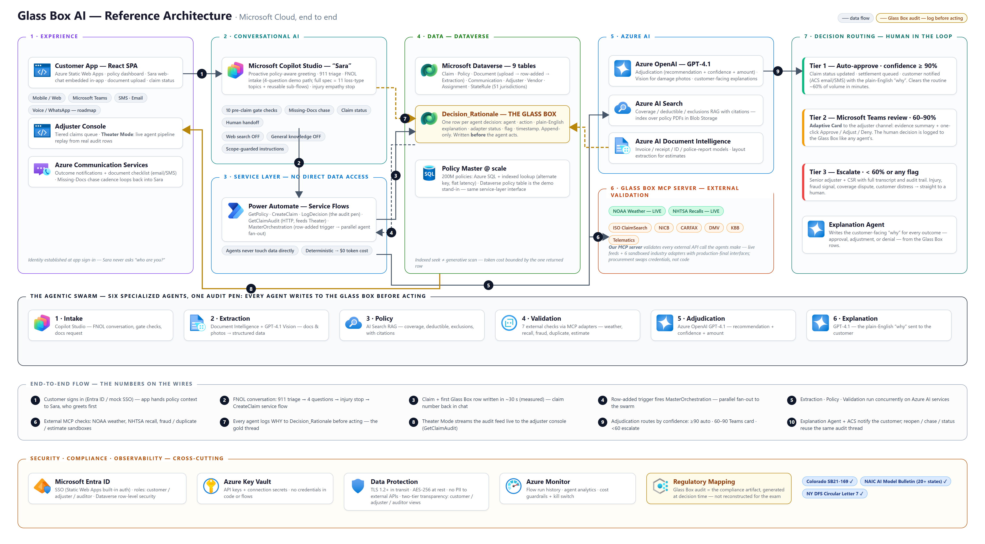
Reference Architecture
LTM
Microsoft
©LTM | Privileged and Confidential
4

Slide 5
Solution Approach
 | Description
Relevance to Challenge (20 Points) | Agentic claims processing, literally: six agents (Intake -> Extraction -> Policy -> Validation -> Adjudication -> Explanation) take a personal-auto FNOL to a decision. Live: a chat with Sara creates a real claim + audit row in Dataverse in ~30s. All 11 auto loss types, all 5 lifecycle phases.
Innovation & Creativity (10 Points) | The Glass Box: every agent logs WHY in plain English BEFORE acting - compliance is the architecture, not a report. Theater Mode: watch the agents decide, live.
Technical Implementation (10 Points) | Built, not slideware: published Copilot Studio agent embedded in our React app · 4 live Power Automate flows · 9-table Dataverse schema · GPT-4.1 adjudication · real NOAA + NHTSA calls · 6 sandboxed MCP tool adapters.
User Experience (15 Points) | One 4-question conversation - 911 triage, injury empathy stop, claim number in chat. Adjusters: tiered queue (auto / review / escalate) + one-click live Theater. Same Sara on app, web, Teams, SMS, email.
Impact & Scalability (15 Points) | FNOL to decision in minutes vs the 19.3-day US norm (J.D. Power 2025); Tier-1 routine claims auto-approve. Policy lookup indexed for 200M policies; audit retrieval is one query per claim.
Presentation & Pitch (10 Points) | Arc: distressed customer -> 4-question chat -> real claim number -> Theater shows the agents deciding -> the audit row that explains it. The video follows the same arc.
Adaptability & Flexibility (10 Points) | Glass Box is decision-agnostic: property, underwriting, lending, benefits reuse the log-before-acting pattern. Loss types, gate checks, state rules are Dataverse config, not code.
Overall Impression (10 Points) | A real system judges can poke: file a claim live, watch it process, read why.
Why does your POC/Tool worthy of GTM development ? | 20+ states adopting NAIC AI accountability -> explainable claims AI becomes a license to automate. Ships on the carrier's existing Microsoft tenant. Path: pilot -> state-filing audit pack -> product.
LTM
Microsoft
©LTM | Privileged and Confidential
5

Slide 6
The Industry Problem - By The Numbers
19.3 days
average US auto repairable-claim cycle time - and that is the IMPROVED number, down from 22.3 days a year earlier
J.D. Power 2025 U.S. Auto Claims Satisfaction Study (9,455 claimants)
$308.6B / year
lost to insurance fraud in the US - ~$45B of it in property & casualty lines. Most fraud checks today are sampled, not universal
Coalition Against Insurance Fraud, 2022
$170B at risk by 2027
global premiums exposed to poor claims experiences: 30% of dissatisfied claimants already switched carriers, another 47% are considering it
Accenture, "Why AI in Insurance Claims & Underwriting" (6,700 policyholders, 25 countries)
24 states
have adopted the NAIC AI Model Bulletin (as of Mar 2025) + Colorado SB21-169 + NY DFS Circular 7: UNEXPLAINABLE AI is now undeployable in US insurance
NAIC / state insurance departments
Handling cost: loss adjustment expense (LAE) runs 8-12% of losses in personal auto - every routine claim carries heavy manual handling cost (industry benchmark). Full source links in slide notes.
LTM
Microsoft
©LTM | Privileged and Confidential
6
Notes:
Sources:
1) J.D. Power 2025 U.S. Auto Claims Satisfaction Study - cycle time 19.3 days (was 22.3): https://www.jdpower.com/business/press-releases/2025-us-auto-claims-satisfaction-study
2) Coalition Against Insurance Fraud (2022) - .6B annual US fraud cost: https://insurancefraud.org/wp-content/uploads/The-Impact-of-Insurance-Fraud-on-the-U.S.-Economy-Report-2022-8.26.2022.pdf
3) Accenture (2022) - Why AI in Insurance Claims and Underwriting - premiums at risk, 30% switched / 47% considering: https://newsroom.accenture.com/news/2022/poor-claims-experiences-could-put-up-to-170b-of-global-insurance-premiums-at-risk-by-2027-according-to-new-accenture-research
4) NAIC AI Model Bulletin adoption - 24 states as of Mar 2025: https://www.insurereinsure.com/2025/03/19/wisconsin-becomes-the-24th-state-to-adopt-the-naic-model-bulletin-on-the-use-of-ais-in-insurance/
5) McKinsey - claims automation reduces loss adjustment expense 25-30%, indemnity 3-5 pts: https://www.mckinsey.com/industries/financial-services/our-insights/insurance-productivity-2030-reimagining-the-insurer-for-the-future

Slide 7
Business Impact & Outcomes
 | Today (US industry) | With Glass Box AI
FNOL intake | 30-min forms + phone queue | 2-minute conversation with Sara
Routine claim decision | 19.3 days (J.D. Power 2025) | Minutes - Tier-1 straight-through
Regulator / exam audit | Weeks reconstructing files | One query - the audit wrote itself
Adjuster capacity | Buried in routine claims | Focused on Tier-2/3 judgment calls
Customer experience | Silence between letters | Plain-English "why" at every step
Value model - anchored to published research
McKinsey: straight-through processing + AI cuts loss adjustment expense 25-30% and indemnity 3-5 pts
Mid-size carrier, 100,000 auto claims/yr: ~60% Tier-1 eligible = 60,000 straight-through · ~$360 LAE avoided each (8-12% LAE benchmark)
= ~$21M annual LAE reduction
Time: 19.3-day industry cycle -> minutes (Tier 1) · Accuracy: 7 validations on 100% of claims, not samples - against a $308.6B/yr fraud drain · Retention: fixes the experience that made 30% of dissatisfied claimants switch.
Measured in this POC today: 30 sec from chat to claim + audit row · 100% of AI decisions logged · live NOAA + NHTSA calls. Sources: J.D. Power 2025 · CAIF 2022 · Accenture 2022 · McKinsey (links in slide notes).
LTM
Microsoft
©LTM | Privileged and Confidential
7
Notes:
Value model math: 100,000 claims/yr x 60% Tier-1 straight-through = 60,000 claims. Personal-auto LAE benchmark 8-12% of losses; avg auto claim severity ~$4-6K -> ~$400-600 LAE per claim; we assume ~$360 avoided per straight-through claim (the human-handling share) = ~$21.6M/yr. This sits inside McKinsey's published 25-30% LAE reduction band for claims automation.
Sources: McKinsey Insurance productivity 2030: https://www.mckinsey.com/industries/financial-services/our-insights/insurance-productivity-2030-reimagining-the-insurer-for-the-future
J.D. Power 2025 Auto Claims Study: https://www.jdpower.com/business/press-releases/2025-us-auto-claims-satisfaction-study
Coalition Against Insurance Fraud 2022: https://insurancefraud.org/wp-content/uploads/The-Impact-of-Insurance-Fraud-on-the-U.S.-Economy-Report-2022-8.26.2022.pdf
Accenture 2022: https://newsroom.accenture.com/news/2022/poor-claims-experiences-could-put-up-to-170b-of-global-insurance-premiums-at-risk-by-2027-according-to-new-accenture-research

Slide 8
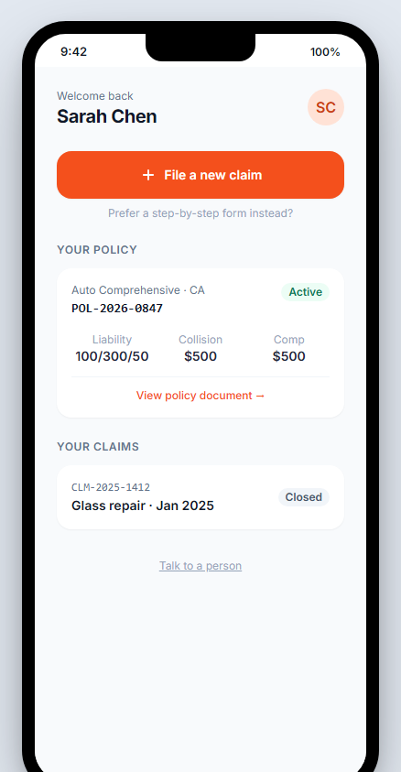
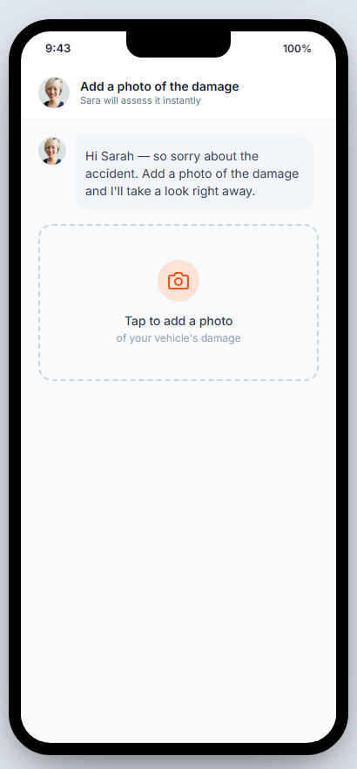
Live POC - Customer Experience
One tap from policy to filing
Sara files a REAL claim in 4 questions
LTM
Microsoft
©LTM | Privileged and Confidential
8

Slide 9
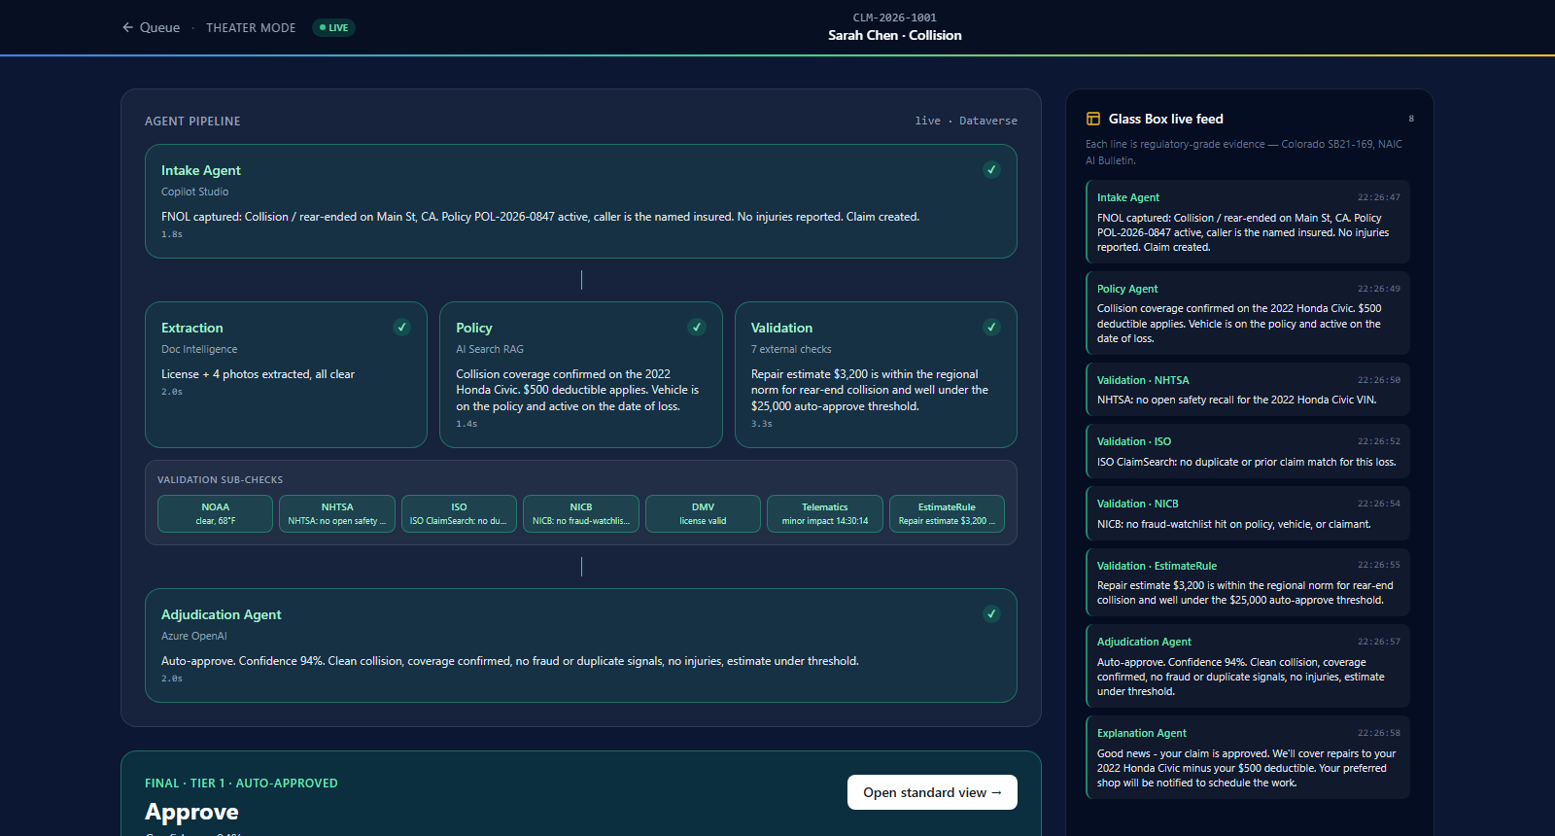
Live POC - Theater Mode, Live
Real Dataverse audit rows: agent pipeline + plain-English Glass Box feed + auto-approve verdict
LTM
Microsoft
©LTM | Privileged and Confidential
9

Slide 10
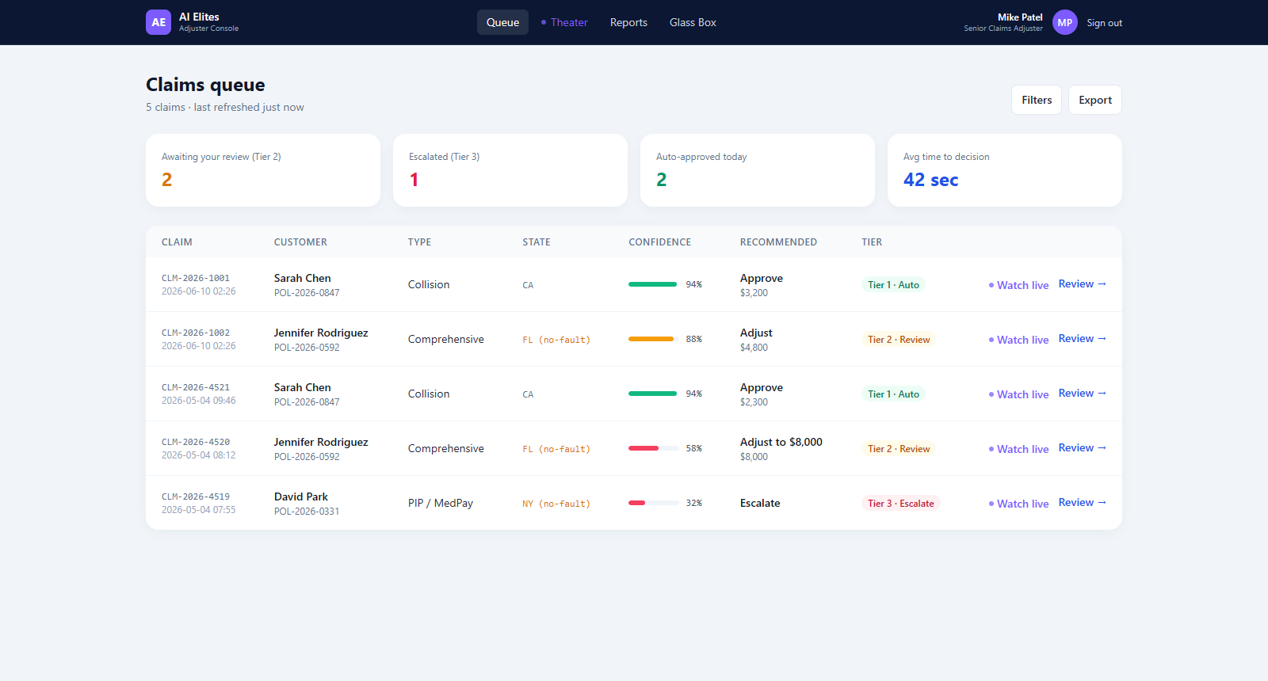
Live POC - Adjuster Command Center
Tiered queue: Tier 1 auto-approved, Tier 2 human review, Tier 3 escalation - one click to watch live
LTM
Microsoft
©LTM | Privileged and Confidential
10

Slide 11
References & Links
Data & research sources
• J.D. Power — 2025 U.S. Auto Claims Satisfaction Study (19.3-day cycle time)
• McKinsey — "Insurance 2030" & "Claims 2030" (straight-through processing; 25-30% LAE)
• Triple-I (Insurance Information Institute) — auto underwriting, 2023-24
• Deloitte — AI fraud-savings analysis (2025); U.S. P&C auto-claims case study
• Accenture — claims-experience research, 2022 (premiums at risk)
• Coalition Against Insurance Fraud — Impact of Fraud, 2022
• Insurance Research Council — auto-injury fraud / buildup
• NAIC — Market Share Report; AI Model Bulletin
Regulatory references
• Colorado SB21-169 — AI/ML insurer governance
• NAIC AI Model Bulletin (adopted in 20+ states)
• NY DFS Circular Letter No. 7 (2024)
• California AB 2930 (pending)
Project links
• GitHub repo — github.com/Sameet1308/Hack2future
• Live app — glassbox-fn-1003787.azurewebsites.net
• Pitch deck — glassbox-fn-1003787.azurewebsites.net/present.html
• Confluence (PM space) — aieliteltm.atlassian.net/wiki/spaces/PM
Microsoft / official
• Microsoft Copilot Studio Kit (learn.microsoft.com)
• microsoft/claims-processing-hack
• MSUSAzureAccelerators/AI-Powered-Insurance-Claims-Automation-Accelerator
Built on
• Copilot Studio · Power Automate · Dataverse
• Azure OpenAI GPT-4.1 · AI Search · Document Intelligence
• Azure Communication Services · Azure Functions
LTM
Microsoft
©LTM | Privileged and Confidential
11

